Slide 1
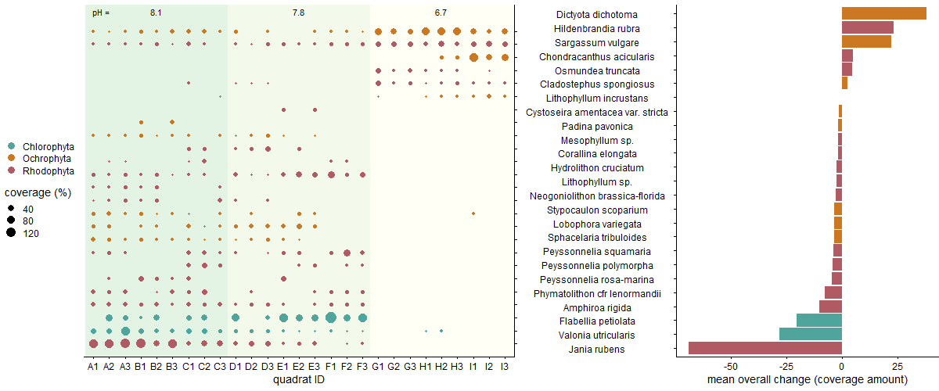
Hi Trevor, I’m trying to get the tick marks on the two facing y-axis to line up. For this plot, I used align = “h”, which aligns the actual height of the plots. But my first plot has a little extra height due to the pH values.

Slide 2
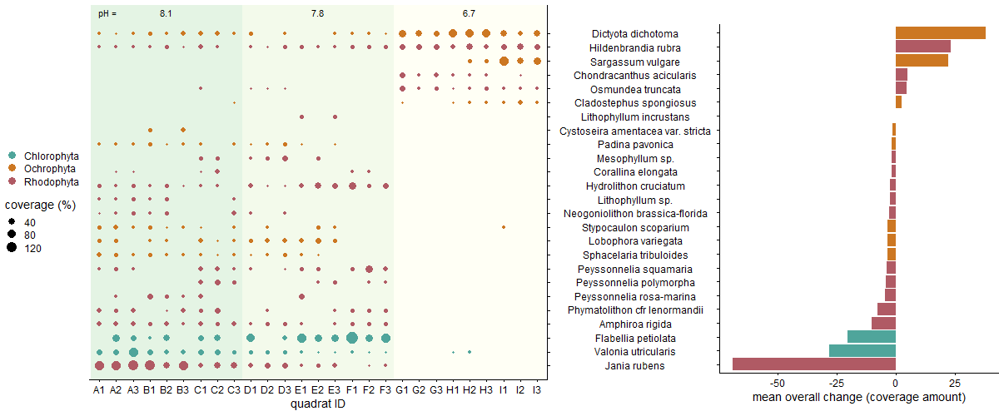
For this plot, I added margin to the top and bottom of the second plot, to try to get the tick marks aligned. But now the horizontal x-axis of each plot are not on the same plane and y-axis are not the same length.

