Slide 1
Animation 1. Changes in macroalgae amount (% lab tray coverage) from each quadrat (A) demonstrate shifts in abundance across an environmental gradient ranging from pH 8.1 to 6.7. The mean abundance (% lab tray coverage) of each species in quadrats A-C compared with quadrats G-I (B) show that several species of macroalgae are absent from the most acidic environments (e.g. Jania rubens, Valonia utriclaris, Flabelia petiolate) as new species arise or increase in abundance (e.g. Dictyota dichotoma, Sarcassum vulgare, Chondracanthus acicularis). [Note: This is an animation that alternates between with and without panel gridlines every 8 seconds (visible from slideshow mode). Hopefully, you can help me determine which to commit to. I enjoyed making my first gif, albeit simple!]
Notes:
Graphical techniques that I learned:
Plot A. I didn’t like that the default plotted points for the values of zero, so for my size call for the points I used ‘size = ifelse(coverage==0, NA, coverage))’ so points are only plotted when the microalgae species was actually in the quadrat sample. Here, zeros in the data plot nothing.
Plot A. Adding the background shaded rectangles.
I used ‘annotate("rect", xmin = 0.5, xmax = 9.5, ymin = 0, ymax = 27, alpha = .2, fill = "#78c679")’ (repeat 2x more times with new xmin, xmax, and fill color.)
It turns out we still use x and y values to describe the position of the shaded area in plot, even if the data is categorical on both axis. The lower left point is assumed to be at x = 1, y =1 and each data row is a unit of 1. I expanded the rectangle above the original plot to make room for the pH text as well.
I added a second call of geom_point() after plotting the rectangles. The rectangles initially were a layer on top of the original points, making the original points faded. However when I moved the geom_point() call to after the rectangle annotation call, I would get an error. So I just added the geom_point() call again, and they are replotted on top of the shaded rectangle. So I plotted each point twice!
I added an invisible rectangle to plot B so that the y-axis was expanded in the same way as plot A. That way, the tick marks all lined up together nicely.
Pushing two plots next to each other so they could share the axis labels.
For plot A, I moved the legend to the left and the scale to the right, but then didn’t write the text using ‘theme(axis.text.y = element_blank())’.
For plot B, I changed the left margin to -30 (-30, expanded it to the left) with ‘theme(plot.margin = margin(t=0,r = 0,b =0,l = -30)’ I believe these values are pixels, and so it was trial and error related to the size I wanted the plot and the distance from plot A.
I used ‘theme(axis.text.y = element_text(hjust=.5,face = "italic"))’ to center justify (the hjust scale is from 0-1, left-right, so .5 means center) and italicize the macroalgae labels.
When I put plot A and B together, I wanted the labels A and B near the actual plot area, so I used ‘plot_grid(label_x = c(.15,.25))’ to move the labels along the x axis away from where they naturally would be.
4) I used gifmaker.me to make this gif that bounces between two versions of the plot, with vs without gridlines (only works in ppt slideshow mode). I took my original ‘plot + theme(panel.grid.major = element_blank)’ to ensure everything else stayed the exact same. I don’t know whether I prefer with or without gridlines. What do you prefer?

Slide 2
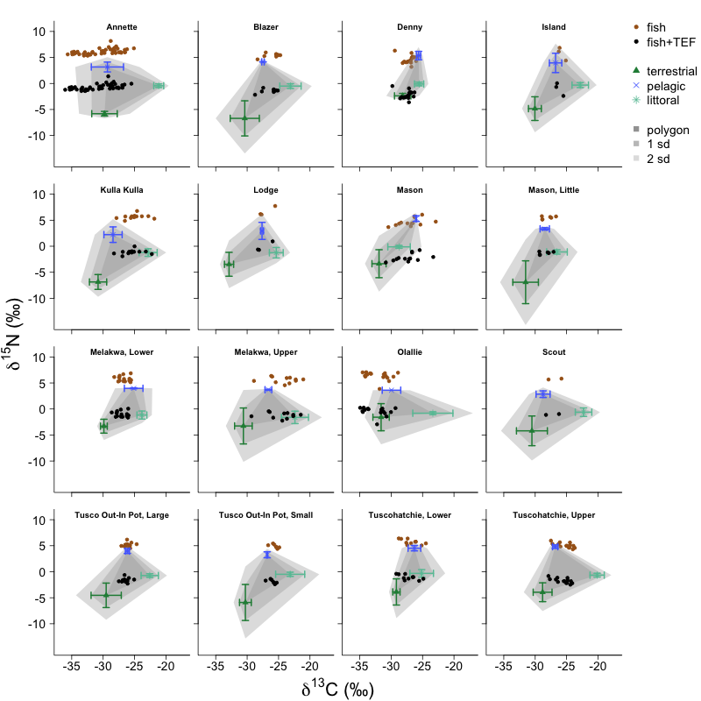
Figure 2. In lake ecosystems, plants and algae in three habitats - littoral (submerged illuminated edge), pelagic (open water) and terrestrial (land surrounding the lake) – convert CO₂ into forms of carbon that are usable to the rest of the food web through photosynthesis. Natural differences in the frequency that atoms contain extra neutrons occurs among these three habitats (greater values reflect higher occurrences of atoms with an extra neutron). Estimates of the importance of each habitat to each fish are obtained by comparing the values in the fish tissue to the values observed in plant tissue from each habitat. The shading gives a sense of uncertainty around source values, lighter gray is more unlikely.
Notes:
NOTE: When fish consume prey, the carbon assimilates into their tissue and takes on extra neutrons in away that reflects the prey, however the body tissue tends to hang onto the nitrogen compounds with the extra neutrons and excretes the normal nitrogen. So nitrogen in the tissue of an organism always has more nitrogen with an extra neutron (nitrogen-15) than the prey, a value that is then adjusted. That adjustment is called a Trophic Enrichment Factor (TEF).
This plot is created in base R. One of my takeaways of working with both systems is the miracle that is “facet_wrap()” in ggplot. In base R, to create these 16 panels, I created a loop that goes through data each lake one at a time, but to get the axis different for four types of plots (y only, x only, x and y, and none) I had to write several if-else statements (about 15 lines of code). Facet_wrap() is mind blowing in this regard.
I am working to create a similar plot with ggplot, but a few things have not been ironed out. For example, in base I’m comfortable plotting and doing calculations simultaneously (ie, means and sd for plants, or trophic adjustments for fish). Also, I’m creating hulls based on the vertices of the calculations. It is straightforward to handle different dataframes differently in base, as I work on layers of a plot.
I’m struggling to do different things with different types of data in ggplot(). I trust it will come, but the first big realization is that my original data needs to be in one giant dataframe, which is a new approach and different starting point.
Comment: Each panel is called an isotope biplot and for my research, an isotope biplot for each lake is expected, even if the plot ends up in the supplementary materials of a publication. My goal is to get as much “required” information into as clean of a space as possible.

