Slide 1
10 R Packages to Win Kaggle Competitions
Xavier Conort
Data Scientist

Slide 2
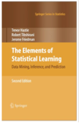
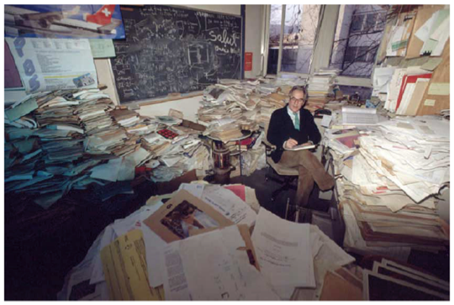
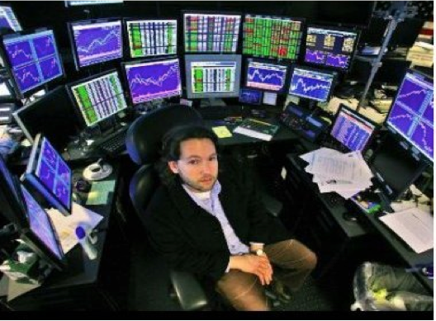


Previously...
… now!

Slide 3




Competitions that boosted my R learning curve
The Machine seems much smarter than I am at capturing complexity in the data even for simple datasets!
Humans can help the Machine too! But don’t oversimplify and discard any data.
Don’t be impatient. My best GBM had 24,500 trees with learning rate = 0.01!
SVM and feature selection matter too!

Slide 4




Competitions that boosted my R learning curve
Word n-grams and character n-grams can make a big difference
Parallel processing and big servers can help with complex feature engineering!
Glmnet can do a great job!
Still many awesome tools in R that I don’t know!

Slide 5
10 R Packages:
Allow the Machine to Capture Complexity
gbm
randomForest
e1071
Take Advantage of High-Cardinality Categorical or Text Data
4. glmnet
5. tau
Make Your Code More Efficient
Matrix
SOAR
forEach
doMC
10. data.table

Slide 6
Capture Complexity Automatically

Slide 7
1. gbm
Gradient Boosting Machine (Freud & Schapiro)
Greg Ridgeway / Harry Southworth
Key Trick:
Use gbm.more to write your own early-stopping procedure

Slide 8
2. randomForest
Random Forests (Breiman & Cutler)
Authors: Breiman and Cutler
Maintainer: Andy Liaw
Key Trick:
Importance=True for permutation importance
Tune the sampsize parameter for faster computation and handling unbalanced classes

Slide 9
3. e1071
3. e1071:Support Vector Machines
Maintainer: David Meyer
Key Tricks:
Use kernlab (Karatzoglou, Smola and Hornik) to get heuristic
Write own pattern search

Slide 10
Take Advantage of High-Cardinality Categorical or Text Features

Slide 11
4. glmnet
Authors: Friedman, Hastie, Simon, Tibshirani
L1 / Elasticnet / L2
Key Tricks:
- Try interactions of 2 or more categorical variables
- Test your code on the Kaggle: “Amazon Employ Access Challenge”

Slide 12
5. tau
Maintainer: Kurt Hornik
Used for automating text-mining
Key Trick:
Try character n-grams. They work surprisingly well!

Slide 13
Make Your Code More Efficient

Slide 14
6. Matrix
Authors / Maintainers: Douglas Bates and Martin Maechler
Key Trick:
Use sparse.model.matrix for one-hot encoding

Slide 15
7. SOAR
Author / Maintainer: Bill Venables
Used to store large R objects in the cache and release memory
Key Trick:
Once I found out about it, it made my R Experience great!
(Just remember to empty your cache … )

Slide 16
8. forEach and 9. doMC
Authors: Revolution Analytics
Key Trick:
Use for parallel-processing to speed up computation

Slide 17
10. data.table
Authors: M Dowle, T Short and others
Maintainer: Matt Dowle
Key Trick:
Essential for doing fast data aggregation operations at scale

Slide 18
Don’t Forget ..
Use your intuition to help the machine!
Always compute differences / ratios of features
This can help the Machine a lot!
Always consider discarding features that are “too good”
They can make the Machine lazy!
An example: GE Flight Quest

Slide 19
Thank you!

