Slide 1
TEAM BEKENSTEIN
High-Quality Code Project
@
https://github.com/Bekenstein-Team/BattleField

Slide 2
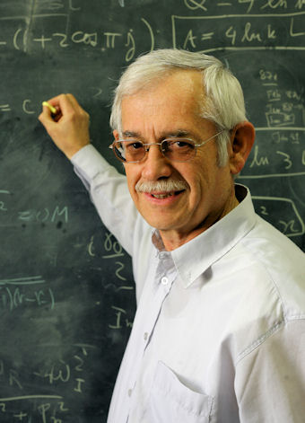
What is Bekenstein?
Who is?
Jacob Bekenstein
Mexican-Israeli theoretical physicist
contribution to the foundation of black hole thermodynamics
to other aspects of the connections between information and gravitation

Slide 3
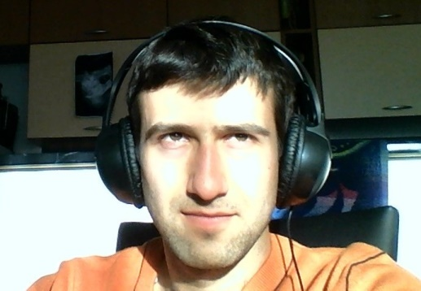
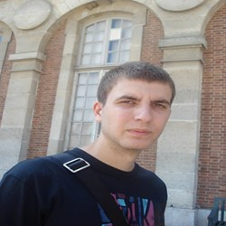


Team Bekenstein – Who we are?
Momchil Dishev - MomchilDishev
Zvezdelin Dimitrov - Tr00per
Christopher Savov - f1mp3r
Hristo Nikov - Icakis

Slide 4
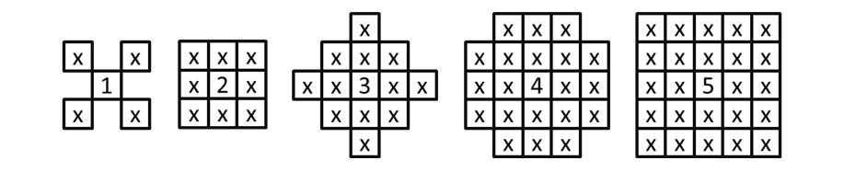
What we have chosen?
Battle-Field Game
Blow My Min’

Slide 5
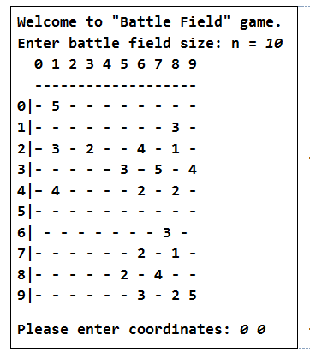
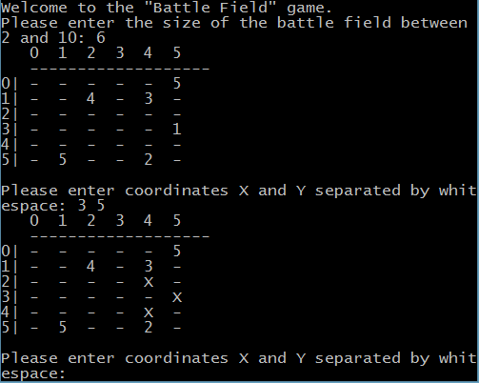
The Game
How should be and How it is

Slide 6
What we did?
Redesigned the project structure
Reformatted the source code
Renamed multiple variables
Best HQ-Code practices followed
Designed and implemented Unit tests
Documentation done

Slide 7
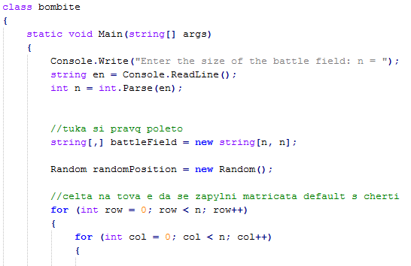
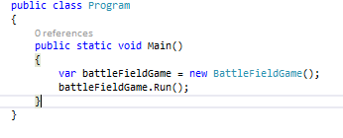
Design and Structure
Old and New

Slide 8
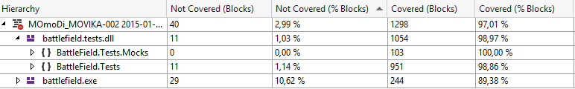

Unit Tests

Slide 9
The End
“ Don’t Repeat Yourself but KISS, KISS, KISS ”
Great thanks to Software University Bulgaria!
https://softuni.bg/trainings/coursesinstances/details/9

