Slide 1
Does underlying structure predict quantum trainability and dequantization?
A dataset of 1 368 learning problems, and a first test of the structure we extract from them
Charbel A. Dargham · DALAS, TME4 · Sorbonne Université, M1 Quantum Information
Notes:
Project question and what this deliverable covers: the dataset and the validation of the structure-extraction step.

Slide 2
Can structure predict how a quantum model will behave?
1
Generic circuits do not train
2
Structure restores gradients
3
…and may remove the advantage
McClean et al. 2018: in random, structure-free circuits, gradients shrink exponentially with the number of qubits (barren plateaus).
Building the problem's symmetry in keeps the dynamical Lie algebra (DLA) small, and a small DLA gives large gradients (Larocca et al. 2022; Ragone et al. 2024).
The same small DLA can let a classical computer imitate the model, i.e. dequantize it (Cerezo et al. 2025; Goh et al., g-sim).
Question. Can the underlying structure of a learning problem (symmetry, locality, spectrum, data complexity) predict, before training, whether structure-preserving quantum models of it will be trainable and resist dequantization? Only symmetry has a theorem linking it to the trainability formula; for the other three the link is our working hypothesis.
Notes:
Sources: PROJECT_DESIGN §2, REFERENCES.md. The hypothesis caveat comes from the LOGBOOK, 5 Oct.

Slide 3
The project runs in two phases; this study checks the first links
Phase A
1
2
3
4
5
Collect problems
Extract structure
Build circuits
Fingerprint & predict
Measure
1 368 real and generated learning problems, four types
factor graph and 12 features per input; validated here
natural (twirled), generic control, path model with dial λ
DLA size and blocks; Ragone and g-sim predictions committed first
output variance, training outcome, classical simulation cost
Phase B: the predictor
A statistical model from a circuit's fingerprint to (trainable?, hard to simulate?). It is always tested on problem families it has never seen, and counts as a success only if it beats the theoretical formulas where their conditions fail: shallow circuits, approximate symmetry.
Notes:
Filled boxes: done in this deliverable. Source: PROJECT_DESIGN §4.

Slide 4
A problem is a learning task whose inputs define an operator
P_{n} = (X_{n}, Y_{n}, μ_{n}, E_{n}, f*)
inputs on n = 4…12 sites, labels ±1, samples with a fixed 70/30 split, one differential equation per input through an operator M(x), and the label rule. The task operator M̄ is built from TRAIN only.
Type | Operator M(x) | Equation | Sources
GRAPH | Laplacian L = BᵀWB | heat | 20 real networks (Netzschleuder), Alchemy & ZINC molecules
COVARIANCE | precision matrix Q = R⁻¹ | Ornstein–Uhlenbeck | EEG (MOABB), 9 UEA sensor sets
DIAGONAL | clause-penalty Hamiltonian | Schrödinger | 11 SAT generators
QUANTUM | non-commuting Hamiltonian | Schrödinger | 8 spin chains, 6 molecules
The type is fixed by the operator, not by the domain: MaxCut encodes like a graph, 3-SAT has three-qubit terms a graph cannot have. Every input passes an equation check (0 failures).
Notes:
Source: HARVEST.md §2–4. Grain: the problem is the row; features are computed per distinct input set (1 107); independence is counted in groups (58).

Slide 5
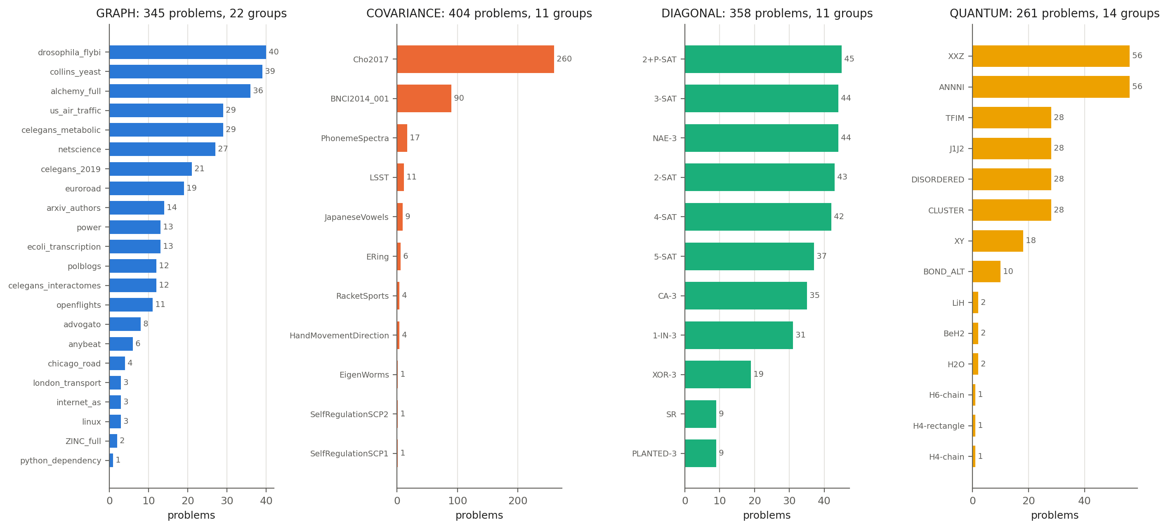
The harvest: 1 368 problems from 58 independent sources
1 368
problems (binary tasks)
58
source groups: the true unit of independence
55%
of problems have real inputs (tiers 1–2)
Weak point: 350 of COVARIANCE's 404 problems come from 2 EEG datasets; GRAPH's 345 problems rest on 93 distinct input sets.
Notes:
Source: results/q1_counts_by_type.md, q1_counts_by_subfamily.md. Note: the 9 molecule problems are labelled SYNTHETIC in provenance but counted tier 2; either way the share rounds to 55%.

Slide 6
Cleaning: six stated rules, raw data untouched
Found in the raw harvest (1 379 problems) | Rule applied
TRAIN/TEST leak: identical inputs on both sides, 22 problems | R2 group-aware re-split; R3 weights
Class balance below 0.2 floor, 1 problem | R1 excluded
Degenerate ground states, 24% of spin samples | re-harvest in a fixed symmetry sector (642 → 10 on a dry run)
Hartree–Fock not converged, 2 H₂O geometries | R5 samples removed
Uninformative operator (identity), 475 UEA samples | R6 flagged, sensitivity check
22 → 0
problems with a TRAIN/TEST leak
0 FAIL
in the audit of the final set (2 WARN: TEST balance 0.17)
337 930
samples in 1 368 problems
The raw files' sha256 is identical before and after the build. XY-periodic (10 problems) excluded: rejected by the pipeline after a solver failure.
Notes:
Source: CLEANUP_LOG.md and data_final/CHANGELOG.md.

Slide 7
One common object for four types: the factor graph
Factor graph of M(x)
12 scale-free features
One node per site, one per term of the operator, each term joined to the sites it acts on and weighted by its normalised coefficient (Kschischang, Frey & Loeliger 2001). It keeps many-body terms, which a coupling matrix would lose.
Locality: terms per site, term sizes, degree spread, support density. Symmetry: colour-refinement classes. Spectrum: entropy, participation ratio and connectivity of the factor graph's Laplacian. Median over each problem's inputs (to be revisited).
Status | Meaning | Use
forced | fixed exactly by the type's definition | pipeline check: must match exactly
predictable | follows from the generator's parameters | finding only if the data deviate
found | depends on real data | finding
Every (feature, type) cell was classified before any result was seen.
Notes:
Source: QnA_what_to_do.md §2.1–2.4.

Slide 8
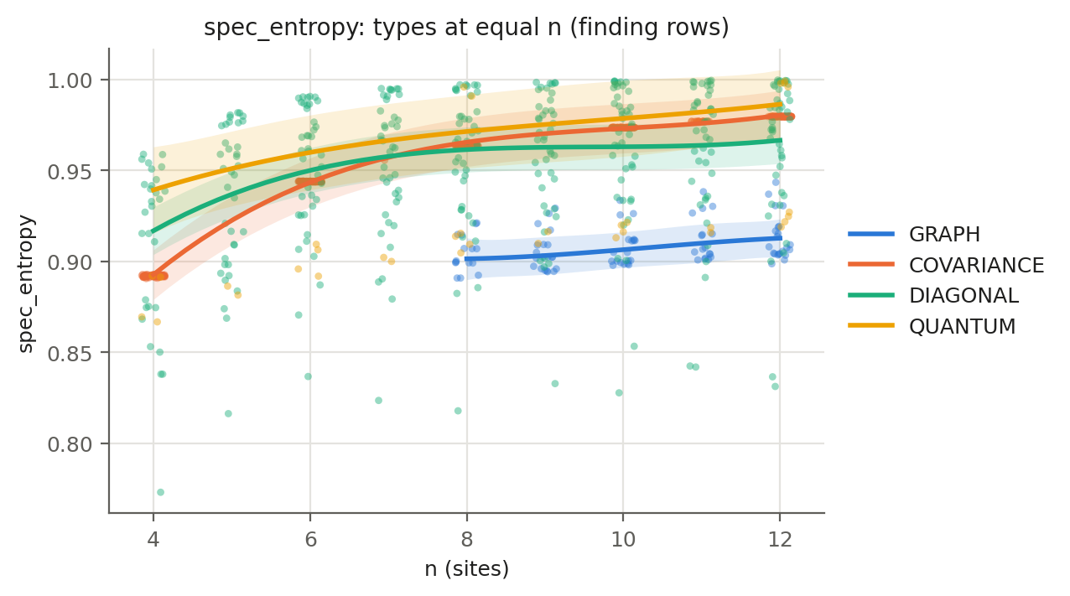
Q2: types differ in spectrum, but only GRAPH stands apart
Method. A mixed model per feature: type baseline + smooth curve in n per type + random offset per source (Wood 2017). Level and shape tests, Holm-corrected over 12 features.
Result. Spectral features differ by type (p 10⁻¹² to 5·10⁻⁷) and scale differently with n; marginal R² 0.30–0.55. GRAPH differs from every type (p < 10⁻⁴); the other three are close (entropy at n = 10: 0.97, 0.96, 0.98).
All forced values match exactly; results unchanged without flagged samples.
18–132
effective observations, not 1 107 (ICC 0.5–0.9): sources dominate
Notes:
Source: ANALYSIS_RESULTS §Q2. Permutation test (5 000 group shuffles) not yet run.

Slide 9
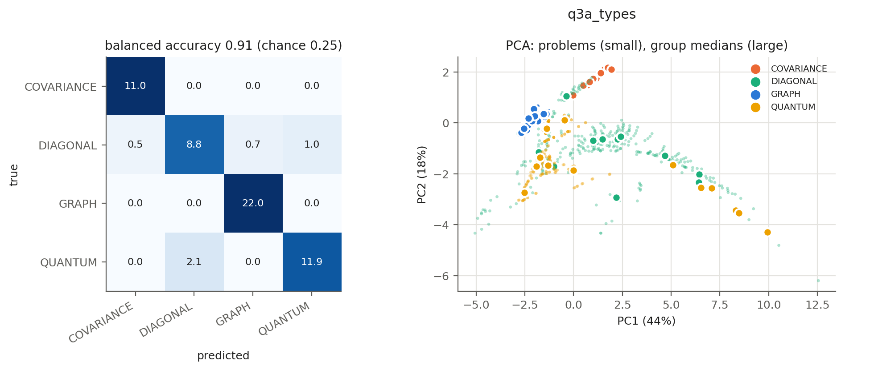
Q3: the type is recovered, the domain within a type is not
Task | Balanced acc. | Chance
Q3a: 4 types | 0.91 | 0.25
Q3b: GRAPH domains | 0.08 | 0.20
Q3b: COVARIANCE | 0.49 | 0.50
Q3b: DIAGONAL | 0.20 | 0.33
Q3b: QUANTUM* | 1.00 | 0.50
Logistic regression, one source held out at a time, three size controls (n-only baseline, Dinga et al. 2020, size-balanced subset). Type errors fall where the operator definitions predict (NAE-3, 2-SAT are pairwise, read as GRAPH). Below-chance scores are a known effect of leave-one-group-out with few sources (Jamalabadi et al. 2016). *Trivial: forced spin-chain features.
Notes:
Source: ANALYSIS_RESULTS §Q3. Two readings remain: features too coarse (Hodge complex would keep term overlaps), or domain is not the partition that matters.

Slide 10
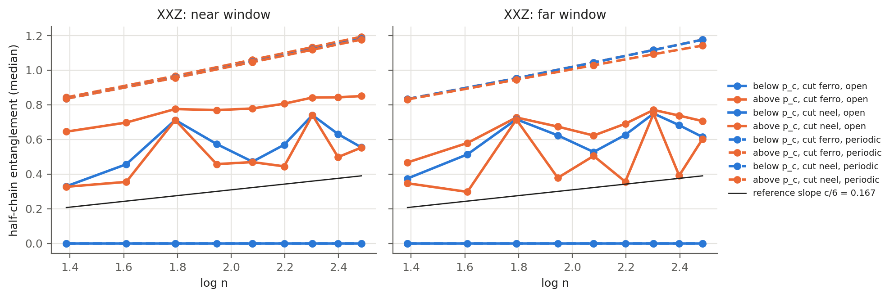
Q4: structure changes lawfully with n
28 / 28
forced laws match exactly
379 / 428
trends monotone in n
19 / 177
Each sub-family followed across n = 4…12. On open XXZ chains in the critical phase, the entanglement slope is 0.18–0.21 against the Calabrese–Cardy prediction c/6 = 0.167, inside the interval in all four cases. Four readings depend on the flagged degenerate states.
laws nameable at n ≤ 12 (ΔBIC > 10)
Notes:
Source: ANALYSIS_RESULTS §Q4. Laws: Calabrese & Cardy 2004, Hastings 2007, Kass & Raftery 1995.

Slide 11
What the study supports
1
Correct. every forced value and law matches; the one bug found was fixed before results were read
2
Varied, but coarse. spectral features separate GRAPH from the rest, not the other three types from each other
3
Lawful in n. monotone trends, Calabrese–Cardy on critical XXZ; most laws unnameable at n ≤ 12
4
Operator, not domain. the kind of operator is recovered; the domain within a type is not
5
Few independent sources. 18–132 effective observations: favour source diversity, hold out whole sources
This validates the extracted structure; trainability and dequantization need simulated circuits.
Notes:
Source: ANALYSIS_RESULTS, 'What the study supports' 1–5.

Slide 12
Next steps
1
Finish the analysis
2
Summarise the inputs
3
Logical State Space
Run the permutation tests (Q2: 5 000, Q3: 1 000 group shuffles) and confirm the open analysis choices. The robustness study (Q6) was not done.
Plot each problem's per-input distributions, then decide how to summarise them; align the molecules' origin tier across files.
A first instance L = (C; F; Φ), Hodge Laplacians on each factor graph's complex: one medium to explain structure ⇒ function.
4
Then the rest of Phase A
Build natural, generic and path circuits from each problem, fingerprint them, commit the Ragone and g-sim predictions, and measure trainability and classical simulation cost; validate the predictor by holding out whole sources.
Notes:
Sources: ANALYSIS_RESULTS status, CLEANUP_LOG, DECISIONS §11, PROJECT_DESIGN §4.

Slide 13
References
McClean et al., Barren plateaus in quantum neural network training landscapes, Nat. Commun. 9, 4812 (2018)
Larocca et al., Group-invariant quantum machine learning, PRX Quantum 3, 030341 (2022)
Ragone et al., A Lie algebraic theory of barren plateaus, Nat. Commun. 15, 7172 (2024); Fontana et al., Nat. Commun. (2024)
Cerezo et al., Cost function dependent barren plateaus, Nat. Commun. 12, 1791 (2021)
Cerezo et al., Does provable absence of barren plateaus imply classical simulability?, Nat. Commun. 16, 7907 (2025)
Goh et al., Lie-algebraic classical simulations for quantum computing, arXiv:2308.01432
Kschischang, Frey & Loeliger, Factor graphs and the sum-product algorithm (2001)
Wood (2017); Pedersen et al. (2019); Aarts et al. (2014); Nakagawa & Schielzeth (2013): mixed models
Roberts et al. (2017); Dinga et al. (2020); Jamalabadi et al. (2016): grouped validation
Calabrese & Cardy (2004); Hastings (2007); Kass & Raftery (1995): laws in n
Data: Netzschleuder; TUDataset (Morris et al. 2020), Alchemy (Chen et al. 2019); MOABB; UEA archive (Bagnall et al. 2018)

