Slide 1
PGPCC - Mentor session
Survey of some Azure Services
Week 3 “Azure Essentials”

Slide 2






Hi, my name is …
Tidjani Belmansour
Cloud Solution Architect | Microsoft Azure MVP
Cofomo – Quebec City - Canada (https://www.cofomo.com)
Co-organizer of the Azure Quebec Community (https://meetup.com/azureqc)
@Tidjani_B
https://espacenuagic.com | https://dev.to/tidjani

Slide 3

Agenda
Azure Storage Account
Azure App Service Web Apps
Azure Functions
Real-world case study
Azure Essentials
Week 3

Slide 4
Azure Storage Account

Slide 5
Azure Storage Accounts
A storage service for many data storage needs
Accessible via HTTPS
Hence, from anywhere
Highly scalable
Virtually unlimited storage capacity
Highly available and durable
Secure
Access Keys
Shared Access Signatures
Azure AD permission model
VNET integration

Slide 6
Azure Storage Accounts
PaaS offering
No need to care about the underlying infrastructure
Can you guess what kind of infrastructure it is under the hoods ?
No?
Me neither! And know what? I don’t care! ☺
It’s billed based on usage & number of transactions
Not by the number of Storage Accounts that you have
Hence, you can create multiple Storage Accounts to help better segmentation of access and permissions
Access to a storage account is through one of its Access Keys and connection string
Keys can be rotated to ensure security

Slide 7
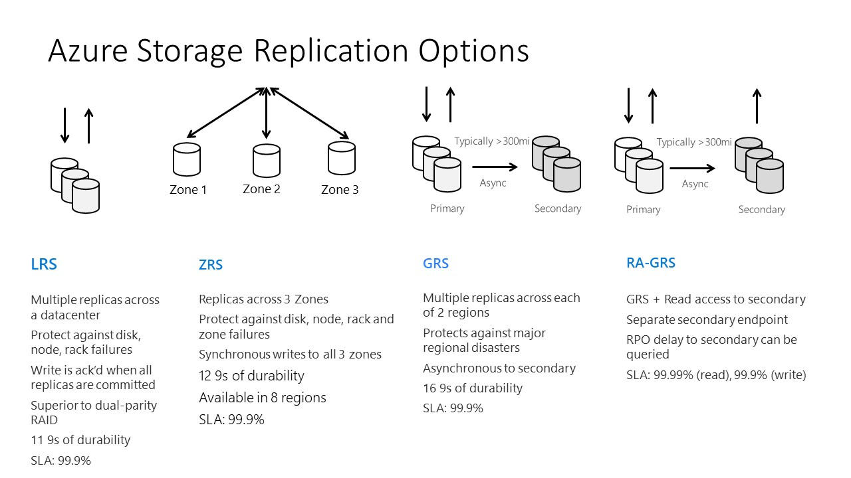
Azure Blob Storage – Replication Options
https://www.jamesserra.com/archive/2019/02/azure-data-lake-store-gen2-is-ga/

Slide 8
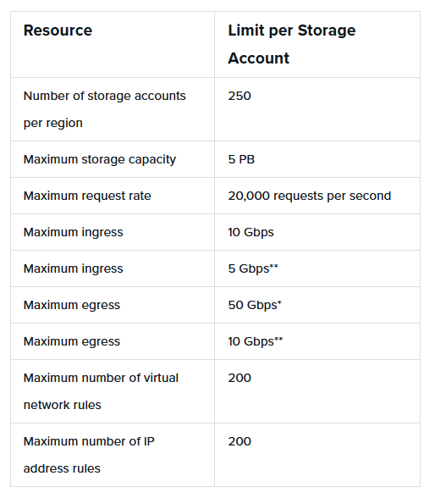
Azure Storage Accounts - Limits
(*) This limit applies to accounts of type “general-purpose v2” or “blob storage”. If you have a “general-purpose v1” account, with RA-GRS/GRS, the limit is 20 Gbps, or 30 Gbps if LRS/ZRS is used.
(**) This limit applies if your storage account uses RA-GRS/GRS. Otherwise, for LRS/ZRS, the limit is 15 Gbps.
https://cloud.netapp.com/blog/azure-anf-blg-azure-storage-limits-at-a-glance#H_H1

Slide 9
Azure Storage Accounts
Comprised of 4 underlying services
Blob Storage: storage of unstructured data (stored in terms of binary large objects or, BLOBs)
Table Storage: storage of NoSQL data (tabular data that have not defined schema)
File Storage: file sharing service supporting the SMB protocol
Queue Storage: simple (yet effective) queuing mechanism

Slide 10
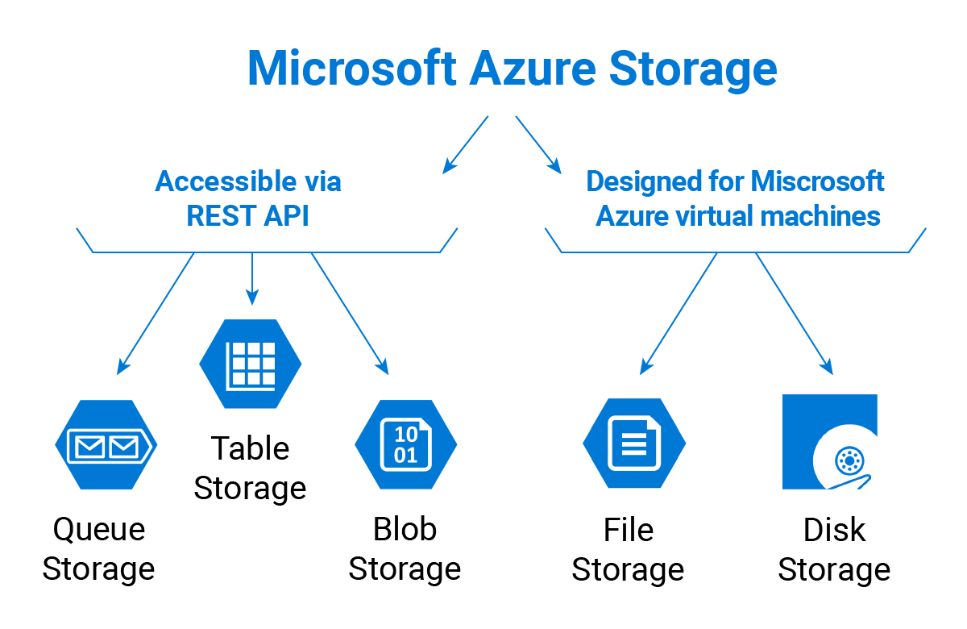
Azure Storage Accounts

Slide 11
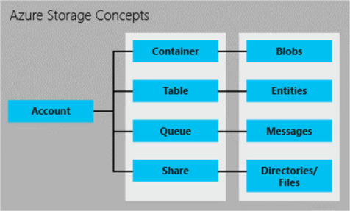
Azure Storage Accounts

Slide 12
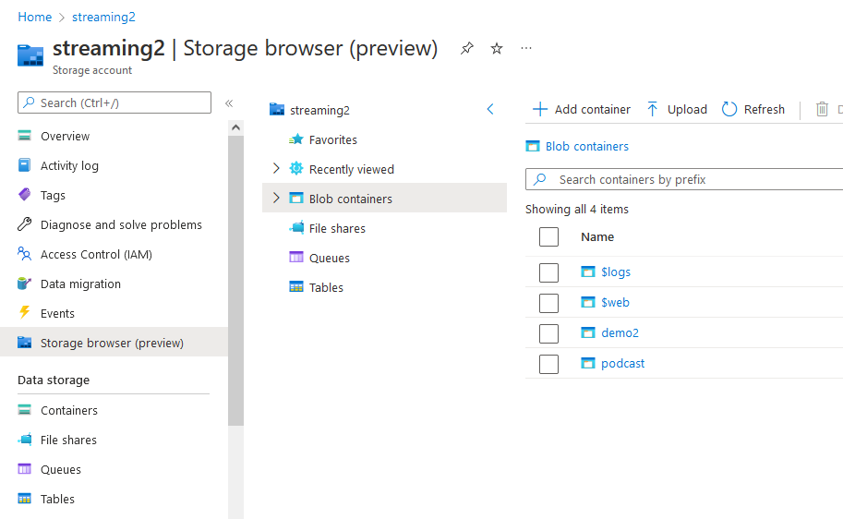
Azure Storage Browser

Slide 13
Azure Storage Account | Files

Slide 14




Azure File Storage
Cloud based network file share
Replacement of network drives
Supports SMB 2.0 & 3.0
SMB can be mounted by Windows, Linux, and MacOS
Supports NFS 3.0 and 4.1 (preview)
In addition to mounting from the O/S, Azure File Sync can be used (from on-premise)
Azure File Sync is a sync between Azure Files and your local file share on a Windows platform
Very useful when it comes to migrating existing applications to the cloud
Azure Storage – File Share
(Cloud Endpoint)
On-premises Windows Server
(Server Endpoint)
Storage Sync
Service

Slide 15
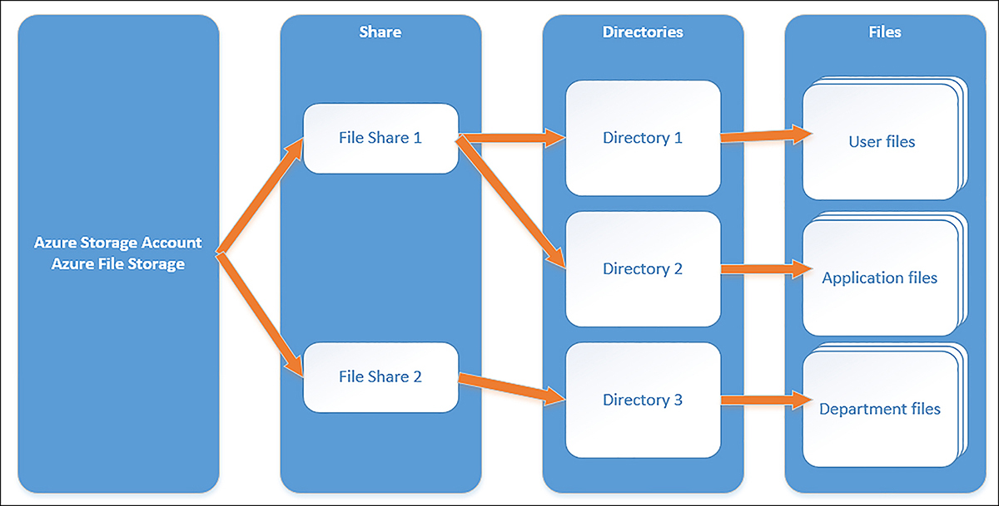
Azure File Storage

Slide 16
Azure Storage Account | Tables

Slide 17
Azure Table Storage
Tabular data with no enforced schema
Non-relational data schemes
If you have many relationships between your data entities, then Table Storage is not the right storage mechanism for you. Consider a SQL-like database
Useful when your app manipulates a small number of entities with no (or very loose) relationships between them
In that case, Table Storage can be a more cost-effective option than a SQL database

Slide 18
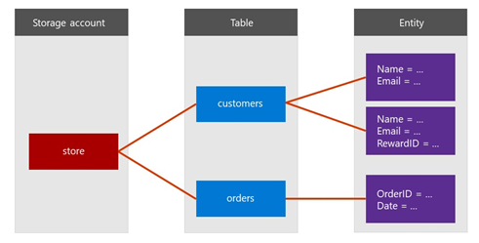
Azure Table Storage

Slide 19
Azure Table Storage
Warning #1: Beware of the way you access your data!
Make sure that the requested column exists for the entity you’re accessing before you try to read its value
Warning #2: Fetching table data is 1,000 items at a time
You need to check if there are more items in the table and fetch the next batch of items
The batch size of 1,000 items doesn’t mean you’ll get exactly 1,000 items (you can get less)

Slide 20
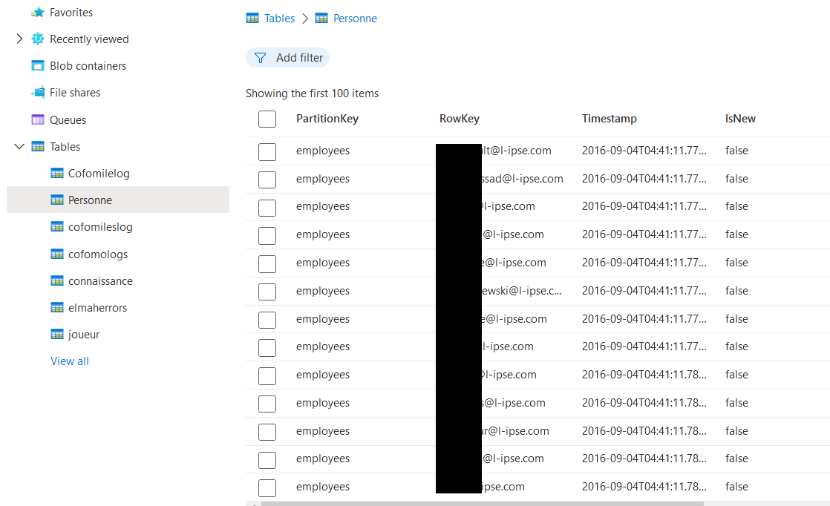
Azure Table Storage
Warning #3: Timestamp refers to the moment the item was pushed into the table
Items are pushed into a table by batch and/or asynchronously
They aren’t necessarily pushed into the table in the same order that they were sent to the Table Storage service
Hence, you can’t refer to that order for processing. You must have some column that tracks the order

Slide 21
Azure Table Storage
PartitionKey and RowKey are a way to segment items in a table
Any query to a table will need the PartitionKey to be specified
They help for faster data retrieval
You can provide the PartitionKey and/or RowKey when querying a table
If you specify both, you will get a most one item
If you specify only the PartitionKey, you may get multiple items
PartitionKey and RowKey together form the unique key for an item
Hence, you can’t have the same PartitionKey and RowKey for multiple items
However, you can have the same PartitionKey with different RowKeys
And you can also have the same RowKey with different PartitionKeys
You need to define your strategy for PartitionKey and RowKey
This strategy should be based on your use case
There is no “one-size-fits-all” way to define PartitionKey and RowKey

Slide 22
Azure Table Storage
A typical example of PartitionKey and RowKey is to use PartitionKey to specify a department in an organization and to use RowKey to specify the employee (by his/her email address, for example)
Another example (in gaming) is to use PartitionKey to specify the game_id and to use the RowKey to specify the player_id

Slide 23
Azure Storage Account | Queues

Slide 24
Azure Queue Storage
Queuing mechanism, just like Azure Service Bus
Allows for asynchronous communication and processing of messages between application’s services
Multiple services can push a message and multiple services can listen to the queue for messages
No notification for a new message (Azure Event Grid does that)
A listener needs to poll the queue, waiting for messages to process
Multiple queues can be created in the same storage queue
Recommended for better segmentation of usages and/or priorities
Billed per message, not per the number of queues

Slide 25
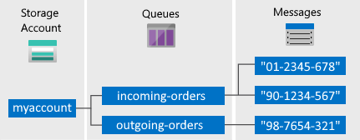
Azure Queue Storage

Slide 26
Azure Queue Storage
Unlike Azure Service Bus:
No Topics / Subscriptions support
No guarantee of the order in which messages will be pushed into the queue
No guarantee of single delivery of a given message
Your code needs to be idempotent

Slide 27
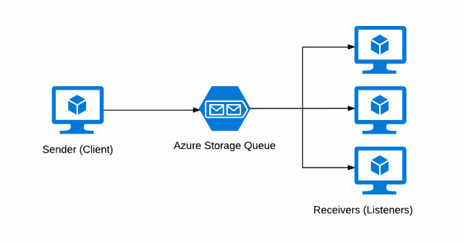
Azure Queue Storage

Slide 28

Azure Queue Storage

Slide 29
Azure Storage Account | Blobs

Slide 30
Azure Blob Storage
Storage of unstructured data
images, PDF files, Word documents, JSON files, …
Common usages:
Gallery of images for your shopping site or catalog
Storage of generated invoices or reports
Blobs are stored in containers
Logical grouping
You may think of it as a folder
Paths aren’t hierarchical !
Snapshots
Soft delete

Slide 31
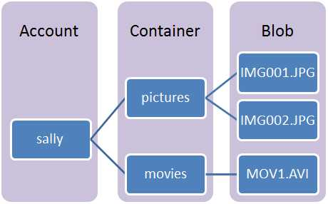
Azure Blob Storage

Slide 32
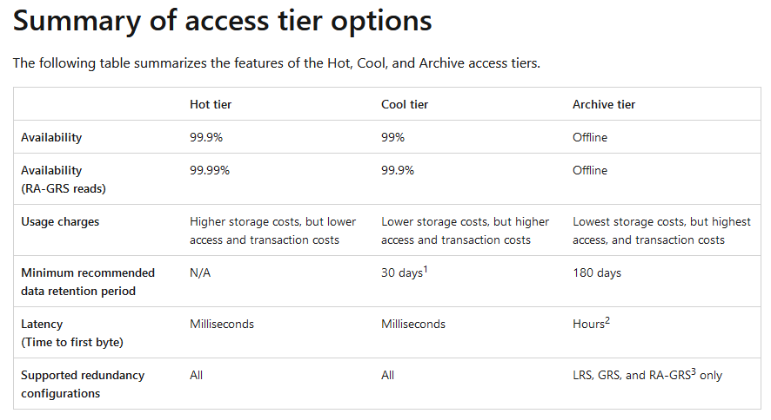
Azure Blob Storage – Access tiers
Cool Storage use cases:
short term storage of backup, telemetry data
Archive Storage use cases:
compliance data, long-term backup, archived datasets
https://docs.microsoft.com/en-us/azure/storage/blobs/access-tiers-overview

Slide 33
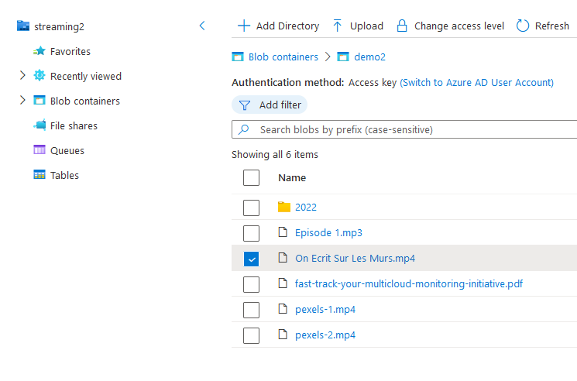

Azure Blob Storage
Access level

Slide 34
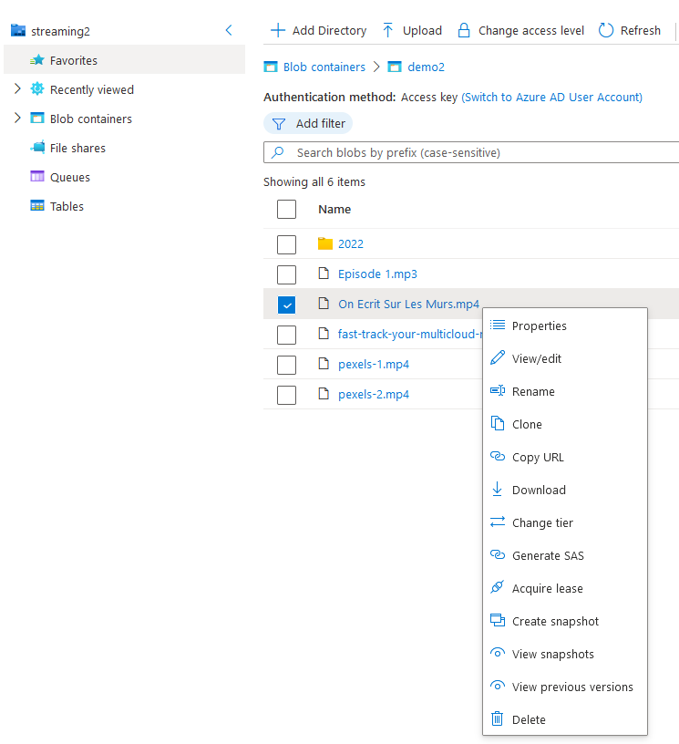
Azure Blob Storage
Sharing content with Shared Access Signatures (SAS)
Can be temporary or permanent
Not very secure since if one gets his/her hand on the SAS, he/she can access the content

Slide 35
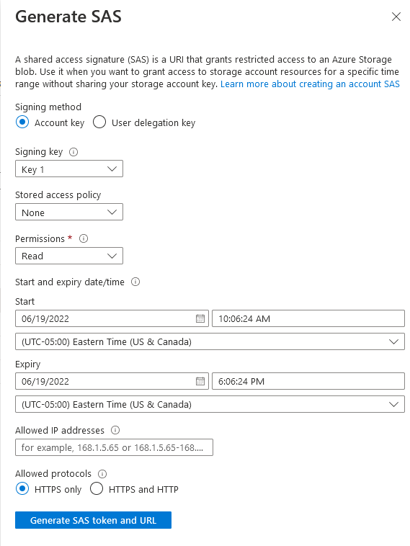
Azure Blob Storage
Sharing content with Shared Access Signatures (SAS)
Can be temporary or permanent
Not very secure since if one gets his/her hand on the SAS, he/she can access the content

Slide 36
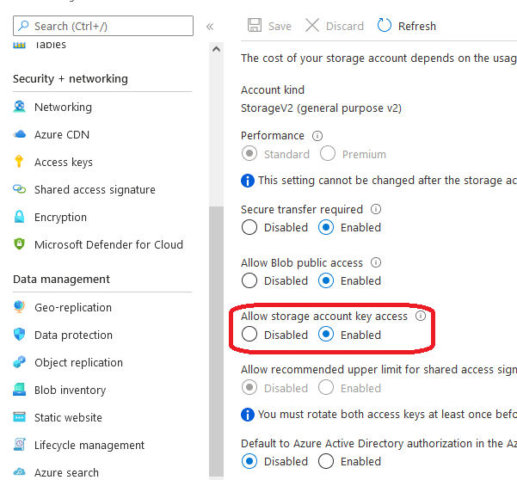
Azure Blob Storage
For better control and security, rely on Azure AD permissions rather than SAS when possible

Slide 37
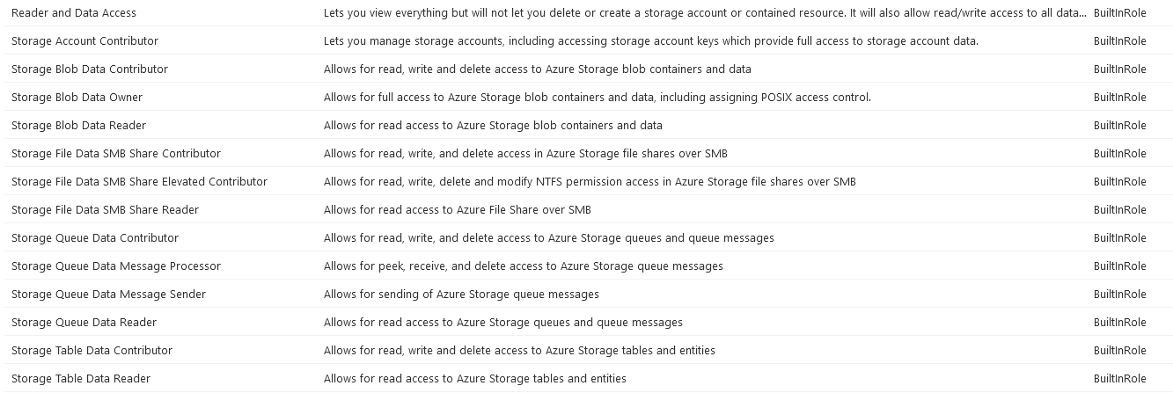
Azure Blob Storage
There are built-in roles for that…

Slide 38
Azure Blob Storage
Static Websites
Host your static website in a Storage Account
E.g., Angular / Vue.js / React website
Very cost effective
Limited functionalities, E.g.,
Only GET HTTP verb supported (hence, not suitable for APIs written in Express.js for example)
No Azure AD authentication integration

Slide 39
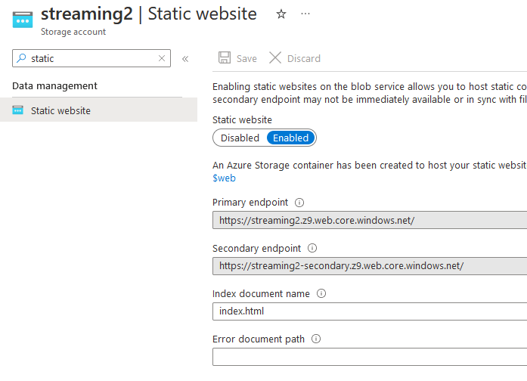
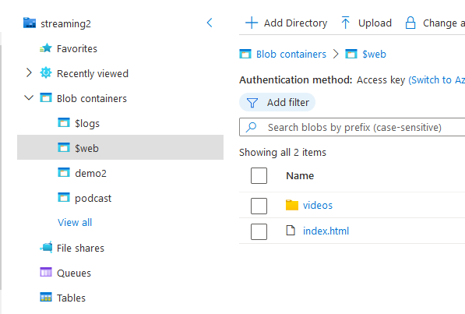
Azure Blob Storage
Static Websites

Slide 40
Azure Blob Storage
Block blobs: used for discrete storage objects like images, documents, … that don’t need random read/write operations
Page blobs: used for random read/write storage objects, usually VHD images
Append blobs: optimized for append operations, usually logs

Slide 41
Azure App Service Web Apps

Slide 42
Azure App Service Web Apps
Hosting of web applications & services
PaaS offering: no need to worry about the underlying infrastructure
But if you wanna know…
Windows App Service Plan ➔ Windows VM with IIS as a hosting service
Linux App Service Plan ➔ Linux VM (CentOS or Ubuntu) with your app running in a docker container (for .NET apps at least…)
You can’t (obviously) run .NET Framework apps in a Linux-based App Service Web App
Not all features are equally available
E.g., extensions are not available for Linux-based App Service Web Apps

Slide 43
Azure App Service Web Apps
App Service Plan ➔ the SKU defining the capacities of the server running your web app (CPU, RAM, IOPS, …)
Think of it as the VM with the web server installed on it
App Service Web App ➔ the instance of the application running on the web server
Multiple Web Apps can be hosted on the same App Service Plan
Keep an eye on the metrics of the App Service Plan…

Slide 44
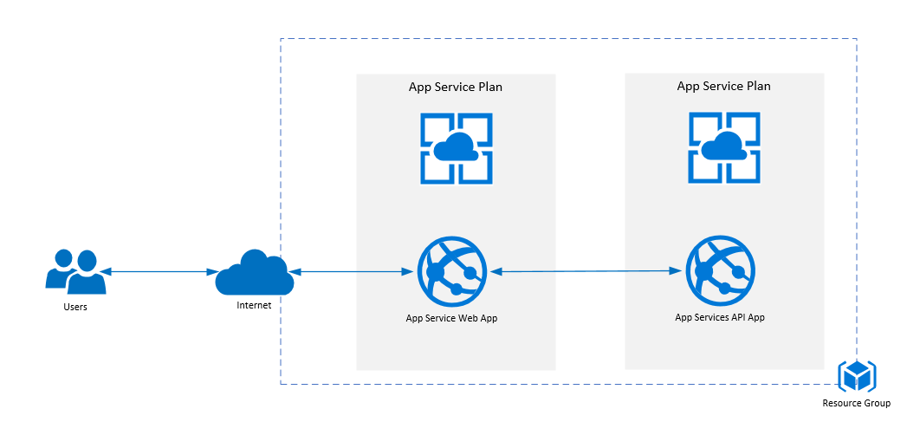
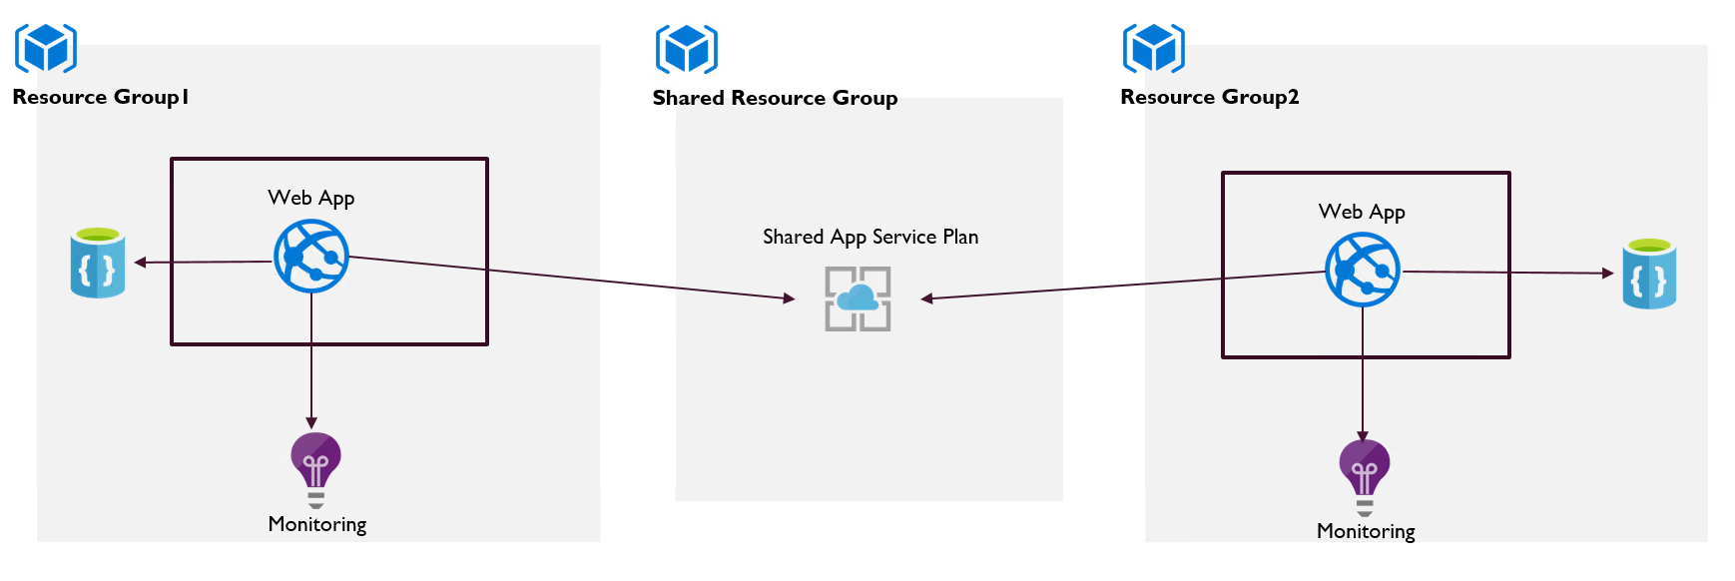
Azure App Service Web Apps

Slide 45
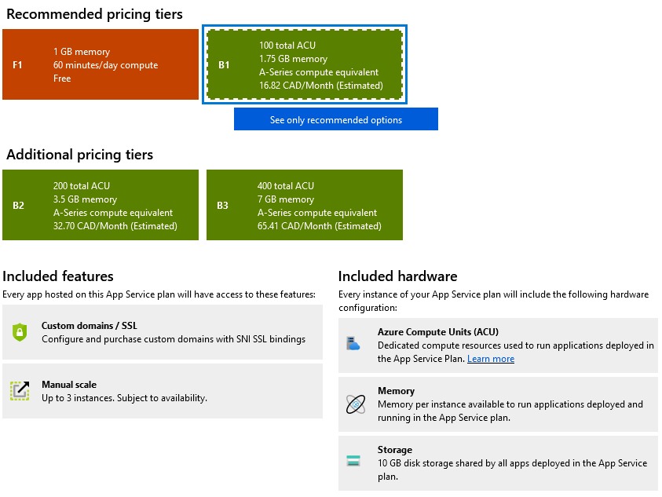
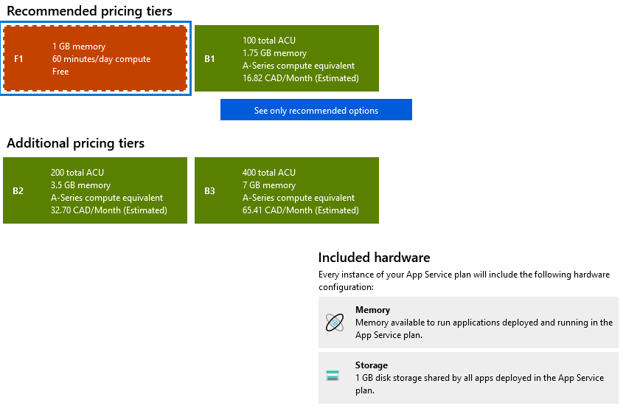
Azure App Service Web Apps
App Service Plan SKUs have limitations
Execution time, autoscaling capabilities, custom domain support, …
You can only have 10 Free (F1) App Service Plans per subscription

Slide 46
Azure App Service Web Apps
Configuration
App Settings and Connection Strings
General Settings
Runtime configuration
HTTPS only
FTPS only
ARR Affinity
Always On
…
Managed Identity
The identity under which your app is running
Think of it as a « managed service account »
Use it to set permission for your app to other dependencies (e.g., the database)

Slide 47
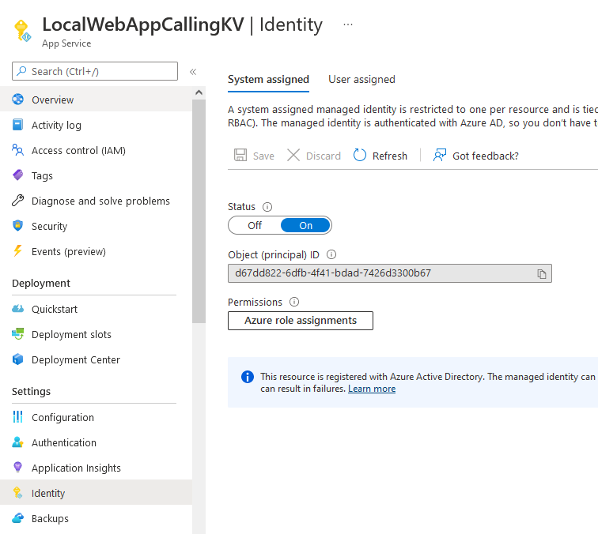
Azure App Service Web Apps

Slide 48
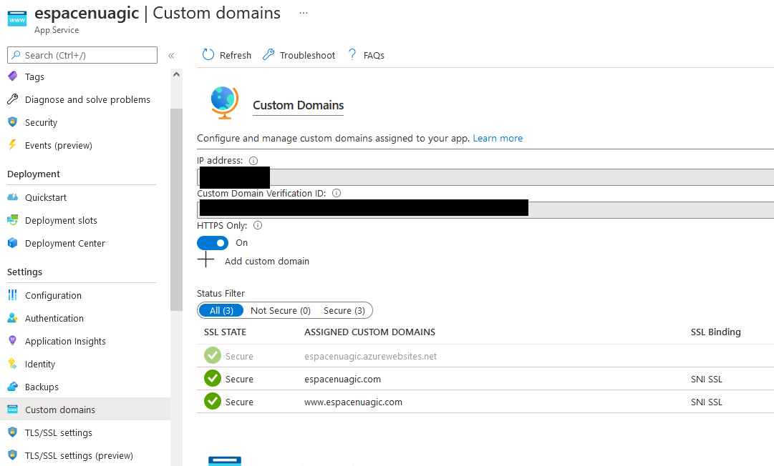
Azure App Service Web Apps
Custom domains and Managed certificates

Slide 49
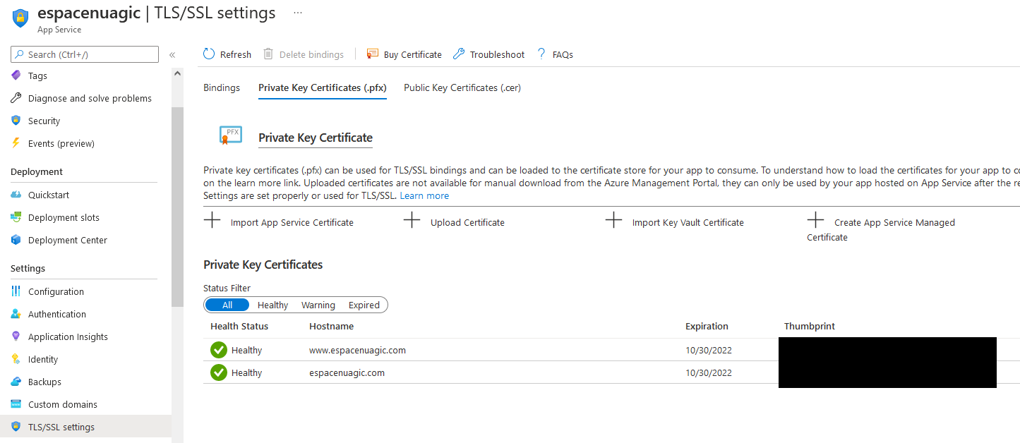
Azure App Service Web Apps
Custom domains and Managed certificates

Slide 50
Azure App Service Web Apps
Management
Kudu Console
App Service Editor
Partial access to the file system of the running instance
Be careful: changes can be undone in case of scaling or recreation of the instance

Slide 51
Azure App Service Web Apps
IP Restrictions
Controls which IP addresses are allowed to communicate with the instance
Useful when no ASE is in place (way more expensive)
Use case:
You only want the FrontEnd Web App to be able to communicate with the BackEnd Web App
You only want the BackEnd Web App to be able to
Be careful: Outbound IPs may change when scaling or recreating the instance

Slide 52
Azure App Service Web Apps
Auto Scaling
Define rules for automatic scale-out and scale-in based on demand
Rules can be based on CPU usage, RAM usage, HTTP requests queue length, number of messages in a queue,…
Common use case
Adapt the number of instances based on the number of messages in the queue
Don’t forget the scale-in rules !

Slide 53
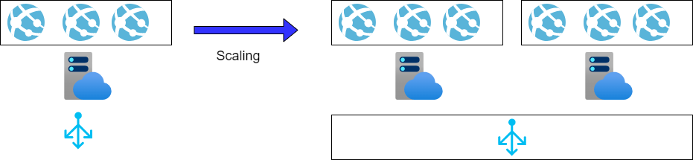
Azure App Service Web Apps
VERY IMPORTANT FACT !
Scaling occurs at the App Service Plan-level (not the Web App-level)
Hence, make sure that scaling is the way to go for your scenario !

Slide 54
Azure Functions

Slide 55
Azure Functions
Event-based processing
i.e., processing is triggered as a response of an event (e.g., a new message in the queue)
Serverless service
Microsoft provides and manages the infrastructure and the middlewares and takes care of scaling (in and out)
A Function App is a collection of functions
Many programming languages are supported: .NET, Java, JavaScript, Python, PowerShell

Slide 56
Azure Functions
Can use Managed Identities for permissions and access
Common use cases:
Some people use Functions for managing the Azure infrastructure
Others use them for business needs (e.g., report generation, thumbnail creation, …)

Slide 57
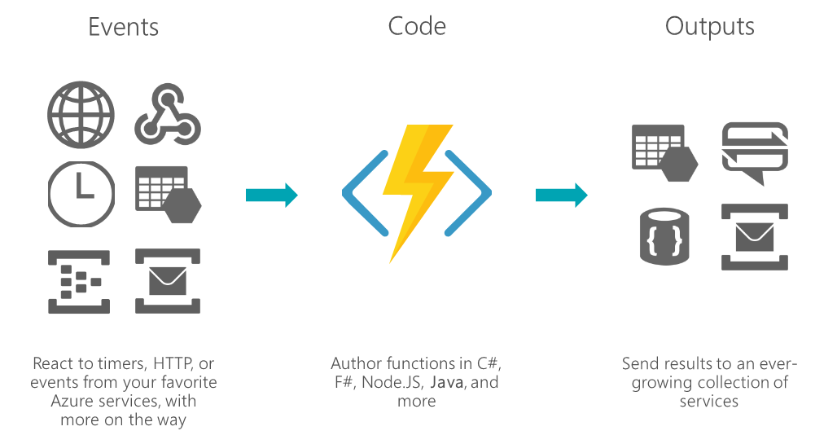
Azure Functions
Multiple triggers exist

Slide 58
Function Hosting Plans
 | Consumption | Premium | App Service Plan
Default/Max Timeout (min) | 5/10 | 30/unlimited | 30/unlimited
Compute | 100 ACUs/1.5 GB | 210-840 ACUs/3.5-14GB | 100-840 ACUs/1.75-14GB
Scaling | Auto-scale (200 max) No control | Auto-scale (200 max) No control | Auto/Manual-scale Better control
Cold-start | Yes | Must have 1 pre-warmed | Runs continuously
Billing | Executions, Execution Time, Memory | Instances running | Depends on App Service Plan

Slide 59
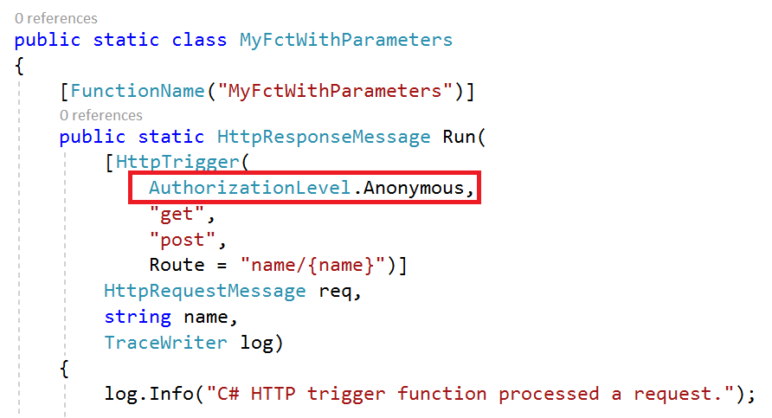
Azure Functions

Slide 60
Real-World Case Study

Slide 61
Cekissa
Cekissa (c’est qui ça ?!) ➔ WhoozDat (who is that?!)
Guess how much it used to cost per month?
100 $
10 $
< 1$
Two things to note here…
Clever designs could lead to very cost-effective applications
« The Cloud is a moving target »
F1 SKU used not to being time-limited back in 2015 (but it had less features than today)

Slide 62
Thank you
@Tidjani_B
Happy Learning!

