Slide 1
Pirate Chat

Slide 2
Pirate Server Features
Uses Python’s socket, ssl, and threads libraries
Client Handling:
Clients are prompted to enter a “pirate name"
Each client is handled in a separate thread.
Graceful handling of multiple clients
Broadcasting:
Messages are sent to all connected clients except the sender.
Thread-safe operations using locks.
User Interaction:
Welcomes users with jolly roger ASCII art.
Handles n like /quit for graceful exits.
Debugging:
Error handling with Exception and custom DEBUG messages.
SSL/TCP Encryption:
Sockets use SSL wrapper
Server uses self-signed certificate

Slide 3

Architecture
Server Workflow:
Starts by binding to a host and port.
Listens for incoming client connections.
Stores any connections in a client list.
Creates a new thread for each client.
Client Workflow:
Connects to the server and receives a welcome message.
Sends and receives messages in real time.
Threading:
Uses threading to handle multiple clients simultaneously.
Ensures thread safety with threading lock
Encryption:
Uses python’s SSL library to wrap sockets
Uses self-signed certificate “server.crt” and “server.key”

Slide 4
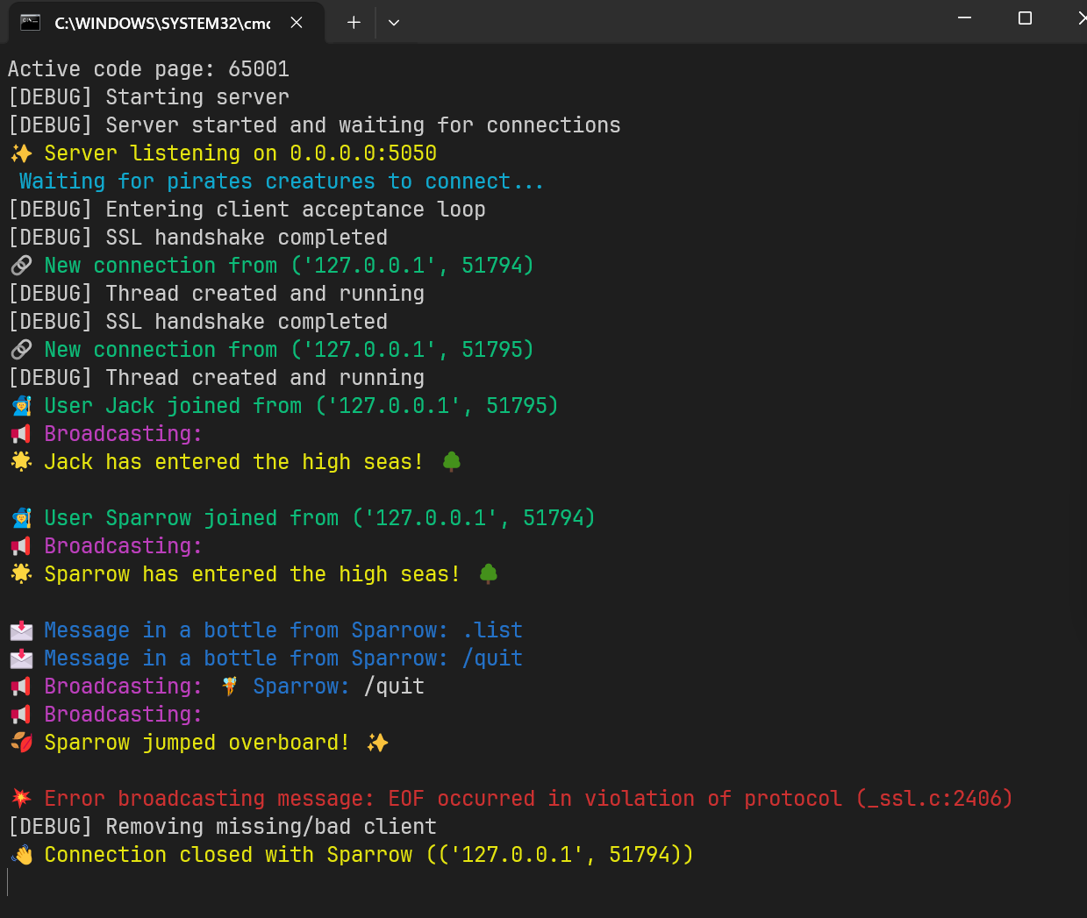
Server Screenshot

Slide 5
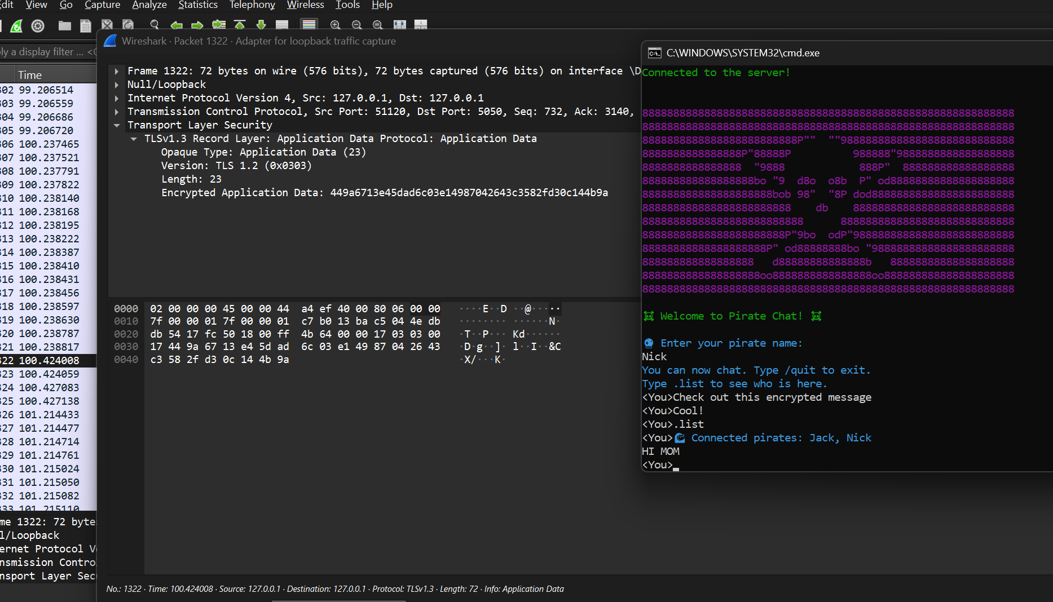
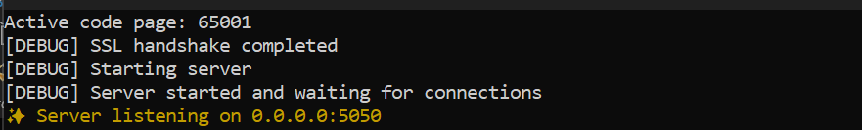

Proof of SSL Encryption

Slide 6
Client Chat Features
Written in Python using socket and threading libraries.
Each client connects to the server and receives a unique ID.
Supports message sending and receiving.
Clients can request an active client list with '.list’.
Handles graceful disconnect with '.exit’.

Slide 7
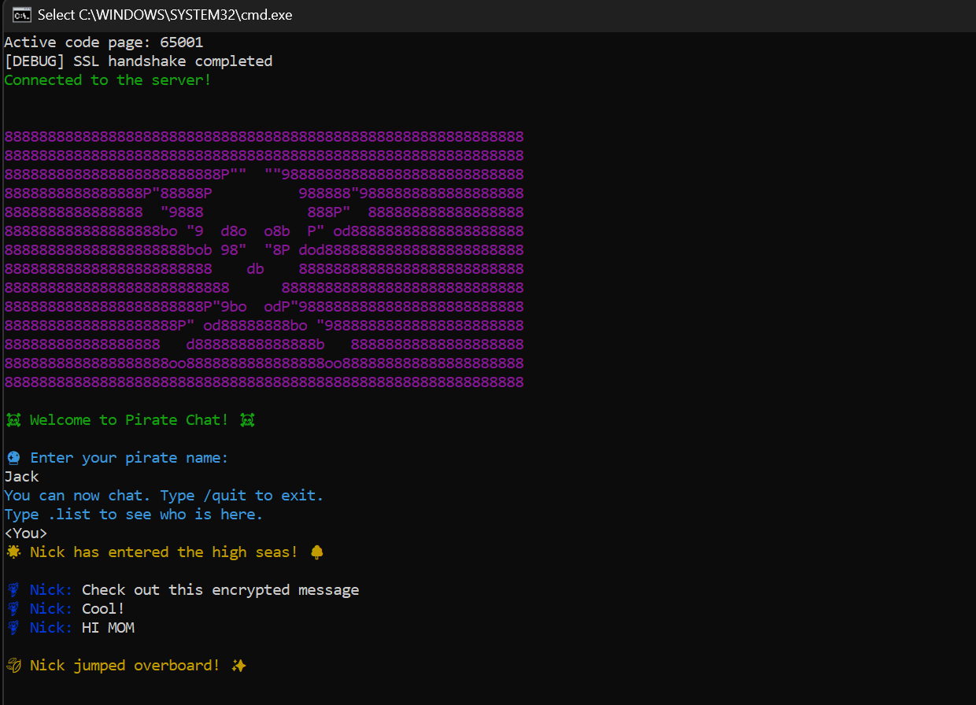
Client Screenshot

Slide 8
Client Code Architecture
ChatClient class encapsulates connection and messaging logic.
connect() handles connection state and thread creation
receive_messages() runs in a background thread for real-time listening.
send_message() sends messages to a specific client using their ID.
handle_user_input() handles user input and special commands
disconnect() ensures proper session closure.

Slide 9
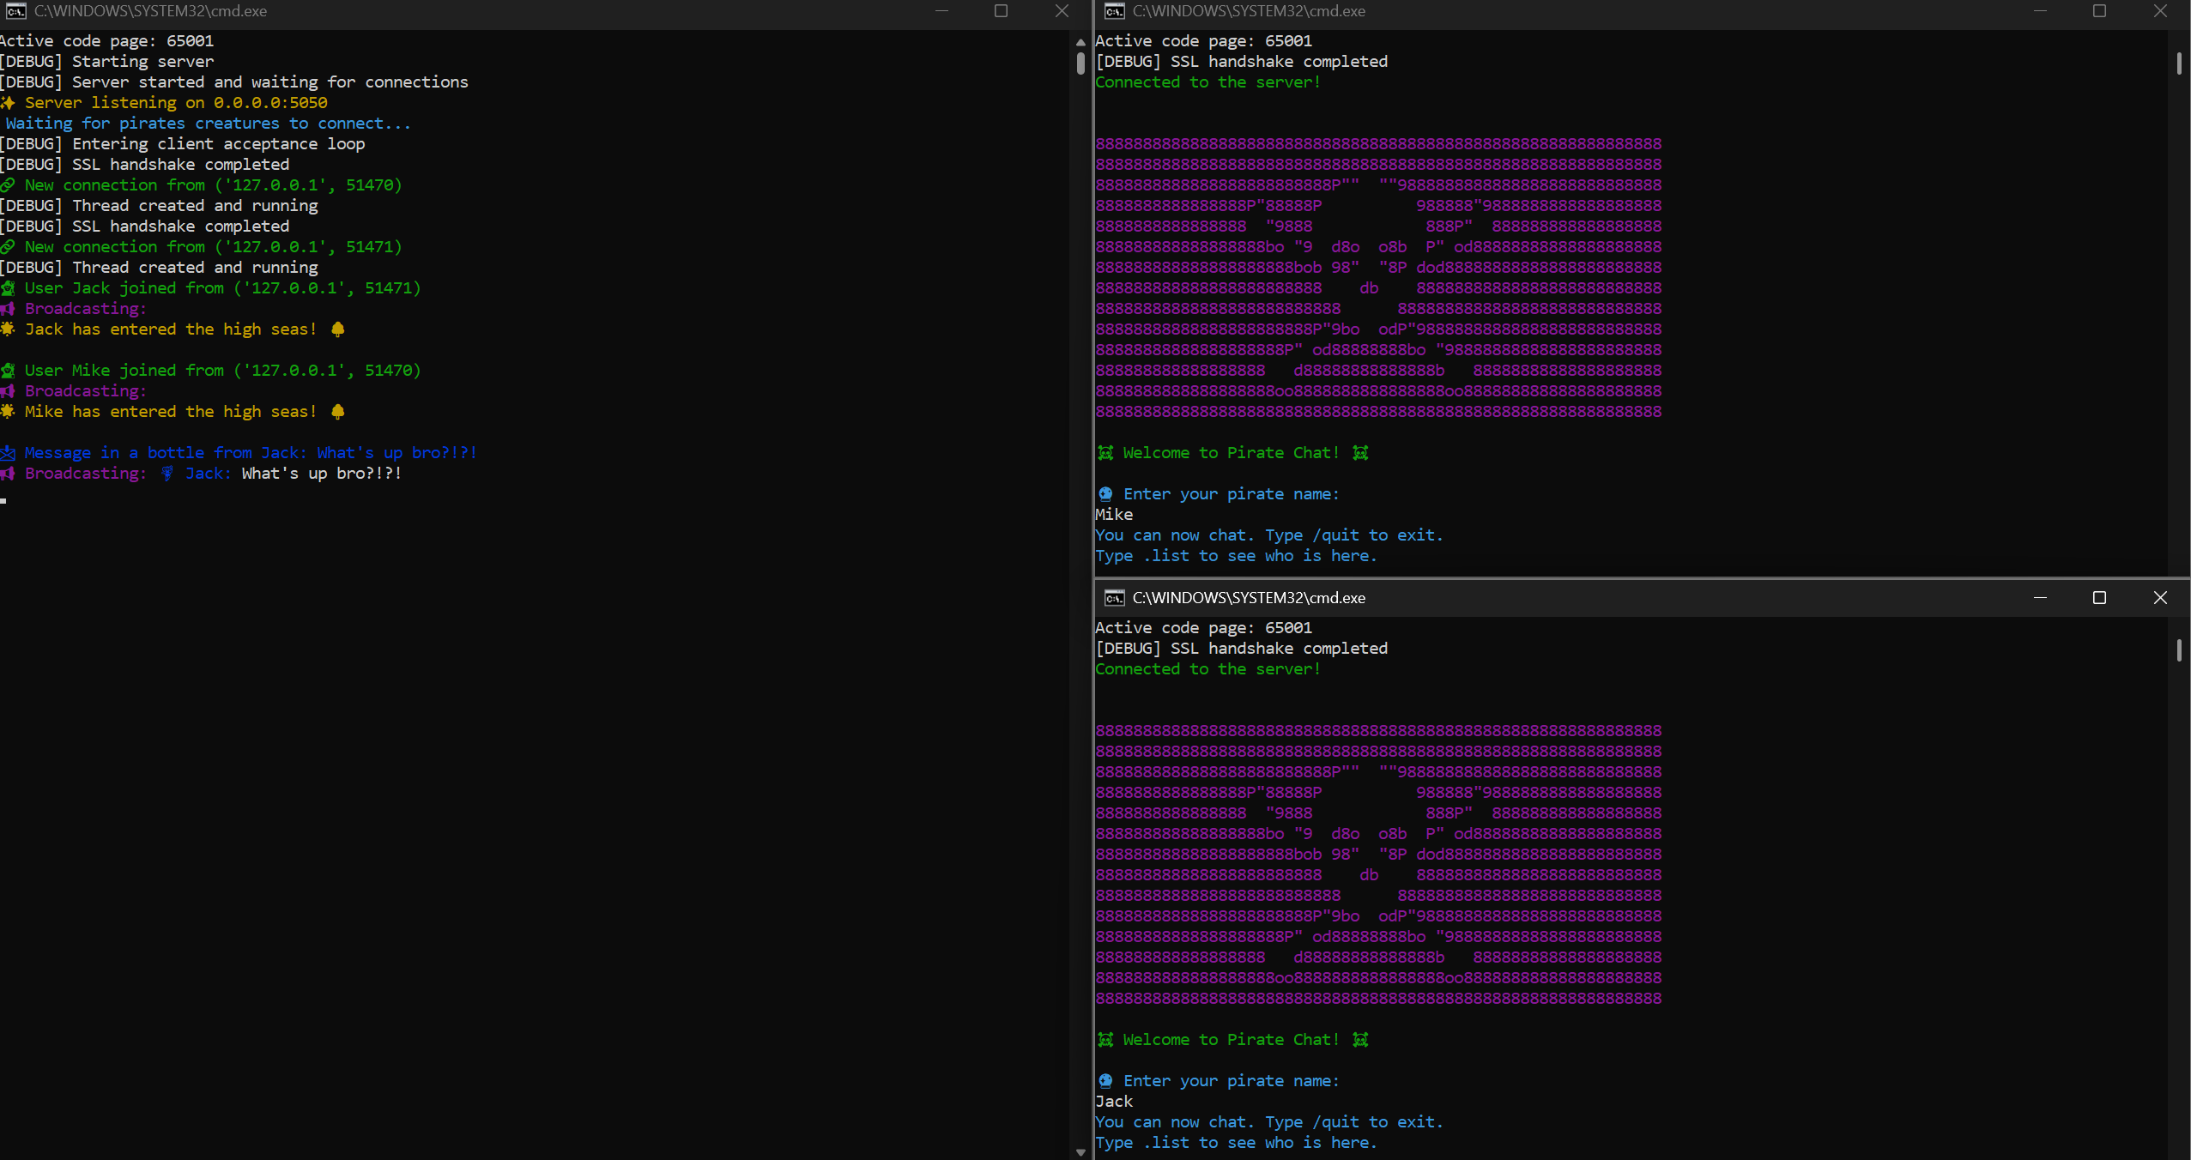
Just Chatting…

Slide 10
Pirate Chat

