Slide 1
Business Data Analytics Process
Chapter 02

Slide 2
Business Analytics Process
The complete business analytic process involves the three major component steps applied sequentially to a source of data (see Figure 1.1 ). The outcome of the business analytic process must relate to business and seek to improve business performance in some way.

Slide 3
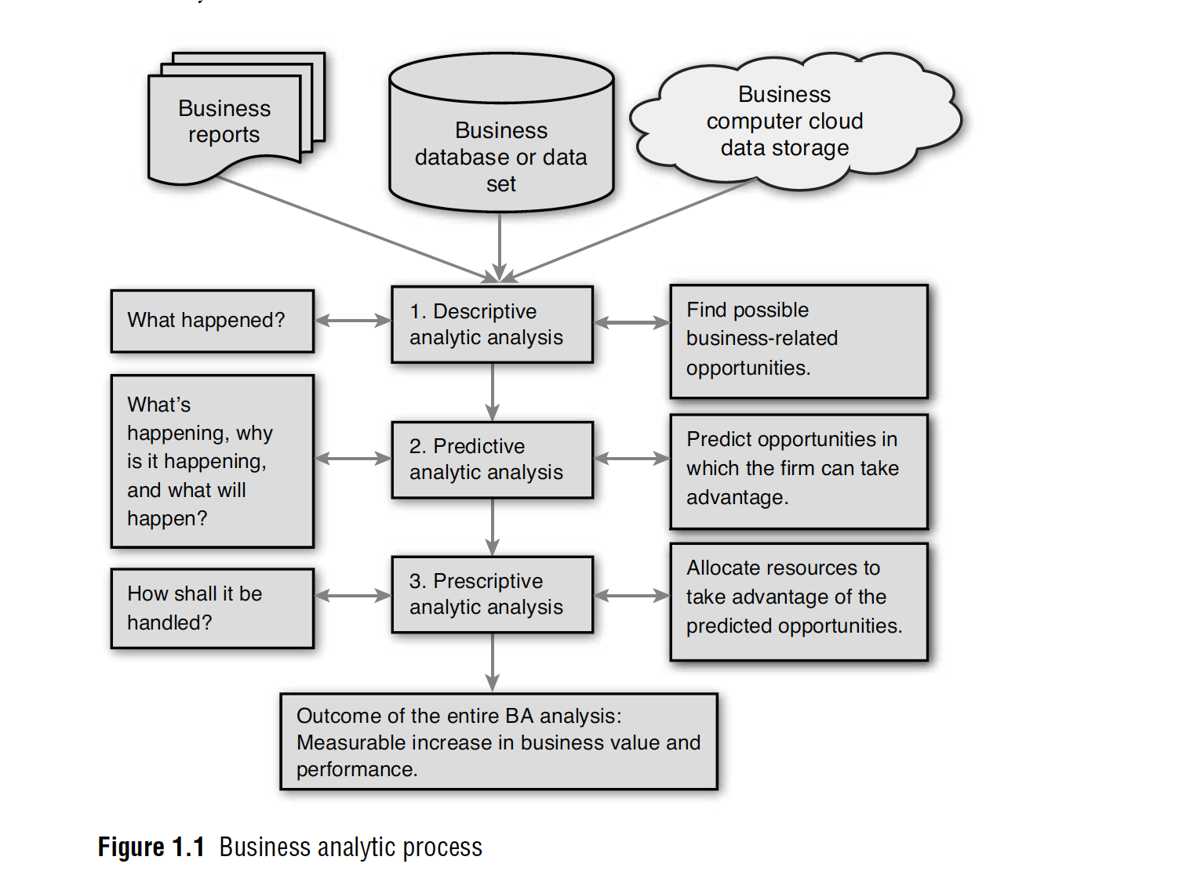

Slide 4
Business Analytics Process
The logic of the BA process in Figure 1.1 is initially based on a question: What valuable or problem-solving information is locked up in the sources of data that an organization has available? At each of the three steps that make up the BA process, additional questions need to be answered, as shown in Figure 1.1 .
Answering all these questions requires mining the information out of the data via the three steps of analysis that comprise the BA process.
The analogy of digging in a mine is appropriate for the BA process because finding new, unique, and valuable information that can lead to a successful strategy is just as good as finding gold in a mine.

Slide 5
Business Analytics Process
Many firms routinely undertake BA to solve specific problems, while other firms undertake BA to explore and discover new knowledge to guide organizational planning and decision-making to improve business performance.
The size of some data sources can be unmanageable, overly complex, and generally confusing. Sorting out data and trying to make sense of its informational value requires the application of descriptive analytics as a first step in the BA process.

Slide 6
Business Analytics Process
Also, incorporating some of the data into spreadsheets like Excel and preparing cross tabulations and contingency tables are means of restricting the data into a more manageable data structure.
Simple measures of central tendency and dispersion might be computed to try to capture possible opportunities for business improvement.
Other descriptive analytic summarization methods, including charting, plotting, and graphing, can help decision makers visualize the data to better understand content opportunities.

Slide 7
Business Analytics Process
From Step 1 in the Descriptive Analytic analysis (see Figure 1.1 ), some patterns or variables of business behavior should be identified representing targets of business opportunities and possible (but not yet defined) future trend behavior.
Additional effort (more mining) might be required, such as the generation of detailed statistical reports(based on percentage analysis, central tendency measure, dispersion) narrowly focused on the data related to targets of business opportunities to explain what is taking place in the data (what happened in the past).
This is like a statistical search for predictive variables in data that may lead to patterns of behavior a firm might take advantage of if the patterns of behavior occur in the future.

Slide 8
Business Analytics Process
For example, a firm might find in its general sales information that during economic downtimes, certain products are sold to customers of a particular income level if certain advertising is undertaken. The sales, customers, and advertising variables may be in the form of any of the measurable scales for data in Table 1.4.
But they have to meet the three conditions of BA previously mentioned: clear relevancy to business, an implementable resulting insight, and performance and value measurement capabilities.

Slide 9
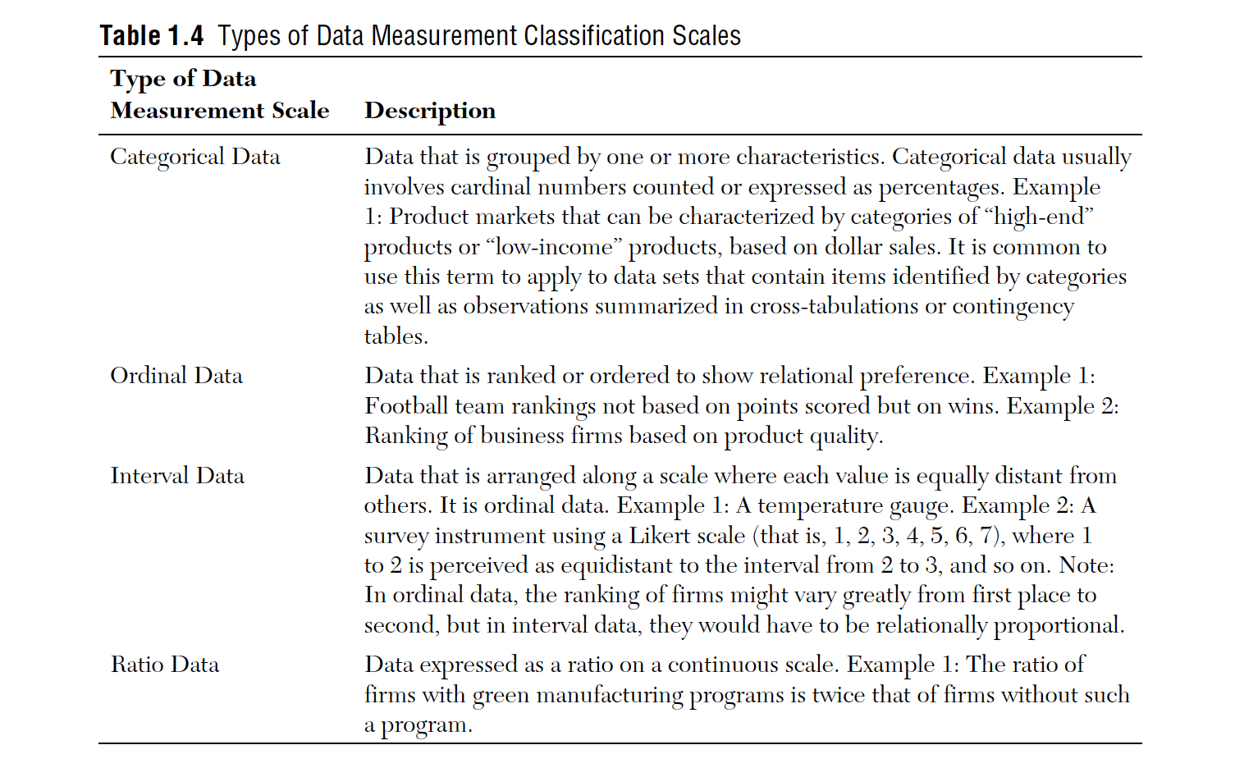

Slide 10
Business Analytics Process
To determine whether observed trends and behavior found in the relationships of the descriptive analysis of Step 1 actually exist or hold true and can be used to forecast or predict the future, More advanced analysis is undertaken in Step 2, Predictive Analytic analysis, of the BA process.
There are many methods that can be used in this step of the BA process.

Slide 11
Business Analytics Process
A commonly used methodology is multiple regression, “Forecasting,” for a discussion on multiple regression and ANOVA testing.
This methodology is ideal for establishing whether a statistical relationship exists between the predictive variables found in the descriptive analysis.
The relationship might be to show that a dependent variable is predictively associated with business value or performance of some kind.

Slide 12
Business Analytics Process
For example, a firm might want to determine which of several promotion efforts (independent variables measured and represented in the model by dollars in TV ads, radio ads, personal selling, and/or magazine ads) is most efficient in generating customer sale dollars (the dependent variable and a measure of business performance).

Slide 13
Business Analytics Process
Care would have to be taken to ensure the multiple regression model was used in a valid and reliable way, which is why ANOVA and other statistical confirmatory analyses are used to support the model development.
Exploring a database using advanced statistical procedures to verify and confirm the best predictive variables is an important part of this step in the BA process. This answers the questions of what is currently happening and why it happened between the variables in the model.

Slide 14
Business Analytics Process
A single or multiple regression model can often forecast a trend line into the future.
When regression is not practical, other forecasting methods in Time series (exponential smoothing, smoothing averages) can be applied as predictive analytics to develop needed forecasts of business trends.
The identification of future trends is the main output of Step 2 and the predictive analytics used to find them. This helps answer the question of what will happen.
If a firm knows where the future lies by forecasting trends as they would in Step 2 of the BA process, it can then take advantage of any possible opportunities predicted in that future state.

Slide 15
Business Analytics Process
In Step 3, Prescriptive Analytics analysis , operations research methodologies can be used to optimally allocate a firm’s limited resources to take best advantage of the opportunities it found in the predicted future trends.
Limits on human, technology, and financial resources prevent any firm from going after all opportunities they may have available at any one time.
The implementation of statistical results are based on the business environment variables seeing the validity and effectiveness of the organization .

Slide 16
Business Analytics Process
Using prescriptive analytics allows the firm to allocate limited resources to optimally achieve objectives as fully as possible.
For example, linear programming (a constrained optimization methodology) has been used to maximize the profit in the design of supply chains.
This third step in the BA process answers the question of how best to allocate and manage decision-making in the future.

Slide 17
Business Analytics Process
In summary, the three major components of descriptive, predictive, and prescriptive analytics arranged as steps in the BA process can help a firm find opportunities in data, predict trends that forecast future opportunities, and aid in selecting a course of action that optimizes the firm’s allocation of resources to maximize value and performance.

Slide 18
Business Process and Decision Making
The BA process can solve problems and identify opportunities to improve business performance.
In the process, organizations may also determine strategies to guide operations and help achieve competitive advantages.
Typically, solving problems and identifying strategic opportunities to follow are organization decision-making tasks

Slide 19
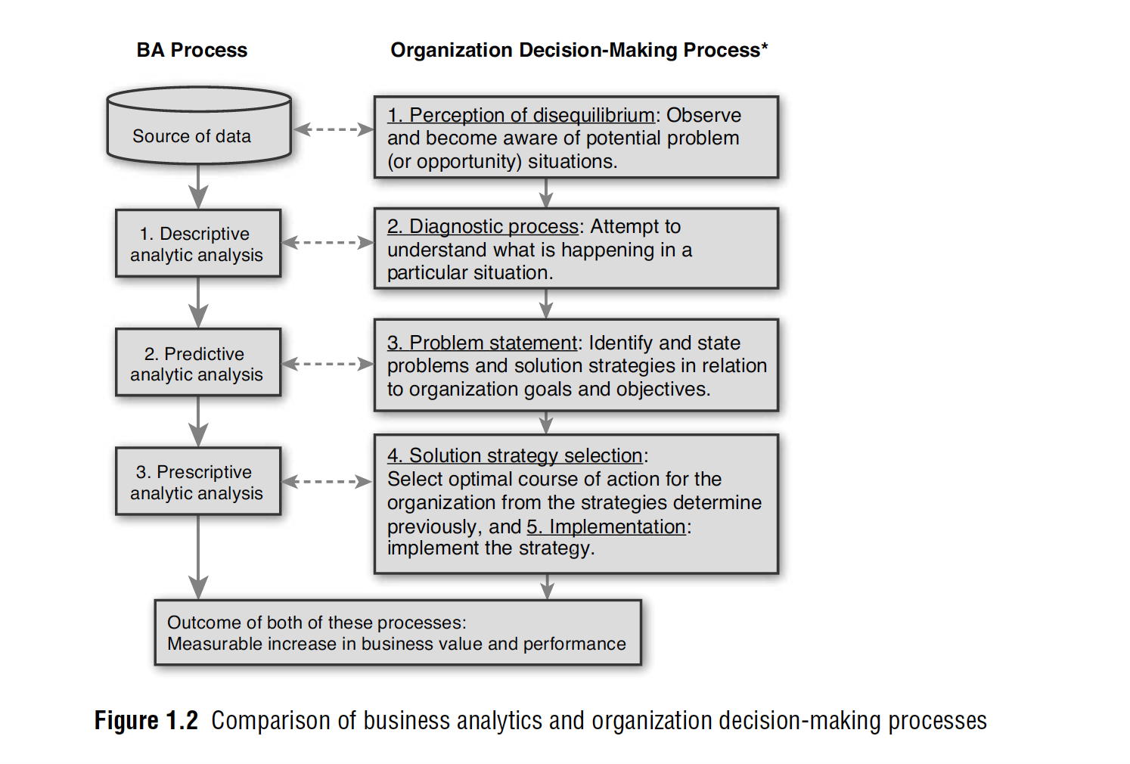

Slide 20
Business Process and Decision Making
As depicted in Figure 1.2 , the business analytic process has an inherent relationship to the steps in typical organization decision-making processes.
The organization decision-making process (ODMP) developed by Elbing (1970) and presented in Figure 1.2 is focused on decision making to solve problems but could also be applied to finding opportunities in data and deciding what is the best course of action to take advantage of them.

Slide 21
Business Process and Decision Making
The five-step ODMP begins with the perception of disequilibrium, or the awareness that a problem exists that needs a decision.
Similarly, in the BA process, the first step is to recognize that databases may contain information that could both solve problems and find opportunities to improve business performance.
Then in Step 2 of the ODMP, an exploration of the problem to determine its size, impact, and other factors is undertaken to diagnose what the problem is.

Slide 22
Business Process and Decision Making
Likewise, the BA descriptive analytic analysis explores factors that might prove useful in solving problems and offering opportunities.
The ODMP problem statement step is similarly structured to the BA predictive analysis to find strategies, paths, or trends that clearly define a problem or opportunity for an organization to solve problems.

Slide 23
Business Process and Decision Making
Finally, the ODMP’s last steps of strategy selection and implementation involve the same kinds of tasks that the BA process requires in the final prescriptive step (make an optimal selection of resource allocations that can be implemented for the betterment of the organization).
The decision-making foundation that has served ODMP for many decades parallels the BA process. The same logic serves both processes and supports organization decision-making skills and capacities.

Slide 24
Decision Models
Model:
An abstraction or representation of a real system, idea, or object
Captures the most important features
Can be a written or verbal description, a visual display, a mathematical formula, or a spreadsheet representation

Slide 25
Decision Models
Example 1 Three Forms of a Model
The sales of a new produce, such as a first- generation iPad or 3D television, often follow a common pattern.
Sales might grow at an increasing rate over time as positive customer feedback spreads.
(See the S-shaped curve on the following slide.)
A mathematical model of the S-curve can be identified; for example, S = ae^{bect}, where S is sales, t is time, e is the base of natural logarithms, and a, b and c are constants.

Slide 26
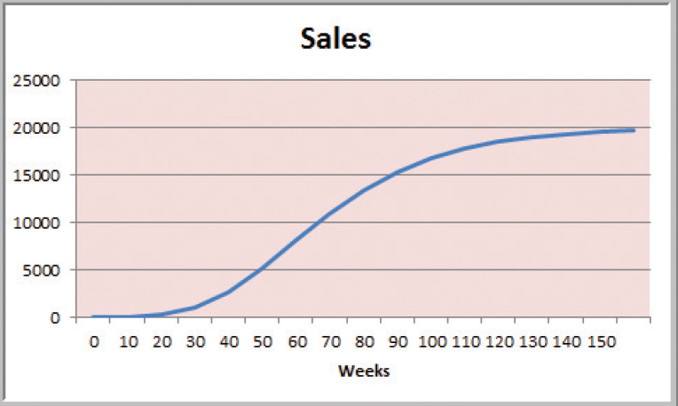

Slide 27
Decision Models
A decision model is a model used to understand, analyze, or facilitate decision making.
Types of model input
- data
- uncontrollable variables
- decision variables (controllable)
Types of model output
- performance measures
- behavioral measures

Slide 28
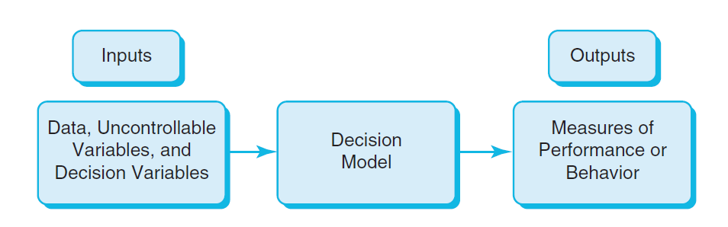
Decision Models
Nature of Decision Models

Slide 29
Decision Models
Example 2 A Sales-Promotion Model
In the grocery industry, managers typically need to know how best to use pricing, coupons and advertising strategies to influence sales.
Using Business Analytics, a grocer can develop a model that predicts sales using price, coupons and advertising.

Slide 30
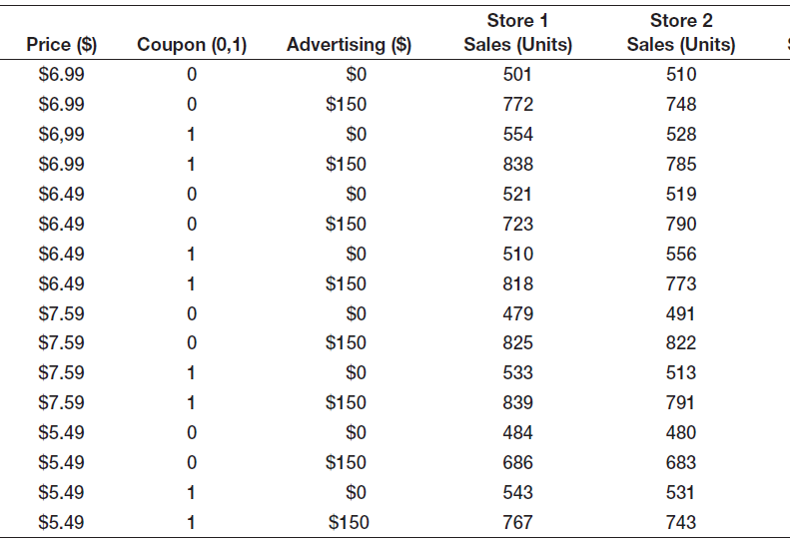
Decision Models
Sales = 500 – 0.05(price) + 30(coupons) +0.08(advertising) + 0.25(price)(advertising)

Slide 31
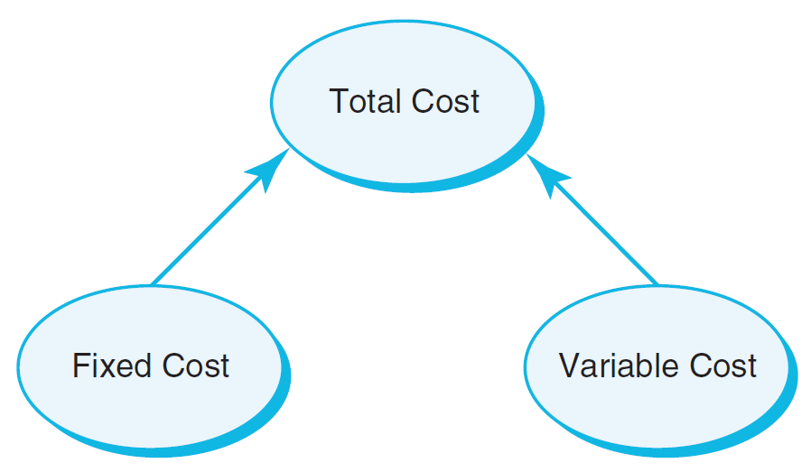
Decision Models
Descriptive Decision Models
Simply tell “what is” and describe relationships
Do not tell managers what to do
Example 3 An Influence Diagram for Total Cost
Influence Diagrams visually show how various model elements relate to one another.

Slide 32
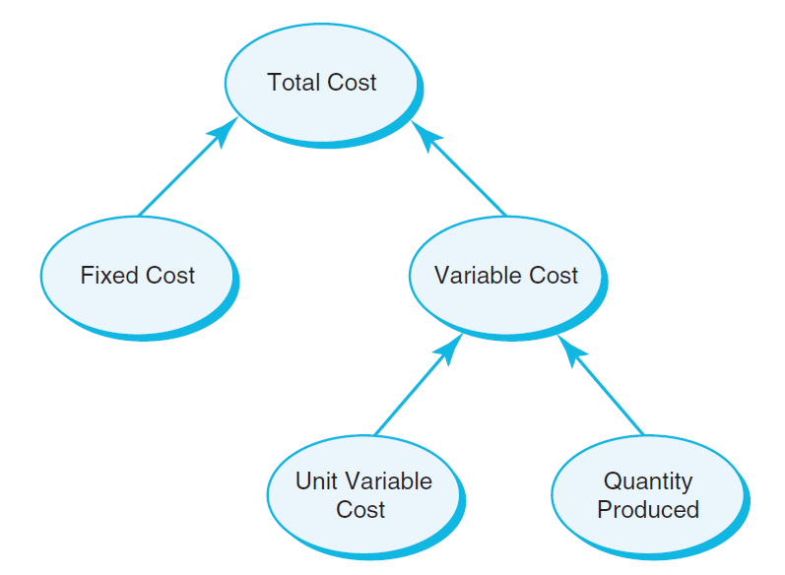
Decision Models
Example 4 A Mathematical Model for Total Cost
TC = F +VQ
TC is Total Cost
F is Fixed cost
V is Variable unit cost
Q is Quantity produced

Slide 33
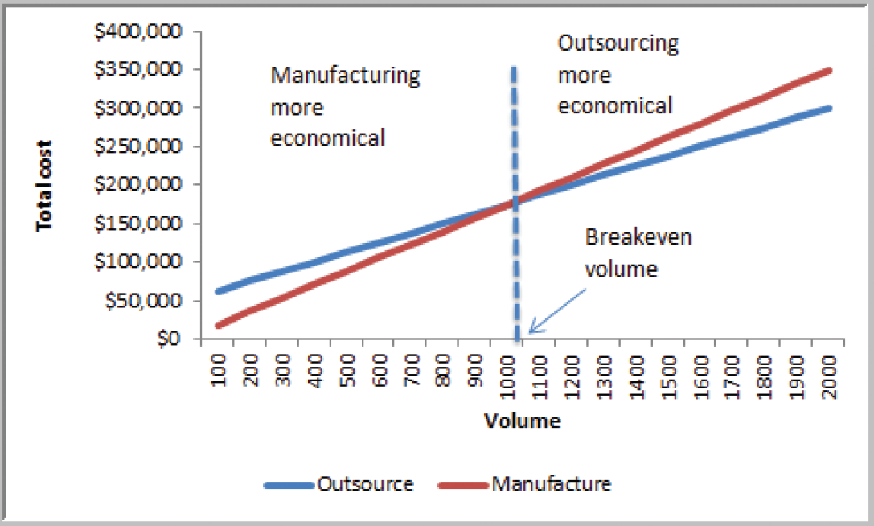
Decision Models
Example 5 A Break-even Decision Model
TC(manufacturing) = $50,000 + $125*Q
TC(outsourcing) = $175*Q
Breakeven Point:
Set TC(manufacturing)
= TC(outsourcing)
Solve for Q = 1000 units

Slide 34
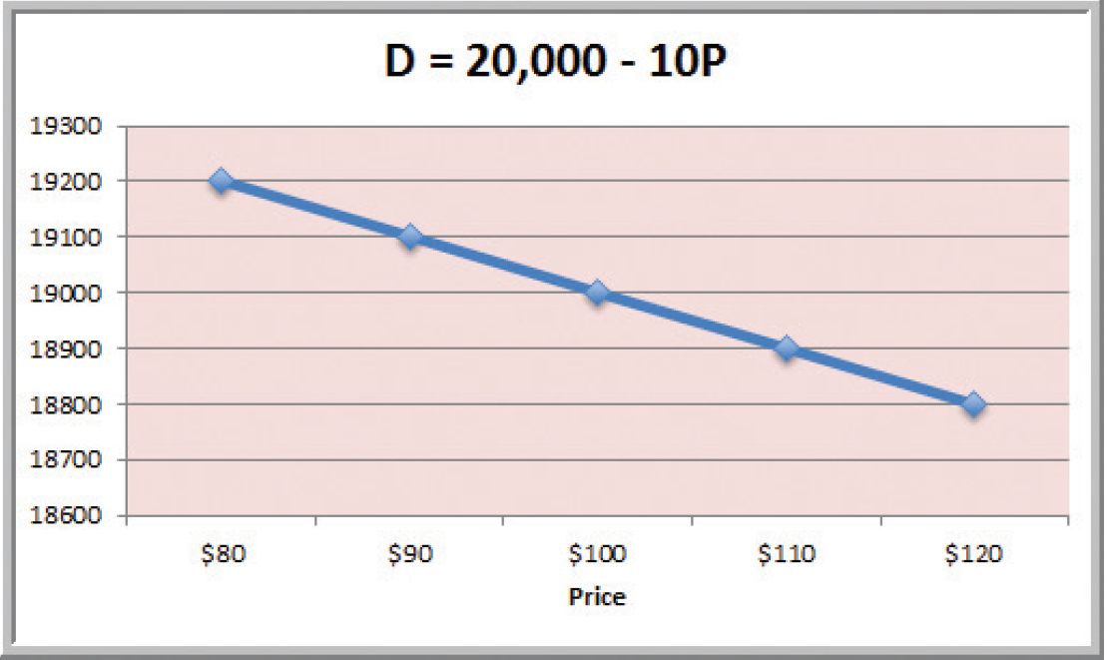
Decision Models
Example 6 A Linear Demand Prediction Model
As price increases, demand falls.

Slide 35
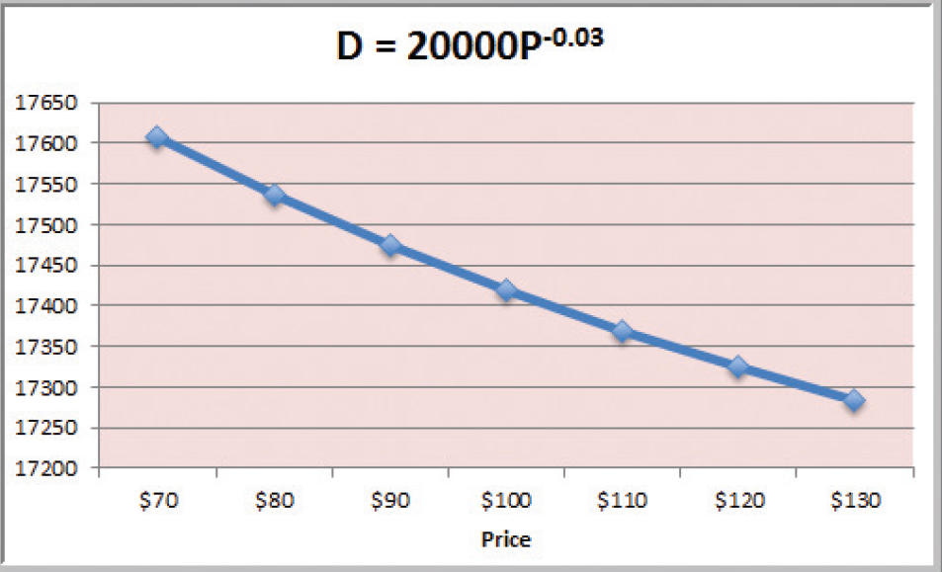
Decision Models
Example 7 A Nonlinear Demand Prediction Model
Assumes price elasticity (constant ratio of % change in demand to % change in price)

Slide 36
Decision Models
Predictive Decision Models often incorporate uncertainty to help managers analyze risk.
Aim to predict what will happen in the future.
Uncertainty is imperfect knowledge of what will happen in the future.
Risk is associated with the consequences of what actually happens.

Slide 37
Decision Models
Prescriptive Decision Models help decision makers identify the best solution.
Optimization - finding values of decision variables that minimize (or maximize) something such as cost (or profit).
Objective function - the equation that minimizes (or maximizes) the quantity of interest.
Constraints - limitations or restrictions.
Optimal solution - values of the decision variables at the minimum (or maximum) point.

Slide 38
Decision Models
Example 1.11 A Pricing Model
A firm wishes to determine the best pricing for one of its products in order to maximize revenue.
Analysts determined the following model:
Sales = -2.9485(price) + 3240.9
Total revenue = (price)(sales)
Identify the price that maximizes total revenue, subject to any constraints that might exist.

Slide 39
Decision Models
Deterministic prescriptive models have inputs that are known with certainty.
Stochastic prescriptive models have one or more inputs that are not known with certainty.
Algorithms are systematic procedures used to find optimal solutions to decision models.
Search algorithms are used for complex problems to find a good solution without guaranteeing an optimal solution.

