Slide 1
Business Data Analytics Tools
Python Libraries

Slide 2
Business Data Analytics Tools
Business analytics professionals need to be fluent in a variety of tools and programming languages. According to the Harvard Business Analytics program, the top tools for business analytics professionals are:
SQL is the lingua franca of data analysis. Business analytics professionals use SQL queries to extract and analyze data from transactions databases and to develop visualizations.
Statistical languages. Business analytics professionals frequently use R for statistical analysis and Python for general programming.
Statistical software. Business analytics professionals frequently use software including SPSS, SAS, Sage, Mathematica, and Excel to manage and analyze data.

Slide 3
Business analytics dashboard components
According to analytics platform company OmniSci, the main components of a typical business analytics dashboard include:
Data aggregation. Before it can be analyzed, data must be gathered, organized, and filtered.
Data mining. Data mining sorts through large datasets using databases, statistics, and machine learning to identify trends and establish relationships.
Association and sequence identification. Predictable actions that are performed in association with other actions or sequentially must be identified.

Slide 4
Business analytics dashboard components
Text mining. Text mining is used to explore and organize large, unstructured datasets for qualitative and quantitative analysis.
Forecasting analyzes historical data from a specific period to make informed estimates predictive of future events or behaviors.
Predictive analytics. Predictive business analytics use a variety of statistical techniques to create predictive models that extract information from datasets, identify patterns, and provide a predictive score for an array of organizational outcomes.

Slide 5
Business analytics dashboard components
Once trends have been identified and predictions made, simulation techniques can be used to test best-case scenarios.
Data visualization. Data visualization provides visual representations of charts and graphs for easy and quick data analysis.

Slide 6
What is Python?
Python is an open-source programming language
It is relatively easy to learn
It is a powerful tool with many modules (libraries) that can be imported in to extend its functionality
Python can be used to automate tasks and process large amounts of data
Python can be used on Mac’s, PC’s, Linux, as well as in a high- performance computing environment (Polaris, Andes, Discovery machines here at Dartmouth)

Slide 7
Development Environment
Python can be run in a variety of environments with various tools:
- From the command line (most Mac’s have Python installed by
default)
- From a windows terminal
- From a Linux terminal
- Using an Integrated Development Environment such as Eclipse or
PyCharm IDE
- Using a web-hosted “sandbox” environment
Notes:
Material reference and basis, Python Software Foundation at Python.org:
https://docs.python.org/3/tutorial/

Slide 8
Why Python for Data Analysis?
Python can be used to import datasets quickly
Python’s importable libraries make it an attractive language for data analysis
- NumPy
- SciPy
- IPython and Jupyter
- Pandas
- Matplotlib
- Natural Language Toolkit (NLTK)
Python can import and export common data formats such as CSV files
Notes:
Reference: Python for Data Analytics, Wes McKinney, 2012, O’Reilly Publishing

Slide 9
NumPy
short for Numerical Python, has long been a cornerstone of numerical computing in Python. It provides the data structures, algorithms, and library glue needed for most scientific applications involving numerical data in Python.

Slide 10
NumPy
NumPy contains, among other things:
A fast and efficient multidimensional array object ndarray
Functions for performing element-wise computations with arrays or mathematical operations between arrays
Tools for reading and writing array-based datasets to disk
Linear algebra operations, Fourier transform, and random number generation
A mature C API to enable Python extensions and native C or C++ code to access NumPy’s data structures and computational facilities

Slide 11
Pandas
Provides high-level data structures and functions designed to make working with structured or tabular data fast, easy, and expressive.
It has helped enable Python to be a powerful and productive data analysis environment.
Pandas blends the high-performance, array-computing ideas of NumPy with the flexible data manipulation capabilities of spreadsheets and relational databases (such as SQL).
It provides sophisticated indexing functionality to make it easy to reshape, slice and dice, perform aggregations, and select subsets of data.

Slide 12
IPython and Jupyter
in 2001 as Fernando Pérez’s side project to make a better interactive Python interpreter.
In the subsequent 16 years it has become one of the most important tools in the modern Python data stack.
While it does not provide any computational or data analytical tools by itself, IPython is designed from the ground up to maximize your productivity in both interactive computing and software development.
It encourages an execute-explore workflow instead of the typical edit-compile run workflow of many other programming languages.
It also provides easy access to your operating system’s shell and filesystem.
Since much of data analysis coding involves exploration, trial and error, and iteration, IPython can help you get the job done faster.

Slide 13
IPython and Jupyter
In 2014, Fernando and the IPython team announced the Jupyter project, a broader initiative to design language-agnostic interactive computing tools.
The IPython web notebook became the Jupyter notebook, with support now for over 40 programming languages.
The IPython system can now be used as a kernel (a programming language mode) for using Python with Jupyter.

Slide 14
IPython and Jupyter
IPython itself has become a component of the much broader Jupyter open -source project, which provides a productive environment for interactive and exploratory computing.
Its oldest and simplest “mode” is as an enhanced Python shell designed to accelerate the writing, testing, and debugging of Python code.
You can also use the IPython system through the Jupyter Notebook, an interactive web-based code “notebook” offering support for dozens of programming languages.
The IPython shell and Jupyter notebooks are especially useful for data exploration and visualization.

Slide 15
IPython and Jupyter
The Jupyter notebook system also allows you to author content in Markdown and HTML, providing you a means to create rich documents with code and text.
Other programming languages have also implemented kernels for Jupyter to enable you to use languages other than Python in Jupyter.

Slide 16
Jupyter Notebook
One of the major components of the Jupyter project is the notebook, a type of interactive document for code, text (with or without markup), data visualizations, and other output.
The Jupyter notebook interacts with kernels, which are implementations of the Jupyter interactive computing protocol in any number of programming languages.
Python’s Jupyter kernel uses the IPython system for its underlying behavior.

Slide 17
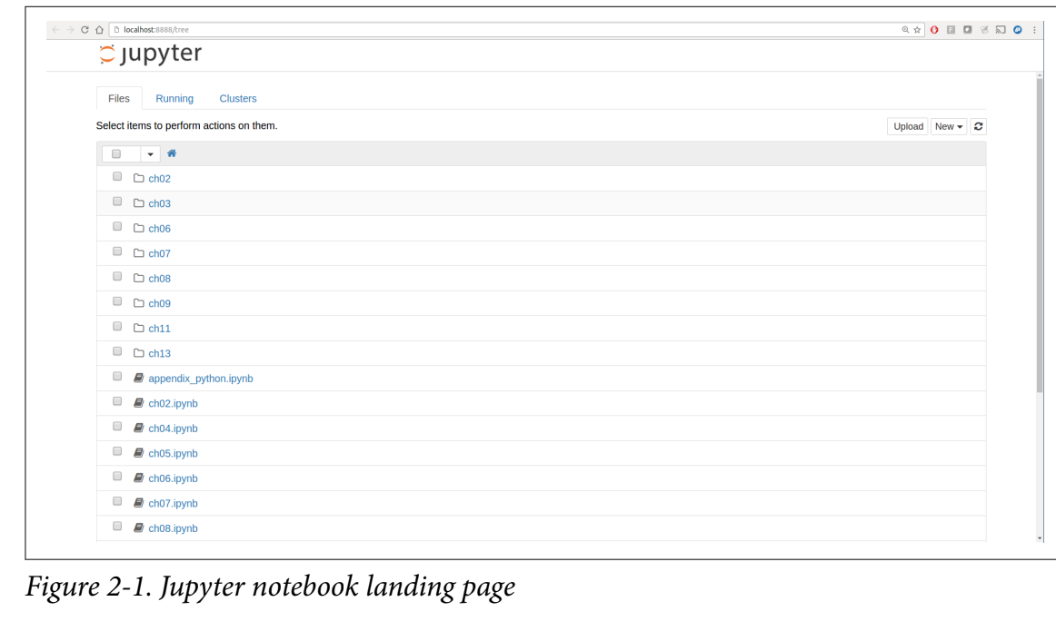

Slide 18
Jupyter Notebook
To create a new notebook, click the New button and select the “Python 3” or “conda [default]” option. You should see something like Figure 2-2.
If this is your first time, try clicking on the empty code “cell” and entering a line of Python code. Then press Shift-Enter to execute it.

Slide 19
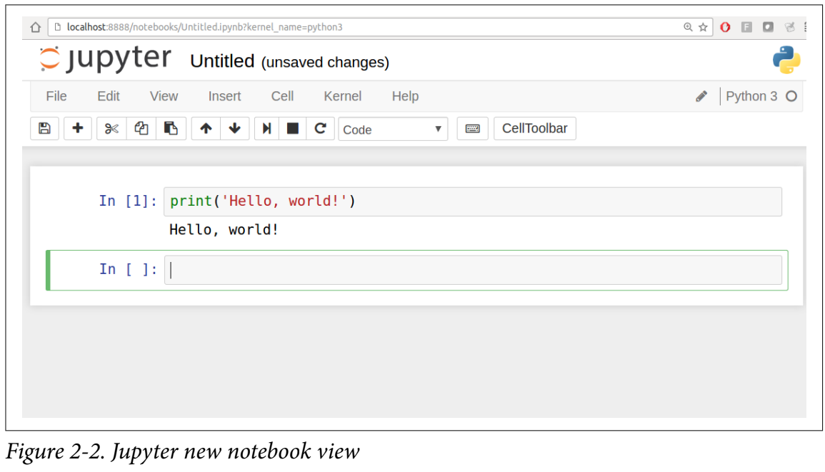

Slide 20
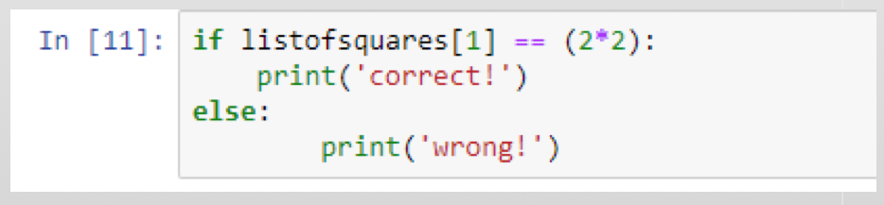
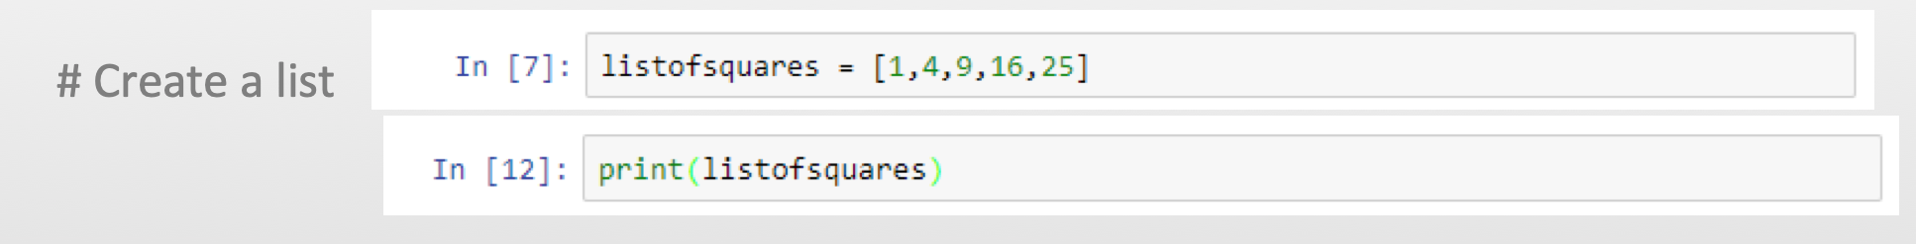
Jupyter

Slide 21
Upload Data
To upload data into the hosted python instance, click the “jupyter” title to go back to upload screen
Use the “Files” tab to upload
Upload>Browse
The hosted environment supports the upload of reasonably-sized csv files
All the CSV examples in this Chapter can be accessed through: https://github.com/wesm/pydata-book

Slide 22
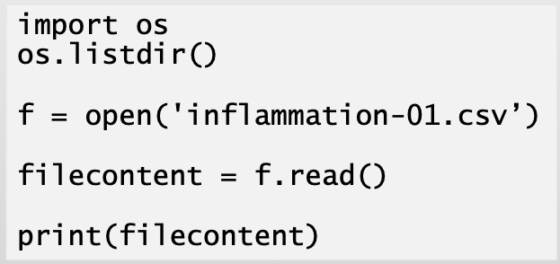
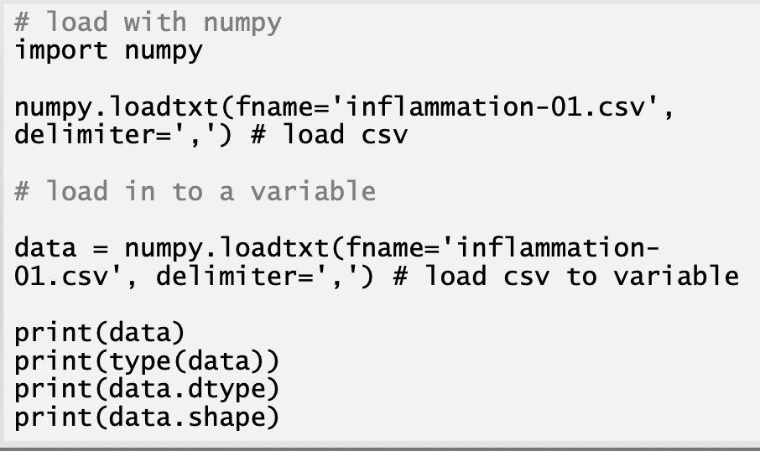
Data Analysis
Let’s examine a dataset of patients (rows) and forty days of inflammation values (columns)

Slide 23
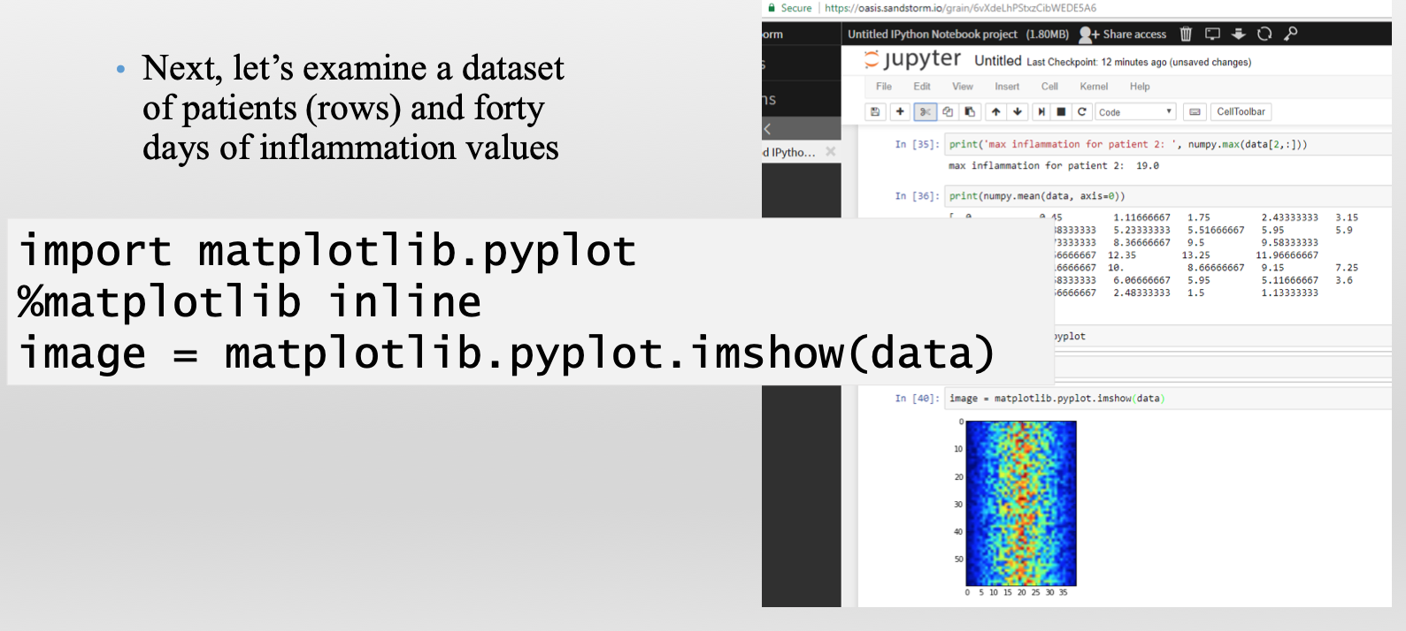
Data Analysis

Slide 24
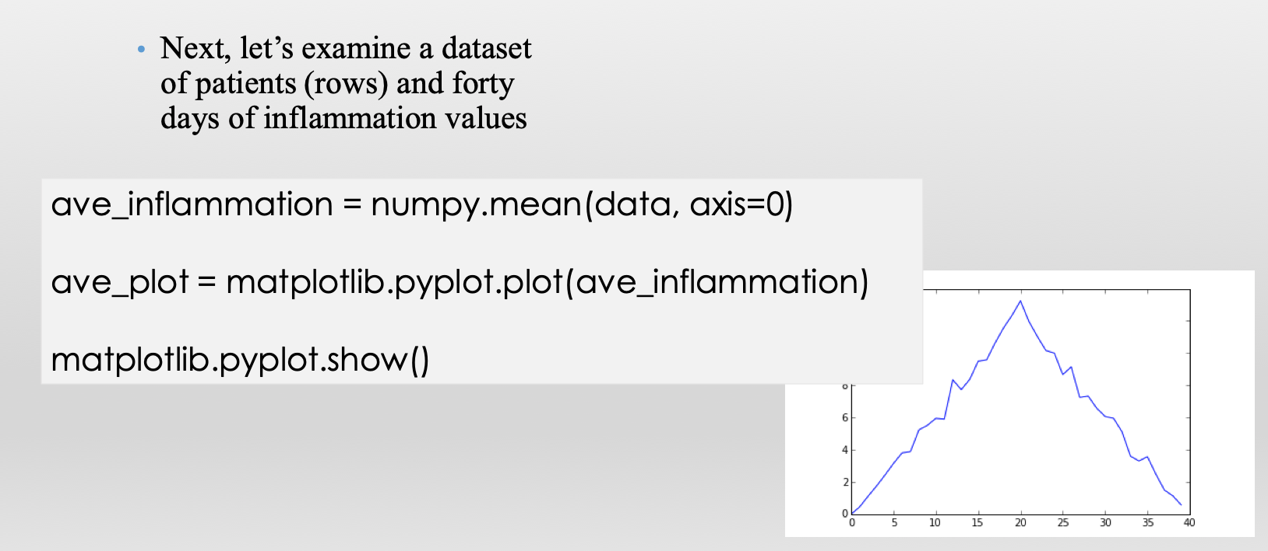
Data Analysis

Slide 25
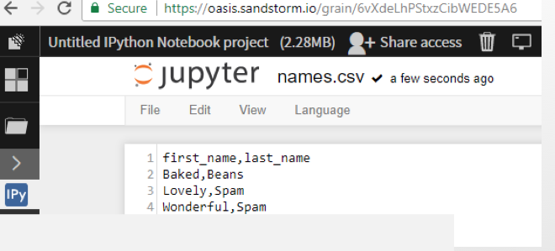
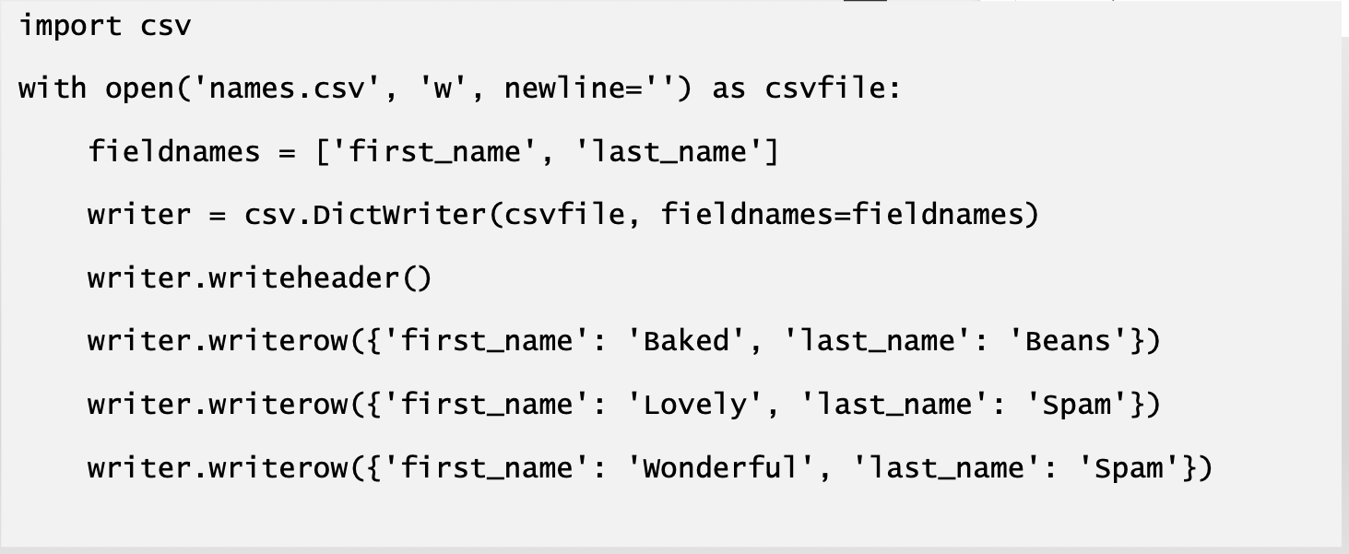
Write to CSV!

Slide 26
Matplotlib Integration
One reason for IPython’s popularity in analytical computing is that it integrates well with data visualization and other user interface libraries like matplotlib.
The %matplotlib magic function configures its integration with the IPython shell or Jupyter notebook.

Slide 27
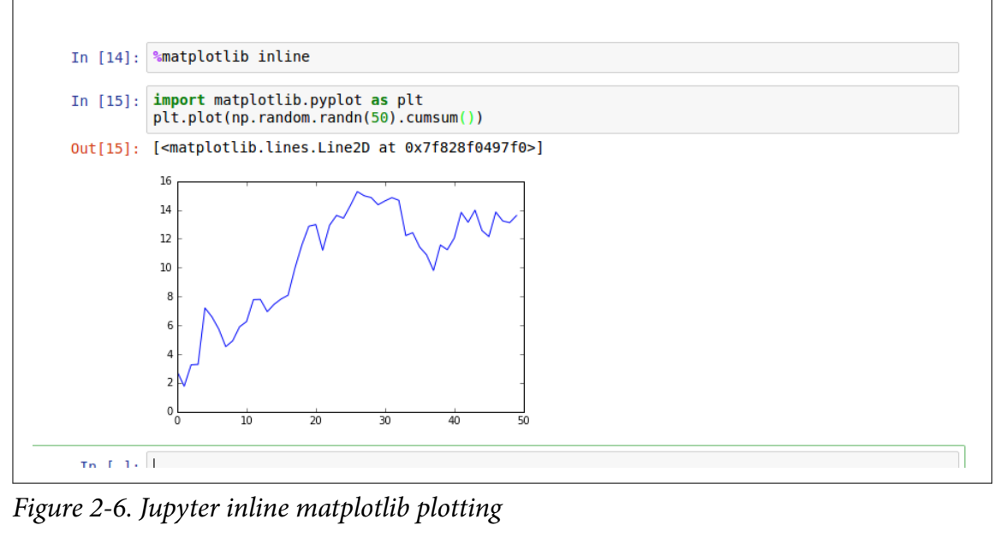
Matplotlib Integration
In Jupyter, the command is:
In [26]: %matplotlib inline
Notes:
https://github.com/wesm/pydata-book

Slide 28
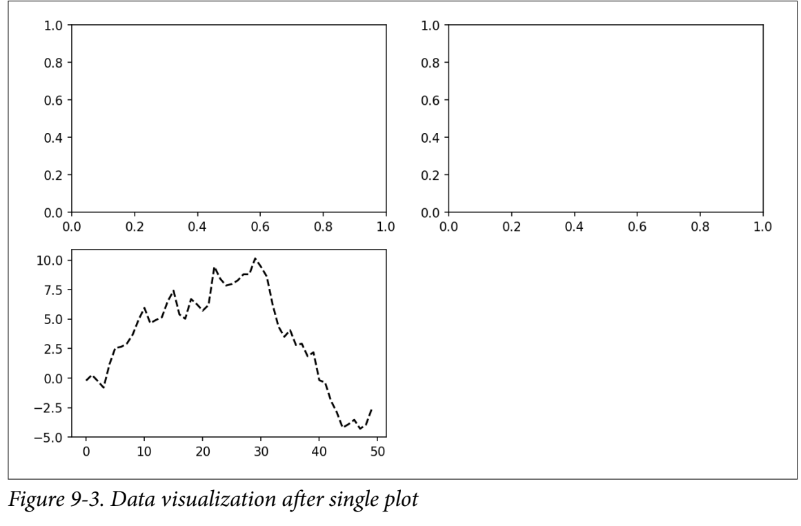
Matplotlib Integration
In [20]: plt.plot(np.random.randn(50).cumsum(), 'k--’)
The 'k--' is a style option instructing matplotlib to plot a black dashed line.
Notes:
https://github.com/wesm/pydata-book

Slide 29
Colors, Markers, and Line Styles
Matplotlib’s main plot function accepts arrays of x and y coordinates and optionally a string abbreviation indicating color and line style.
For example, to plot x versus y with green dashes, you would execute:
ax.plot(x, y, 'g--’)
The same plot could also have been expressed more explicitly as:
ax.plot(x, y, linestyle='--', color='g')

Slide 30
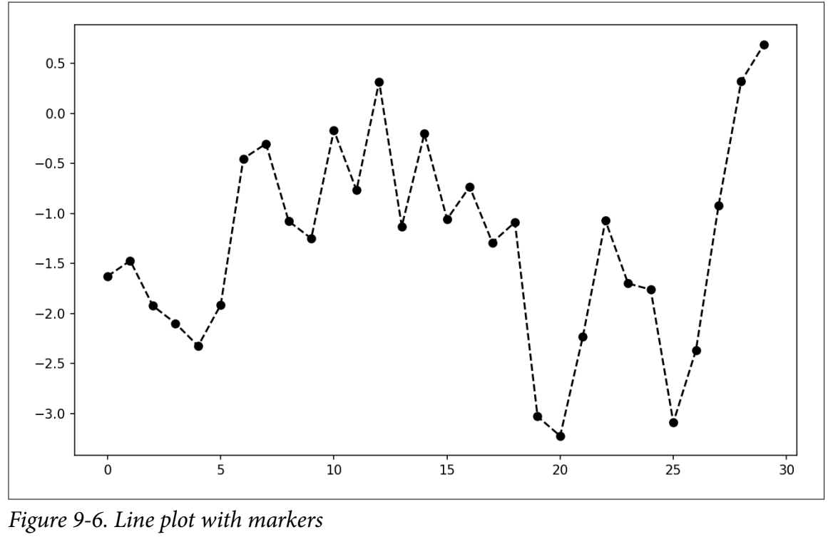
Example
In [30]: from numpy.random import randn
In [31]: plt.plot(randn(30).cumsum(), 'ko--’)
This could also have been written more explicitly as:
plot(randn(30).cumsum(), color='k’, linestyle='dashed', marker='o')

Slide 31
Ticks, Labels, and Legends
For most kinds of plot decorations, there are two main ways to do things: using the procedural pyplot interface (i.e., matplotlib.pyplot) and the more object-oriented native matplotlib API.
The pyplot interface, designed for interactive use, consists of methods like xlim, xticks, and xticklabels. These control the plot range, tick locations, and tick labels, respectively.
They can be used in two ways:
Called with no arguments returns the current parameter value (e.g., plt.xlim() returns the current x-axis plotting range)
Called with parameters sets the parameter value (e.g., plt.xlim([0, 10]), sets the x-axis range to 0 to 10)

Slide 32
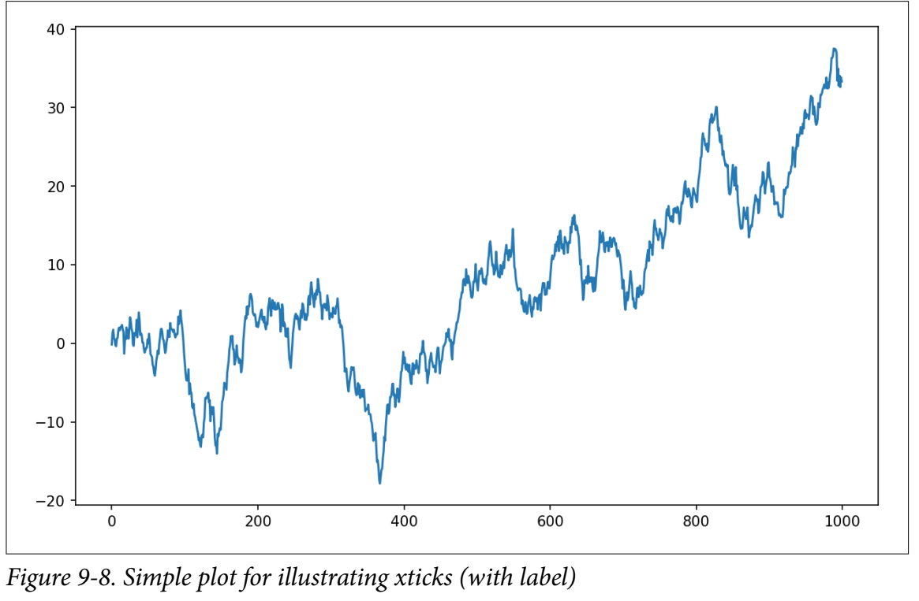
Example 1
In [37]: fig = plt.figure()
In [38]: ax = fig.add_subplot(1, 1, 1)
In [39]: ax.plot(np.random.randn(1000).cumsum())

Slide 33
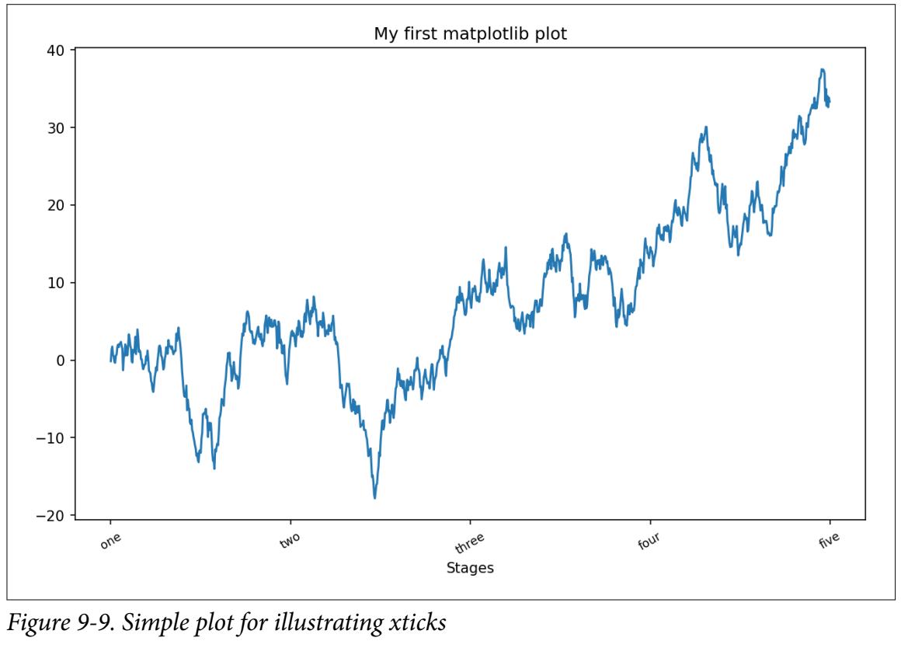
Example 2
In [42]: ax.set_title('My first matplotlib plot')
Out[42]: <matplotlib.text.Text at 0x7fb624d055f8>
In [43]: ax.set_xlabel('Stages’)

Slide 34
Adding Legends
Legends are another critical element for identifying plot elements. There are a couple of ways to add one. The easiest is to pass the label argument when adding each piece of the plot:
In [44]: from numpy.random import randn
In [45]: fig = plt.figure(); ax = fig.add_subplot(1, 1, 1)
In [46]: ax.plot(randn(1000).cumsum(), 'k', label='one')
Out[46]: [<matplotlib.lines.Line2D at 0x7fb624bdf860>]
In [47]: ax.plot(randn(1000).cumsum(), 'k--', label='two')
Out[47]: [<matplotlib.lines.Line2D at 0x7fb624be90f0>]
In [48]: ax.plot(randn(1000).cumsum(), 'k.', label='three')
Out[48]: [<matplotlib.lines.Line2D at 0x7fb624be9160>]
Once you’ve done this, you can either call ax.legend() or plt.legend() to automatically create a legend. The resulting plot is in Figure 9-10:

Slide 35
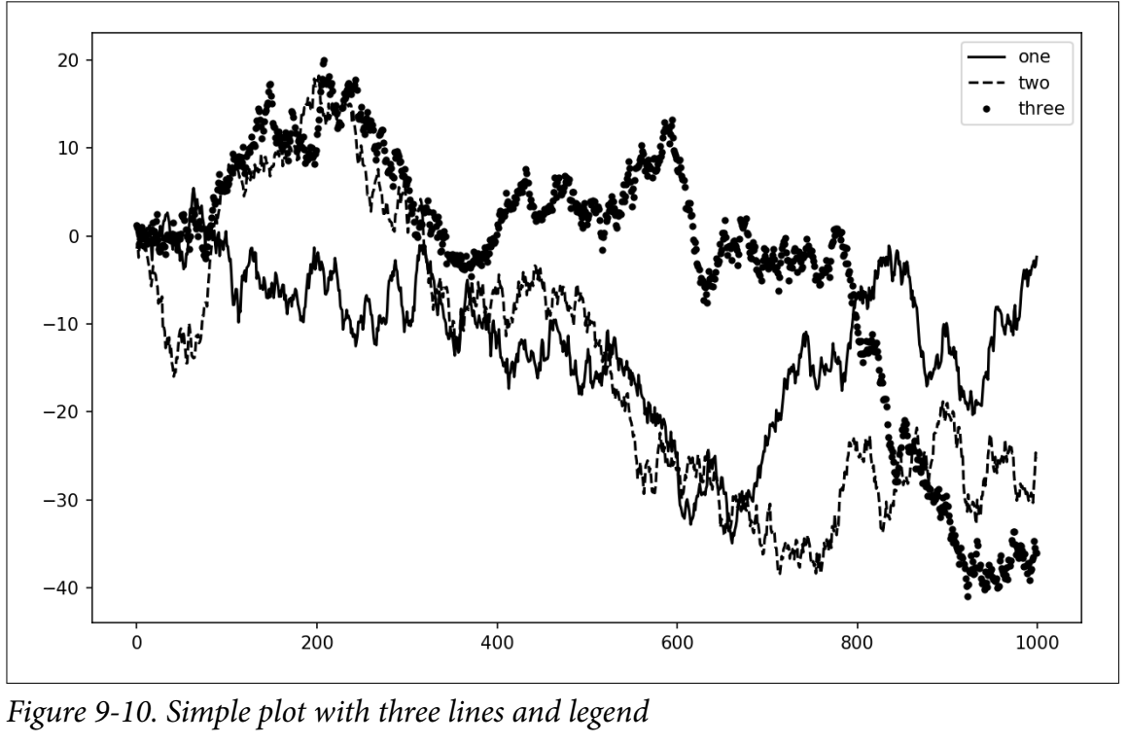
Example
In [49]: ax.legend(loc='best’)

Slide 36
Annotations and Drawing on a Subplot
In addition to the standard plot types, you may wish to draw your own plot annotations, which could consist of text, arrows, or other shapes.
You can add annotations and text using the text, arrow, and annotate functions. text draws text at given coordinates (x, y) on the plot with optional custom styling:
ax.text(x, y, 'Hello world!’, family='monospace', fontsize=10)

Slide 37
Annotations and Drawing on a Subplot
Annotations can draw both text and arrows arranged appropriately.
As an example, let’s plot the closing S&P 500 index price since 2007 (obtained from Yahoo! Finance) and annotate it with some of the important dates from the 2008–2009 financial crisis.
You can most easily reproduce this code example in a single cell in a Jupyter notebook. See Figure 9-11 for the result:

Slide 38
Example
from datetime import datetime
fig = plt.figure()
ax = fig.add_subplot(1, 1, 1)
data = pd.read_csv('examples/spx.csv', index_col=0, parse_dates=True)
spx = data['SPX']
spx.plot(ax=ax, style='k-')
crisis_data = [
(datetime(2007, 10, 11), 'Peak of bull market'),
(datetime(2008, 3, 12), 'Bear Stearns Fails'),
(datetime(2008, 9, 15), 'Lehman Bankruptcy')
]
for date, label in crisis_data:
ax.annotate(label, xy=(date, spx.asof(date) + 75),
xytext=(date, spx.asof(date) + 225),
arrowprops=dict(facecolor='black', headwidth=4, width=2,
headlength=4),
horizontalalignment='left', verticalalignment='top')
# Zoom in on 2007-2010
ax.set_xlim(['1/1/2007', '1/1/2011'])
ax.set_ylim([600, 1800])
ax.set_title('Important dates in the 2008-2009 financial crisis')

Slide 39
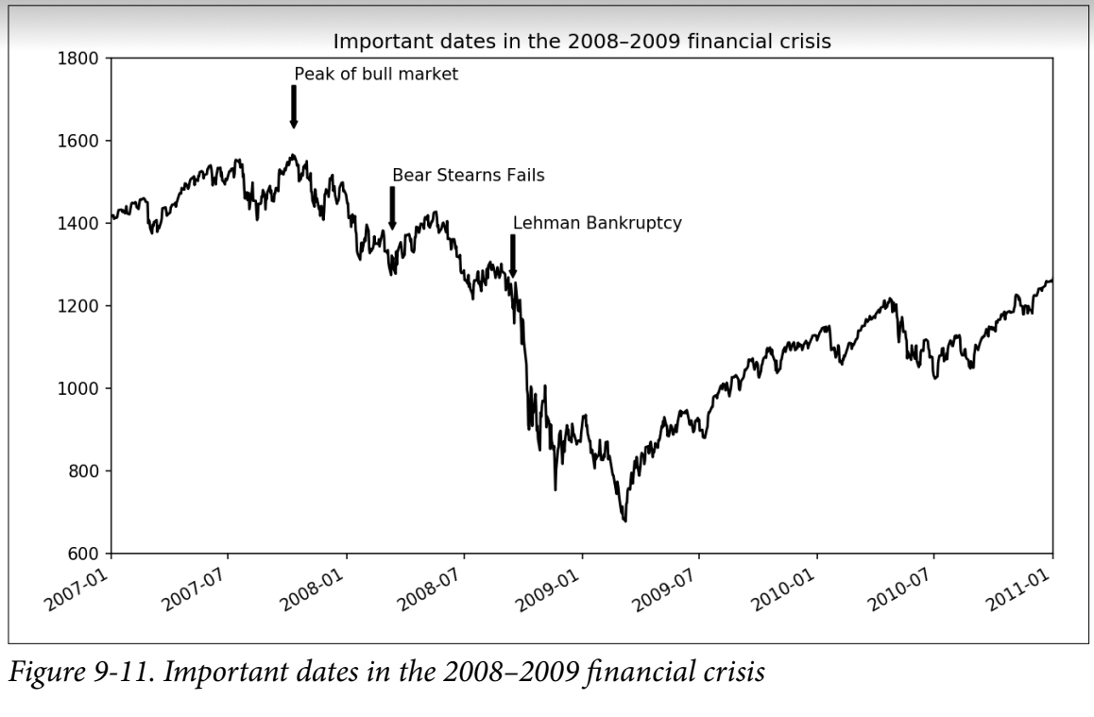

Slide 40
Drawing Sahpes
Drawing shapes requires some more care. matplotlib has objects that represent many common shapes, referred to as patches.
Some of these, like Rectangle and Circle, are found in matplotlib.pyplot, but the full set is located in matplotlib.patches.
To add a shape to a plot, you create the patch object shp and add it to a subplot by calling ax.add_patch(shp) (see Figure 9-12).

Slide 41
Example
fig = plt.figure()
ax = fig.add_subplot(1, 1, 1)
rect = plt.Rectangle((0.2, 0.75), 0.4, 0.15, color='k', alpha=0.3)
circ = plt.Circle((0.7, 0.2), 0.15, color='b', alpha=0.3)
pgon = plt.Polygon([[0.15, 0.15], [0.35, 0.4], [0.2, 0.6]],
color='g', alpha=0.5)
ax.add_patch(rect)
ax.add_patch(circ)
ax.add_patch(pgon)

Slide 42
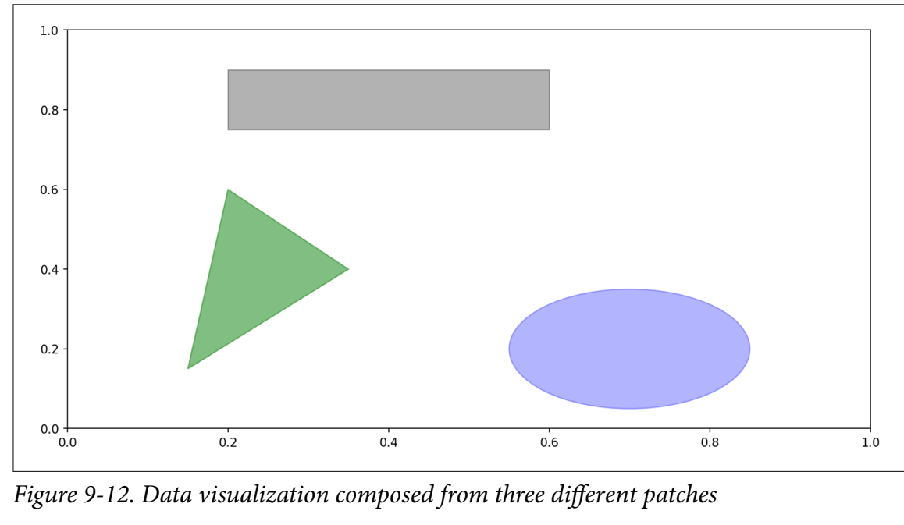

Slide 43
Saving Plots to File
You can save the active figure to file using plt.savefig. This method is equivalent to the figure object’s savefig instance method.
For example, to save an SVG version of a figure, you need only type:
plt.savefig('figpath.svg')
The file type is inferred from the file extension. So if you used .pdf instead, you would get a PDF.
There are a couple of important options that are used for publishing graphics: dpi, which controls the dots-per-inch resolution, and bbox_inches, which can trim the whitespace around the actual figure.
To get the same plot as a PNG with minimal whitespace around the plot and at 400 DPI, you would do:
plt.savefig('figpath.png', dpi=400, bbox_inches='tight')

Slide 44
Saving Plots to File
savefig doesn’t have to write to disk; it can also write to any file-like object, such as a BytesIO:
from io import BytesIO
buffer = BytesIO()
plt.savefig(buffer)
plot_data = buffer.getvalue()
See Table 9-2 for a list of some other options for savefig.

Slide 45
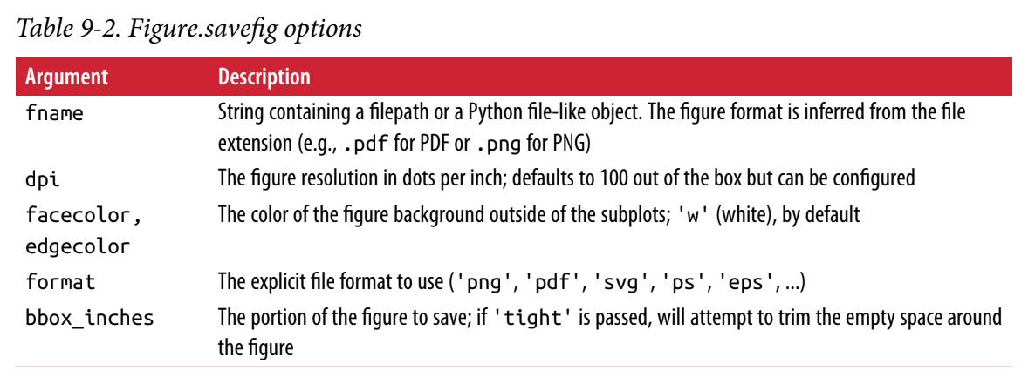

Slide 46
Bar Plots- Example 1
The plot.bar() and plot.barh() make vertical and horizontal bar plots, respectively. In this case, the Series or DataFrame index will be used as the x (bar) or y (barh) ticks (see Figure 9-15):
In [64]: fig, axes = plt.subplots(2, 1)
In [65]: data = pd.Series(np.random.rand(16), index=list('abcdefghijklmnop’))
In [66]: data.plot.bar(ax=axes[0], color='k', alpha=0.7)
Out[66]: <matplotlib.axes._subplots.AxesSubplot at 0x7fb62493d470>
In [67]: data.plot.barh(ax=axes[1], color='k', alpha=0.7)
The options color='k' and alpha=0.7 set the color of the plots to black and use partial transparency on the filling.

Slide 47
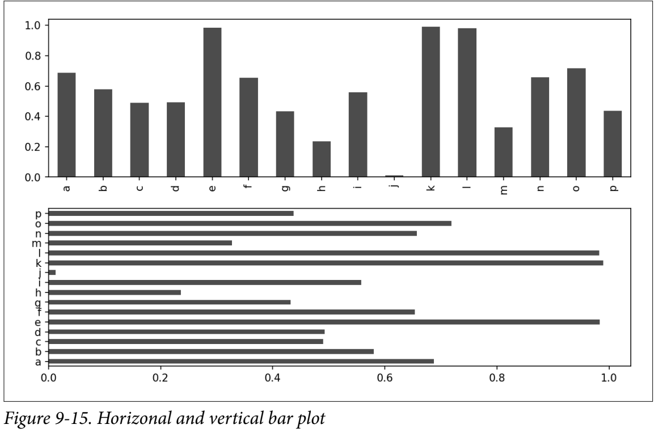

Slide 48
Bar Plots-Example 2
With a DataFrame, bar plots group the values in each row together in a group in bars, side by side, for each value. See Figure 9-16:
In [69]: df = pd.DataFrame(np.random.rand(6, 4),
....: index=['one', 'two', 'three', 'four', 'five', 'six'],
....: columns=pd.Index(['A', 'B', 'C', 'D'], name='Genus'))
In [70]: df
Out[70]:
Genus A B C D
One 0.370670 0.602792 0.229159 0.486744
Two 0.420082 0.571653 0.049024 0.880592
three 0.814568 0.277160 0.880316 0.431326
Four 0.374020 0.899420 0.460304 0.100843
Five 0.433270 0.125107 0.494675 0.961825
six 0.601648 0.478576 0.205690 0.560547

Slide 49
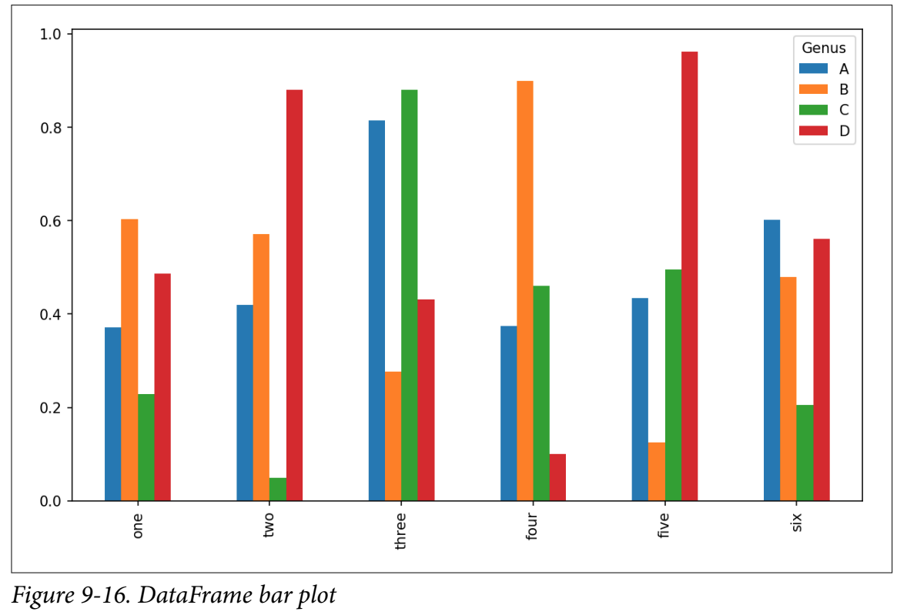
Bar Plots-Example 2
In [71]: df.plot.bar()
Note that the name “Genus” on the DataFrame’s columns is used to title the legend.

Slide 50
Bar Plots-Example 3
In [79]: party_pcts = party_counts.div(party_counts.sum(1), axis=0)
In [80]: party_pcts
Out[80]:
size 2 3 4 5
day
Fri 0.888889 0.055556 0.055556 0.000000
Sat 0.623529 0.211765 0.152941 0.011765
Sun 0.520000 0.200000 0.240000 0.040000
Thur 0.827586 0.068966 0.086207 0.017241
In [81]: party_pcts.plot.bar()

Slide 51
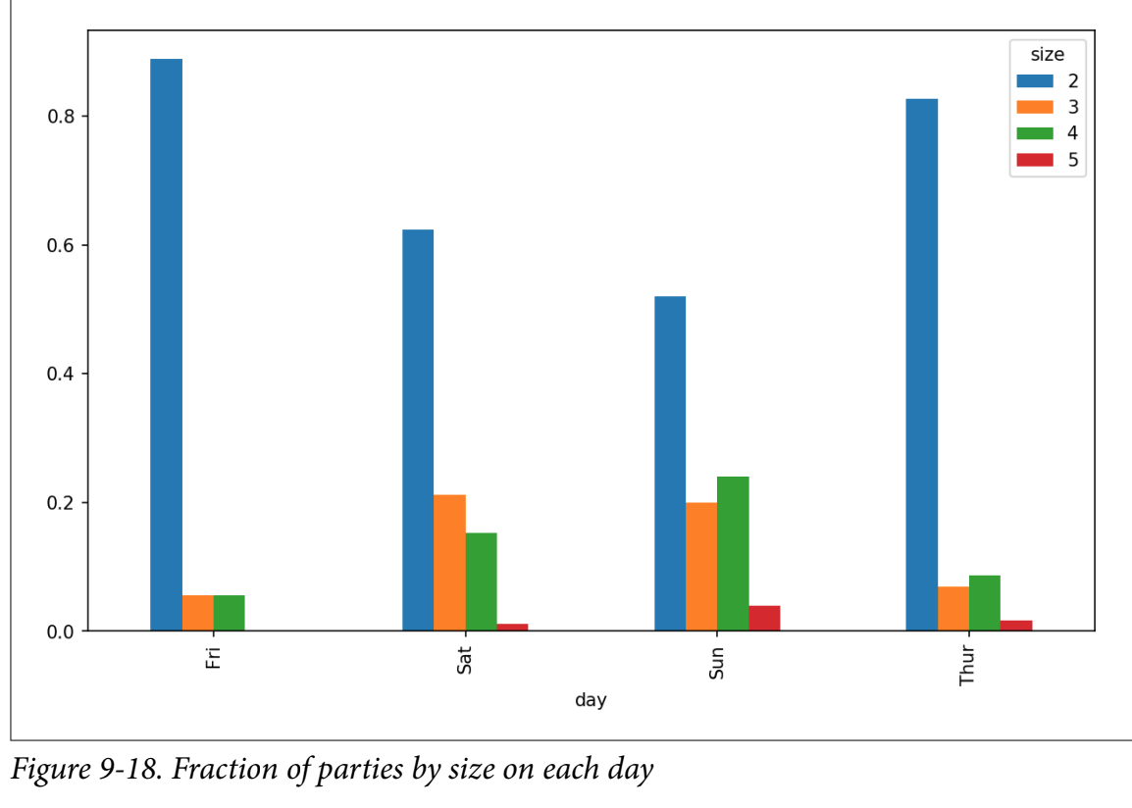

Slide 52
Histograms and Density Plots
A histogram is a kind of bar plot that gives a discretized display of value frequency.
The data points are split into discrete, evenly spaced bins, and the number of data points in each bin is plotted.
In [92]: tips['tip_pct'].plot.hist(bins=50)

Slide 53
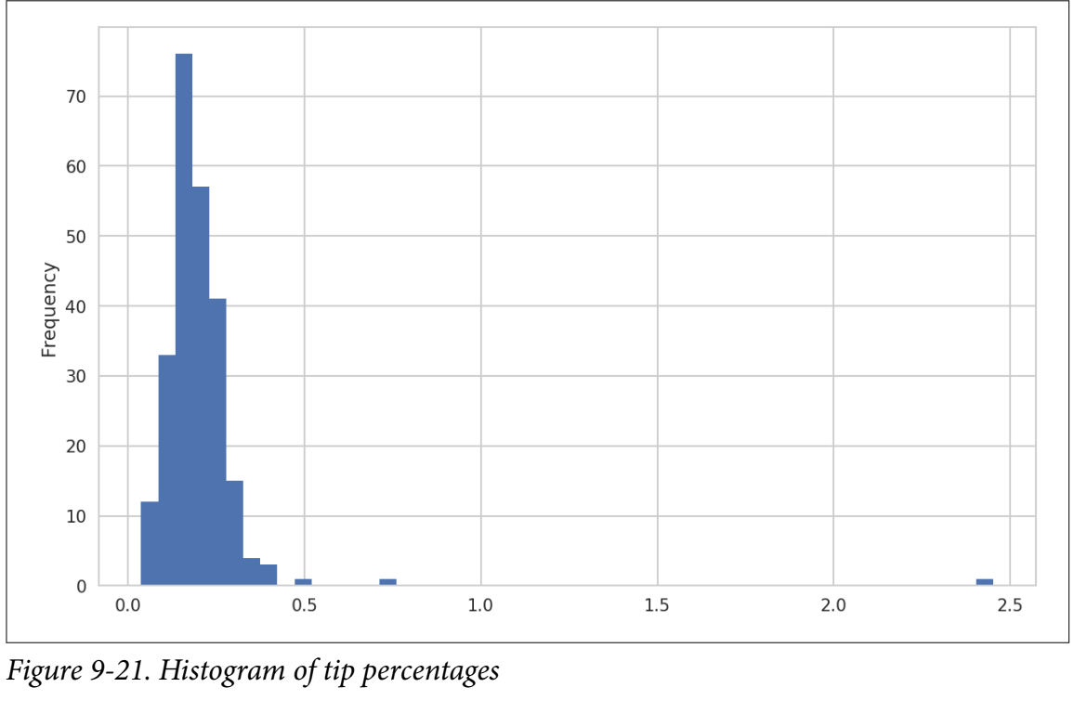

Slide 54
Histograms and Density Plots
A related plot type is a density plot, which is formed by computing an estimate of a continuous probability distribution that might have generated the observed data.
The usual procedure is to approximate this distribution as a mixture of “kernels”—that is, simpler distributions like the normal distribution.
Thus, density plots are also known as kernel density estimate (KDE) plots.
Using plot.kde makes a density plot using the conventional mixture-of-normals estimate (see Figure 9-22):

Slide 55
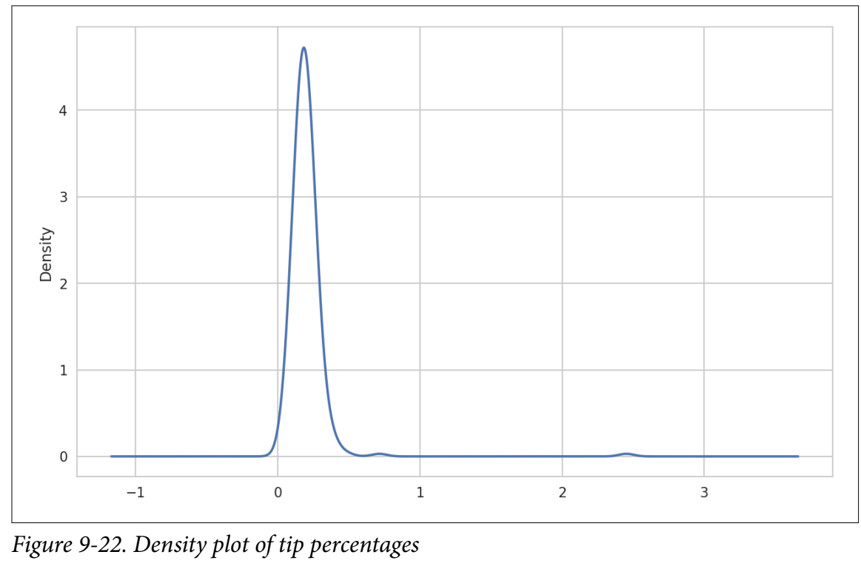
Example
In [94]: tips['tip_pct'].plot.density()

Slide 56
References
Text Book: Python for Data Analysis, Data Wrangling with Pandas, NumPy, and Ipython, 2nd edition, Wes McKinney.
Materials download: www.dartgo.org/workshopsg and download IntroDataAnalysisPython
Material reference and basis, Python Software Foundation at Python.org: https://docs.python.org/2/tutorial/
Python 2.7.13 https://docs.python.org/2/tutorial/
Python 3.6 https://docs.python.org/3.6/tutorial/
Numpy • http://cs231n.github.io/python-numpy-tutorial/
PythonCSVlibrarytutorial • https://docs.python.org/2/library/csv.html

