Slide 1
PWM Drawer
Utilizing the “tiny” for useful applications.

Slide 2
Table of contents
01
02
03
04
05
06
Description
Features
Materials
Working Principle
Flow Chart
Schematic Diagram

Slide 3
01
Description

Slide 4
Description
The ATtiny84 PWM Wave Drawing Project utilizes the capabilities of the ATtiny84 microcontroller to visualize Pulse Width Modulation (PWM) waves generated by an external signal generator
on an LCD display. This innovative project offers an exploration of microcontroller interfacing
and signal processing using Timer 1 of the microcontroller. The ATtiny84, a compact yet
powerful microcontroller, interprets the incoming PWM signals and displays their
Frequencies and Duty cycles, then translates the input wave into a visual
representation. With this compact device, users can observe and
analyze the waveform characteristics.

Slide 5
02
Features

Slide 6
Features
100KHz
100%
4
The project can measure up to 100KHz
In the 100KHz range, it provides a 100% accuracy
Up to 4 significant figures in frequency measurement.

Slide 7
03
Materials

Slide 8
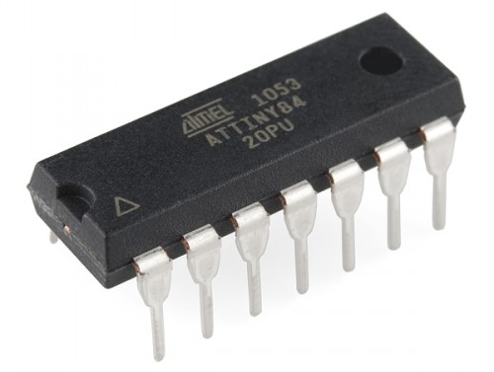
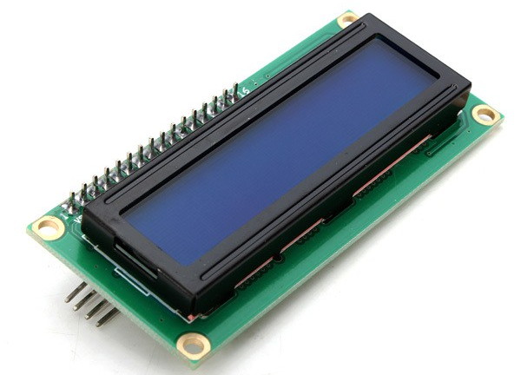
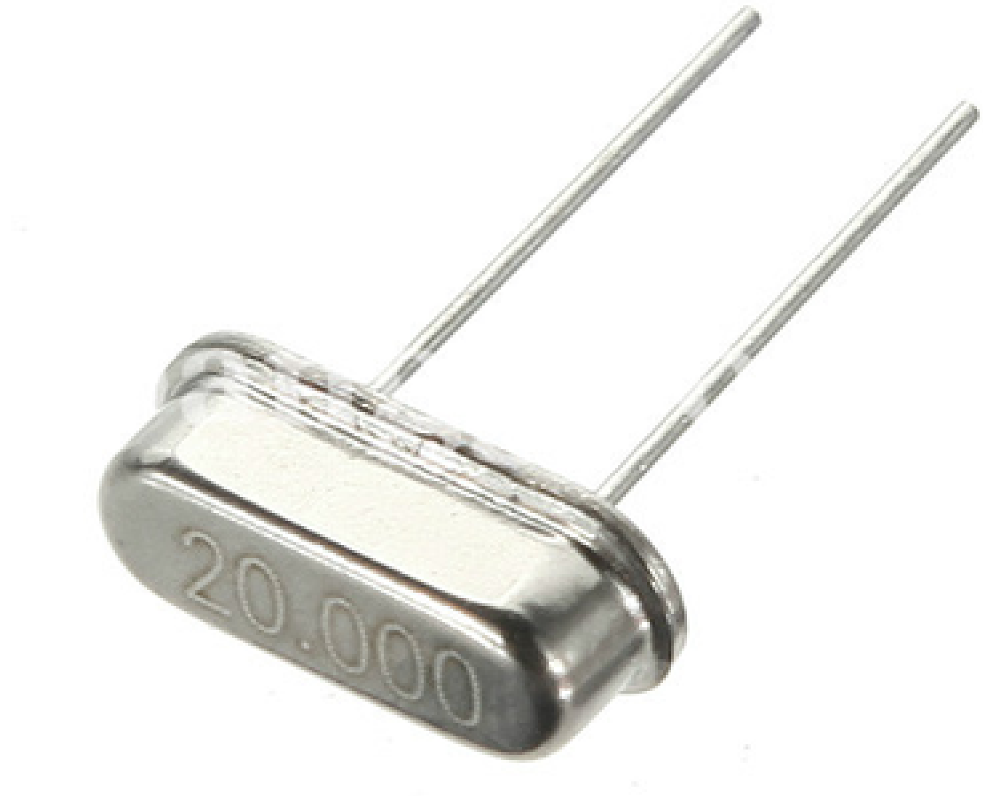
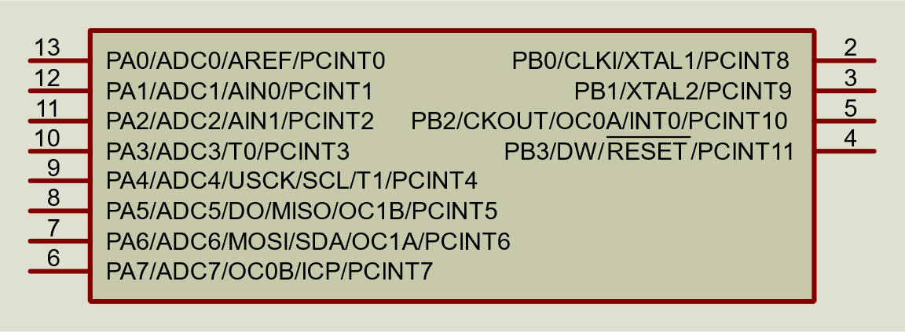
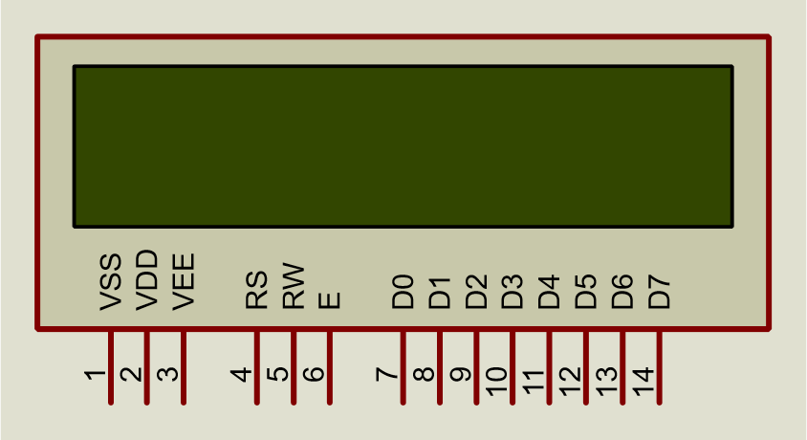
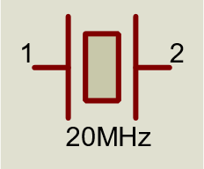
Materials
ATtiny84
16*2 LCD Screen
20MHz Crystal Oscillator

Slide 9
04
Working Principle

Slide 10
Working Principle
The main principle of operation is using the input capture unit (ICU) of ATtiny84’s Timer 1 to measure the frequency and duty cycle using the following steps:
The ICU captures the time between 3 consecutive edges of the input PWM wave (2 rising, 1 falling).
The frequency is calculated getting the reciprocal of the time difference between the 1st and 3rd captures (Period).
The duty cycle is calculated by dividing the time difference between 1st and 2nd captures by the Period.

Slide 11
05
Flow Chart

Slide 12
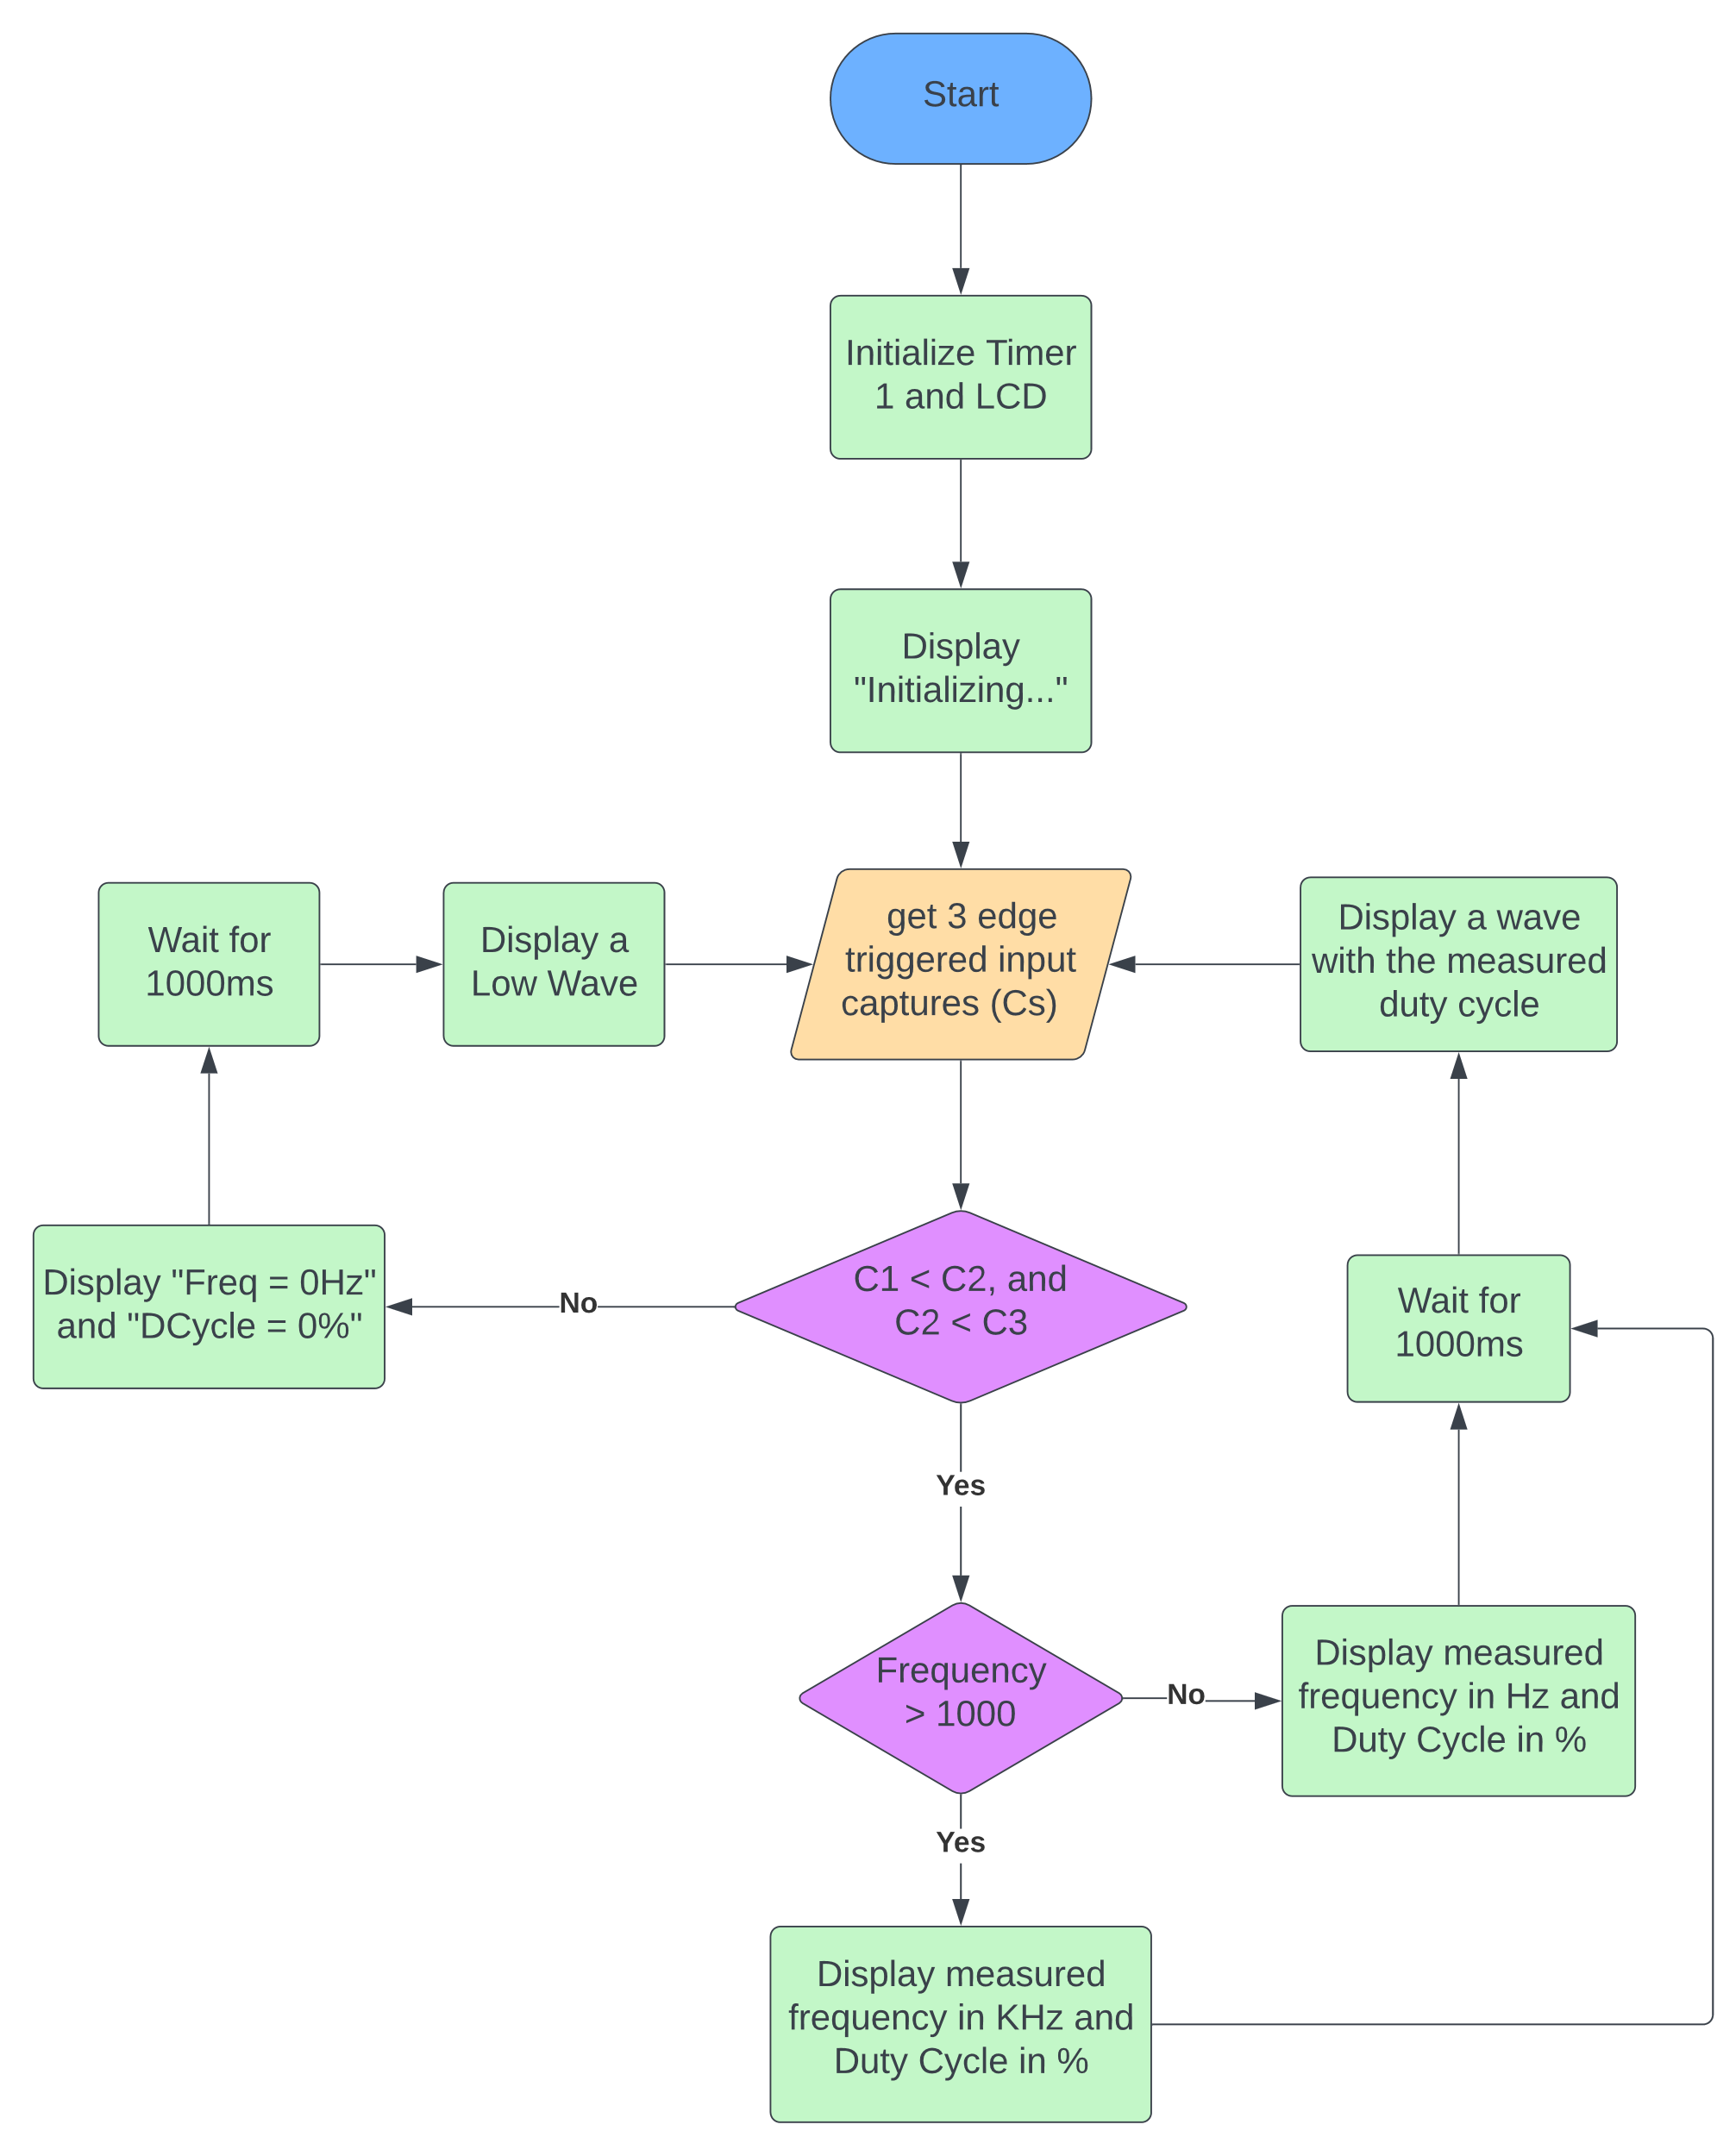
Flow Chart:

Slide 13
06
Schematic Diagram

Slide 14
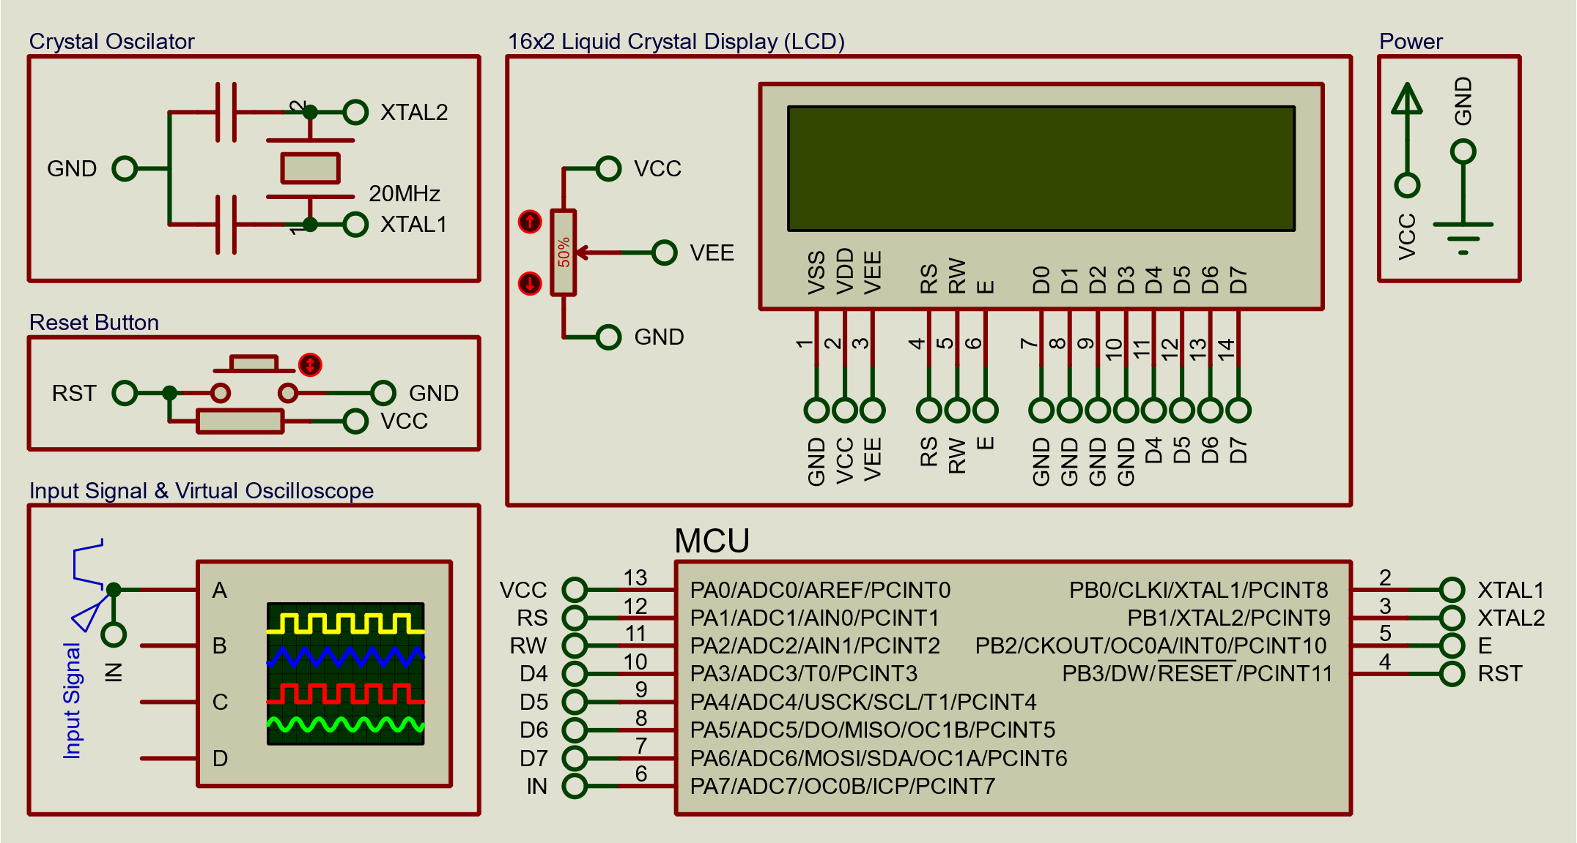
Schematic Diagram

Slide 15


Thanks
Made by: Belal Hassan
Email: Bilal.1021023@stemegypt.edu.eg
Phone Number: +20 120 439 7890
Please keep this slide for attribution

