Slide 1

SkiSmart
The Ultimate Ski Resort Finder
Shunzi Yao , Ana Pechonkin, Belal Mohsen

Slide 2
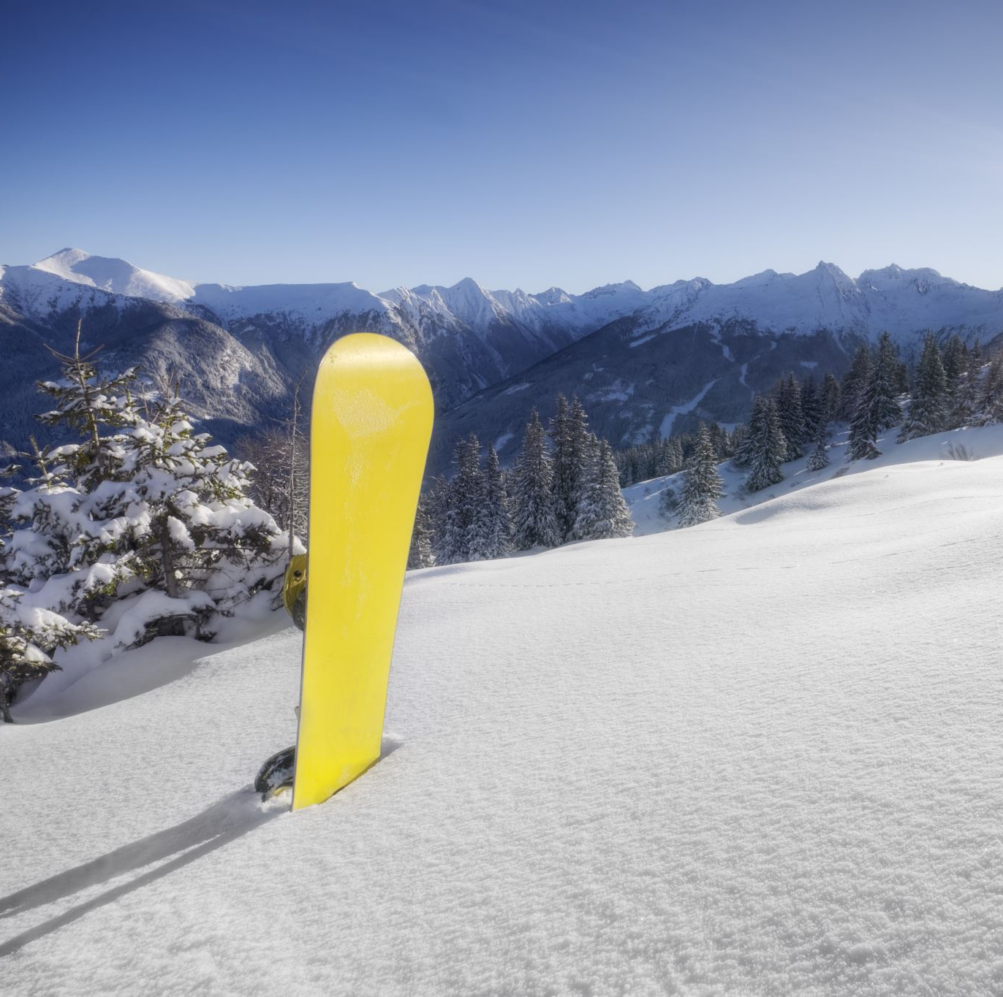
Description
SkiSmart is an application designed for ski enthusiasts looking for the perfect skiing destination. It offers users tailored resort recommendations based on location, date and distance preferences.

Slide 3
Key Features
Personalized Search: Users can input their postal code or city, select their desired skiing date, and adjust their preferred search radius for resort recommendations.
Comprehensive Resort Details: Each ski resort listing provides users with essential details, from weather forecasts, basic information about the resort and user reviews.
Interactive Map View: An integrated map view allows users to visually explore resorts in relation to their location.
User Profiles: Skiers can create profiles to save favourite resorts, access past searches, and customize app settings.
Algorithmic Resort Rating: Resorts are rated based on current weather conditions (temperature, wind conditions), snow quality (fresh snowfall, snow depth), and user reviews, ensuring skiers find the best conditions for their trip.

Slide 4
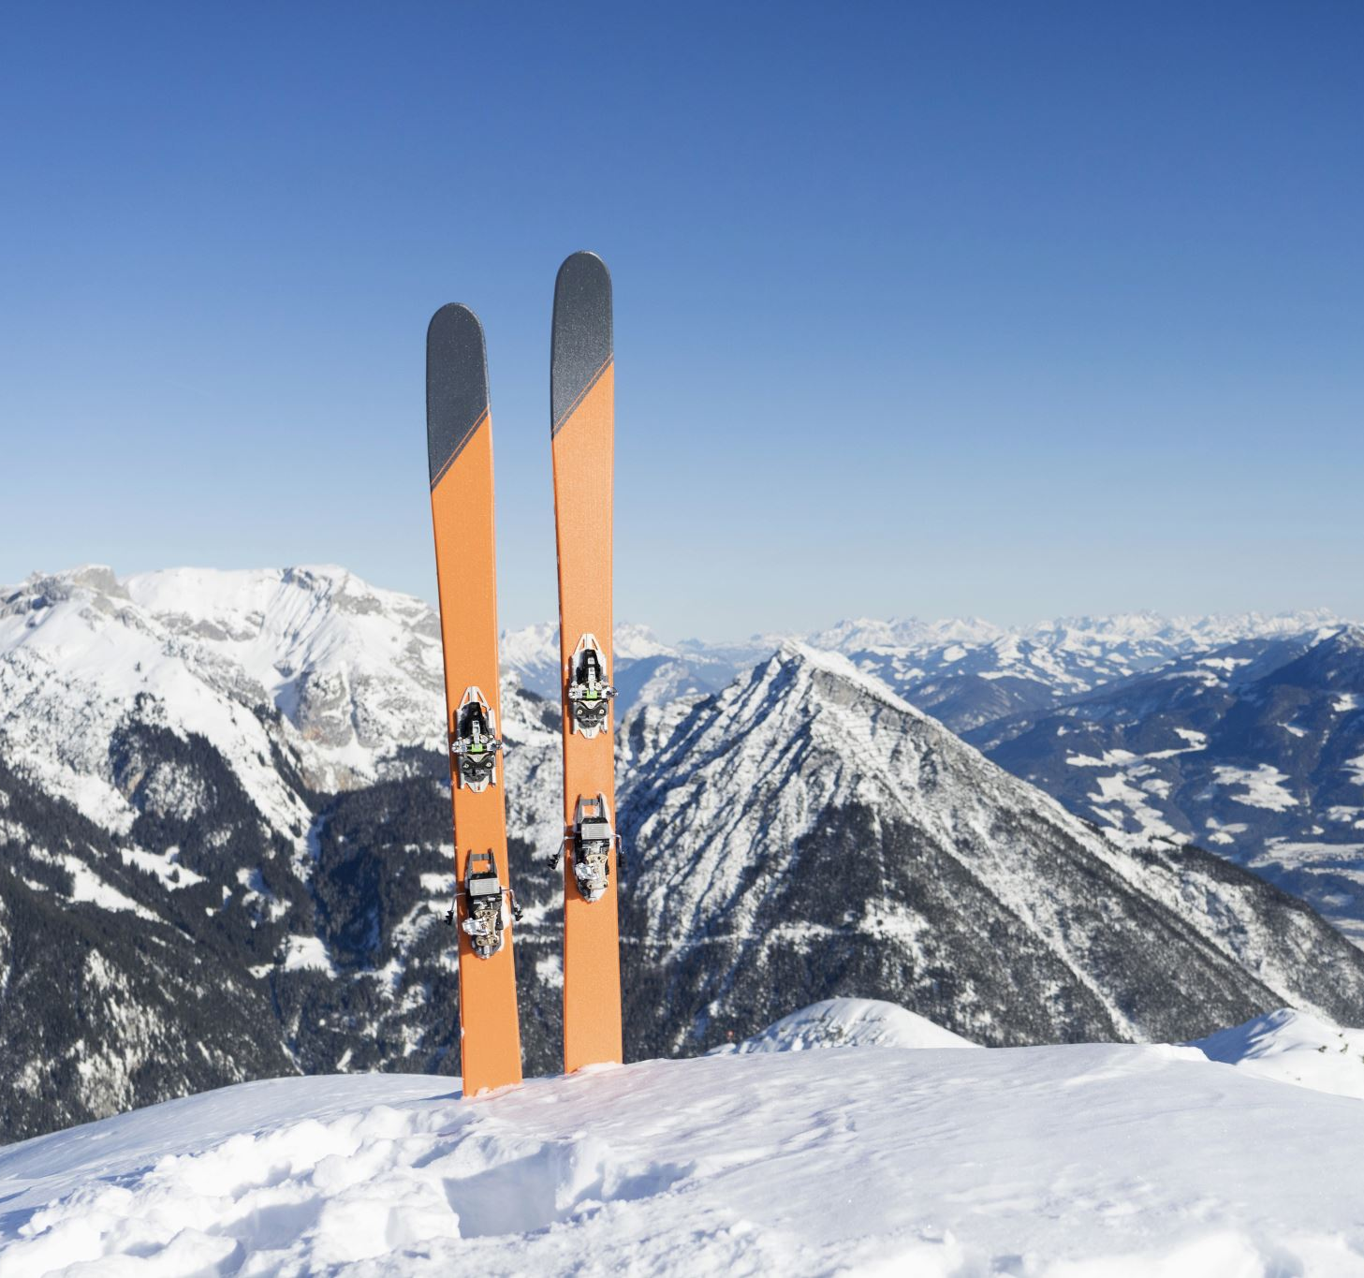
Project Objective
To create a user-centric platform that simplifies finding the best ski resorts based on real-time conditions and user preferences, fostering a vibrant community of skiing enthusiasts.

Slide 5

Chosen Database
After careful consideration, we've chosen MongoDB as the database for SkiSmart. MongoDB's flexible schema design, scalability, and geospatial query support align well with our project's dynamic data needs and location-based features. It offers real-time data handling and a developer-friendly JSON-like document format. However, we must ensure proper data modelling and address the potential learning curve for team members new to NoSQL databases.

Slide 6
Mock-Up Design

Slide 7
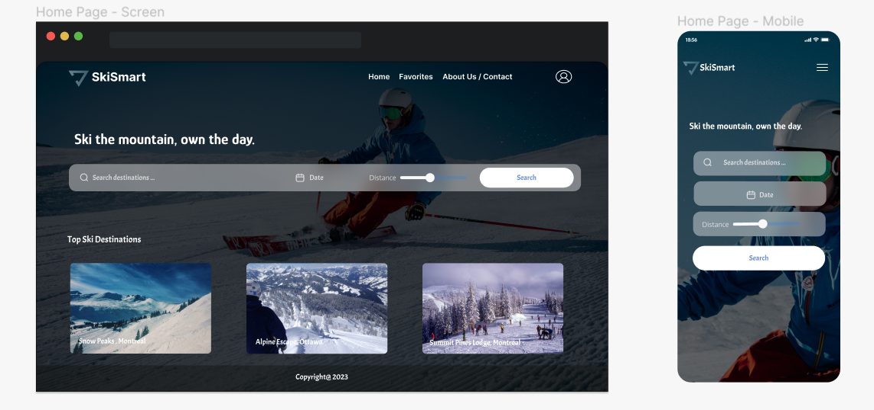
Home Page
The home page of our app, SkiSmart, provides a user-friendly interface.
It features our logo, app name, and essential tools like a navigation bar, search bar for postal codes, date selector, and distance slider.
Users can quickly input their preferences and start their journey to find the ideal skiing destination

Slide 8
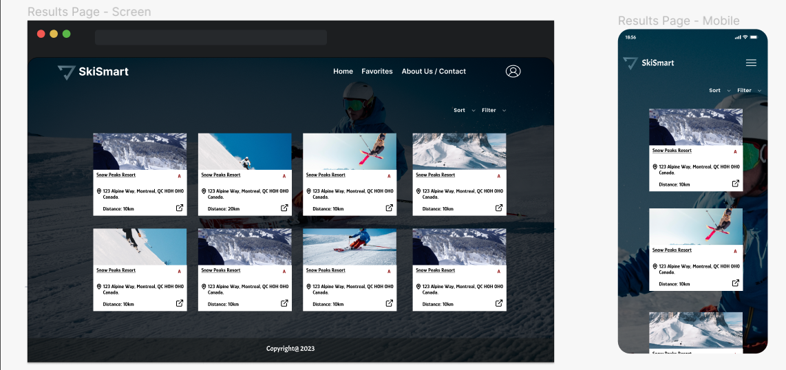
Results Page
Users can easily explore a list of ski resorts on the results page.
Each resort has a small thumbnail image and a clickable name that leads to more information and details, such as the distance from the user’s location and rating.
Users can use filter and sort options to make finding the perfect resort easier.

Slide 9
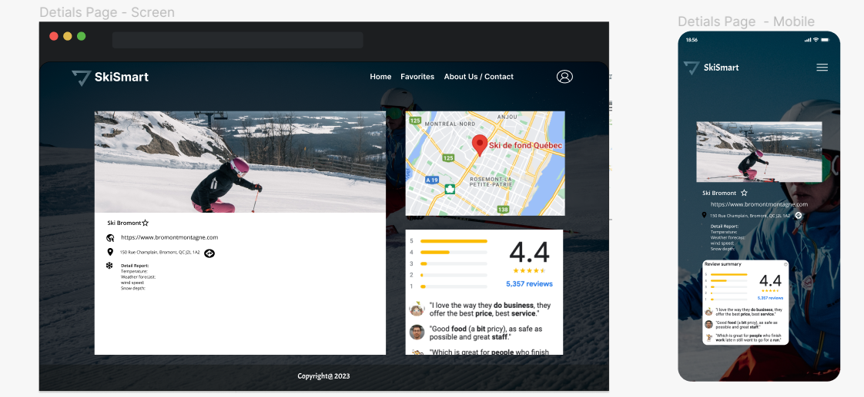
Resort Details Page
The Resort Details Page is your go-to for essential information.
It includes a carousel of resort images, real-time weather data, user reviews with ratings, direct links for contacting resorts or booking, and an option to view the address on a map.
It's your all-in-one resort exploration hub.

Slide 10
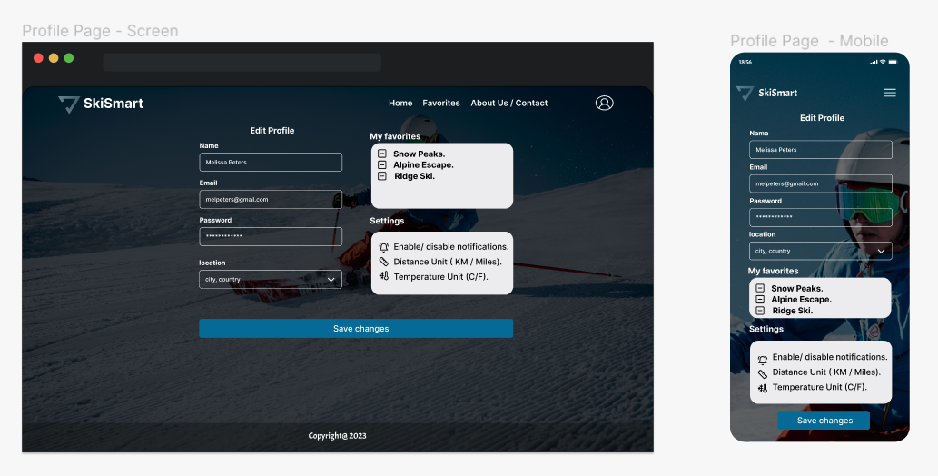
User Profile and Settings Page
The User Profile & Settings Page is a central hub, offering access to display names, email addresses, and passwords for efficient account management.
It also lists saved resorts, simplifying resort selection and customizable app settings for tailoring distance and temperature.
This page provides a platform for personalized and user-friendly skiing experiences.

Slide 11
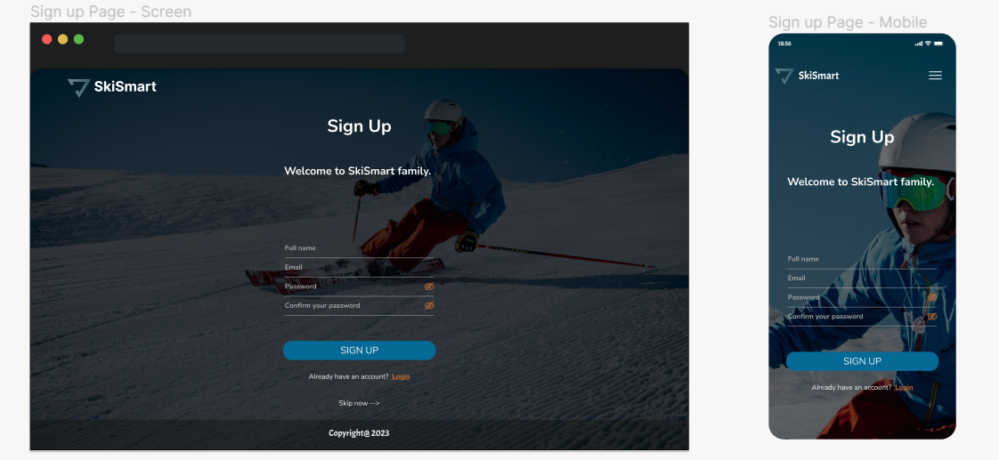
Sign Up Page
The Sign-Up Page lets new users quickly register for SkiSmart by providing their name, email, and password.
Existing users can easily access the Login Page, while those who prefer to explore the app first can choose the 'Skip for Now' option for a hassle-free experience.
It's a flexible and user-friendly registration process.

Slide 12
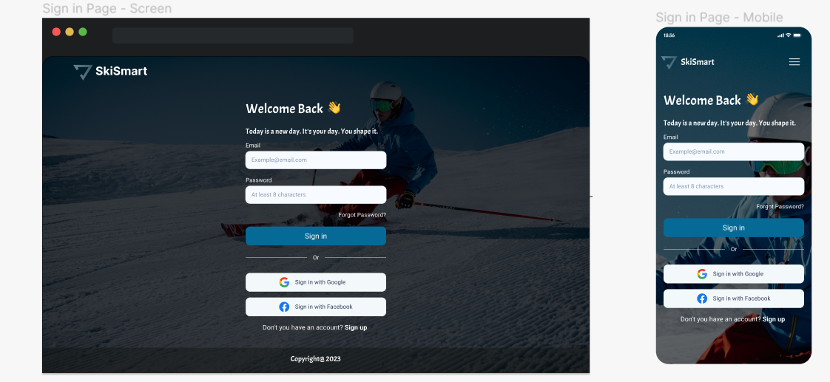
Log-In Page
The Log-In Page warmly welcomes returning users and prompts them to enter their registered email and password for quick access.
For added convenience, users can also choose to log in using their Google or Facebook accounts.
It's a user-friendly and secure log-in experience.

Slide 13
Thank you for your attention today!
Q&A

