Slide 1
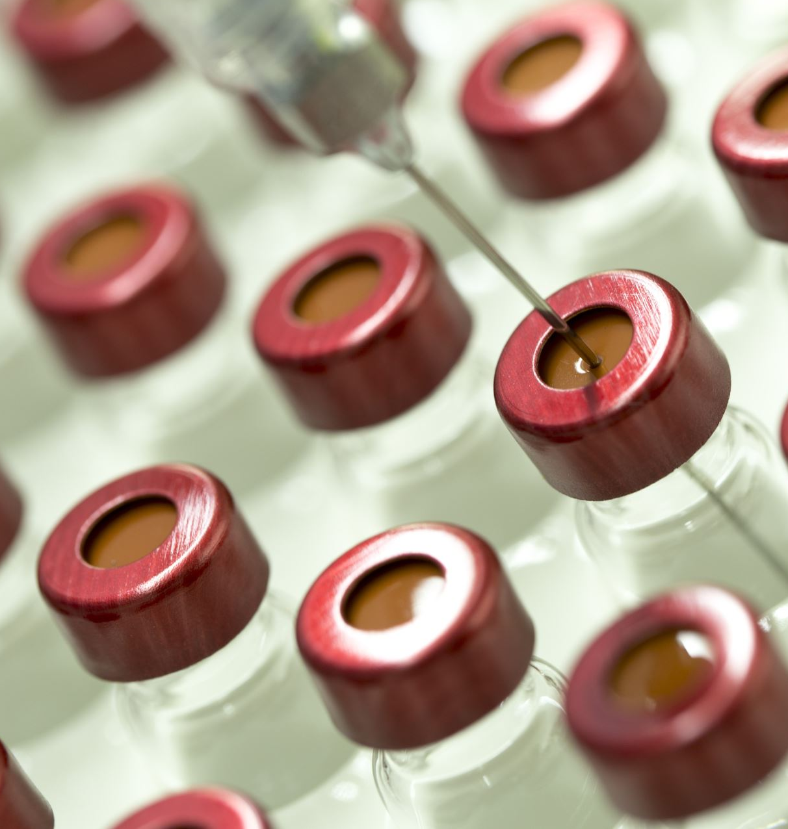
GymRats Nutrition Bot
A Personalized Fitness & Nutrition Assistant

Slide 2

Team contributions
Youssef Khafagy – State Management & Main Loop (Chatbot control flow & state transitions)
Youssef Atwa – Quiz Module (Quiz questions, answers, scoring)
Ahmed Tamer – User Profile & Analytics (User data, input parsing, analytics)
Belal Mohamed – Recommendations (Nutrition/fitness advice, BMI, plans)

Slide 3
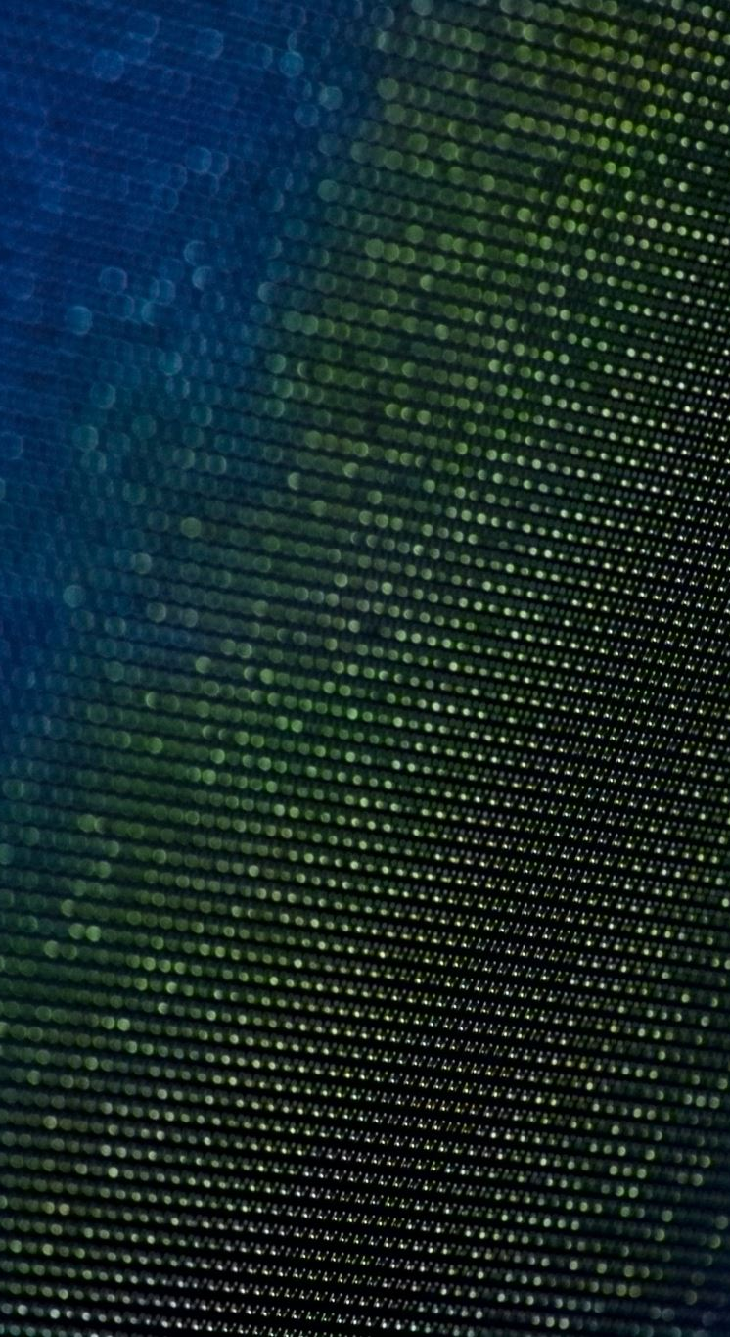
Motivation
Many people lack accessible, reliable fitness guidance.
Challenges include misinformation and lack of structured plans.
GymRats Bot provides:
Education on fitness and nutrition
Personalized health planning
Engaging quiz interaction

Slide 4
Key Features
🧠 Quiz System (Nutrition-focused)
🧍 Personalized Plan Generator
🗣️ Natural Language Input Handling
📊 Interaction Logging & Analytics
🎯 BMI-based Suggestions

Slide 5
Flow of Interaction
Finite State Machine Design:
Greeting → Quiz Start → Quiz Topic → Quiz → User Info → Goal Setting → Exit
State Types: Greeting, QuizInProgress, GatherUserInfo, etc.

Slide 6
Quiz System
Users select a topic: (Nutrition)
Multiple-choice format with immediate feedback
Results logged and analyzed
Correct/Incorrect/Invalid answer handling
Final summary provided

Slide 7
Analytics Example
Total Interactions: 18
Quiz Questions Answered: 6
Correct Answers: 5
Quiz Accuracy: 83%
Most Common Interaction: Quiz

Slide 8
User Profile & Input Handling
Collected fields: Name, Gender, Age, Height, Weight, Preferences
Intelligent parsing via Regex/CSV
Basic NLP for goal detection

Slide 9
Personalized Plan Generator
Computes BMI using height and weight
Plans vary by goal (lose/gain weight)
Includes caloric advice, hydration, workouts
Example: Lose 5kg → -500 kcal/day + cardio/HIIT

Slide 10
Testing Strategy
Manual Testing of core functions
Quiz validation and BMI calculation
Edge cases handled (typos, empty input)

Slide 11
Conclusions
Engaging UX (emojis, friendly tone)
Modular Scala design (pattern matching, recursion)
Educational and actionable chatbot output

Slide 12
Thank You
Thank you for your attention!
💪 Stay healthy with GymRats Bot!

