Slide 1
Stress-Testing EfficientNetB2 for Brain Tumor MRI Classification
Patient-wise validation · Class-balanced focal loss · Deduplicated external test (BRISC 2025)
Milestones M4 (implementation + ablations) and M5 (failure analysis + paper)
Base paper: Zulfiqar et al., Biomed. Signal Process. Control 84 (2023) — Figshare CE-MRI, 3 classes
Vaishnav Verma · CV Research-Reproduction Project · No clinical claims

Slide 2
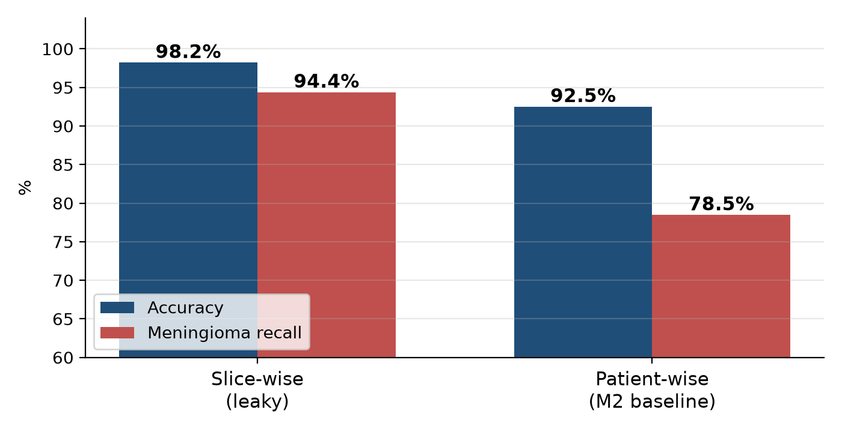
Where M3 left us: the leakage gap
Same model, same data — only the split changed
• Figshare CE-MRI: 3,064 slices from only 233 patients (~13 slices / patient)
• Slice-wise split puts neighbouring slices of the same patient in train AND test → memorisation
• Patient-wise test: accuracy 98.21% → 92.50%, meningioma recall 94.37% → 78.47%
• Even with a patient-wise test, the checkpoint was picked with validation_split=0.1 on augmented copies → val accuracy 99.44% (leaky)
• Meningioma is the weak class: 19/144 → pituitary, 12/144 → glioma
Brain Tumor CE-MRI · M4 & M5 · benchmark study, no clinical claims 2 / 12

Slide 3
Hypotheses from M3 — what we tested and why
Budget: two training runs → one experimental variable
# | Hypothesis | Role in M4 | Cost | Decision
H1 | Pick best model on NEW patients (patient-grouped val) | Protocol fix (both runs) | 0 extra runs | ✔ Done
H2 | Extra attention to meningioma (class-balanced focal loss) | THE one experimental change | 1 run | ✔ Main test
H3 | Fix randomness (seeds, hashes, config logs) | Reproducibility support | Unit test only | ✔ Done
H4 | Test on a different dataset (BRISC 2025) | Evaluation only | Inference only | ✔ Done
H5 | Scanner-style intensity augmentation | Would need a 3rd run | 1+ run | ✘ Future work
Run A and Run B differ ONLY in the loss function — split, seed, backbone, optimiser, augmentation files and epoch budget are identical
Brain Tumor CE-MRI · M4 & M5 · benchmark study, no clinical claims 3 / 12

Slide 4
Predictions written BEFORE training (results/predictions.md)
Handout rule 1: predict first — being wrong is fine
Hypothesis | Prediction | Mechanism
H2 · meningioma recall | +3 to +8 pp vs CE | Fewest source slices (484 vs 1,024) + hardest class
H2 · macro recall | +1 to +3 pp | Gain concentrated in meningioma
H2 · accuracy | within ±1 pp (may dip) | Some glioma/pituitary pushed toward meningioma
H2 · macro AUC | stable (±0.01) | Focal changes calibration more than ranking
H1 · patient val | close to test (≤ ~3 pp), far below 99.4% | Val patients unseen in training
H4 · BRISC | accuracy drops 10–25 pp; meningioma worst | Different scanners, JPEG, mixed planes
H3 · determinism | same seed → identical first-epoch loss (CPU) | Seeded RNGs + op determinism
• Falsification rule: H2 is NOT supported if meningioma recall gains < 1 pp or the bootstrap CIs overlap almost completely
Brain Tumor CE-MRI · M4 & M5 · benchmark study, no clinical claims 4 / 12

Slide 5
Experimental design
Patient-grouped splits with zero overlap (asserted by unit tests)
Split | Glioma | Meningioma | Pituitary | Total
Train (source slices) | 1,024 (61 pts) | 484 (56 pts) | 637 (42 pts) | 2,145 (159 pts)
Train (augmented files) | 3,072 | 2,903 | 3,185 | 9,160
Val (patient-grouped) | 170 (10 pts) | 80 (9 pts) | 109 (7 pts) | 359 (26 pts)
Test (patient-wise, untouched) | 232 (18 pts) | 144 (17 pts) | 184 (13 pts) | 560 (48 pts)
• Run A: categorical cross-entropy
• Run B: class-balanced focal loss
  – FL = −Σ αc · yc · (1 − pc)^γ · log pc, γ = 2
  – αc from PRE-augmentation counts (Cui et al., β = 0.999)
  – α = [0.744, 1.243, 1.012] → meningioma 1.67× glioma
• Why pre-aug counts? Offline aug already equalises files; 2,903 meningioma files come from only 484 slices
• Shared: EfficientNetB2 (ImageNet), 240 px, Adam 1e-3, batch 32, seed 42, max 25 epochs
• LR ×0.3 after 3 epochs without val gain; early stop after 7; checkpoint = best patient-val macro-F1 (tie-break meningioma recall)
• Test set touched once, after training · 1,000× bootstrap CIs resampling PATIENTS
Brain Tumor CE-MRI · M4 & M5 · benchmark study, no clinical claims 5 / 12

Slide 6
Implementation & compute (H3 reproducibility)
Both runs in parallel on AWS SageMaker, every epoch saved to S3
 | Run A (CE) | Run B (CB-Focal)
Instance | ml.g5.xlarge (A10G 24 GB) | ml.g5.2xlarge (A10G 24 GB)
Speed | ~26 s / epoch | ~26 s / epoch
Epochs run → best | 11 → epoch 4 | 21 → epoch 14
Billable time | 767 s (12.8 min) | 974 s (16.2 min)
Approx. cost | ≈ $0.30 | ≈ $0.41
• 12/12 unit tests pass (tests/test_m4.py):
  – zero patient overlap across 233 patients
  – every augmented file maps to a training patient
  – focal(γ=0, α=1) == cross-entropy
  – metrics match scikit-learn; bootstrap CI narrows with n
  – pHash robust to JPEG / resize
  – same seed → identical first-epoch loss (CPU)
• config.json per run: args, seed, data SHA-256, library versions, instance
• GPU kernels are not bit-exact → reported as a limitation
• Saved every epoch: epoch_XX / best / last weights, train_state.json, history.csv → auto-resume on restart
• All AWS resources deleted afterwards (0 jobs, 0 buckets)
• Local M5 Air estimate for the same work: ~6–9 h
Brain Tumor CE-MRI · M4 & M5 · benchmark study, no clinical claims 6 / 12

Slide 7
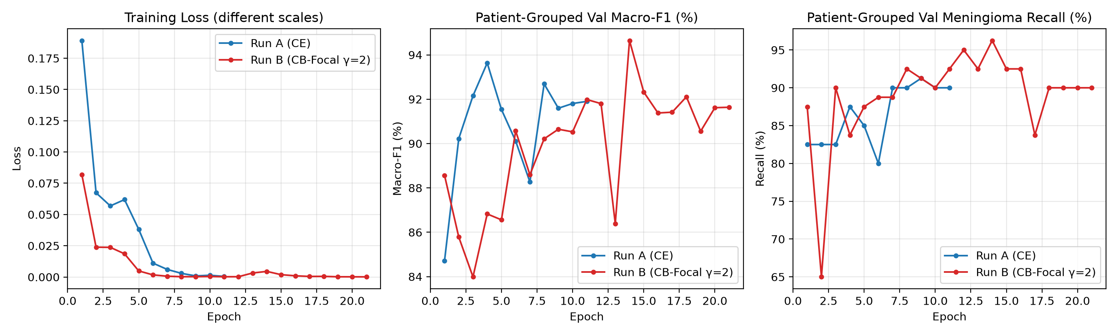
Training dynamics
CE peaks early; CB-Focal keeps improving after the LR drop
• Run A: train accuracy > 99.6% by epoch 6; patient-val macro-F1 peaks at epoch 4 (93.6%), then declines → early stop
• Run B: patient-val macro-F1 rises to 94.6% at epoch 14 (val meningioma recall 96.3%) → early stop at epoch 21
Brain Tumor CE-MRI · M4 & M5 · benchmark study, no clinical claims 7 / 12

Slide 8
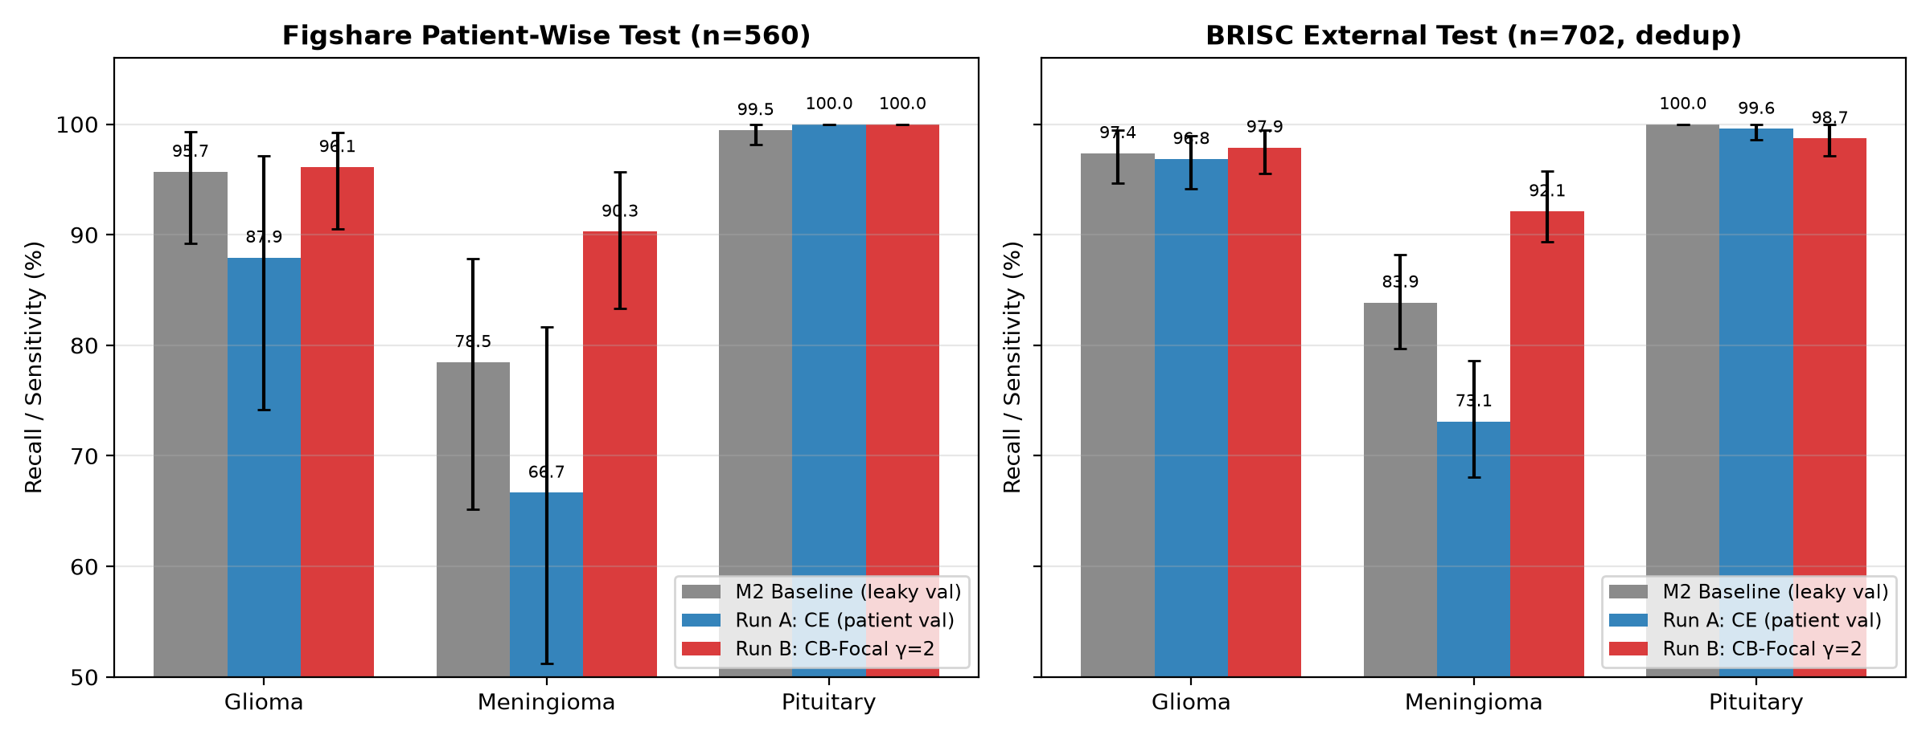
Results — Figshare patient-wise test (48 patients, 560 slices)
95% CIs from 1,000 patient-level bootstrap resamples
Model | Accuracy | Macro-F1 | Macro recall | Meningioma recall | Macro AUC
M2 baseline (CE, leaky val) | 92.50 [87.6–96.1] | 91.56 | 91.21 | 78.47 [64.0–88.2] | 0.989
Run A (CE, patient val) | 86.43 [78.0–93.0] | 84.93 | 84.87 | 66.67 [50.7–81.9] | 0.982
Run B (CB-Focal, patient val) | 95.89 [93.1–98.1] | 95.50 | 95.47 | 90.28 [83.2–96.2] | 0.997
• Gain, not loss
• Meningioma recall: +23.6 pp vs Run A, +11.8 pp vs M2 (130/144 vs 96/144)
• Accuracy +9.5 pp vs Run A; pituitary stays 100%, glioma 96.1%
• Flip analysis: B fixes 59 slices A got wrong, breaks 6 → net +53
• Caveat: single seed; Run A < M2, so the conservative gain is B vs M2
Brain Tumor CE-MRI · M4 & M5 · benchmark study, no clinical claims 8 / 12

Slide 9
H4 — external test on BRISC 2025
Glioma / meningioma / pituitary test slices; no_tumor excluded; evaluation only
pHash dedupe vs 3,064 Figshare slices | Raw | Dropped (dH ≤ 5) | Kept
Glioma | 254 | 64 (25.2%) | 190
Meningioma | 306 | 27 (8.8%) | 279
Pituitary | 300 | 67 (22.3%) | 233
Total | 860 | 158 (18.4%) | 702
Model (702 slices) | Accuracy | Meningioma recall | Macro AUC
M2 baseline | 92.88 | 83.87 | 0.996
Run A (CE) | 88.32 [85.9–90.7] | 73.12 [67.7–78.3] | 0.992
Run B (CB-Focal) | 95.87 [94.3–97.3] | 92.11 [89.2–95.4] | 0.999
• Meningioma gain transfers: 73.1% → 92.1%
• Run A's main error on BRISC: 51/279 meningioma → pituitary (Run B: 13)
• Predicted a 10–25 pp drop → did NOT happen (≈0 pp)
  – Likely: residual near-duplicates beyond dH = 5 and similar acquisition
• 124 of the 158 were exact hash matches (dH = 0) → BRISC re-uses Figshare slices
• Without the dedupe, the 'external' test would leak training data
• No patient IDs in BRISC → image-level CIs only
Brain Tumor CE-MRI · M4 & M5 · benchmark study, no clinical claims 9 / 12

Slide 10
Predictions vs reality
Where we were right, wrong, and why
Hypothesis | Predicted | Observed | Verdict
H2 meningioma recall | +3 to +8 pp | +23.6 pp vs A / +11.8 pp vs M2 | Supported (bigger than expected)
H2 accuracy | ±1 pp, may dip | +9.5 pp vs A / +3.4 pp vs M2 | Wrong direction (better)
H2 macro AUC | stable ±0.01 | 0.982 → 0.997 | Slightly better than predicted
H1 patient val ≈ test | ≤ ~3 pp gap | Run B 0.9 pp; Run A 8.7 pp | Partly (B yes, A no)
H4 BRISC drop | −10 to −25 pp | ≈ 0 pp (95.9 vs 95.9) | Falsified
H4 meningioma worst | yes | yes, for all three models | Supported
H3 determinism (CPU) | identical loss | identical loss | Supported
• Why the gain beat our prediction: CE saturates fast (loss → 0 by epoch 6), so honest early stopping froze Run A at epoch 4. Focal loss keeps gradients on hard boundary slices, so learning continued to epoch 14
Brain Tumor CE-MRI · M4 & M5 · benchmark study, no clinical claims 10 / 12

Slide 11
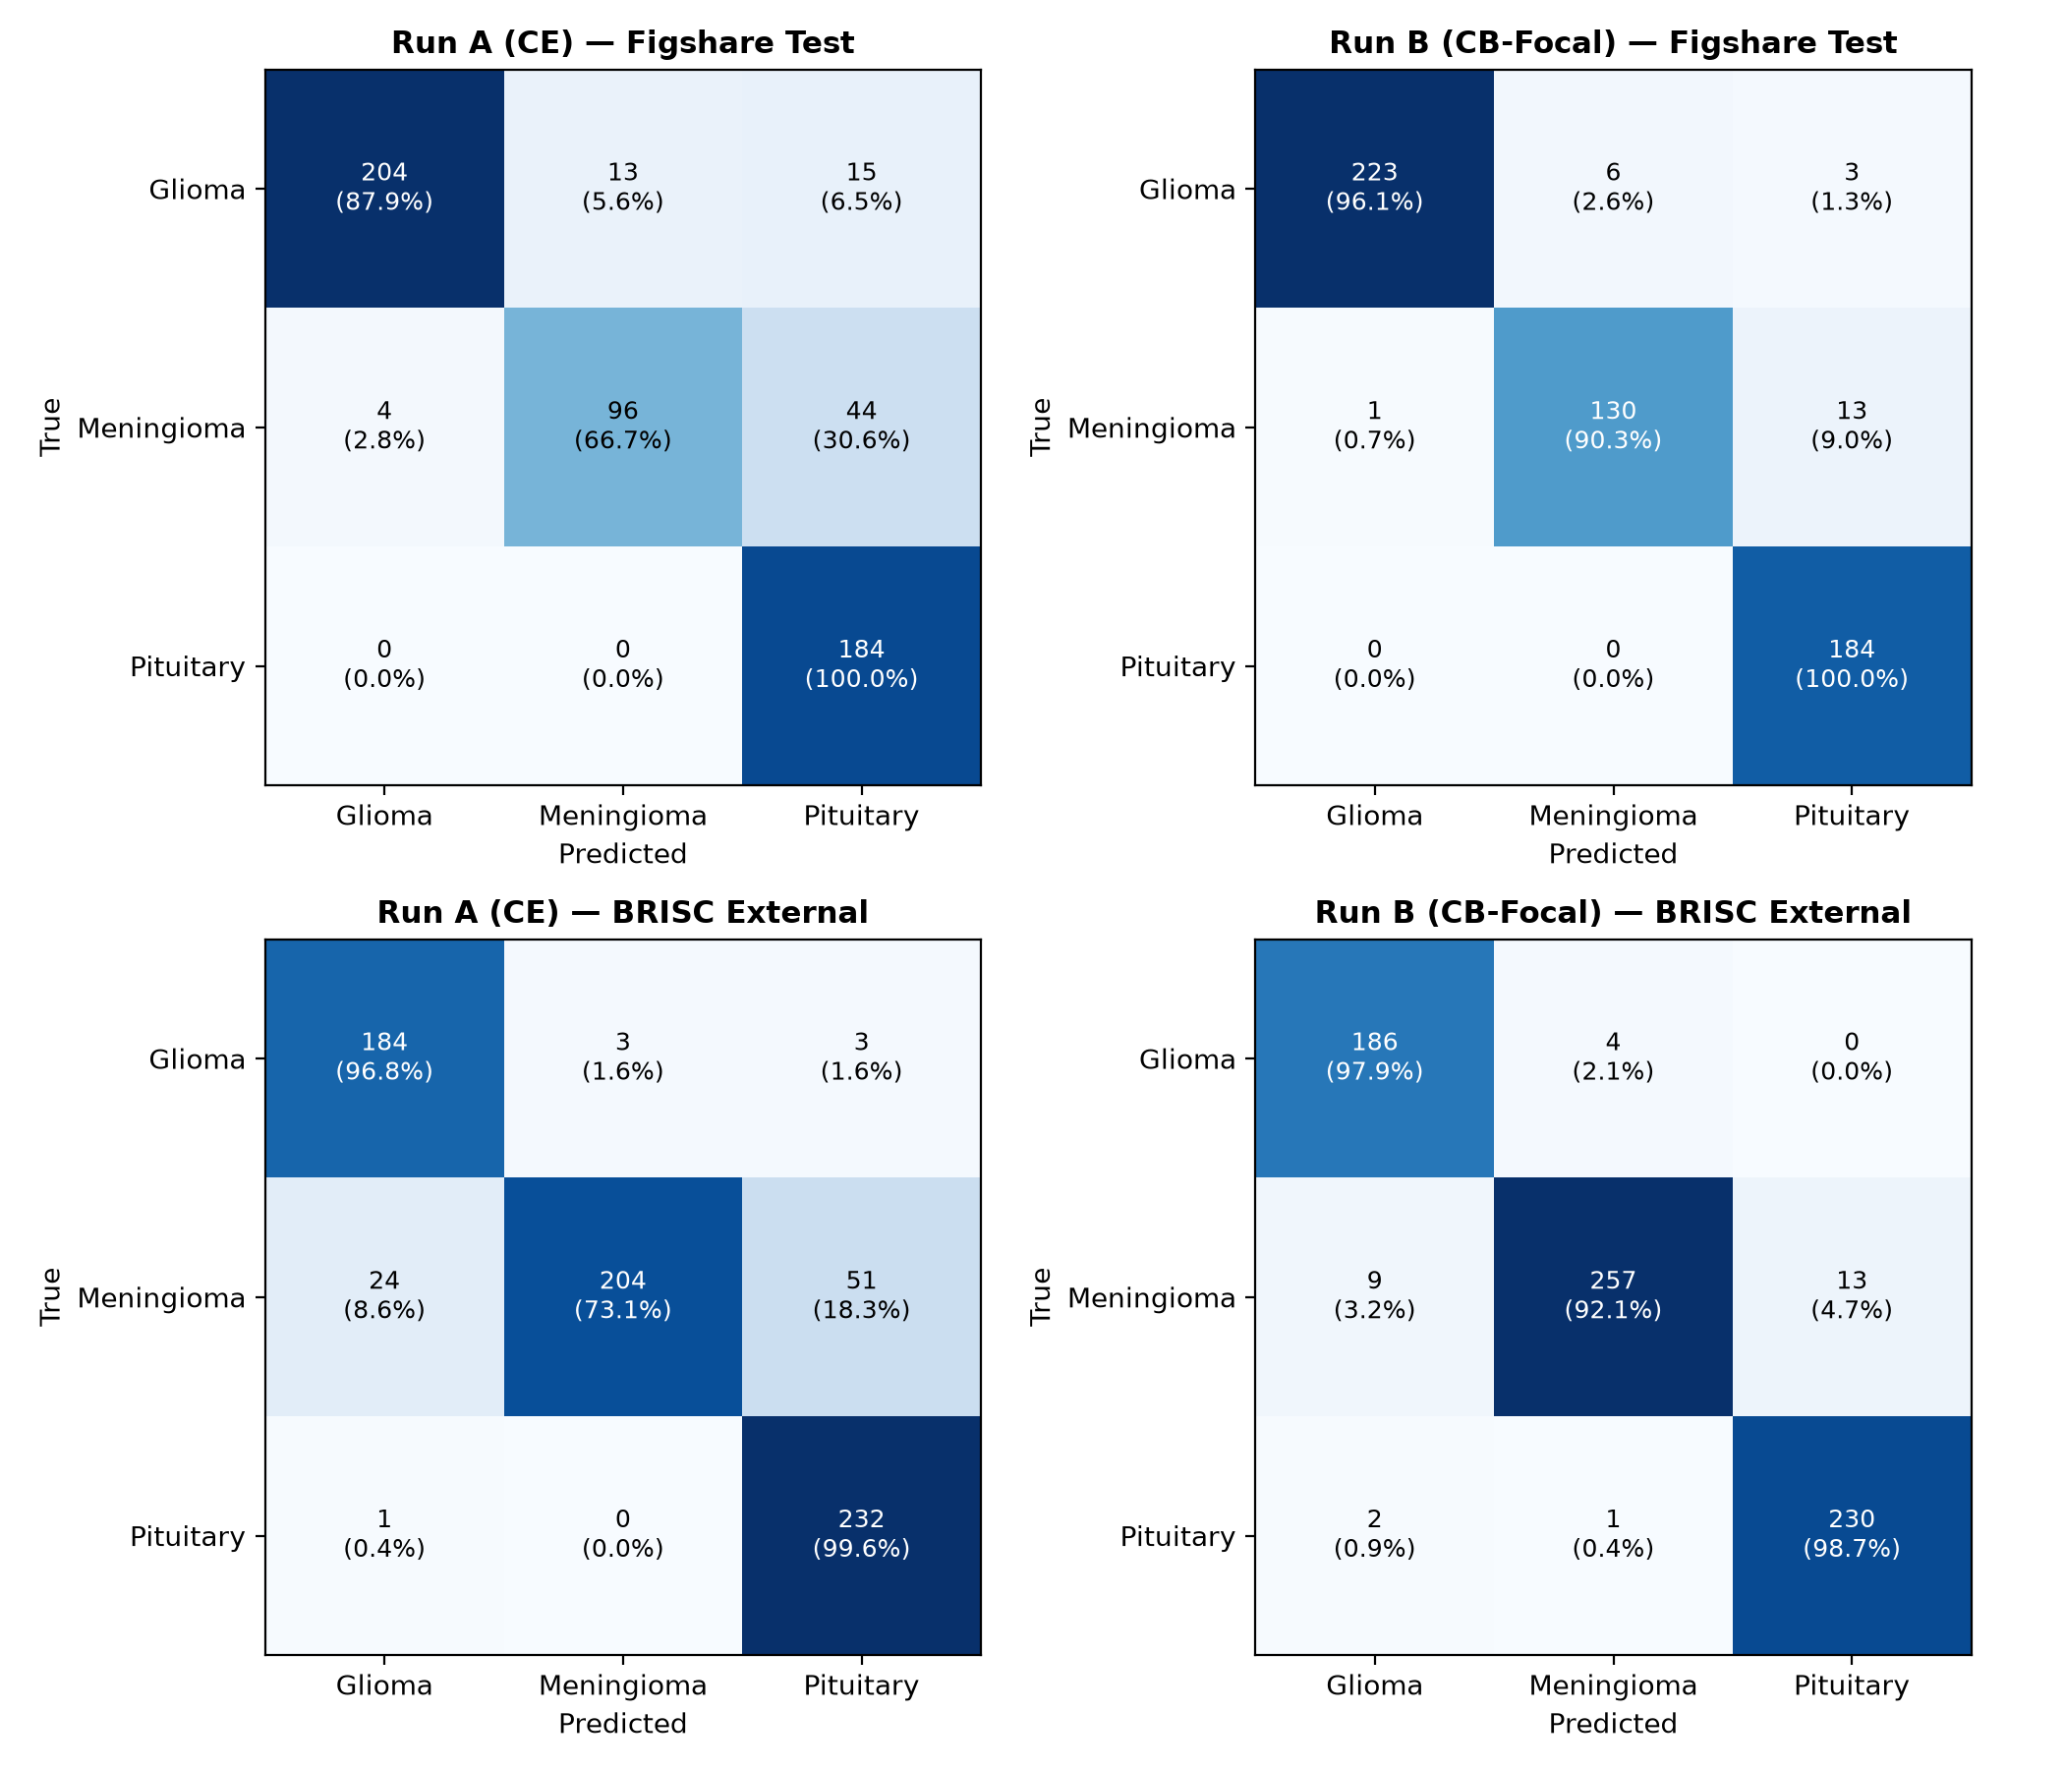
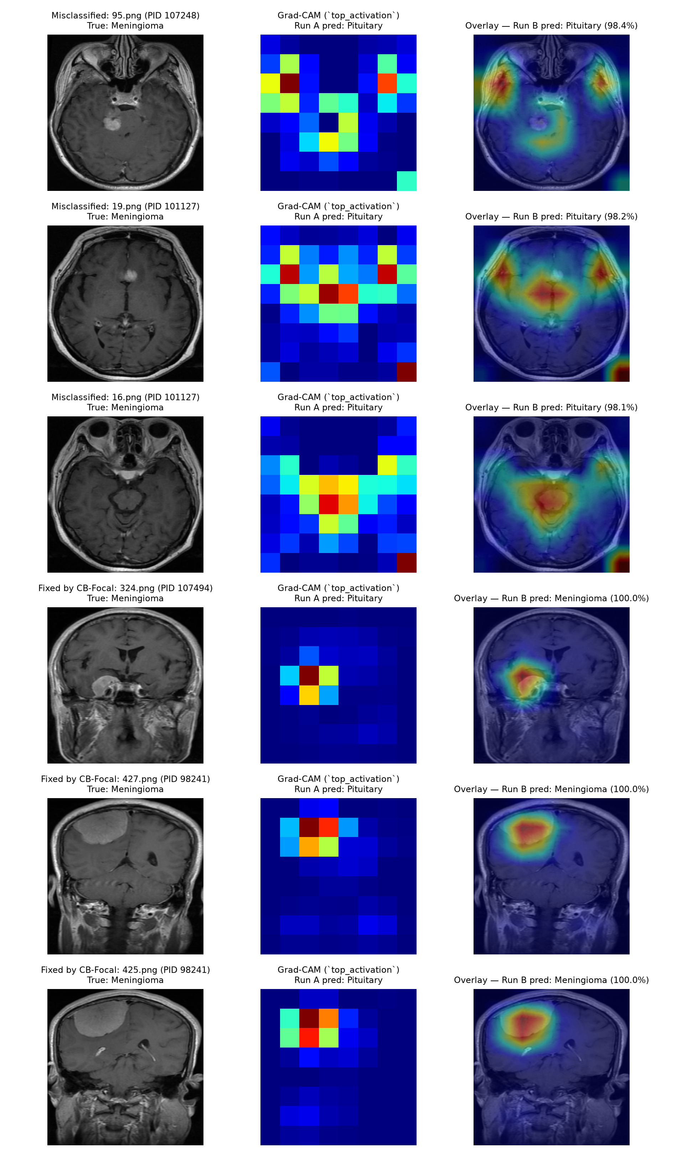
M5 failure analysis
Which classes get confused, which patients fail, and where the model looks
• Main error: meningioma → pituitary (A: 44, B: 13 on Figshare); parasellar meningiomas sit next to the sella
• Run B errors cluster: 23 errors in 12 of 48 patients; 6 patients hold 17 of them
• Grad-CAM: on the remaining errors, attention often sits on bright sellar/vessel regions, not the lesion (qualitative only)
Brain Tumor CE-MRI · M4 & M5 · benchmark study, no clinical claims 11 / 12

Slide 12
Limitations & conclusion
• Limitations
• Single split and single seed (2-run budget); CIs only partly capture run-to-run variance
• Run A scored below M2 → part of the A→B gap may be CE instability
• Keras 3.4 (SageMaker) vs 3.15 (local): input normalisation differs vs M2 (not between A and B)
• GPU kernels are not bit-exact; 2D slices only; no_tumor excluded
• BRISC lacks patient IDs; pHash dH ≤ 5 may miss re-cropped duplicates
• No clinical claims
• Conclusion
• Slice-wise splits hide a 5.7 pp accuracy / 15.9 pp meningioma gap
• Patient-grouped validation gives an honest model-selection signal (H1)
• CB-Focal (γ = 2): meningioma recall 90.3% on patients the model never saw, 92.1% on deduplicated BRISC (H2, H4)
• 18.4% of BRISC test slices duplicate Figshare → always dedupe before 'external' validation
• Next steps
• 3 seeds × 5 patient folds; test H5 (scanner augmentation); 3D multi-site data
Brain Tumor CE-MRI · M4 & M5 · benchmark study, no clinical claims 12 / 12

