Slide 1

Data Engineering ALX1_AIS4_S2e
CUSTOMER FEEDBACK ANALYSIS AND IMPROVEMENT
GROUP (4)
Belal Saeid
Rewaa Alaa
Mahmoud Tawfik Robaa
Ahd Hesham
Fayrouz Ehab

Slide 2

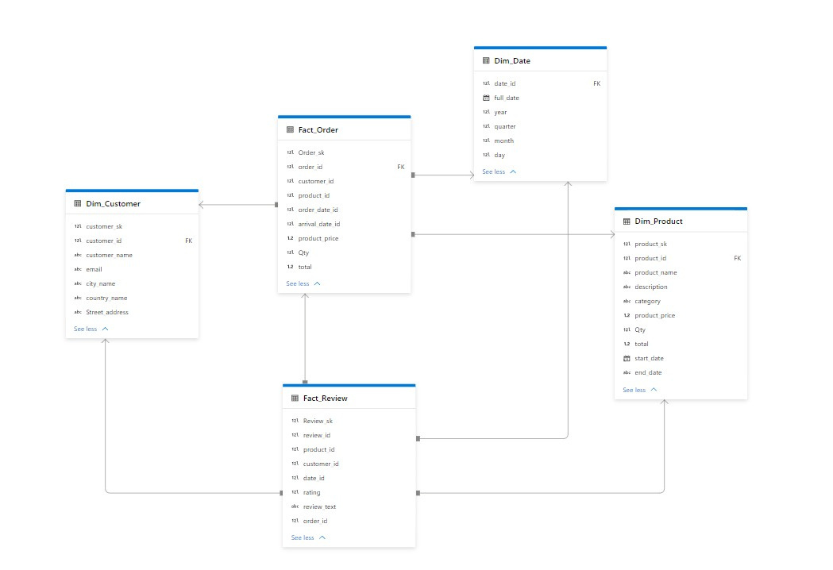
Database Schema

Slide 3
Database Schema
This schema represents a star schema design for a data warehouse, with a central Fact Table surrounded by Dimension Tables.
Fact_Order:
Dim_Customer (customer_id): Links each order to a customer.
Dim_Product (product_id): Links each order to a product.
Dim_Date (order_date_id, arrival_date_id): Links to the date the order was placed and the date it arrived.
Fact_Review:
Dim_Customer (customer_id): Links each review to a customer.
Dim_Product (product_id): Links each review to a product.
Dim_Date (date_id): Links each review to the date it was written.
Fact_Order (order_id): Links each review to the corresponding order.
Dim_Customer:
Fact_Order (customer_id): Relates customers to their orders.
Fact_Review (customer_id): Relates customers to their reviews.
Dim_Product:
Fact_Order (product_id): Relates products to orders.
Fact_Review (product_id): Relates products to reviews.
Dim_Date:
Fact_Order (order_date_id, arrival_date_id): Relates orders to order and arrival dates.
Fact_Review (date_id): Relates reviews to the review date.
Each fact table connects to dimension tables through foreign keys, facilitating detailed analysis.

Slide 4
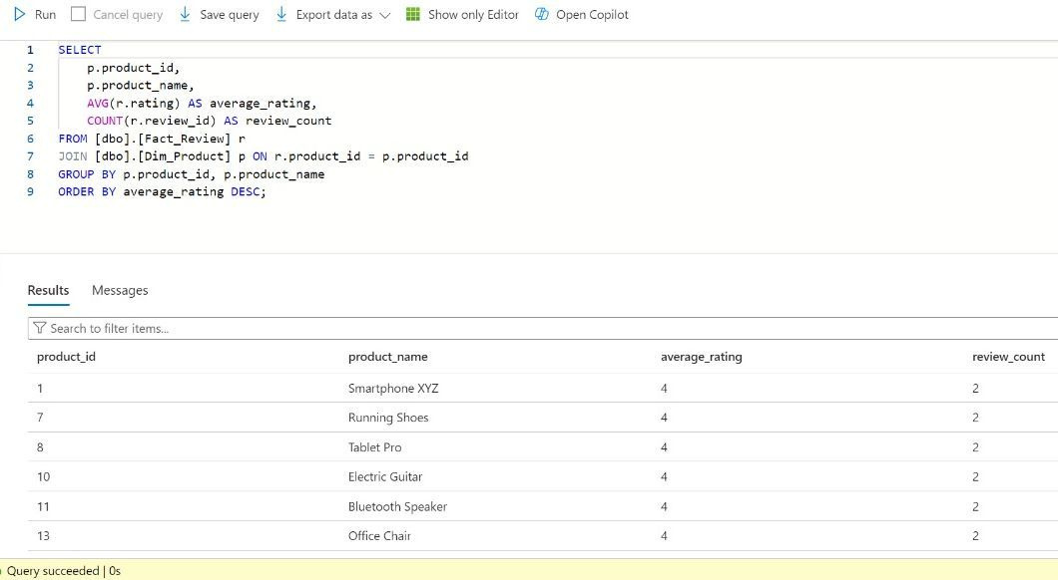

Slide 5
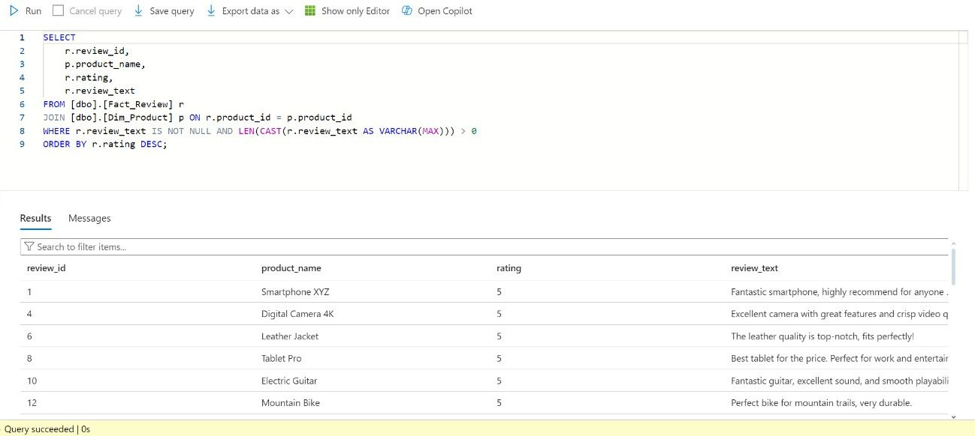

Slide 6
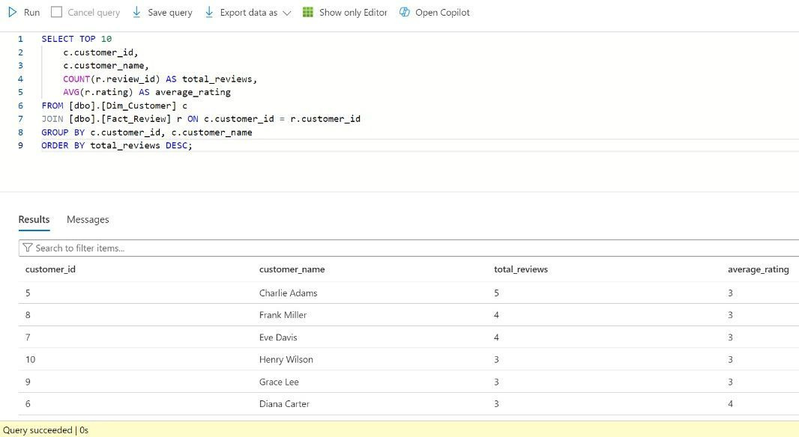

Slide 7
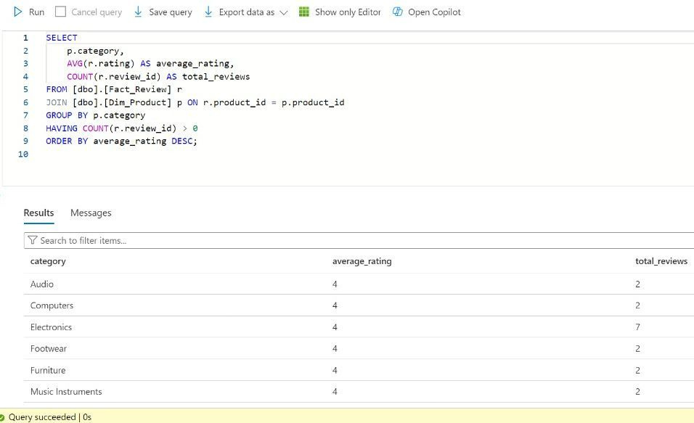

Slide 8
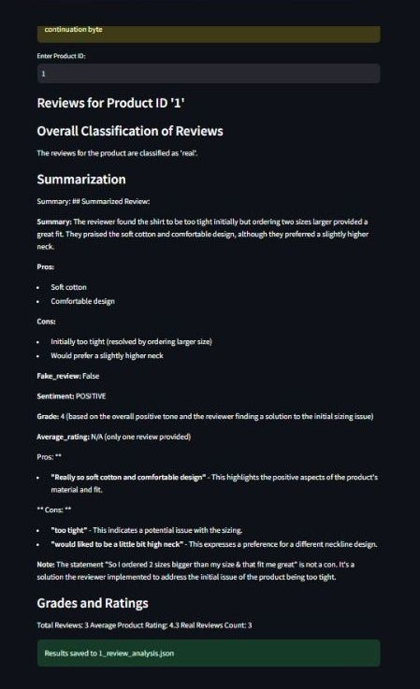
Sentiment Analysis
This sentiment analysis model evaluates customer reviews scraped from Shein, offering insights into product quality and customer satisfaction through a user-friendly Streamlit web GUI. For each product ID, it assesses comment authenticity to distinguish real from fake reviews, generates concise summaries of all feedback, and assigns a grade reflecting overall customer sentiment (negative, positive, neutreal), Additionally, the model highlights key pros and cons based on customer input.

Slide 9
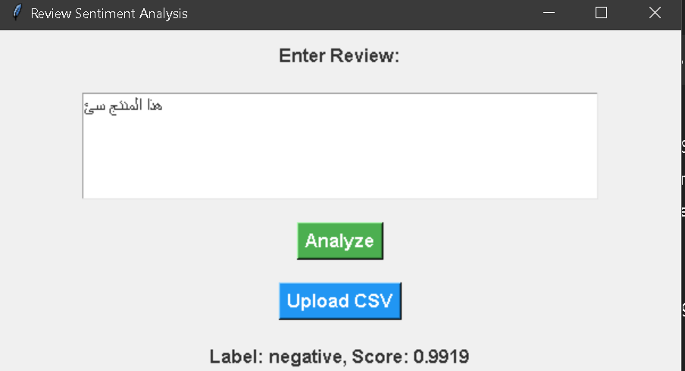
Sentiment Analysis
This customer sentiment analysis model utilizes a Hugging Face transformer model to assess sentiment from text or CSV files, providing insights into customer feedback. Users can easily input their data, and the model determines whether the sentiments expressed are positive or negative. Alongside the sentiment classification, the model also outputs the percentage probability of each sentiment, offering a quantifiable measure of confidence in the predictions. This tool empowers businesses to quickly gauge customer opinions, enabling informed decision-making and enhancing overall customer engagement.

Slide 10
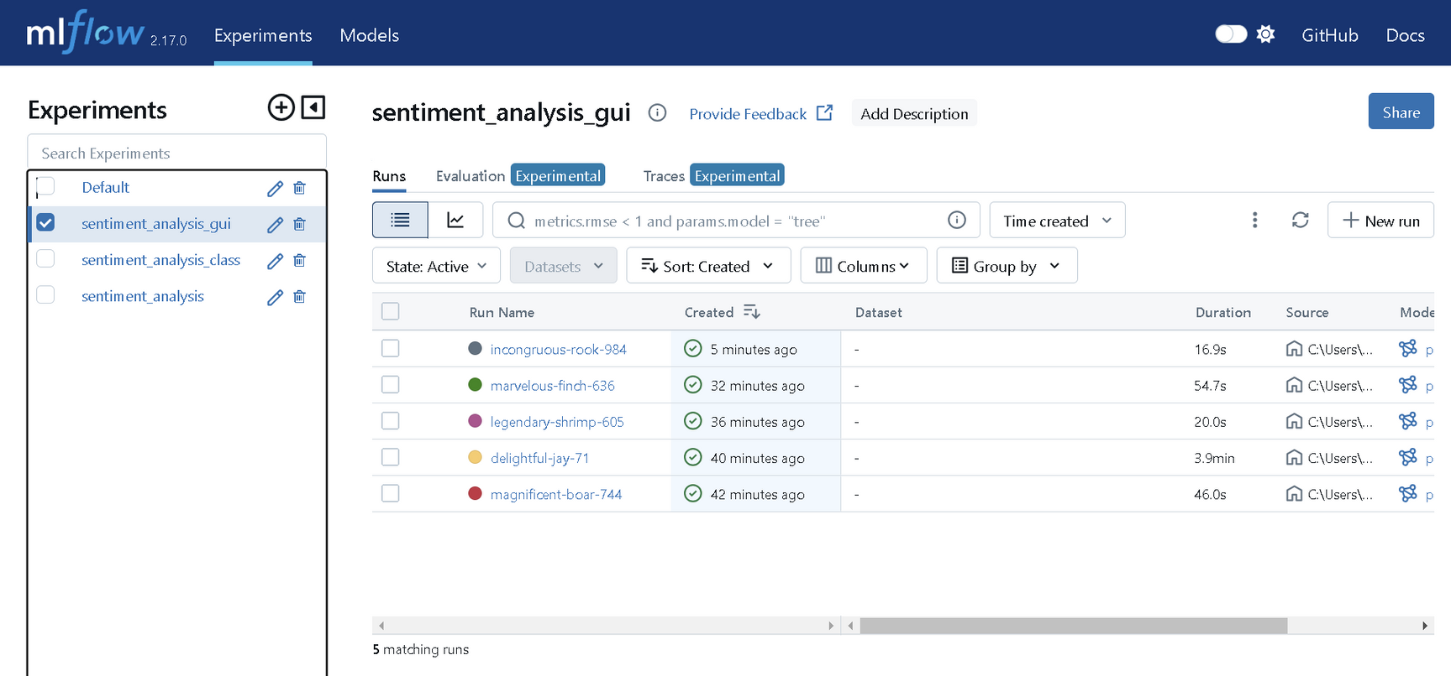
MLflow is an open-source platform for managing the machine learning lifecycle, encompassing experimentation, reproducibility, and deployment. In the development of a customer reviews sentiment analysis model, MLflow was used to track experiments by logging parameters, metrics, and artifacts, enabling easy comparison of model iterations. The best-performing model was packaged using MLflow Models for deployment via a REST API. Additionally, the MLflow Registry was utilized to version the model, facilitating tracking of changes and allowing for rollback if necessary. This approach streamlined the workflow and enhanced management of the model throughout its lifecycle.
MLOps

Slide 11
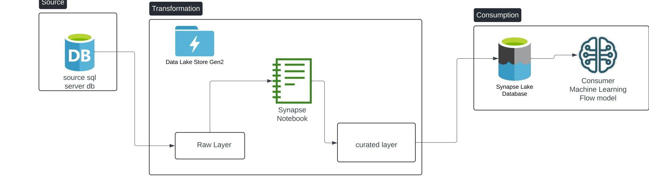
data pipeline architecture diagram

Slide 12
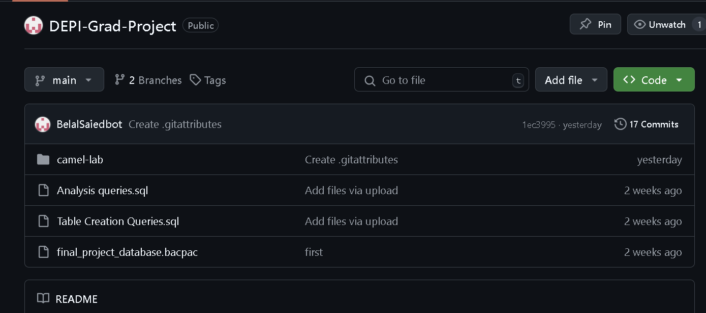
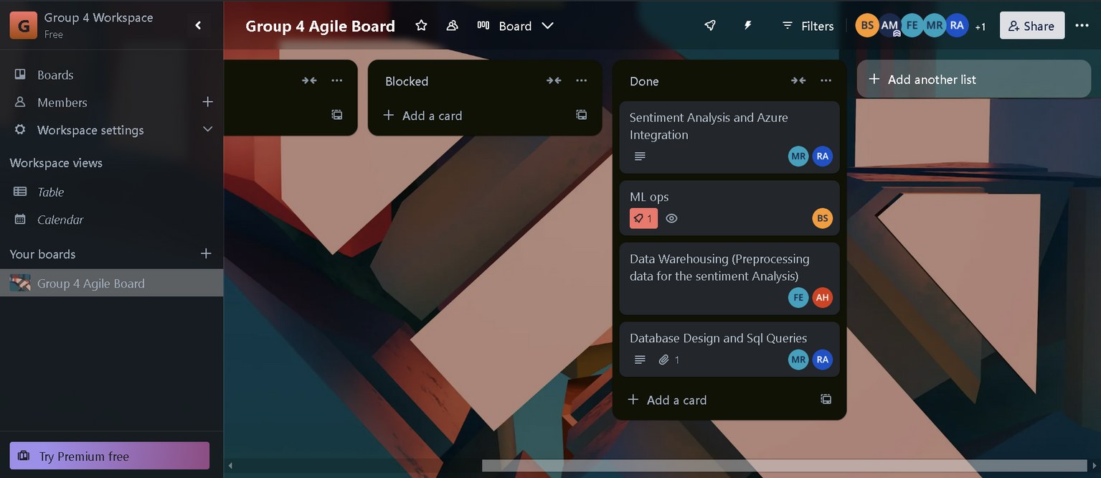
Github and trello were used for agile and cooperative development

