Slide 1

Real-time Particle System using OpenGL
BY: Belal Hesham232465 & Abdelrahman Mohamed233729
Supervisor: Prof. Tamer M. Nassef
TA Supervisor: ENG. Youssef Amer

Slide 2

Introduction: Dynamic Fire Simulation
This project showcases a real-time 3D particle-based fire simulation. Implemented with OpenGL Legacy and CPU-based physics, it features 3D particle movement, vortex motion, and user-controlled lateral forces.
Realistic Visuals
Core Concepts
Achieving lifelike fire effects through advanced particle dynamics.
Demonstrates fundamental computer graphics and animation principles.
Real-time Performance
Ensuring smooth interaction and visual feedback.

Slide 3

System Overview: Core Components
CPU-based Simulation
1
Manages particle behavior and physics calculations.
OpenGL Rendering
2
Utilizes the fixed-function pipeline for visual output.
Interactive Camera
3
Orbit camera with mouse and keyboard controls for dynamic viewing.
Wind & Vortex Control
4
Lateral wind and optional vortex motion for enhanced realism.

Slide 4
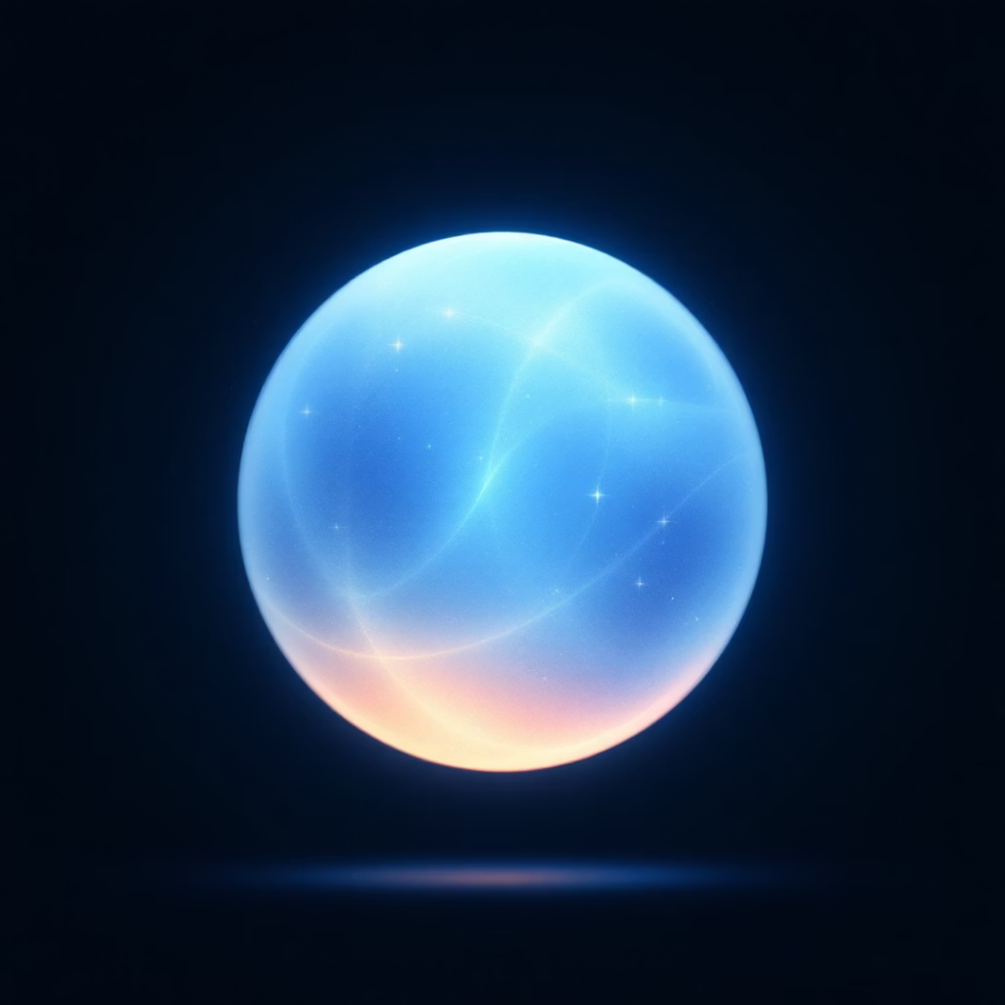
Particle Structure: Defining Fire Elements
Each particle is defined by key properties:
Position (x, y, z): 3D coordinates.
Velocity (vx, vy, vz): Movement direction and speed.
Life (life, maxLife): Manages particle duration.
Angle & Spin: Controls rotation for visual variation.
Particles are initialized with randomized values for natural fire behavior.

Slide 5





Simulation & Physics: The Update Loop
Lifetime Management
Movement Update
Vortex & Angle
Particles respawn upon reaching zero lifetime.
Position updated based on velocity and time, incorporating side forces.
Particles rotate around the Y-axis and spin for realism.

Slide 6
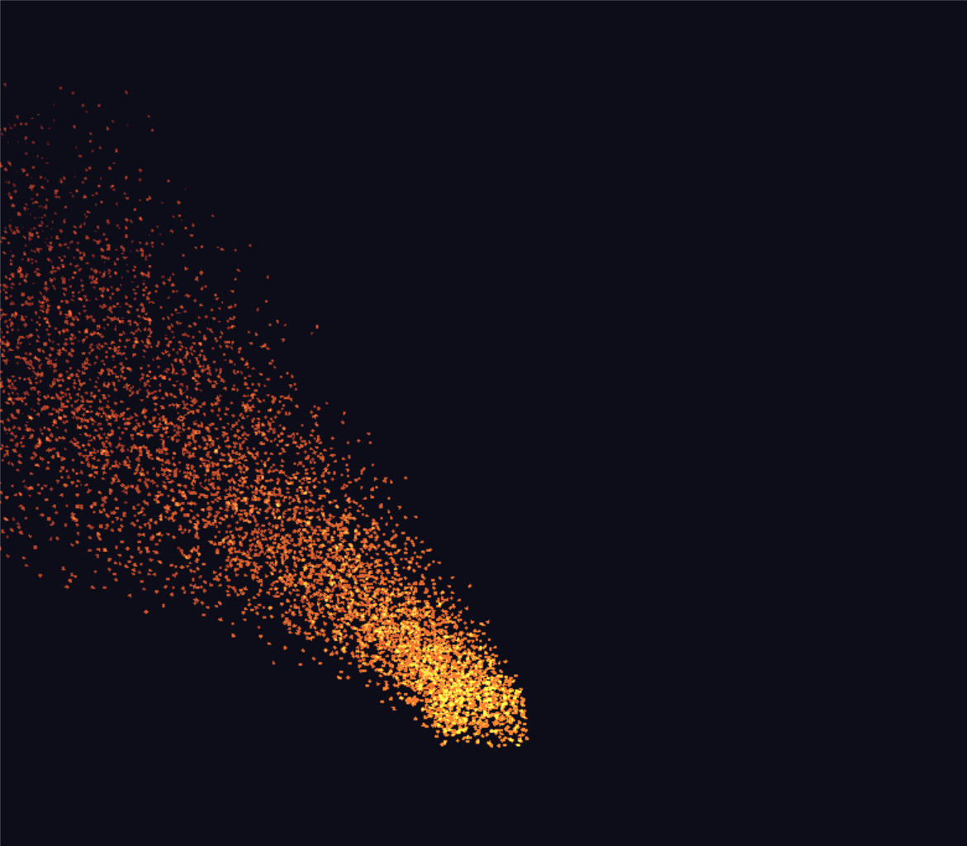
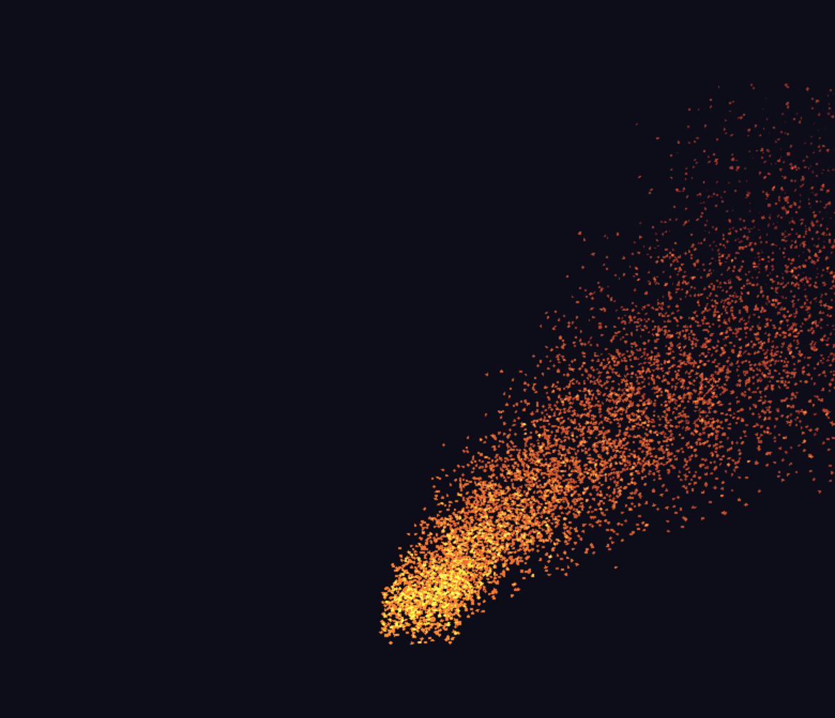

Dynamic Forces: Wind & Vortex
Lateral Force Control
A/D keys control sideForceTarget (-1 for left, +1 for right).
sideForce smoothly interpolates towards the target, creating a fluid swaying motion for the fire.

Slide 7

Rendering: Visualizing Particles
1
Quad Representation
Each particle is drawn as a 3D quad.
2
Additive Blending
glColor4f(1.0f, 0.5f*alpha, 0.1f, alpha) for glowing effect.
3
Life-based Scaling
Particle size scales with remaining life.
4
Depth Testing
Ensures proper occlusion and perspective.

Slide 8
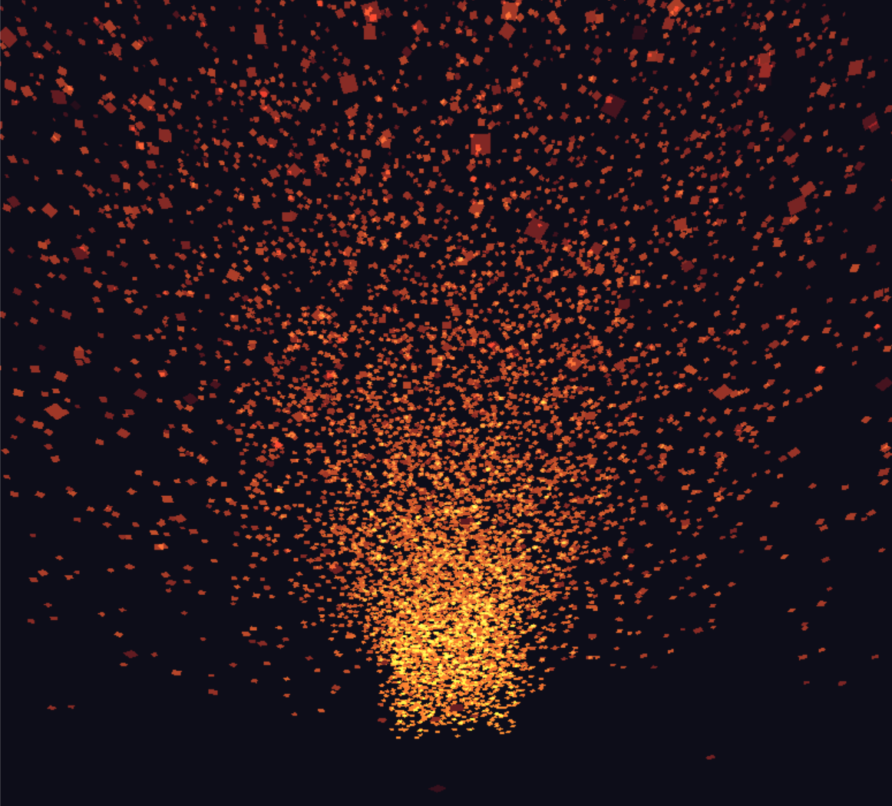
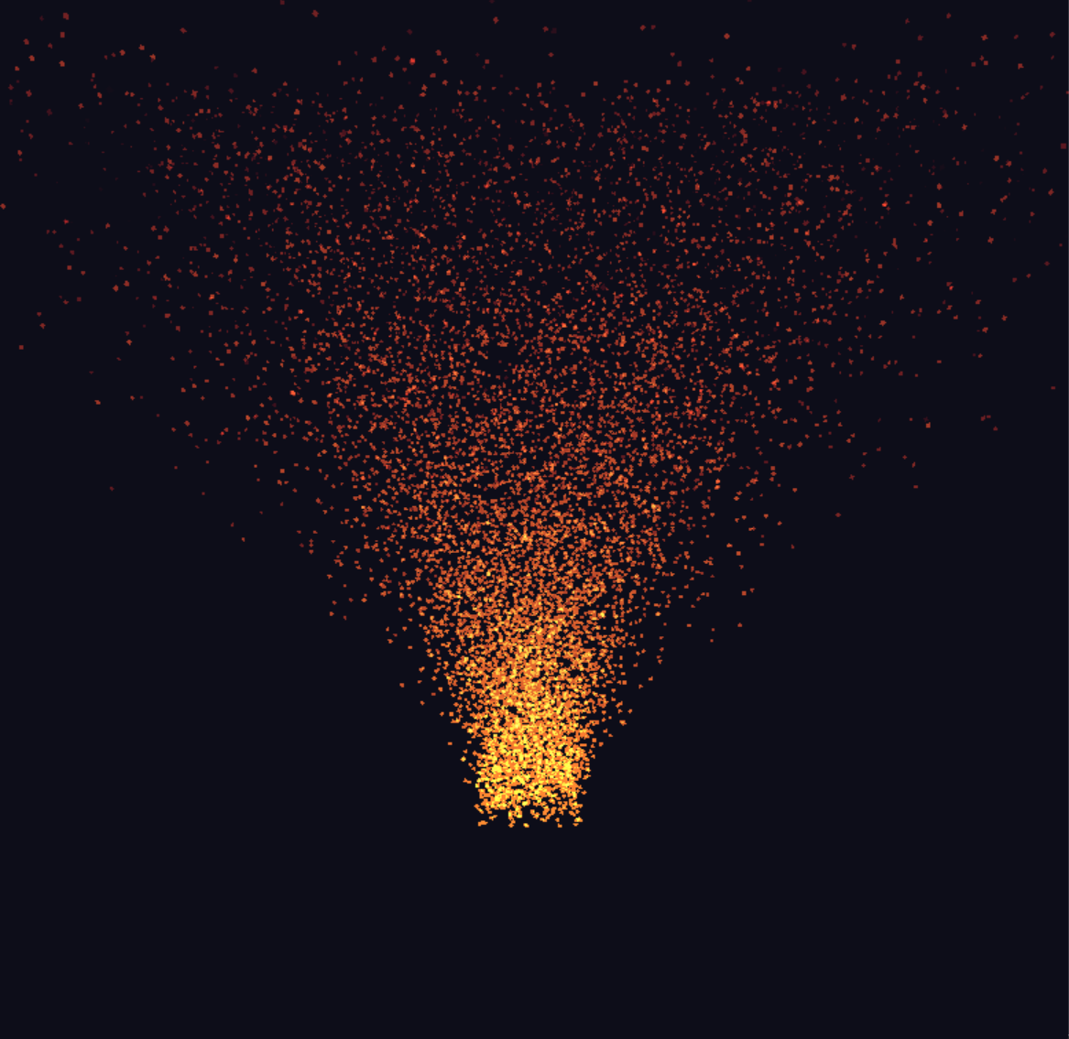

Interactive Camera System
Orbit Camera
Camera Constraints
Uses spherical coordinates for dynamic viewing, controlled by mouse drag (yaw/pitch) and mouse wheel (zoom).
Pitch: Clamped between -89° and +89° to prevent flipping.
Distance: Clamped between 0.8 and 6.0 units for optimal view.
gluLookAt(cx, cy, cz, 0, 0, 0, 0, 1, 0);

Slide 9






User Interaction: Control Your Fire
Particle Count
Particle Size
Lateral Wind
+/- keys to adjust number of particles.
Up/Down keys to change particle dimensions.
A/D keys for left/right wind force.
Vortex Motion
Camera Control
Left/Right arrow keys to activate vortex.
Mouse drag for view, wheel for zoom.

Slide 10
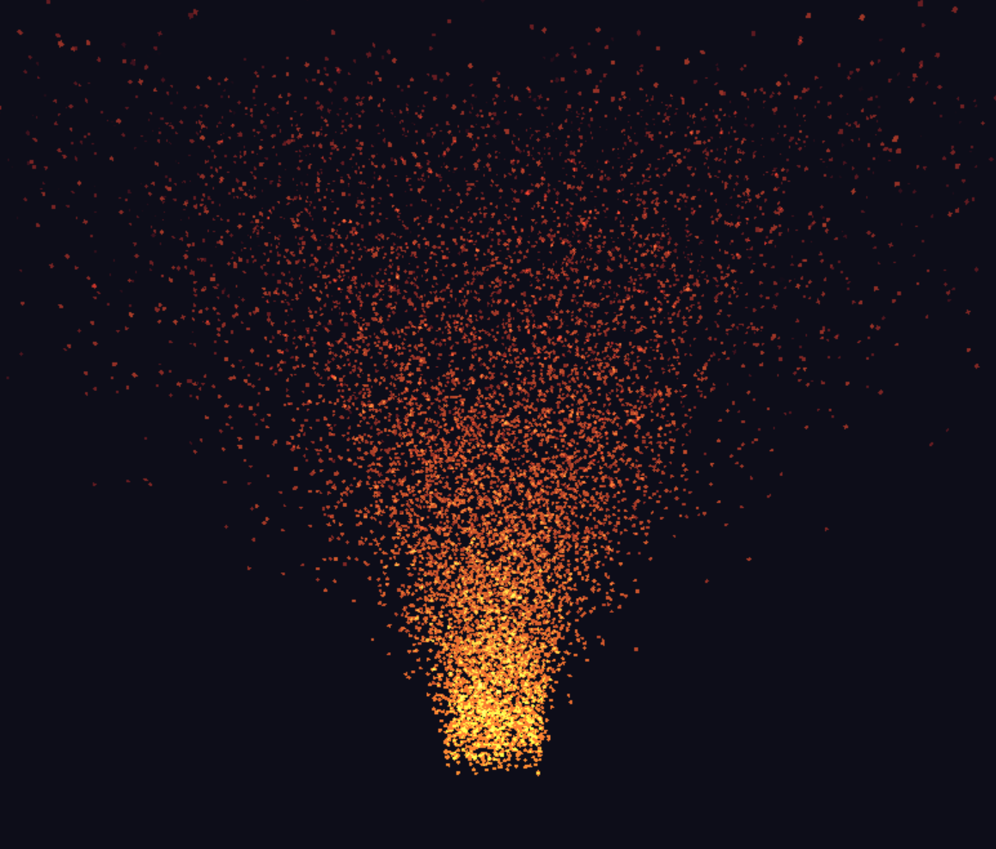
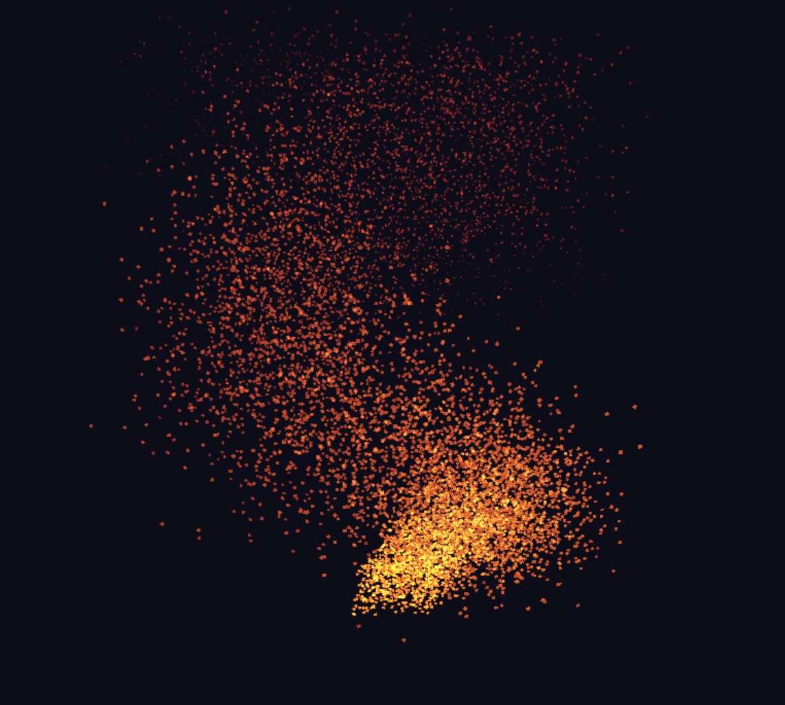



Conclusion: A Dynamic Fire Simulation
This 3D particle system delivers a realistic fire simulation in an OpenGL legacy environment.
Figure 1: Initial particle state before user interaction.
Figure 2: Particle system after user interaction.
The combination of vortex, wind, particle spin, and interactive camera provides visual appeal and interactivity for educational purposes.

