Slide 1

NOVA
AI QUEST
Turn your learning goal into a quest.
Android app prototype for
CLOCK IN: Solana Mobile Hackathon 2026
NOVA
AI QUEST
Personalized learning journeys, game-like progress, and a Seeker Daily Quest on Solana Devnet.
NOVA AI QUEST | CLOCK IN 2026
1
Notes:
Sources: project source code and resources. Hackathon naming and context: https://solanamobile.com/blog/clock-in-the-solana-mobile-hackathon

Slide 2
02
The learning-path problem
Product observations, not market statistics
A broad learning goal does not automatically become a structured plan.
Learning content can feel fragmented when progress lacks a visible path.
Motivation can fall when feedback and progression arrive too late.
NOVA frames the learning path as a sequence of quests the learner can see and complete.
NOVA AI QUEST | CLOCK IN 2026
2
Notes:
Product framing based on implemented journey, chapter, lesson, quiz and progress flows in the project source.

Slide 3
03
NOVA AI Quest
A goal becomes a structured learning journey
Goal
›
AI backend
›
Journey
›
Lessons
›
Quizzes
›
Progress
The Android client sends the goal, level, daily time, and duration to its configured backend. The returned journey contains chapters, lessons, quizzes, and challenges.
NOVA AI QUEST | CLOCK IN 2026
3
Notes:
Sources: MainActivity.kt, GeneratingActivity.kt, GenerateJourneyRequest.kt, ApiService.kt, JourneyResponse.kt, JourneyMapper.kt.

Slide 4
04
How the product works
Current user flow
Sign in
›
Set goal
›
Generate
›
Learn
›
Quiz
›
Unlock
Google sign-in creates the user session.
The learner selects level, daily time, and duration before generation.
Passing a lesson quiz marks the lesson complete and updates progress.
Chapter challenges gate chapter completion when present.
NOVA AI QUEST | CLOCK IN 2026
4
Notes:
Sources: WelcomeActivity.kt, AuthManager.kt, MainActivity.kt, GeneratingActivity.kt, LessonActivity.kt, QuizActivity.kt, ResultActivity.kt, ChallengeActivity.kt.

Slide 5
05
AI-powered personalization
The current backend generates the learning structure
INPUTS
OUTPUT
Learning goal
Journey title and description
Level
Chapters and lessons
Daily time
Quiz questions
Duration
chapter challenge
The source code identifies this component only as an AI-powered backend. It does not identify a model provider or claim autonomous tutoring.
NOVA AI QUEST | CLOCK IN 2026
5
Notes:
Sources: RetrofitInstance.kt, ApiService.kt, GenerateJourneyRequest.kt, JourneyResponse.kt. No model/provider is named in the inspected client source.

Slide 6
06
Game-like progress
Implemented systems make learning state visible
XP & levels
Coins
Achievements
Correct answers add XP. Total XP determines level, with Nova evolving visually as the learner levels up.
Passing quizzes and completing the verified daily quest can add Coins.
Completion milestones are stored in Firestore and can trigger notifications.
Journey map
Leaderboard
Cosmetics
Lessons, challenges, and chapter gates control progression.
Weekly XP powers a Firestore backed Top 100 leaderboard.
Coins unlock additional Nova themes and themed UI styling.
NOVA AI QUEST | CLOCK IN 2026
6
Notes:
Sources: ProgressManager.kt, FirebaseProgressManager.kt, AchievementsActivity.kt, LeaderboardActivity.kt, CosmeticsActivity.kt.

Slide 7
07
Solana verification
Wallet-signed proof for achievements and the Seeker Daily Quest
Achievement
›
Wallet sign
›
Devnet memo
›
Explorer proof
›
Daily quest
On-Chain Achievement Verification
An achievement can be verified on Solana Devnet through a wallet-signed transaction. The transaction includes a Memo identifying the achievement and can be opened in Solana Explorer.
For Seeker Daily Quest, a verified wallet can earn +5 in-app Coins once per day after a qualifying quiz.
No NFT or token reward is involved; SKR integration is not part of the current prototype.
NOVA AI QUEST | CLOCK IN 2026
7
Notes:
Sources: AchievementsActivity.kt, SolanaAchievementManager.kt, FirebaseProgressManager.kt, SeekerQuestActivity.kt. The achievement flow creates a Devnet memo transaction and exposes the Explorer link.

Slide 8
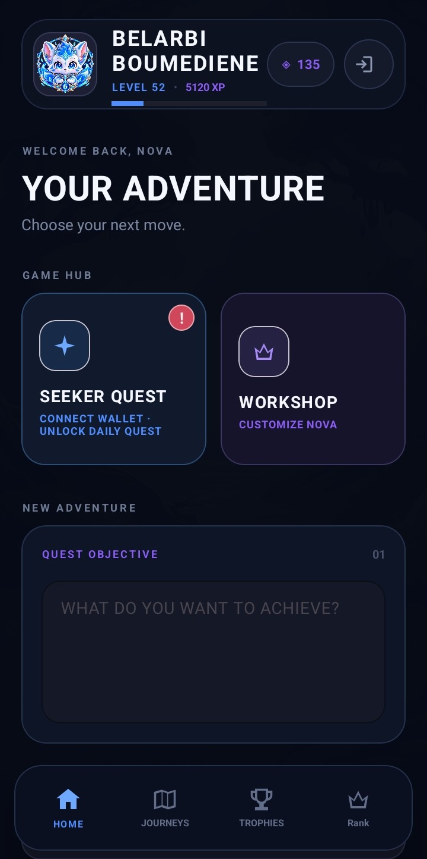
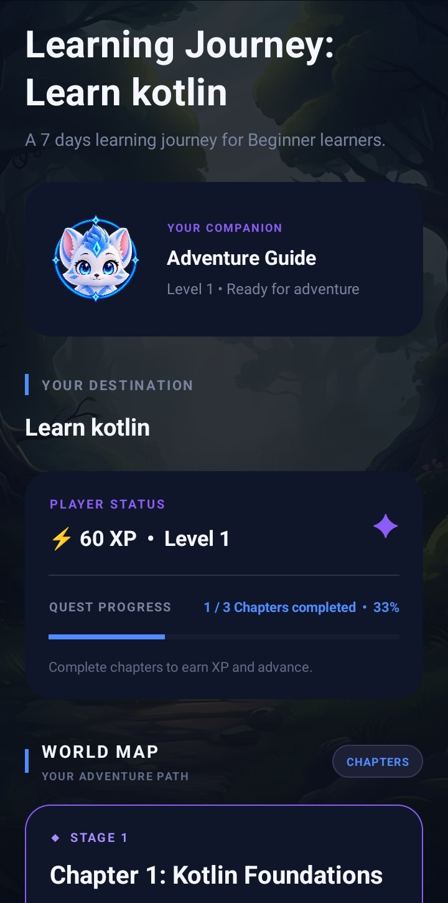
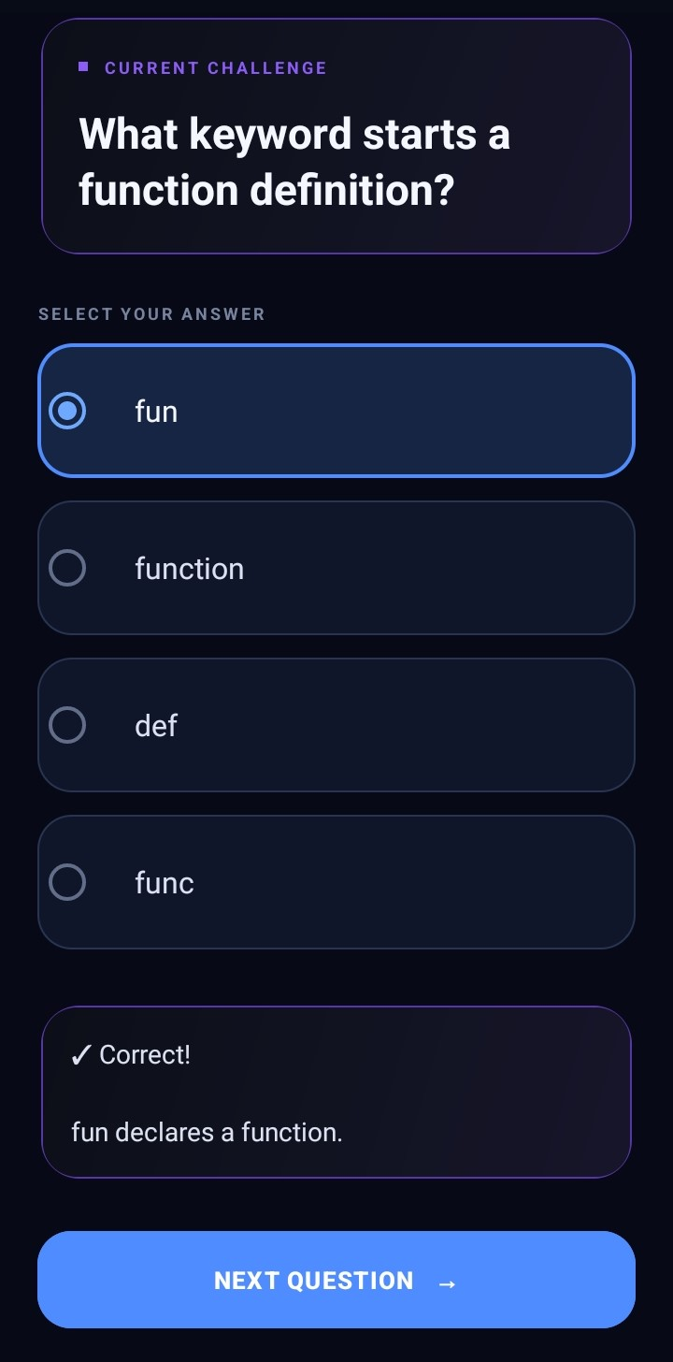
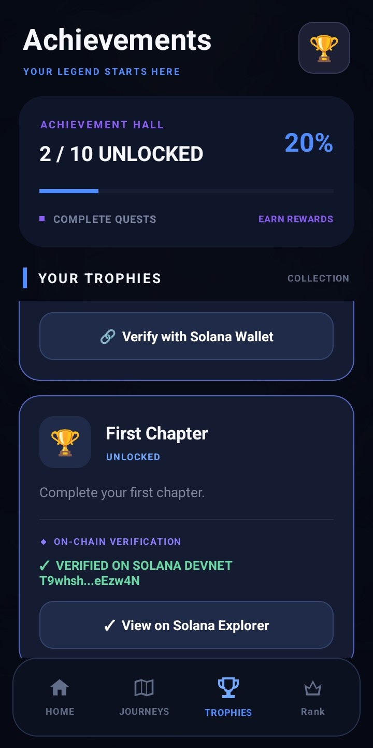
08
Product experience
The prototype uses a cohesive dark, game-inspired interface
Home
Journey
Quiz
Achievements
Goal input, player stats, Seeker Quest, cosmetics
Chapter map and progress
Question feedback and explanation
Milestones and wallet verification action
NOVA AI QUEST | CLOCK IN 2026
8
Notes:
Sources: activity_main.xml, activity_journey.xml, activity_quiz.xml, activity_achievements.xml and drawable resources. This slide intentionally does not represent the mockups as screenshots.

Slide 9
09
Technology
Verified client-side stack
Android client
Data and network
Media and Solana
Kotlin
Android SDK
Material Components
Coroutines
Firebase Authentication
Cloud Firestore
Credential Manager
Retrofit and Gson
Glide
Solana Mobile Wallet Adapter
Solana RPC on Devnet
NOVA AI QUEST | CLOCK IN 2026
9
Notes:
Sources: app/build.gradle.kts, AuthManager.kt, RetrofitInstance.kt, SolanaAchievementManager.kt.

Slide 10
010
What we built
Verified in the current Android prototype
IMPLEMENTED
Google authentication and Firestore-backed user data
Generated journeys with lessons, quizzes, and challenges
XP, Coins, levels, achievements, cosmetics, and leaderboard
Wallet-signed Solana Devnet verification for achievements, with Explorer links
Seeker Daily Quest with a once-per-day +5 in-app Coin reward after a qualifying quiz
Current prototype, verified against the project source.
NOVA AI QUEST | CLOCK IN 2026
10
Notes:
Sources: project source, including AchievementsActivity.kt, SolanaAchievementManager.kt, FirebaseProgressManager.kt and SeekerQuestActivity.kt.

Slide 11
011
Future work
Possible directions, not current product claims
Richer adaptive learning that responds to learner performance.
Deeper Seeker-native experiences beyond the current verification and daily quest flow.
Broader learning content and additional social or community features.
Additional on-chain utility, subject to product and technical validation.
NOVA AI QUEST | CLOCK IN 2026
11
Notes:
Future work proposed in the supplied brief; not represented as present functionality.

Slide 12
NOVA AI QUEST
From a learning goal to a playable journey.
A functional Android learning prototype that combines AI-generated learning journeys, game-like progression, on-chain achievement verification, and a Solana Devnet Seeker Daily Quest.
CLOCK IN: Solana Mobile Hackathon 2026
Functional APK • GitHub source • Demo video • Pitch deck
NOVA AI QUEST | CLOCK IN 2026
12
Notes:
Product claims: project source. Hackathon submission materials and event facts: https://solanamobile.com/blog/clock-in-the-solana-mobile-hackathon

