Slide 1
Review: Exceptions
Unscheduled function call to exception handler
Caused by:
Hardware, also called an interrupt, e.g. keyboard
Software, also called traps, e.g. undefined instruction
When exception occurs, the processor:
Records cause of exception (Cause register)
Jumps to exception handler (0x80000180)
Returns to program (EPC register)

Slide 2
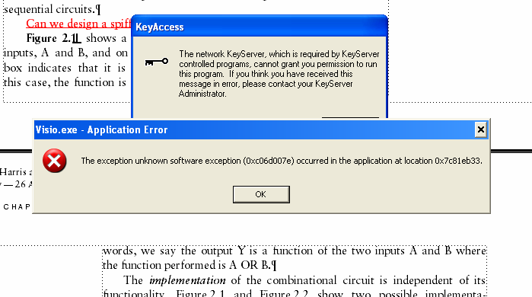
Example Exception

Slide 3
Exception Registers
Not part of register file
Cause
Records cause of exception
Coprocessor 0 register 13
EPC (Exception PC)
Records PC where exception occurred
Coprocessor 0 register 14
Move from Coprocessor 0
mfc0 $t0, Cause
Moves contents of Cause into $t0

Slide 4
Exception Causes
Exception | Cause
Hardware Interrupt | 0x00000000
System Call | 0x00000020
Breakpoint / Divide by 0 | 0x00000024
Undefined Instruction | 0x00000028
Arithmetic Overflow | 0x00000030
Extend multicycle MIPS processor to handle last two types of exceptions

Slide 5
Exception Hardware: EPC & Cause

Slide 6
Control FSM with Exceptions

Slide 7
Exception Hardware: mfc0

Slide 8
Advanced Microarchitecture
Deep Pipelining
Branch Prediction
Superscalar Processors
Out of Order Processors
Register Renaming
SIMD
Multithreading
Multiprocessors

Slide 9
Deep Pipelining
10-20 stages typical
Number of stages limited by:
Pipeline hazards
Sequencing overhead
Power
Cost

Slide 10
Branch Prediction
Ideal pipelined processor: CPI = 1
Branch misprediction increases CPI
Static branch prediction:
Check direction of branch (forward or backward)
If backward, predict taken
Else, predict not taken
Dynamic branch prediction:
Keep history of last (several hundred) branches in branch target buffer, record:
Branch destination
Whether branch was taken

Slide 11
Branch Prediction Example
add $s1, $0, $0 # sum = 0
add $s0, $0, $0 # i = 0
addi $t0, $0, 10 # $t0 = 10
for:
beq $s0, $t0, done # if i == 10, branch
add $s1, $s1, $s0 # sum = sum + i
addi $s0, $s0, 1 # increment i
j for
done:

Slide 12
1-Bit Branch Predictor
Remembers whether branch was taken the last time and does the same thing
Mispredicts first and last branch of loop

Slide 13
2-Bit Branch Predictor
Only mispredicts last branch of loop

Slide 14
Superscalar
Multiple copies of datapath execute multiple instructions at once
Dependencies make it tricky to issue multiple instructions at once

Slide 15
Superscalar Example
lw $t0, 40($s0)
add $t1, $t0, $s1
sub $t0, $s2, $s3 Ideal IPC: 2
and $t2, $s4, $t0 Actual IPC: 2
or $t3, $s5, $s6
sw $s7, 80($t3)

Slide 16
Superscalar with Dependencies
lw $t0, 40($s0)
add $t1, $t0, $s1
sub $t0, $s2, $s3 Ideal IPC: 2
and $t2, $s4, $t0 Actual IPC: 6/5 = 1.17
or $t3, $s5, $s6
sw $s7, 80($t3)

Slide 17
Out of Order Processor
Looks ahead across multiple instructions
Issues as many instructions as possible at once
Issues instructions out of order (as long as no dependencies)
Dependencies:
RAW (read after write): one instruction writes, later instruction reads a register
WAR (write after read): one instruction reads, later instruction writes a register
WAW (write after write): one instruction writes, later instruction writes a register

Slide 18
Out of Order Processor
Instruction level parallelism (ILP): number of instruction that can be issued simultaneously (average < 3)
Scoreboard: table that keeps track of:
Instructions waiting to issue
Available functional units
Dependencies

Slide 19
Out of Order Processor Example
lw $t0, 40($s0)
add $t1, $t0, $s1
sub $t0, $s2, $s3 Ideal IPC: 2
and $t2, $s4, $t0 Actual IPC: 6/4 = 1.5
or $t3, $s5, $s6
sw $s7, 80($t3)

Slide 20
Register Renaming
lw $t0, 40($s0)
add $t1, $t0, $s1
sub $t0, $s2, $s3 Ideal IPC: 2
and $t2, $s4, $t0 Actual IPC: 6/3 = 2
or $t3, $s5, $s6
sw $s7, 80($t3)

Slide 21
SIMD
Single Instruction Multiple Data (SIMD)
Single instruction acts on multiple pieces of data at once
Common application: graphics
Perform short arithmetic operations (also called packed arithmetic)
For example, add four 8-bit elements

Slide 22
Advanced Architecture Techniques
Multithreading
Wordprocessor: thread for typing, spell checking, printing
Multiprocessors
Multiple processors (cores) on a single chip

Slide 23
Threading: Definitions
Process: program running on a computer
Multiple processes can run at once: e.g., surfing Web, playing music, writing a paper
Thread: part of a program
Each process has multiple threads: e.g., a word processor may have threads for typing, spell checking, printing

Slide 24
Threads in Conventional Processor
One thread runs at once
When one thread stalls (for example, waiting for memory):
Architectural state of that thread stored
Architectural state of waiting thread loaded into processor and it runs
Called context switching
Appears to user like all threads running simultaneously

Slide 25
Multithreading
Multiple copies of architectural state
Multiple threads active at once:
When one thread stalls, another runs immediately
If one thread can’t keep all execution units busy, another thread can use them
Does not increase instruction-level parallelism (ILP) of single thread, but increases throughput
Intel calls this “hyperthreading”

Slide 26
Multiprocessors
Multiple processors (cores) with a method of communication between them
Types:
Homogeneous: multiple cores with shared memory
Heterogeneous: separate cores for different tasks (for example, DSP and CPU in cell phone)
Clusters: each core has own memory system

Slide 27
Other Resources
Patterson & Hennessy’s: Computer Architecture: A Quantitative Approach
Conferences:
www.cs.wisc.edu/~arch/www/
ISCA (International Symposium on Computer Architecture)
HPCA (International Symposium on High Performance Computer Architecture)

