Slide 1
Russia-Ukraine war Russian combat losses data analysis

Slide 2
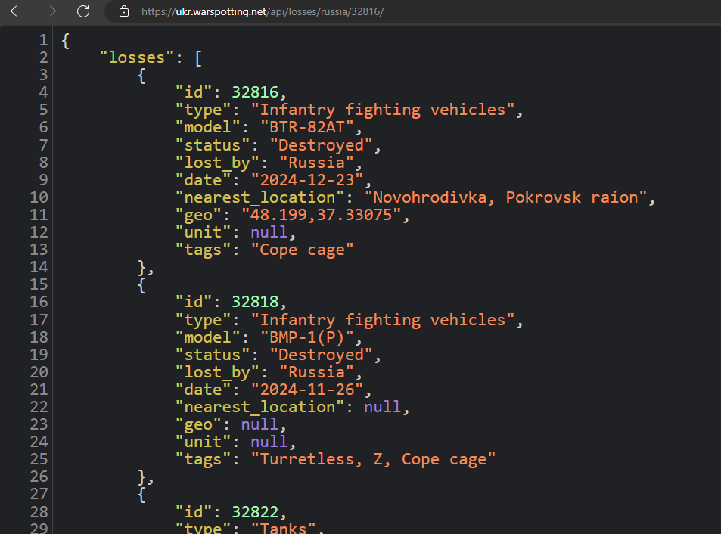
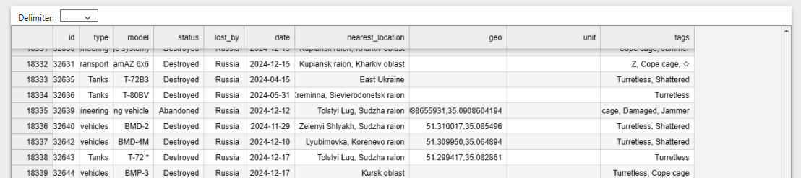
Database Design
Raw data about Russian losses is pulled from https://ukr.warspotting.net/api/losses/russia using API call, and Jason requests with jupyter_notebook.
Data is then converted into panda_df and saved as a csv file “russia_losses.csv” for future use.

Slide 3
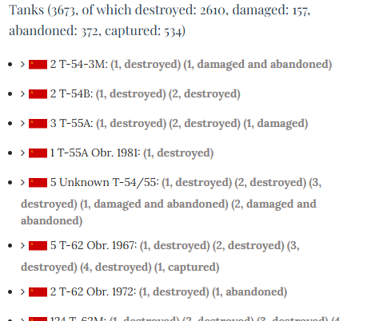
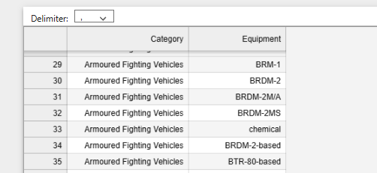
Database Design
Additional data about Russian equipment is pulled from https://www.oryxspioenkop.com, parsed using BeautifulSoup, and cleaned with python in jupyter_notebook,
Data is then converted into panda_df and saved as a csv file “equipment_by_category.csv” for future use.

Slide 4
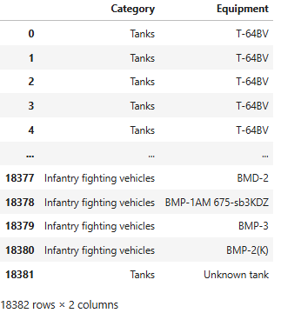
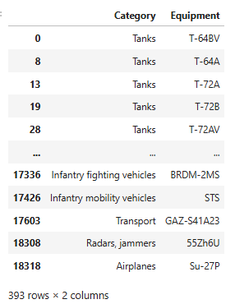
Data transformation – update Equipment database
Data from russia_losses.csv was imported into jupyter_notebook
Columns “type” and “model” were saved as separate dataFrame “equipment_df”. Data was cleaned by removing duplicates and unwanted text in “Equipment column”. Data was saved as “clean_equipment_df” and then merged with “old_equipment_df” and new csv was created "new_equipment_by_category.csv"
new_equipment_by_category.csv was update with 250 new rows of data

Slide 5
Data transformation – transform Location data
Data from russia_losses.csv was imported into jupyter_notebook and converted into Pandas dataFrame “losses_df”. Unwanted columns “lost_by” and “unit” were dropped.
Column “geo” was split into “lat” and “lon” and rounded to 6 decimals for uniformity.
New columns “front”, “oblast”, “raion”, “town” were created.
Column “nearest_location” was split by comma, and with a special function used to populate corresponding cells in columns “front”, “oblast”, “raion”, “town”.
Data from specially created files “regions.csv” and “unique_locations.csv” was used to populated missing data “front”, “oblast”, “raion”, “town” columns.
Data was then saved as csv file “russia_losses_cleaned.csv”.

Slide 6
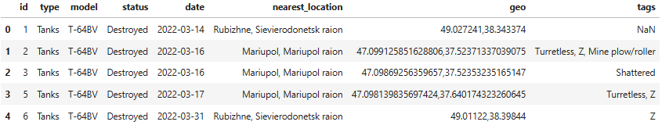
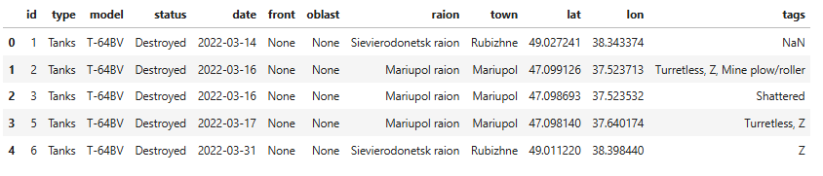
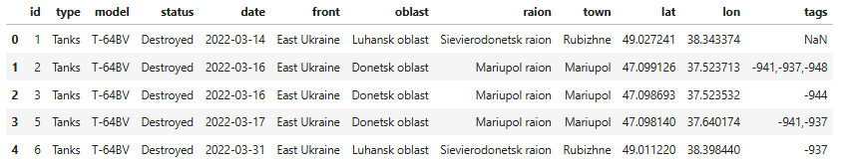
Data transformation – transform Location data

Slide 7
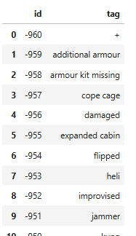
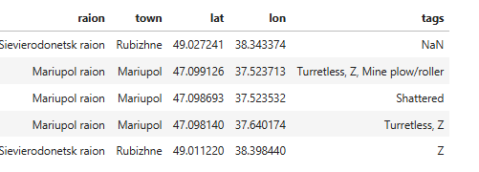
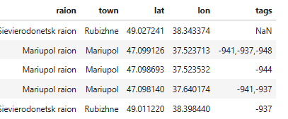
Data transformation – transform “tags” column
Column “tags” was split by comma then flattened with duplicate values dropped and stored as a list “tags_unique_list”.
From the “tags_unique_list” a dataFrame “tags_df” was created with columns “id” and “tag”.
Value in column “id” was modified from single- or double-digit value to a three-digit value with a leading “-” such as “-958” to prevent any future false positive matches. “tags_df” was then saved as csv file “tags_index.csv”
Data in “tags_df” was converted into “tag_to_index” dictionary and text in “losses_df.tags” was replaced with corresponding “ids”
Data was then saved as csv file “russia_losses_cleaned.csv”.

Slide 8
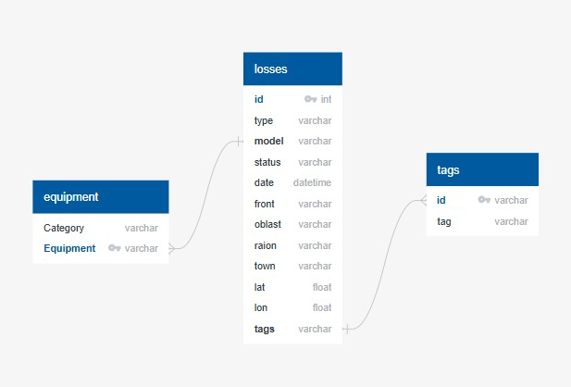
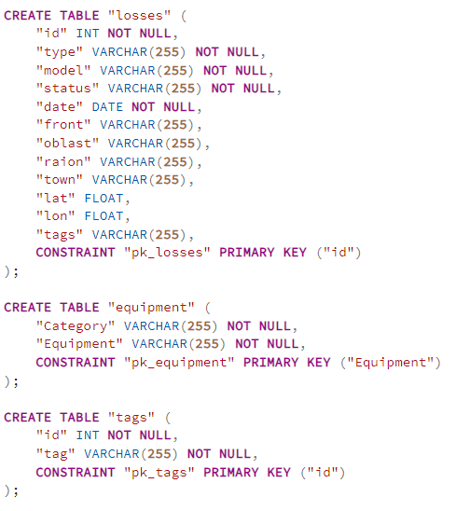
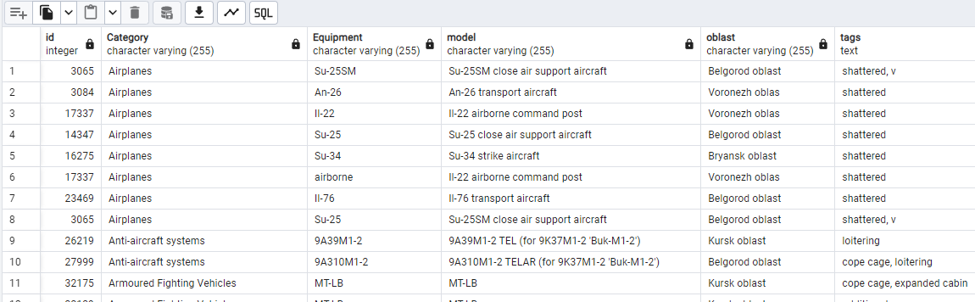
Data storage
Data is stored using pgAdmin as PostgressSQL database.
PostgressSQL allows to do following quarries:
Find all Equipment that was destroyed in Central Russia, and has tag assigned to it. Sort it by id, Category, Equipment, and Oblast.

Slide 9
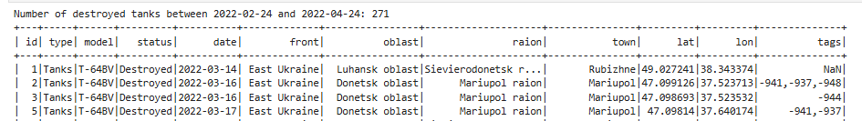
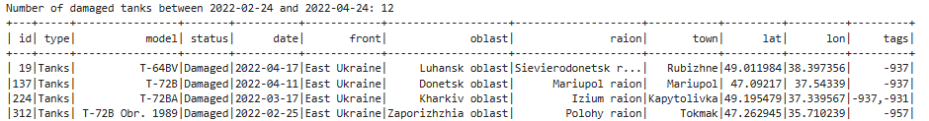
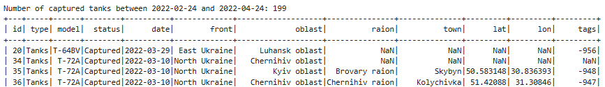
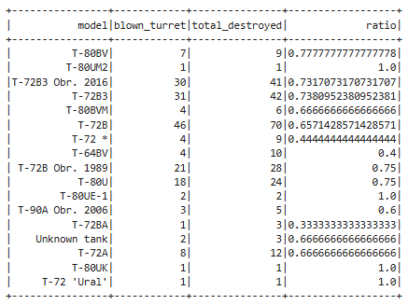
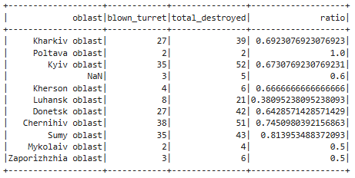

Data Analysis - Pyspark
russia_losses_cleaned.csv was imported into Jupyter_notebook
pySpark library was used to convert csv files into spark DataFrames and calculate following statistics.

Slide 10

Thank you

