Slide 1
YOLOv4: Optimal Speed and Accuracy of Object Detection
YOLOv3 but fast

Slide 2
Detection vs Classification
Classification = predicting the class of one object in an image
Localisation = identifying the location of one or more objects
Detection = Localisation + Classification

Slide 3
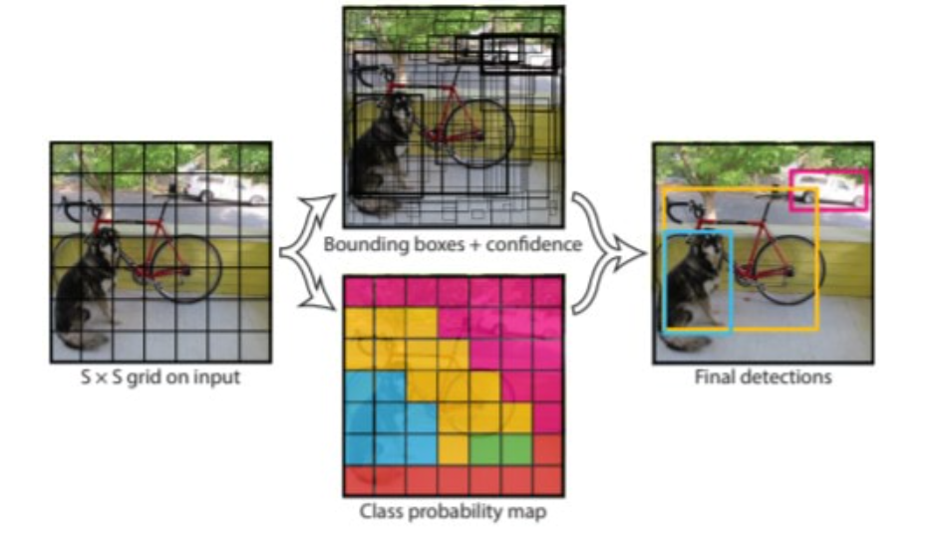
You Only Look Once (YOLO)
Split image into s x s grid
Predict object class per grid cell
Predict B bounding boxes
Combine bounding boxes + class label to achieve final result
Notes:
YOLOv3 uses a grid size of 16, 32 and 64 and a B value of 3

Slide 4
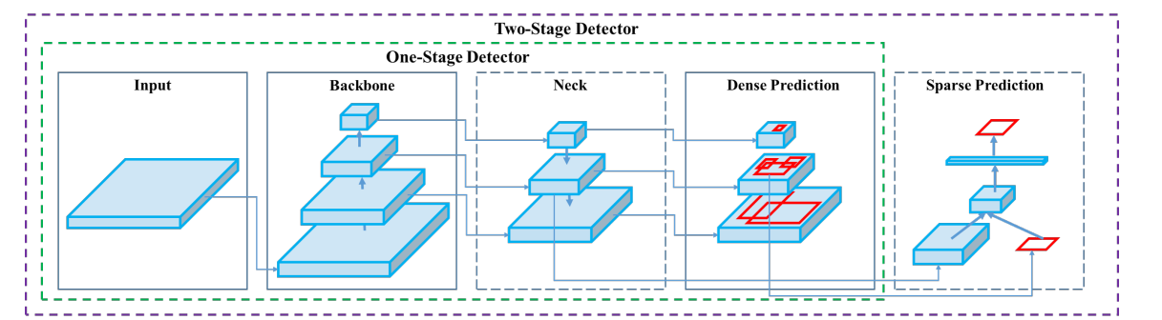
Architectural Components
Input => Input Image
Backbone => Feature extraction
Neck => Feature aggregation
Head => Detector
One stage (Predict a label for every pixel)
Two stage (Feature map from neck + proposed region from dense prediction)

Slide 5
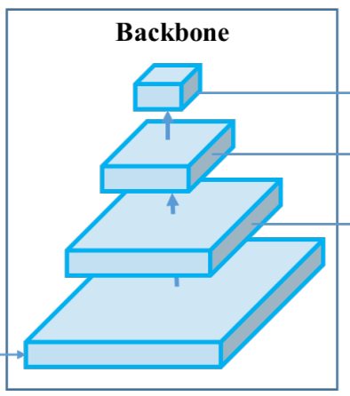
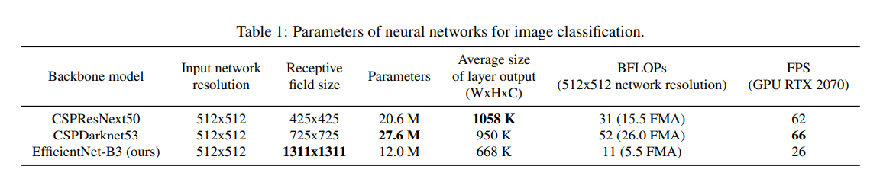
Backbone
A pre-trained object classifier
Good object classifier =/= good object detector
Detection requires:
higher input image resolution
more layers to cover increased input size
more parameters

Slide 6
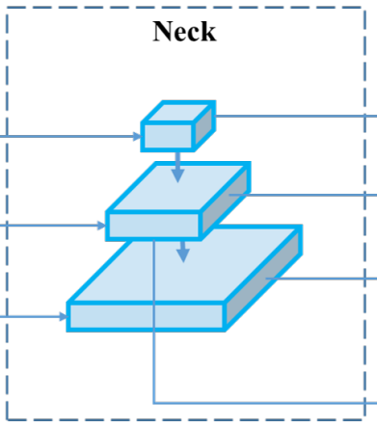
Neck
Spatial Pyramid Pooling (SPP)
Perform max pooling on several d x d blocks
Increases receptive field, separates the most significant features, no reduction in speed
Path Aggregation Network (PANet)
Parameter aggregation

Slide 7
YOLOv4 Architecture
Backbone: CSPDarknet53
Neck: SPP, PANet
Head: YOLOv3

Slide 8
Bag of Freebies (BoF)
Modify the training strategy or cost without modifying inference
Key techniques:
CutMix
Mosaic
DropBlock regularization
Class Label Smoothing
CIoU Loss (IoU + centre point Δ + aspect ratio)
Self Adversarial Training
Cross mini-Batch Normalization

Slide 9
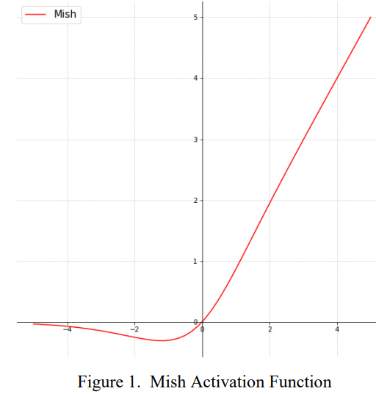
Bag of Specials (BoS)
Slightly increase the inference but significantly improve the object detection accuracy
Key techniques:
Mish activation function
Cross-Stage Partial connection (CSP)
Multi-input Weighted Residual Connections (MiWRC)
Spatial Pyramid Pooling (SPP)
Spatial Attention Module (SAM)
Path Aggregation Network (PANet)
DIoU (IoU + centre point Δ)

Slide 10
YOLOv4 Innovations and Modifications
Numerous modifications to allow for the operation of YOLO on a single GPU. These include:
Modified Spatial Attention Module (SAM)
Modified Path Aggregation Network (PANet)
Modified Cross iteration Batch Normalization (CBN)
Several new techniques were also developed:
Self Adversarial Training (SAT)
Mosaic Augmentation

Slide 11
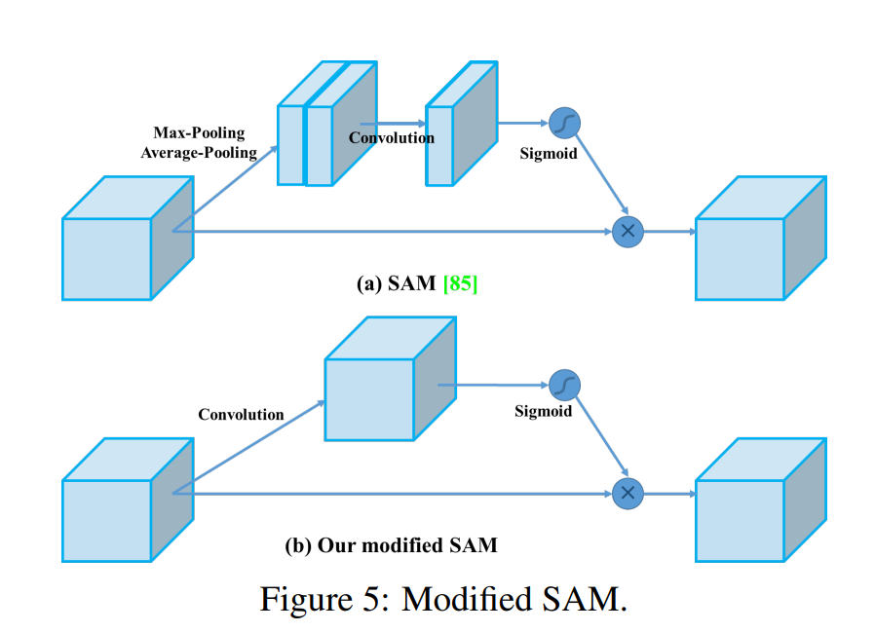
Modified SAM
Modified from feature-wise spatial attention to point-wise attention
Notes:
SAM generates a spatial attention map by utilizing the inter-spatial relationship of features. EG This feature is this far from this feature. This modification enables SAM to go this point is this far from this point

Slide 12
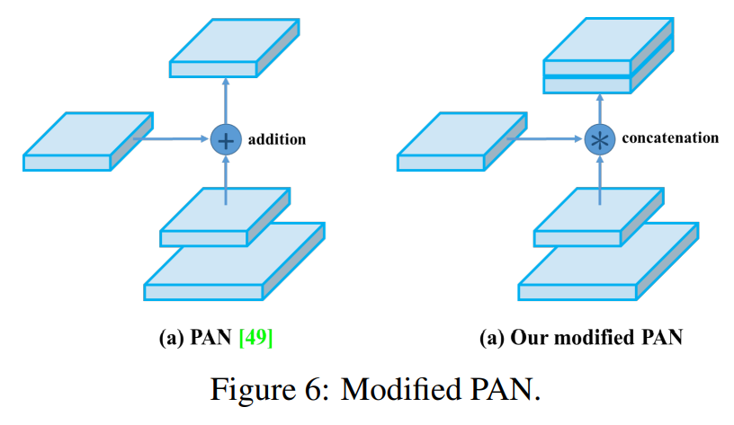
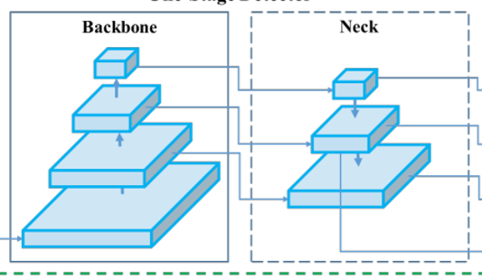
Modified PAN
Modified the addition short cut connection to instead be concatenation
Notes:
Helps to preserve the information from low-level features which tends to be related to localization information

Slide 13
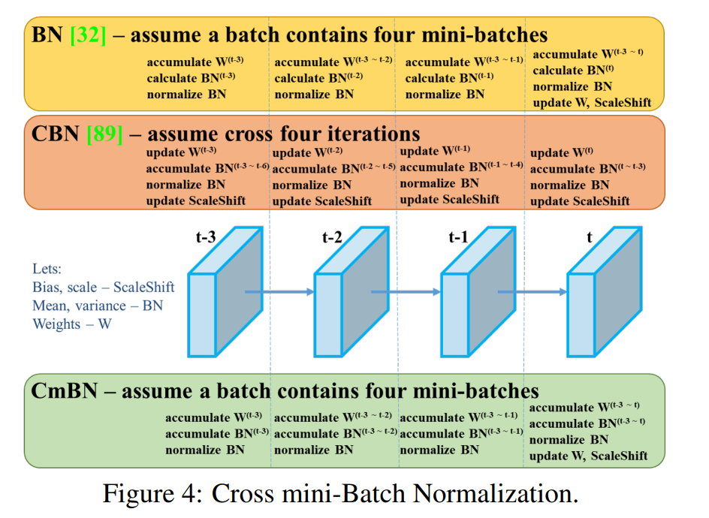
Modified CBN
A modified version of Cross iteration Batch Normalization
Notes:
Batch normalization, taking into account the previous iterations for when a batch size is small. But this modification only Mini-batch size is usually 32 or 64 but as the models got more complex, GPUs ran out of memory with mini-batch sizes dropping to around four mini batches. CBN would consider statistics across iterations, but CmBN allows us to consider stats between mini-batches and iterations

Slide 14
Self Adversarial Training
Operates in two stages
Backward pass which modifies the input image
Forward pass which trains the network on this modified image

Slide 15
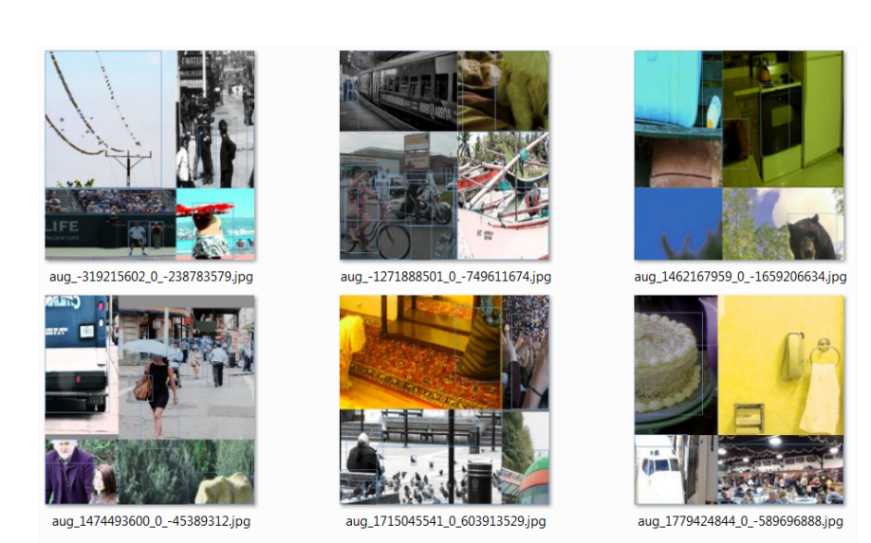
Mosaic
Input image contains 2x2 images
Reduced mini-batch size as each mini-batch can collect statistics from four images at a time

Slide 16
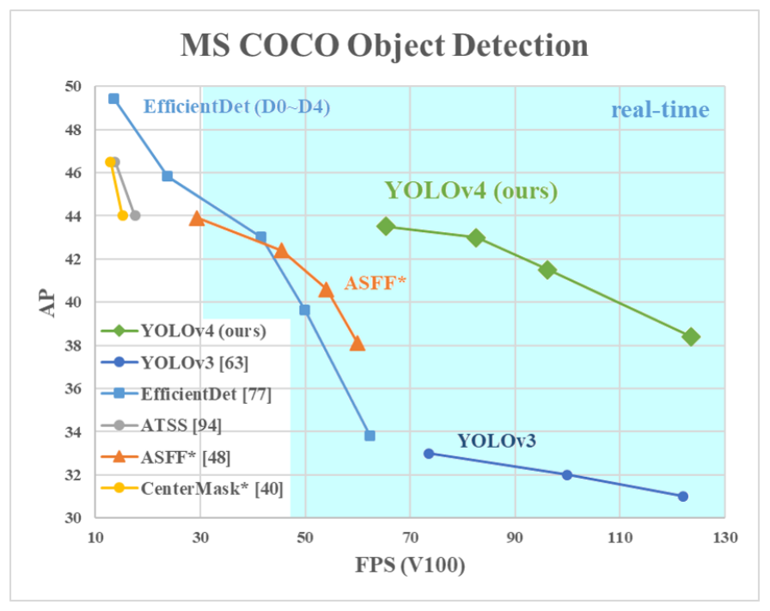
Results
Better average precision at the same FPS when compared to YOLOv3
Great success!
Notes:
10% AP and 12% fps on v3

Slide 17
Limitations
Average precision still has room for improvement
Still a relatively heavy model

