Slide 1

BIOINFORMATIKA - projekt
Izgradnja binarnog stabla valića kao RRR strukture
Matej Peroš, Nina Duhović
2018.

Slide 2
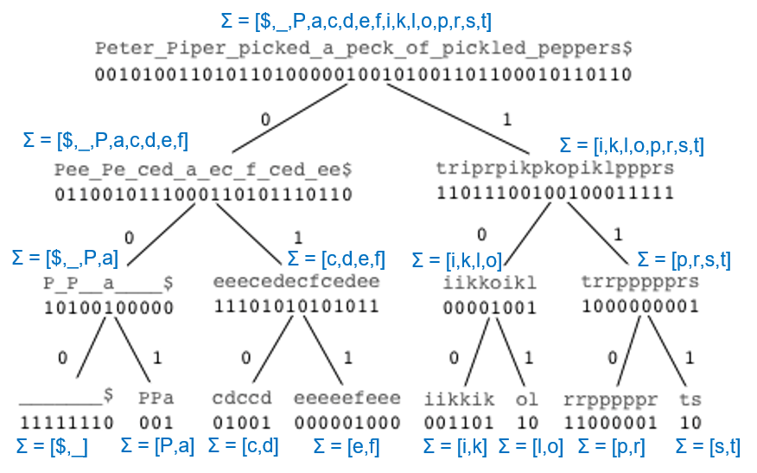
Stablo valića

Slide 3
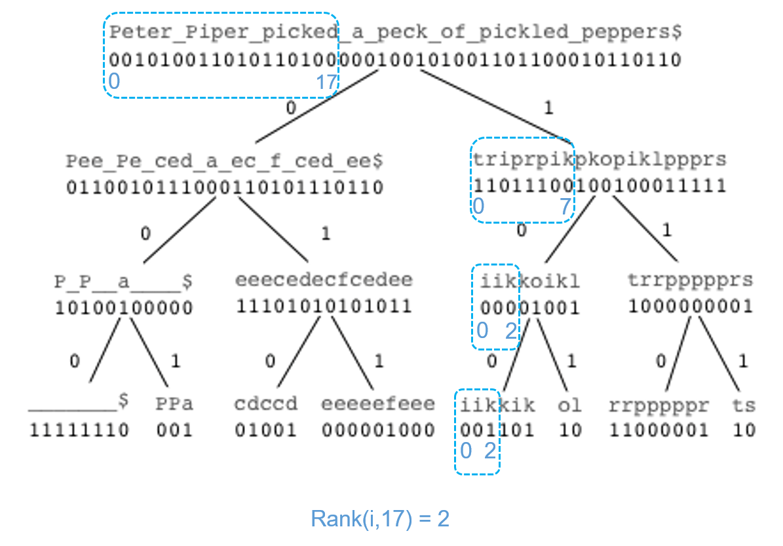

Slide 4
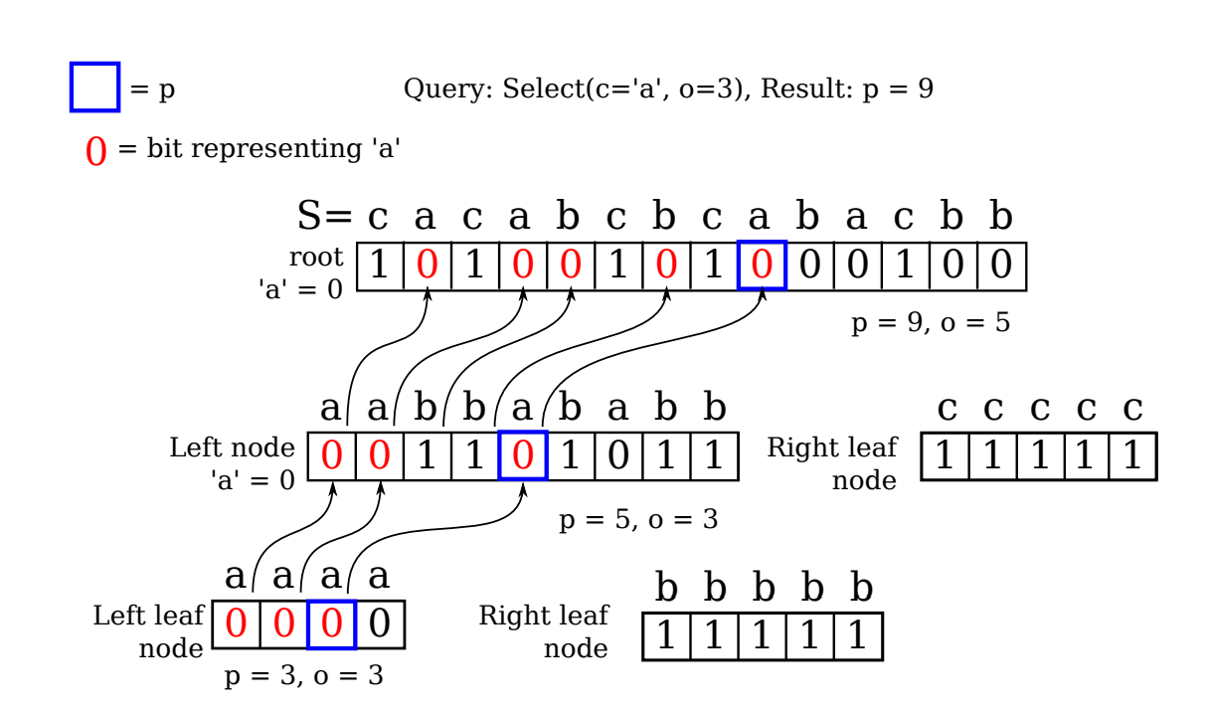

Slide 5
Select(6)
6
5
2
1

Slide 6
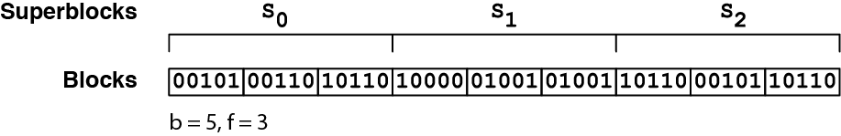
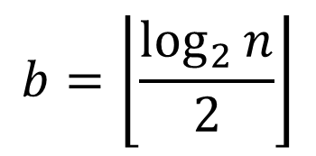

RRR
$$s={\left\lfloor \log_{2}{n}\right\rfloor }^{2}$$
$$b=\left\lfloor \frac{\log_{2}{n}}{2}\right\rfloor$$

Slide 7
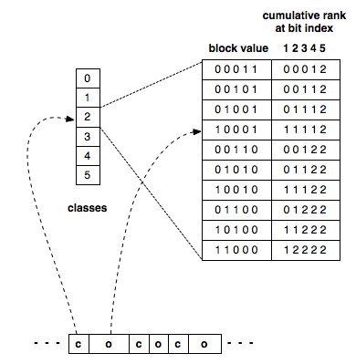
RRR
1
0
0
1
1
razred
pomak

Slide 8
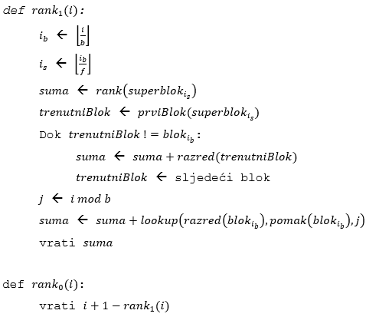

Slide 9
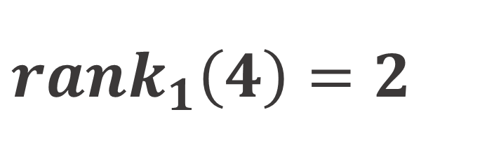
RRR
0
0
0
0
$$rank_{1}\left(4\right)=2$$
0
1
0
1
1
0
1
1
1
1
1
2
0, 0
1, 6
0
1
0
0
0
0
0
1
1
0
1
1

Slide 10
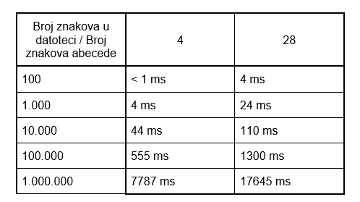

Slide 11
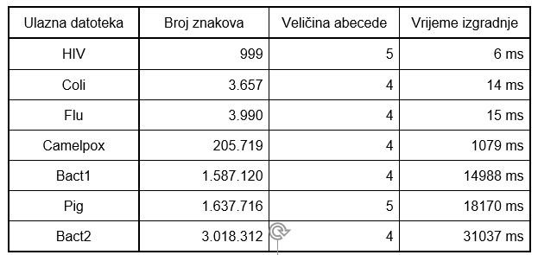

Slide 12
