Slide 1
.NET Data Access

Slide 2
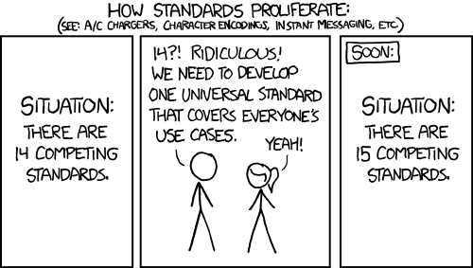

Slide 3

Hannes Lowette
.NET Consultant & Competence Coach @ Axxes
Lives in Mol – For you city folk: this is not Limburg
Born in Hasselt – This is Limburg
0x24 years old – Or 0b100100
Father of 3 kids
Likes: backend development, ORM’s, services, databases (SQL and other), actor frameworks, bus architectures, Azure, sarcasm
Dislikes: frontend development, javascript, people who are easily offended
Hobbies: woodworking, guitars, Lego, poker, absinthe & whisky (amongst other things)

Slide 4
Overview
Introductie
Linq
Entity Framework - Overzicht
Coding: Entity Framework – Database first
Coding: Entity Framework – Model first
Coding: Entity Framework – Code first
Database migrations
Dapper?

Slide 5
Introductie
Data Access

Slide 6
De belangrijkste .Net data componenten
ADO.NET → Database connectiviteit
LINQ: Language Integrated Query → Query (bijna) alles
System.Data → DataSets, DataTables, etc.
Serialization → Conversie tussen objecten & tekst (XML)

Slide 7
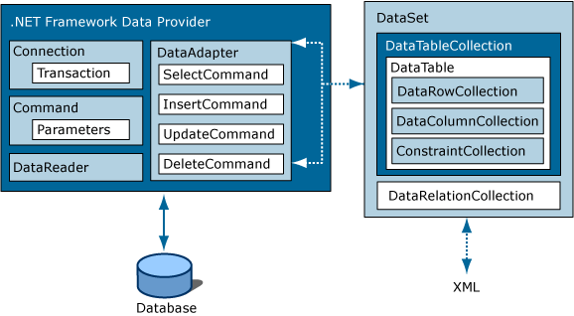
De klassieke manier van werken

Slide 8
Object relational mappers (ORM)
Link tussen data source en code objecten
Encapsulatie van de DB access
Transparant voor de code (bv. Wanneer de DB API verandert)
Queries → objecten
Objecten → data store
Linq to SQL is geen volwaardige ORM, hoewel:
Caching
Object materialisatie
Tracking van wijzigingen

Slide 9
Beschikbare ORM tools
Entity Framework (Microsoft)
Nhibernate (community)
LLBLGen Pro (Solutions Design)
DataObjects.Net (X-Tensive)
BLtoolkit (bltoolkit.net)
OpenAccess (Telerik)
XPO (DevExpress)
...
Vergelijking:
www.ormeter.net
www.c2.com/cgi/wiki?ObjectRelationalToolComparisonDotNet

Slide 10
LINQ
Language Integrated Query

Slide 11
LINQ
Language Integrated Query
Queries uitvoerenop ongeveer alles in .Net:
Lijsten en arrays van objecten (IEnumerable<T>)
DataSets (LINQ to DataSets)
XML documents (LINQ to XML)
SQL Server (LINQ to SQL)
Entity Framework (LINQ to Entities)
OData Services
...
... En zelfs “buiten” .Net:
Google, Twitter, Wikipedia, NHibernate, ...

Slide 12
LINQ
SQL-achtige syntax:
var results =
from c in SomeCollection
where c.SomeProperty < someValue
select new {c.SomeProperty, c.OtherProperty};
OF Lambda expressions:
var results =
SomeCollection
.Where(c => c.SomeProperty < someValue)
.Select(c => new {c.SomeProperty, c.OtherProperty});

Slide 13
Waarop is LINQ gebaseerd?
New features in .Net 3.0:
Lamba expressions
Extension methods
Het yield keyword
Het var keyword
Object & Collection initializers
In .Net 3.5 → LINQ is introduced

Slide 14
LINQ query – Deferred execution
using (AdventureWorksEntities context = new AdventureWorksEntities())
{
IQueryable<Product> productsQuery = from p in context.Products select p;
IQueryable<Product> largeProducts = productsQuery.Where(p => p.Size == "L");
Console.WriteLine("Products of size 'L':");
foreach (var product in largeProducts)
{
Console.WriteLine(product.Name);
}
}

Slide 15
LINQ query – Deferred execution
using (AdventureWorksEntities context = new AdventureWorksEntities())
{
IQueryable<Product> productsQuery = from p in context.Products select p;
(hier wordt nog niets uitgevoerd)
IQueryable<Product> largeProducts = productsQuery.Where(p => p.Size == "L");
(hier ook nog niet)
Console.WriteLine("Products of size 'L':");
foreach (var product in largeProducts) ← De query begint hier uit te voeren
{
Console.WriteLine(product.Name);
}
}

Slide 16
LINQ query – Immediate execution
using (AdventureWorksEntities context = new AdventureWorksEntities())
{
ObjectSet<Product> products = context.Products;
Product[] prodArray = (
from product in products
orderby product.ListPrice descending
select product).ToArray();
Console.WriteLine("Every price from highest to lowest:");
foreach (Product product in prodArray)
{
Console.WriteLine(product.ListPrice);
}
}

Slide 17
LINQ query – Immediate execution
using (AdventureWorksEntities context = new AdventureWorksEntities())
{
ObjectSet<Product> products = context.Products;
Product[] prodArray = (
from product in products
orderby product.ListPrice descending
select product).ToArray(); ← ToArray zorgt ervoor dat de query uitvoert
Console.WriteLine("Every price from highest to lowest:");
foreach (Product product in prodArray)
{
Console.WriteLine(product.ListPrice);
}
}

Slide 18
LINQ query – Store execution
using (AdventureWorksEntities context = new AdventureWorksEntities())
{
IQueryable<SalesOrderHeader> salesInfo =
from s in context.SalesOrderHeaders
where s.SalesOrderID == orderID
select s;
foreach (SalesOrderHeader sale in salesInfo)
{
Console.WriteLine("OrderID: {0}, Total due: {1}", sale.SalesOrderID, sale.TotalDue);
}
}

Slide 19
LINQ query – Store execution
using (AdventureWorksEntities context = new AdventureWorksEntities())
{
IQueryable<SalesOrderHeader> salesInfo =
from s in context.SalesOrderHeaders
where s.SalesOrderID == orderID ← Wordt vertaald naar een SQL where-clause
select s;
foreach (SalesOrderHeader sale in salesInfo) ← Hier wordt de query uitgevoerd
{
Console.WriteLine("OrderID: {0}, Total due: {1}", sale.SalesOrderID, sale.TotalDue);
}
}

Slide 20
IEnumerable<T> vs. IQueryable<T>
IEnumerable<T>
Een lijst waarover je kunt itereren
LINQ queries:
In memory uitgevoerd
foreach met ‘yield return’
IQueryable<T>
LINQ queries:
Vertaald naar data store (SQL query)
Uitgevoerd op de store

Slide 21
Entity Framework - Overzicht
Een zeer complete ORM tool

Slide 22
Basics
Support voor:
SQL Server, Oracle, MySQL, DB2, PostgreSQL, Firebird, SQLite, ...
3 delen:
Code (Entities / POCO objects)
Model (EDMX, of in-memory)
Database
De .edmx file bevat:
CSDL (conceptual schema definition language)
MSL (mapping shema language)
SSDL (storage schema definition language)

Slide 23
Features
Data opvragen:
LINQ
Entity SQL
Streaming data
Database queries
Lazy & eager loading
T4 (Text Template Transformation Toolkit): code genereren
Mogelijkheid tot gebruik van POCO objecten

Slide 24
Mapping mogelijkheden
Complex Type properties
Self-referencing associations
Stored procedure ondersteuning:
CRUD operatie via stored procedures
Gebruik van stored procedures in Context
Entities als parameters / return waardes
Table splitting
Entity Splitting
Inheritance:
Table per Hierarchy (TPH)
Table per Type (TPT)
Table per Concrete Class (TPC – not in designer)

Slide 25
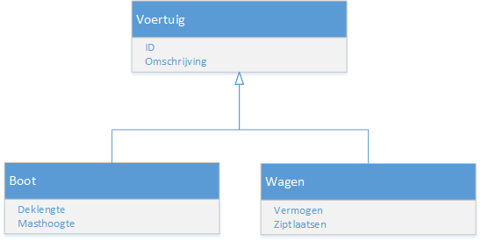
Inheritance

Slide 26
Table Per Hierarchy
ID | Omschrijving | Type | Deklengte | Masthoogte | Vermogen | Ziplaatsen
1 | BMW M4 | Wagen | NULL | NULL | 431 pK | 4
2 | Sun Odyssey 29.2 | Boot | 8,8 m | 13,2 m | NULL | NULL

Slide 27
Table Per Type
ID | Omschrijving
1 | BMW M4
2 | Sun Odyssey 29.2
ID | Vermogen | Ziplaatsen
1 | 431 pK | 4
ID | Deklengte | Masthoogte
2 | 8,8 m | 13,2 m

Slide 28
Table Per Concrete Class
ID | Omschrijving | Vermogen | Ziplaatsen
1 | BMW M4 | 431 pK | 4
ID | Omschrijving | Deklengte | Masthoogte
2 | Sun Odyssey 29.2 | 8,8 m | 13,2 m

Slide 29
TPT vs. TPH
Criterium | Beste keuze | Reden
Performantie | TPH | Geen joins
Flexibiliteit | TPT | Nieuwe subtypes zonder basis-tabel te wijzigen
DB Validatie | TPT | Bij TPH veel nullable velden nodig
Opslag | TPT | TPH heft veel NULL waardes. Op zich geen enorm problem, maar ALLE velden bestaan voor ELK record.
Esthetiek | ? | Subjectief. TPT mapt wel 100% op de classes in .NET
TPC als oplossing?
In Code First: Ja, tenzij je een foreign key wilt leggen naar je super-klasse.

Slide 30
CODING
Let the coding begin…

Slide 31
DAPPER
Micro - ORM

Slide 32
Why a Micro ORM?
Full ORM drawbacks:
No control over SQL
Inefficient to query complex stuff
Too much ‘magic’ (if you don’t know it well)
Tricky to map complex queries to a simple structure
Hand coding drawbacks:
Very verbose
Same actions over and over again (connection, command, parameters, …)

Slide 33
Why a Micro ORM?
“SQL is the best DSL for working with data”
Often, you know what SQL you would want to write.
Have a small framework to take care of the hassle

Slide 34
Dapper pros & cons
PRO
Nearly as fast as a hand coded solution
No need for the hassle of commands, readers & casting
CON
No checks on your SQL (not type safe)
Painful to maintain (schema change = change all SQL)
… Goes for nearly any Micro-ORM
So … choose your usecase wisely!

Slide 35
Repositories & Unit of Work
Data access design patterns

Slide 36
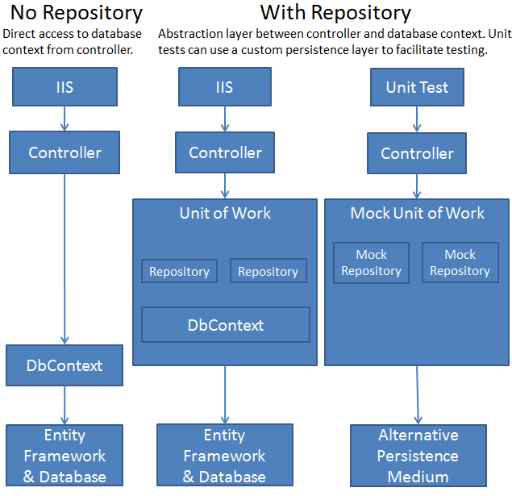
What it looks like …

Slide 37
Why?
Separation of Concearns
Controller: UI logic
Unit Of Work: Business
Repository: Data Access
Making all parts injectable by the IOC container
Making every part mockable to the upper layer (unit testing)
Keeping the tested parts small

Slide 38
Beware of anti-patterns!
Abstractions over abstractions over abstractions over …
UI → Facade → Service → Unit Of Work → Repository → DbContext → DB
Using DI to inject many abstractions will:
Cause a performance hit
Make code navigation complex
Make debugging complex
Using all of these in EVERY case is NOT productive
Generic repository
Isn’t a DbContext a repository?

Slide 39
Bronnen
www.xkcd.com
msdn.microsoft.com

