Slide 1
Services in .NET

Slide 2
Services in .NET
Windows Communication Foundation - RRSL (Agatha) –
Azure Service Bus – WebAPI – OData – ServiceStack - Nancy

Slide 3
Overzicht
Inleiding & Achtergrond
WCF – basisprincipes
WCF – advanced
RRSL (Agatha)
Windows Azure Service Bus
And more …

Slide 4
Inleiding & Achtergrond
Waarom hebben we services nodig?

Slide 5
De nood stijgt
N-Tier architectuur
Diversiteit van de consumers (devices)
Interactie tussen systemen
SAAS

Slide 6
Wat gebruiken?
Intern & B2B:
Sterke contracten en integratie
SOAP
WCF, Agatha, …
Extern, Mobile, Web:
Flexibele formaten (XML, JSON, …)
REST
WebAPI, Odata, Nancy, ServiceStack, …
Asynchroon
Message passing
MSMQ, Azure Service Bus, RabbitMQ, NServiceBus, …

Slide 7
Voor WCF
ASMX
Active Server Method File
Heeft IIS nodig
Enkel HTTP (SOAP 1.1 & 1.2)
Vanaf .Net 1.1
WSE
Web service extensions
WS-* standaarden in ASMX
SOAP en REST
Security

Slide 8
.Net 3.0 → WCF is introduced
WCF = “Services done right”
Volledig uitbreidbaar en aanpasbaar
Compatibiliteit
Veel WS-* standaarden reeds geïmplementeerd
Flexibel
Transport (HTTP, TCP, MSMQ, …)
Format (SOAP, REST, JSON, …)
Onafhankelijk van IIS

Slide 9
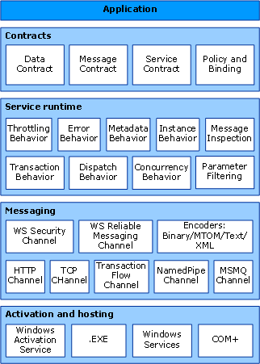
WCF architectuur

Slide 10
WCF - Basisprincipes
De basis voor service applicaties

Slide 11
Het ‘ABC’ van WCF (1)
Address
Waar is de service te vinden?
bv.
http://someserver:8064/someservice/
net.tcp://someserver:8128/someservice/
Gedefinieerd in het Endpoint

Slide 12
Het ‘ABC’ van WCF (2)
Binding
Hoe kan ik met de service communiceren?
Transport Protocol
HTTP, HTTPS, TCP, MSMQ, Named Pipes, …
Message Protocol
XML (SOAP), Binary, JSON, …
WS-* Protocols
Security, sessies, transacties, etc.
….
100% aanpasbaar
http://msdn.microsoft.com/en-us/library/ms730879.aspx

Slide 13
Het ‘ABC’ van WCF (3)
Contract
Wat biedt de service aan?
Service Contract
Operaties
Data Contract
Data structuren (~ klasses)
Message Contract
Hoe ziet een boodschap eruit?
Meestal bepaald door de Binding

Slide 14
Demo time
Standard WCF demo stuff

Slide 15
Windows Azure Service Bus
Een Enterprise Service Bus in de Cloud

Slide 16
Service bus details
Exchange messages between applications
Both on and off premise
Loosely coupled
99,9% uptime SLA

Slide 17
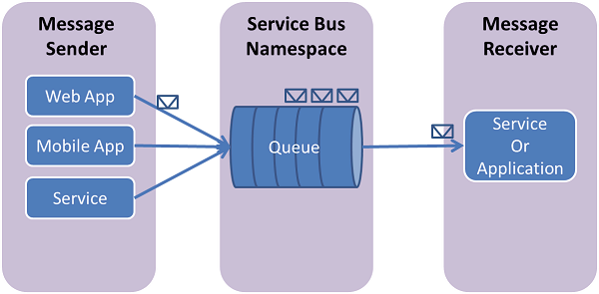
Queues (1/3)
FIFO guaranteed message delivery

Slide 18
Queues (2/3)
Standard Protocols: WS*, REST, AMQP
+ API’s for put/pull queueing
Topics with subscriptions allow for:
Multiple delivery
Filtering

Slide 19
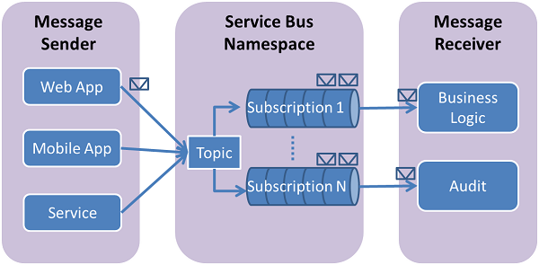
Queues (3/3)

Slide 20
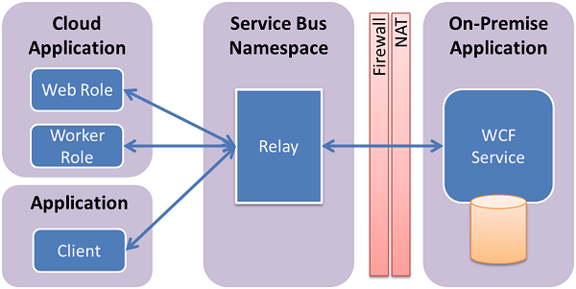
Relay (1/3)
Connect ‘on premise’ services to the cloud

Slide 21
Relay (2/3)
Requires some ports to be open
Facilitates direct connection where possible
Server creates a service URI in the namespace
Multiple listeners possible
Similar bindings to standard WCF
Doesn’t require changes in source code

Slide 22
Relay (3/3)
WCF Binding | Relay Binding | Client Ports | Server Ports
BasicHttpBinding | BasicHttpRelayBinding | HTTP: 80 HTTPS: 443 | 9351
WebHttpBinding | WebHttpRelayBinding
WsHttpBinding | WsHttpRelayBinding
WS2007HttpBinding | WS2007HttpRelayBinding
NetTcpBinding | NetTcpRelayBinding | No Hybrid: 9352 With Hybrid: 9352-9353
N/A | NetOnewayRelayBinding | Normal: 9350 Security: 9351 | 9351
N/A | NetEventRelayBinding
N/A | NetMessagingBinding | 9352 – 9353

Slide 23
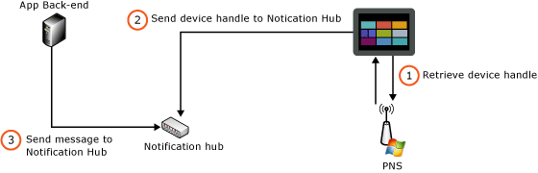
Notification Hubs (1/2)
Push notification delivery

Slide 24
Notification Hubs (2/2)
Supports multiple platforms
Windows Store
iOS
Android – coming soon
Windows Phone – coming soon
Use tags for sub-routing
Scales to millions of devices

Slide 25
Demo: Relay Service
Demo time!

Slide 26
Demo: Queues
More demo!

Slide 27
REST
REST-ful services

Slide 28
REST
Representational State Transfer
Gebaseerd op HTTP:
GET → List (Collection) / Retrieve (Element)
PUT → Replace (Update) or Create (Element)
POST → Create Entry (Collection)
DELETE → Delete

Slide 29
WebAPI Historiek
WCF met REST extension
Project Astoria (ADO.Net data services)
MVC Controllers met JSON results
Concurrentie van 3rd party frameworks
→ WebAPI

Slide 30
Query Strings
Examples:
Collection query:
http://.../OData.svc/Category(1)/Products?$top=2&$orderby=name
http://.../OData.svc/Suppliers?$filter=Address/City eq 'Redmond'
Operation call:
http://.../OData.svc/ProductsByColor?color='red‘

Slide 31
Output
Standard: AtomPub
Can be: JSON, XML, …

Slide 32
DEMO
OData demo time!

Slide 33
ServiceStack
#VISUG
Simplicity at Speed.
One framework to power them all

Slide 34
What is ServiceStack? – The Service
#VISUG
“One size fits all” service framework:
SOAP, REST & MQ type services
Multi-format: XML, JSON, CSV, JSV, …
Razor view engine
→ An alternative to WCF, WebAPI and MVC

Slide 35
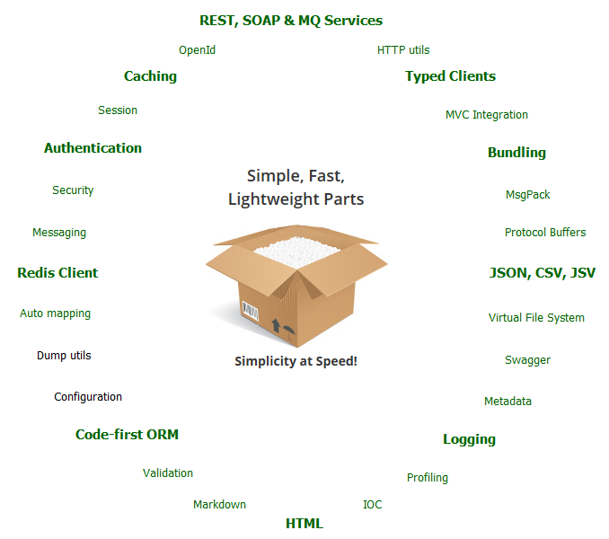
What is ServiceStack? – The Stack
#VISUG
ORM
Serializers
Filters
Logging
Client Framework
Caching
Authentication
Redis Client
…

Slide 36
The philosophy
#VISUG
1 operation = 1 Request DTO (philosophically)
Simplicity
POCO (Code First) approach
Convention based
Focus on core logic
Minimize configuration
Let the developer think about the logic, not the transport

Slide 37
The philosophy (2)
#VISUG
Speed
Every part is written or chosen for speed
Use of conventions to increase performance
Simplify things for added speed
Every part of the stack is important, from the ORM to the serializers

Slide 38
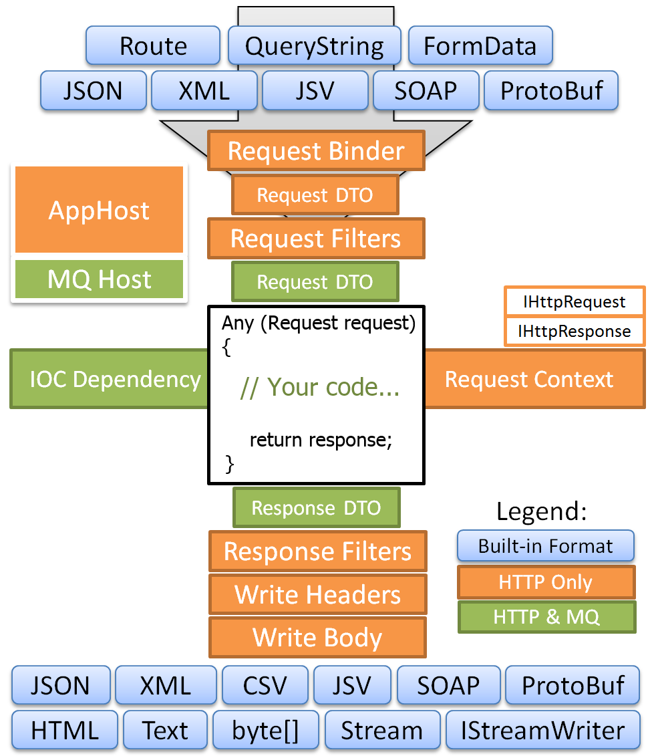
Server Architecture
#VISUG

Slide 39
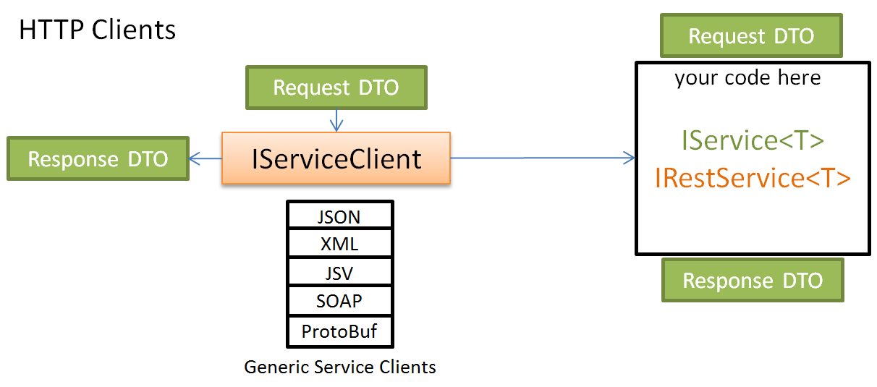
Client Architecture
#VISUG

Slide 40
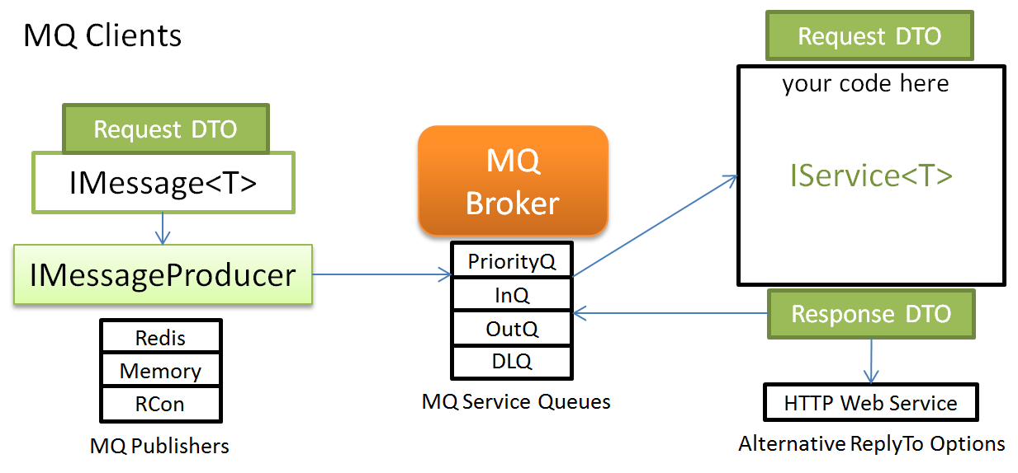
Client Architecture (2)
#VISUG

Slide 41

Demo time
#VISUG
Remember this?
“Plug & play”

Slide 42
Nancy
#VISUG
A lightweight, low-ceremony, framework for building HTTP based services

Slide 43
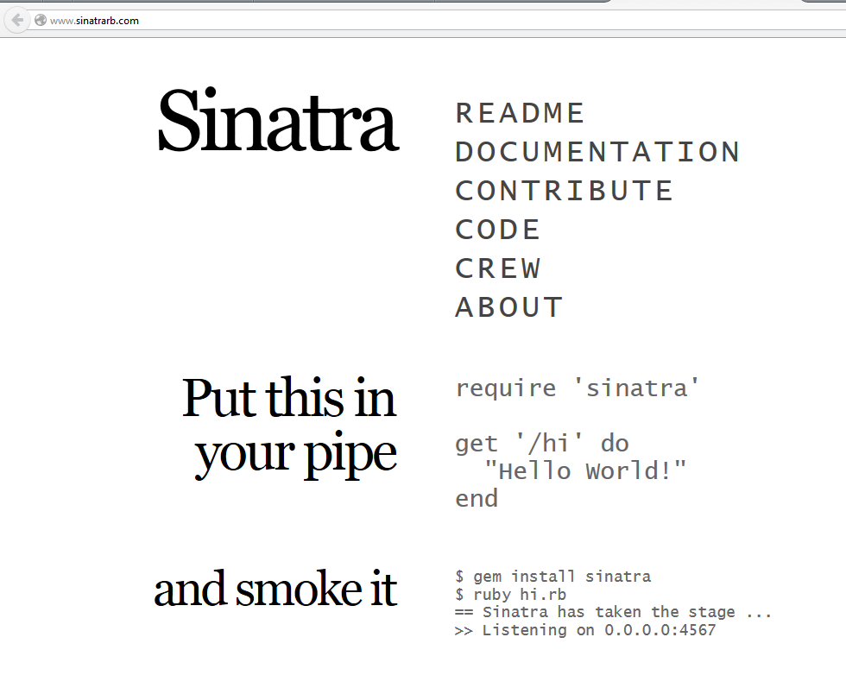
.Net port of Sinatra
#VISUG

Slide 44
The Philosophy
#VISUG
The Super-Duper-Happy-Path (SDHP):
It just works
Easily customizable
Low ceremony
Low friction

Slide 45
The Framework
#VISUG
100% route-based
Choice of serializers:
Nancy, Newtonsoft, ServiceStack, …
Choice of View Engines:
Razor, Handlebars, Spark, …
Choice of hosting environments:
ASP.NET, OWIN, Self-hosted, Mono, …

Slide 46
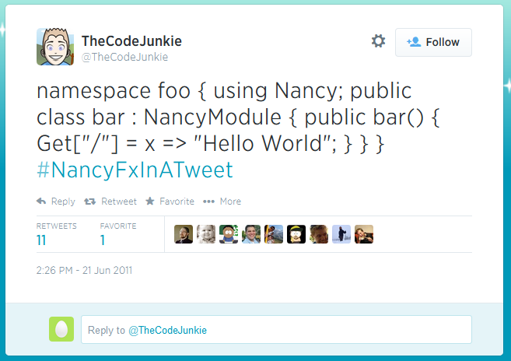
Nancy app in a tweet
#VISUG

Slide 47
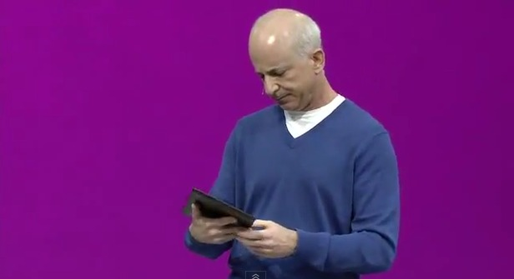
Demo time
#VISUG
Think they learned?

Slide 48
Url Patterns (1/2)
#VISUG
Literal segment (10000)
/some/literal/segments
exact match
Capture segment (1000)
/{name}
catures a portion of the route
Optional capture segment (1000)
/{name?}
Optional capture segment with default (1000)
/{name?unnamed}
what comes after the ? is the default

Slide 49
Url Patterns (2/2)
#VISUG
RegEx segment (1000)
/(?<age>[\d]{1,2})
named group capture, if needed
Greedy Segment (0)
/{name*}
matches everything from this / forward
Greedy RegEx Segment (100)
/^(?<name>[a-z]{3,10}(?:/{1})(?<action>[a-z]{5,10}))$
Always starts with ^ and ends with $
Multiple Captures Segment (100)
/{file}.{extension} (2 captures)
/{file}.ext (capture & literals)

Slide 50
Action return values
#VISUG
Return value | Interpreted as …
int | HTTP status code
HttpStatusCode (enum) | HTTP status code (duh!)
string | Response body
Action<Stream> | Stream writes the response body
Anything else | Content negotiation

Slide 51
Route conditions
#VISUG
Func<NancyContext, bool>
Post["/login", (ctx) => ctx.Request.Form.remember] = _ =>
{
return "Handling code when remember is true!";
}
Post["/login", (ctx) => !ctx.Request.Form.remember] = _ =>
{
return "Handling code when remember is false!";
}

Slide 52
Route segment constraints
#VISUG
Get["/intConstraint/{value:int}"]
int, decimal, guid, bool
alpha (only alphabetical chars)
datetime, datetime(format)
min(minimum), max(maximum), range(minimum, maximum) (integer values only)
minlength(length), maxlength(length), length(minimum, maximum)
Custom …

Slide 53
Locating Views
#VISUG
ViewName (from returned type)
Tournament → Tournament.cshtml
TournamentModel → Tournament.cshtml
Locations:
/
/Views
/Views/ModulePath
/ModulePath
/ModuleName
/Views/ModuleName

Slide 54
Wrapping things up
#VISUG
Because we’d like to get to the beer…

Slide 55

Comparison
#VISUG
ServiceStack | Nancy
+ Multiple protocols + Focus on DTO objects + Focus on speed + Queue support + Client packages - From v.4: €€€ - Lots of DTO objects | Components easily interchangeable + Focus on developer happiness + Does REST extremely well + Different View Engines + Focus on routes + Nancy attributes in Data - Route discipline -

Slide 56
Bronnen
http://msdn.microsoft.com
http://www.dilbert.com
https://servicestack.net
http://nancyfx.org/

