Slide 1

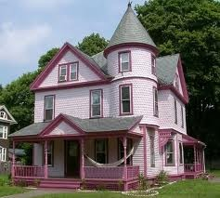
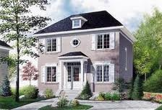
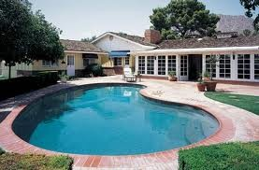
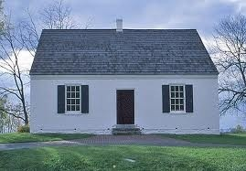
Chapter 3
What is Architecture and architect role
Architecture Patterns
pipe and filter 2.event-based, 3.layered etc
Architectural view models

Slide 2


What is Software Architecture?
The architecture of a system consists of:
the structure(s) of its parts
including design-time, test-time, and run-time hardware and software parts
the externally visible properties of those parts
modules, hardware units
the relationships and constraints between them
Architecture is the fundamental organization of a system, embodied in its components, their relationships to each other and the environment, and the principles governing its design and evolution”. [ANSI/IEEE 1471- 400]
Architecture is:
All about communication
What ‘parts’ are there?
How do the ‘parts’ ﬁt together?
Architecture is not:
About development
About algorithms
About data structures

Slide 3

Other Deﬁnitions of Software Architecture
Architecture is high-level design.
❑
❑
Architecture is the overall structure of the system.
Architecture is a set of principal design decisions about a software system
❑
Architecture is the structure of the components of a program or system, their interrelationships, and the principles and guidelines governing their design and evolution over time.
Architecture is components and connectors
Note: Almost all of the above deﬁnitions focus on reasoning about the structural system issues.

Slide 4

Fundamental concepts of Architecture
Three fundamental understandings of software architecture.
Every application has an architecture.
Every application has at least one architect.
Architecture is not a phase of development.
Note: Architecture is a design, but every design is not an architecture.

Slide 5


Architecture-Centric Design
Traditional design phase suggests translating the requirements into algorithms, so a programmer can implement them
Architecture-centric design includes the following considerations:
Stakeholder issues
Decision about use of COTS /ready made component
Overarching style and structure
Package and primary class structure
Deployment issues
Post implementation/post deployment issues

Slide 6


Software Architecture (contd)
A software architecture deﬁnes:
The components of the software system
How the components use each other’s functionality and data
How control is managed between the components
Software architecture is the blueprint for a software system’s construction and evolution
Architecture = {components, connectors, constraints}
10/05/16
ASTU 3rd Year SE Chapter-2

Slide 7
Architecture Business Cycle
Software architecture is a result of technical, business, and social influences.
Its existence, in turn, influences these technical, business, and social environments.
This cycle of influences from the environment to the architecture and back to the environment is called the Architecture Business Cycle.

Slide 8
Where do Architectures come from?
Architectures are influenced by:
System stakeholders
The developing organization
The background and experience of the architects
The technical environment

Slide 9
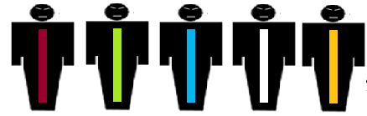
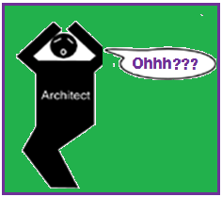
Developing organization management stakeholder
Marketing stakeholder
End User
Stakeholder
Maintenance organization stakeholder
Customer
stakeholder
Low Cost
Neat features,
Short time to market, Low Cost
Behaviour,
Performance,
Security , Reliability, Usability
Modifiability
Low cost, Timely delivery, not changed often
Influence of system stakeholders on Architect

Slide 10
ARCHITECTURES INFLUENCED BY SYSTEM STAKEHOLDERS
Acceptable system involves properties such as performance, reliability, availability, memory utilization, security, modifiability, usability, interoperability with other system.
The underlying problem, is that each stakeholder has different concerns and goals, some of which may be contradictory.
The reality is that the architect often has to fill in the blanks and mediate the conflicts.

Slide 11
ARCHITECTURES INFLUENCED BY THE DEVELOPING ORGANIZATION
Architecture is also influenced by the structure and nature of organization.
There are three classes of influence that come from the developing organization
Immediate business
Long-term business
Organizational structure (subcontract)

Slide 12
ARCHITECTURES INFLUENCED BY THE BACKGROUND AND EXPERIENCE OF THE ARCHITECTS
Architects for a system have had good results using a particular architectural approach,
Chances are that they will try that same approach on a new development effort, or may be reluctant to try it again.
Architectural choices may also come from an architect's education and training, exposure to successful architectural patterns,
exposure to systems that have worked particularly poorly or particularly well – or to experiment also

Slide 13
ARCHITECTURES INFLUENCED BY THE TECHNICAL ENVIRONMENT
Architect's background and experience is reflected by the technical environment
Current environment will influence the architecture– standard industry practices or software engineering techniques

Slide 14
Ramifications _{Effect} of the Various Influences on an Architecture
The properties required by the business and organizational goals are seldom completely understood.
Customer requirements are often not complete or well documented.
Architects must identify and actively engage stakeholders to solicit their needs and expectations.
In addition to technical skills, architects need to be skilled in diplomacy, negotiation, and communication.

Slide 15
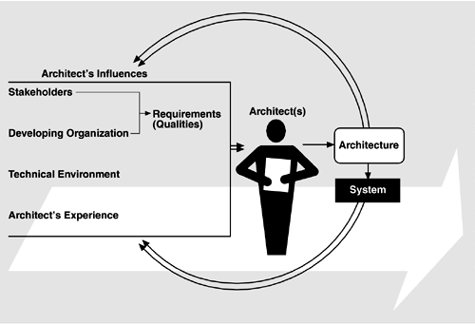
Influences on the Architecture

Slide 16
Architectures affect the factors, that Influence them
Relationship among business goals, product requirement, architects experience, architectures and fielded system form a cycle with feedback loop

Slide 17
Architectures affect the factors, that Influence them
The structure of the developing organization.
The goals of developing organization.
Customer requirements for the next system.
The architect’s experience with subsequent systems.
The software engineering culture.(i.e technical environment ..)

Slide 18
Structure of the developing organization
Architecture affect the structure of the organization
It prescribes the units of software to be implemented.
Development, test , integration.
Teams are formed for individual software unit.
Teams become the part of the organization structure.

Slide 19
Goals of developing organization
It enables a company to establish a strong foothold in the market area.
Architecture provides an opportunity for the organization to adjust its goal, so that it can take advantage from the market.

Slide 20
Customer requirements for the next system
Architecture gives the customer an opportunity to receive a system that is more reliable, timely and economic than a system which is build from scratch.
The customer may be willing to relax some requirements to gain the economies.

Slide 21
The architect’s experience with subsequent systems
It’ll affect the architect’s experience with subsequent systems by adding to the corporate experience base.

Slide 22
The software engineering culture
A few systems will influence and change the s/w engineering culture i.e. the technical environment in which system builders operate and learn.

Slide 23
Software processes and ABC Many activities are involved in creating SA, using that arch., to realize design and then to implement or manage the system. Software Architecture Activities are………
Creating the business case for the system.
Understanding the requirements
Creating or selecting the architecture
Documenting and Communicating the architecture
Analyzing or evaluating the architecture
Implementing based on the architecture
Ensuring conformance to an architecture

Slide 24
Creating the business case for the system
It is simple to create a business case than understanding the needs of market
How much should be the product cost?
What is the Targeted market?
What is the targeted time to market?
Will it need to interface other system?
Are there system limitations?

Slide 25
Understanding the requirements
There are variety of techniques to understand requirements from stakeholders.
Object oriented analysis : use cases & scenarios
Safety Critical Systems:
Finite state machine models
Formal specification languages
Quality attributes
Prototypes
Regardless of technique used, --
the desired qualities of the system to be constructed determine the shape of architecture.

Slide 26
Creating or selecting the architecture
Conceptual integrity
A small no. of minds coming together to design the system’s architecture.

Slide 27
Communicating the architecture
For effective architecture
It must be communicated clearly and unambiguously to all stakeholders.
Developers must understand work assignments.
Testers must understand the task structures
Management must understand the scheduling implications

Slide 28
Analyzing or Evaluating the architecture
Out of multiple designs, after analysing, some design will be accepted or some are rejected.
Evaluating an architecture for the qualities it supports is essential to ensure the stakeholders satisfaction (needs).
Scenario- based techniques are for evaluation of architecture.

Slide 29
Implementing based on the architecture
Concerned with keeping the developers faithful to the structures.
Should have an environment that assists developers in creating the architecture.
Ensuring conformance to an architecture
Finally, when an architecture is created and used, it goes into maintenance phase.
Constant vigilance is required to ensure that actual architecture and its implementations remain faithful to each other.

Slide 30
What Makes a ‘Good’ Architectural Process?
Given the same technical requirements for a system, two different architects in two diff. organisations, will produce different architectures.
Then how to decide which is right one ? Rules of thumb/observations that should be followed when designing an architecture.
These are divided into two clusters:
Process recommendations
2. Product(structural) recommendations.

Slide 31
Process recommendations are:(The architecture)
be product of a single architect or small group of architects.
gather both the functional requirements and a well specified, prioritized list of quality attributes.
be well documented, with at least one static view and one dynamic view.
be reviewed by the system’s stakeholders.
be analyzed for applicable quantitative measures and formally evaluated for quality measures.
develop a “skeletal” system to facilitate incremental implementation.

Slide 32
The structural rules of thumb are:
The architecture should feature well-defined modules based on the principles of information hiding and separation of concerns.
Each module should have a well-defined interface that hides changeable aspects.
Quality attributes should be achieved using well-know architectural tactics.
The architecture should be independent of particular versions of commercial products or tools.
Modules that produce data should be separate from modules that consume data.

Slide 33


Components
A software component is an architectural entity that
encapsulates a subset of the system’s functionality and/or data
restricts access to that subset via an explicitly defined interface
has explicitly defined dependencies on its required execution context
Components typically provide application-specific services.
Types of components
computational: does a computation of some sort. E.g. function, filter .
memory: maintains a collection of persistent data. E.g. data base, file system, symbol table.
manager: contains state + operations. State is retained between invocations of operations. E.g. server.
controller: governs time sequence of events. E.g. control module,

Slide 34


Connectors
A software connector is an architectural building block ,regulating interactions among components.
In many software systems, connectors are usually simple procedure calls or shared data accesses
Much more sophisticated and complex connectors are possible!
Connectors typically provide application-independent interaction facilities.
Types of connectors:
Procedure call connectors
Shared memory connectors
Message passing connectors
Streaming connectors
Distribution connectors
Wrapper/adaptor connectors

Slide 35


Conﬁguration/Topology
Components and connectors are composed in a specific way in a given system’s architecture to accomplish that system’s objective.
An architectural conﬁguration/topology, is a set of specific associations between the components and connectors of a software system’s architecture

Slide 36

Prescriptive vs. Descriptive Architecture
A system’s prescriptive architecture captures the design decisions made prior to the system’s construction.
It is the as-conceived or as-intended architecture
A system’s descriptive architecture describes how the system has been built
It is the as-implemented or as-realized architecture

Slide 37

Domain Speciﬁc Software Architecture
Domain-specific software architectures (DSSAs):
Specialized for a particular task (domain).
Generalized for eﬀective use in that domain.
Composed using a standardized topology.
Key beneﬁt:
maximal reuse of knowledge.
Key drawback:
only applicable in specific domain.

Slide 38


Why Software Architecture is Important
1. Communication among stakeholders
Each stakeholder (customer, user, project manager, coder, tester and so on) of a system is concerned about diﬀerent characteristics of the system that will be aﬀected by the architecture.
A user is concerned that the system is reliable and available when needed;
The customer is concerned that the architecture can be implemented on schedule and within budget;
The manager is worried (as well as about cost and schedule) that the architecture will allow teams to work largely independently, interacting in disciplined and controlled ways.
The software architect is worried about strategies to achieve all of those goals.
Architecture provides a common language in which diﬀerent concerns can be expressed, negotiated, and resolved at a highly intellectually manageable level.

Slide 39


Why Software Architecture is Important
2. It helps to make early design decisions :
Software architecture manifests the earliest design decisions about a system, which inﬂuence the system's remaining development, its deployment, and its maintenance life.
The architecture defines constraints on implementation
The architecture dictates organizational structure
The architecture inhibits or enables a system's quality attributes
e.g. If your system requires high performance, you need to manage the time- based behavior of elements and the frequency and volume of inter-element communication
Predicting system qualities by studying the architecture
The architecture enables more accurate cost and schedule estimates

Slide 40

Why Software Architecture is Important
3.It provides a transferable, re-usable model
Software architecture constitutes a relatively small, intellectually graspable model for how a system is structured and how its elements work together, and this model is transferable across systems.
In particular, it can be applied to other systems exhibiting similar quality attribute and functional requirements and can promote large-scale re- use.
➢
➢
➢
Systems can be built using large, externally developed elements
An architecture permits template-based development
An architecture can be the basis for training

Slide 41


Role of Software Architect
Convert customer requirements into technical design
Lead the problem domain analysis team
Ensure that the technical design meets quality requirement
Perform continuous risk assessment, develop risk mitigation strategies
Perform early prototyping aimed at mitigating major risks
Communicate with stakeholders through detailed technical presentations
Listen to stakeholders and build consensus
Review developer code and ensure conformance to the architecture and good coding practices
Serve as a mentor for analysts, designers, and developers

Slide 42


Architectural Design Process
System structuring and partitioning
Decomposition of software system into sub-systems and communications between sub-systems
Sub-system is an independent system from other sub-systems.
Decomposition of sub-system into modules or components
Component (module) provides services to other component.
Reuse component

Slide 43

Sub-systems, Modules and Components
A sub-system is a system in its own right whose operation is independent of the services provided by other sub-systems.
A module is a system component that provides services to other components but would not normally be considered as a separate system.
A component is an independently deliverable unit of software that encapsulates its design and implementation and oﬀers interfaces to the out-side, by which it may be composed with other components to form a larger whole.

Slide 44


Architecture Style
Set of rules, constraints, or patterns of how to structure a system into a set of components and connectors.
An architectural style defines a family of systems in terms of a pattern of structural organization. More specifically, an architectural style defines a vocabulary of components and connector types, and a set of constraints on how they can be combined.
— Shaw and Garlan

Slide 45


Types of Architectural Styles
Pipes-and-Filter
Client-Server
Peer-to-Peer
Event Based
Layering
MVC
SOA (Service Oriented Architecture)

Slide 46


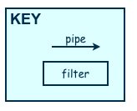
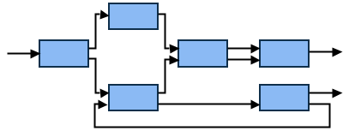
Pipes-and-Filter
The system has
Streams of data (pipe) for input and output
Transformation of the data (ﬁlter)
KEY
pipe
"The Pipes and Filters architectural pattern provides a structure for systems that process a stream of data. Each processing step is encapsulated in a filter component. Data [are] passed through pipes between adjacent filters. Recombining filters allows you to build families of related filters."

Slide 47

Contd..
Implementation steps:
Divide the functionality of the problem into a sequence of processing steps.
Deﬁne the type and format of the data to be passed along each pipe.
Determine how to implement each pipe connection.
Design and implement the ﬁlters.
Note: The design of a filter is based on the nature of the task to be performed and the natures of the pipes to which it can be connected.

Slide 48

Contd..
Several important properties
The designer can understand the entire system's eﬀect on input and output as the composition of the filters
The filters can be reused easily on other systems
System evolution is simple
Drawbacks
Encourages batch processing
Not good for handling interactive application
Duplication in filters functions

Slide 49


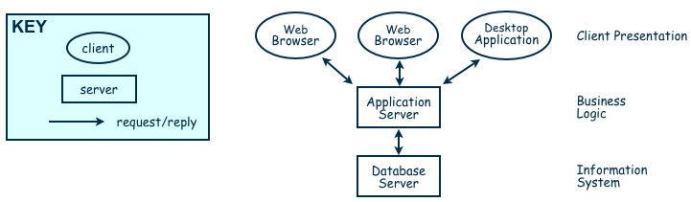
Client-Server
A client-server architecture distributes application logic and services respectively to a number of client and server sub- systems, each potentially running on a diﬀerent machine and communicating through the network (e.g, by RPC).
Two types of components:
Server components oﬀer services(Response/Reply)
Clients sends request and receive response from server.
Client may send the server a request and server reply a response to the request. It is a kind of request and response/reply mechanism.

Slide 50

Contd..
Advantages
Distribution of data is straightforward
Makes eﬀective use of networked systems.
May require cheaper hardware
Easy to add new servers or upgrade existing servers
Disadvantages
Redundant management in each server
May require a central registry of names and services — it may be hard to find out what servers and services are available

Slide 51


Peer-to-Peer (P2P)
Each component acts as its own process and acts as both a client and a server to other peer components.
Any component can initiate a request to any other peer component.
Characteristics
Scale up well
Increased system capabilities
Peers are distributed in a network, can be heterogeneous, and mutually independent.
Robust in face of independent failures. Highly scalable
This diﬀers from client/server architectures, in which some computers are dedicated to serving the others.
Components do not oﬀer the same performance under heavy loads.

Slide 52


Event-Based Architecture
Components interact by broadcasting and reacting to events
Component expresses interest in an event by subscribing to it
When another component announces (publishes) that event has taken place, subscribing components are notified
Implicit invocation is a common form of publish-subscribe architecture
Registering: subscribing component associates one of its procedures with each event of interest (called the procedure)
Characteristics
Strong support for evolution and customization
Easy to reuse components in other event-driven systems
Difficult to test

Slide 53

Contd..
In broadcast models an event is broadcast to all sub-systems. Any sub-system which can handle the event may do so.
Subscribe(register)
Event Source
Event Sink1
Publish(broadcast)
Event Sink2

Slide 54


Layering
Layers are hierarchical
Each layer provides service to the one outside it and acts as a client to the layer inside it
Layer bridging: allowing a layer to access the services of layers below its lower neighbor
Each layer has two interfaces.
Upper interface provides services and Lower interface requires services.
The design includes protocols
Explain how each pair of layers will interact
Advantages
High levels of abstraction
Relatively easy to add and modify a layer
Disadvantages
Not always easy to structure system layers
System performance may suﬀer from the extra coordination among layers

Slide 55

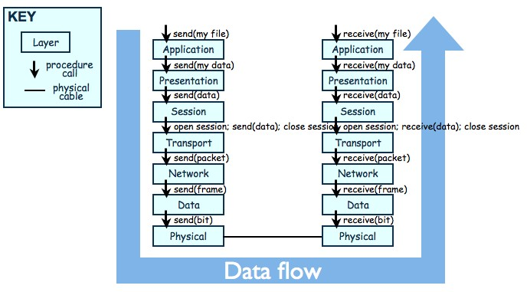
Contd..
The OSI Model

Slide 56


MVC (Model-View-Controller)
In the MVC paradigm, the user input, the modeling of the external world, and the visual feedback to the user are explicitly separated and handled by three types of objects, each specialized for its task.
The view manages the graphical and/or textual output to the portion of the bitmapped display that is allocated to its application.
The controller interprets the mouse and keyboard inputs from the user, commanding the model and/or the view to change as appropriate.
The model manages the behavior and data of the application domain, responds to requests for information about its state (usually from the view), and responds to instructions to change state (usually from the controller).

Slide 57


MVC (Model-View-Controller)
The MVC paradigm is a way of breaking an application, or even just a piece of an application's interface, into three parts: the model, the view, and the controller. MVC was originally developed to map the traditional input, processing, output roles into the GUI realm:
Input → Processing → Output Controller → Model → View

Slide 58

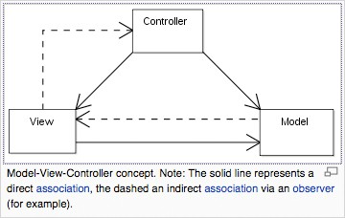
MVC (Model-View-Controller)
The pattern isolates business logic from input and presentation, permitting independent development, testing and maintenance of each.

Slide 59


MVC Beneﬁts
Clarity of design
easier to implement and maintain
Modularity
changes to one don't aﬀect the others
can develop in parallel once you have the interfaces

Slide 60

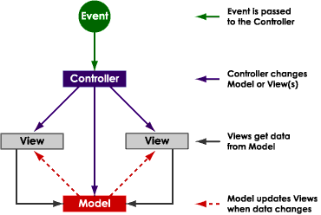

Slide 61


Summary (MVC)
The intent of MVC is to keep neatly separate objects into one of tree categories
Model
The data, the business logic, rules, strategies, and so on
View
Displays the model and usually has components that allows user to edit change the model
Controller
Allows data to ﬂow between the view and the model
The controller mediates between the view and model

Slide 62

Combining Architectural Styles
Actual software architectures rarely based on purely one style
Architectural styles can be combined in several ways
Use diﬀerent styles at diﬀerent layers (e.g., overall client-server architecture with server component decomposed into layers)
Use mixture of styles to model diﬀerent components or types of interaction (e.g., client components interact with one another using publish-subscribe communications
If architecture is expressed as collection of models, documentation must be created to show relation between models

Slide 63


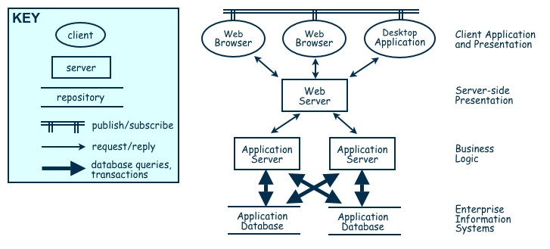
Combination of Event-based, Client-Server, and Repository Architecture Styles

Slide 64


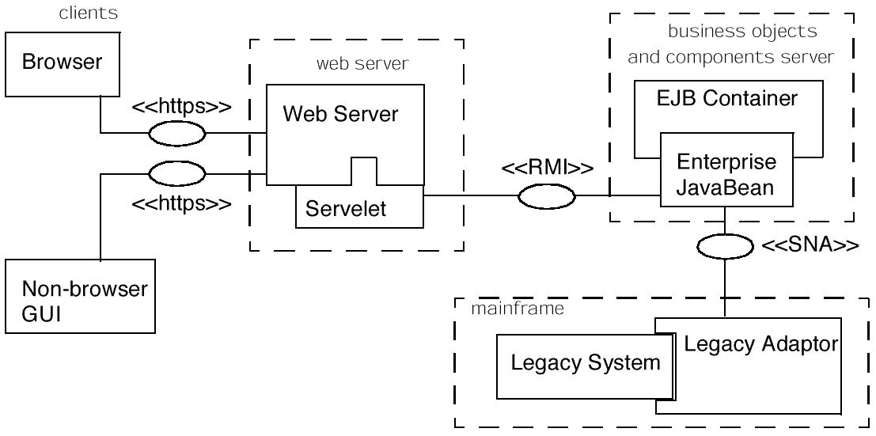
Four-Tier Architectures

Slide 65
Architectural view models
Architecture documents do not address the concerns of all stakeholders .
Deferent Stakeholders : end-user, system engineers, developers, clients, architects and project managers.
Architecture documents contained complex diagrams, some times they are hard to be represented on the documentation.
Using diﬀerent notations for several Views, each one addressing specific set for concerns. Using “4+1” view model.

Slide 66







4+1 View Model of Architecture
End user
Development view
Programmers & software managers
Logical view
Scenarios
Process View
Physical View
Integrator
System Engineer

Slide 67



Questions Please!!!!

