Slide 1
INTERPRETER DESIGN PATTERN
By:
Name ID
Belete Dereje 1601435.

Slide 2
Interpreter Design Pattern
The Interpreter Design Pattern is a behavioral pattern used to define and evaluate the grammar of a expressions and language .
It represents each rule of the language as a class.
It is mainly used for parsing and interpreting structured expressions like mathematical formulas or command languages.

Slide 3
Cont….
The Interpreter Design Pattern works as:
Defining grammar rules
Creating classes for each rule
Building a tree structure of expressions called an Abstract Syntax Tree (AST).
Evaluating (interpreting) the tree

Slide 4
Components
Abstract Expression: This is an abstract class or interface that declares an abstract interpret() method. Defines the interpret method used by all expressions.
Terminal Expression: These are the concrete classes that implement the Abstract Expression interface
represent the terminal symbols or leaves in the grammar.
are the basic building blocks that the interpreter uses to interpret the language
Example:
Numbers(5,10)
Variables(x)
Constants
Non-Terminal Expression: These are the also concrete classes that implement the Abstract Expression interface.
Non-terminal expression classes are responsible for handling composite expressions, which consist of multiple sub-expressions.

Slide 5
Cont….
Represents grammar rules that implement the Abstract Expression.
Context: This class contains information that is global to the interpreter and is maintained and modified during the interpretation process. The context may include variables, data structures, or other state information that the interpreter needs to access or modify while interpreting expressions. Stores information needed during interpretation.
Client: The client is responsible for creating the abstract syntax tree (AST) and invoking the interpret() method on the root of the tree.
The AST is typically created by parsing the input language and constructing a hierarchical representation of the expressions.

Slide 6
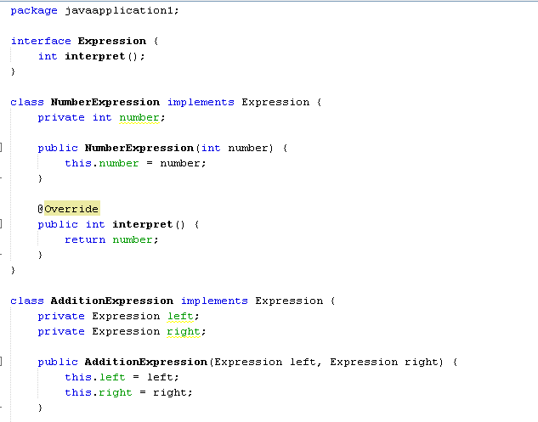
Java Sample Code

Slide 7
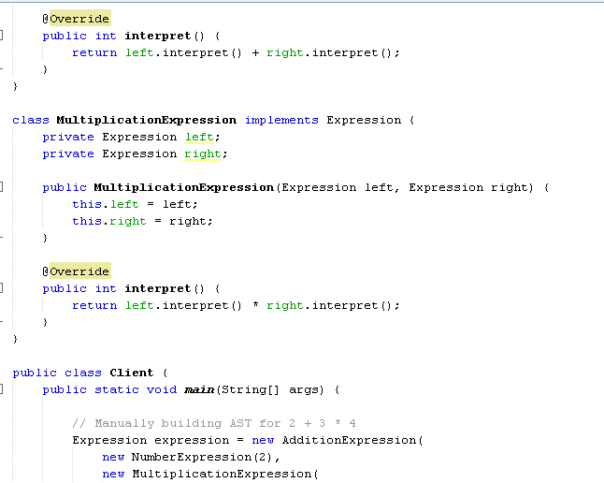
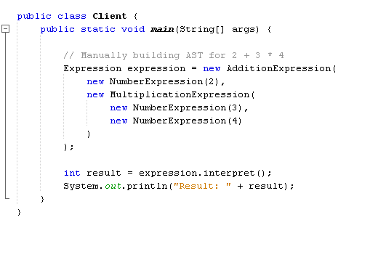
Cont….

Slide 8
Communication flow
Expression = " 2+3*4 ":
The interpreter processes the expression by building and evaluating an expression tree step by step.
Client Input: Client passes the expression (2 + 3 × 4) to the interpreter.
Parsing & Tree Creation: Expression is converted into a tree with terminal (2, 3, 4) and non-terminal (+, ×) nodes.
Evaluation & Result: Interpreter evaluates 3 × 4 = 12, then 2 + 12 = 14, and returns 14 to the client.

Slide 9
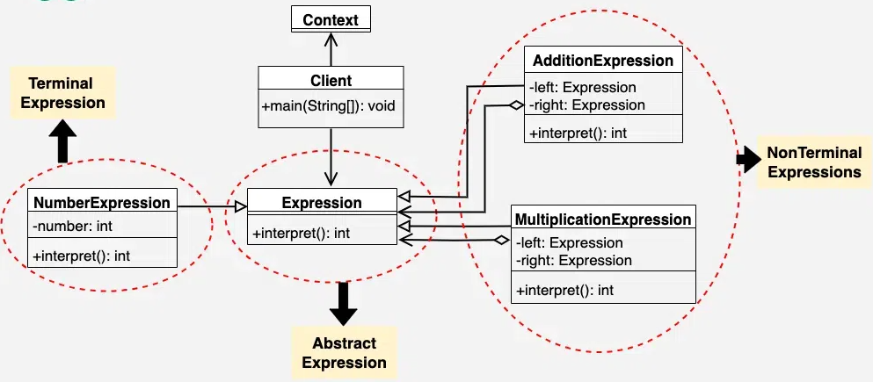
UML Diagram for Interpreter Design Pattern

