Slide 1


Phénix 2018-2021
Torque and Servo Deflection Calculation
Electronics department

Slide 2
Plan
Introduction
Fundamentals for mechanism analysis
Conclusion

Slide 3
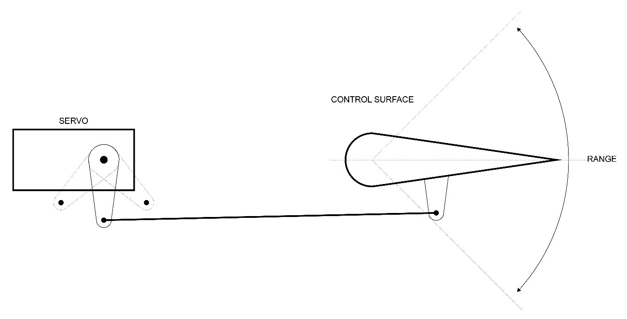
Introduction
Without smooth, non-binding control-surface movements, our planes would be nearly impossible to direct. Linkage systems, including the servo, servo arm, pushrod and control horn, are often overlooked, but they are the keys to smooth, strong and equal control-surface deflections. Take the time to install the linkages properly and securely to guarantee control surfaces that work properly for the life of the plane. Let’s look at these vital links and see where we can improve them, starting with the servo.

Slide 4
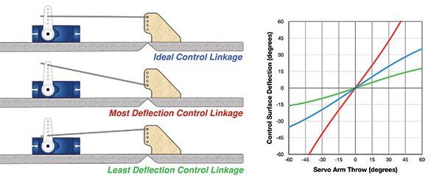
Fundamentals for mechanism analysis
Hypothesis and expectation
Based on the flight physics theory and aerodynamics, the following hypothesis are expected to be observed :
More servo arm + Less control surface horn arm = More deflection of control surface + weaker servo action
Less servo arm + More control surface horn arm = Less deflection of control surface + stronger servo action

Slide 5
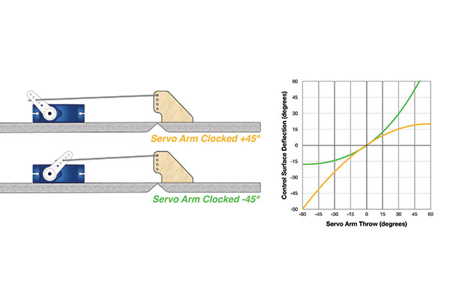
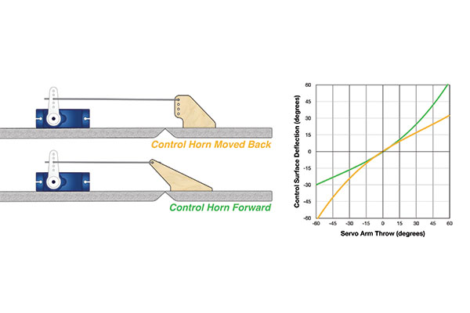
Fundamentals for mechanism analysis
These illustrations show the alternative starting servo arm angles. The servo will still rotate plus or minus 45° from this starting angle, which has a large effect on the control surface, as seen in the graph.
This is especially useful when implemented on the ailerons. The control horn can be moved in such a manner that the ailerons will bias toward more upward deflection and have less downward deflection. This will create roll differential to help counter adverse yaw.

Slide 6
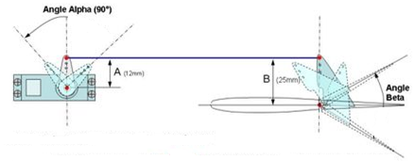
Fundamentals for mechanism analysis
Deflection angle

