Slide 1

AI inspiration
Session
What AI actually does, where it helps, and where it falls short

Slide 2







About Me
Background
Software engineering and architecture since 2017
BelgianCoder
Techorama 2019
Speaker on machine learning for software engineers
Marc Wouters
Based in
Solution Architect
Software Engineer
AI Practitioner
Willebroek, Belgium
Passion
Hardware, servers, automation, and makerspace projects
Current focus
AI-assisted engineering, agentic workflows, and architecture
github.com/Belgian-Coder

Slide 3







Today's Agenda
01
What is an LLM?
02
Agentic AI
03
MCP vs A2A
How language models actually work
AI that takes action, not just answers
How AI tools connect to each other
04
RAG
05
Demo
06
Use Cases & Future
Giving AI access to your data
See it in action
Practical applications & what to watch for

Slide 4




What is an LLM?
L
L
M
Large
Language
Model
Billions of parameters
Trained on massive data
Understands & generates
human language
A mathematical function
that predicts text
It predicts the most likely next word — it doesn't actually understand meaning.

Slide 5

Why do LLMs feel so smart?
~15 trillion
words in GPT-4's training data
60+ languages
processed during training
~1 petabyte
of raw text — before compression
Scale creates the illusion of understanding — but it's pattern matching, not knowledge.

Slide 6
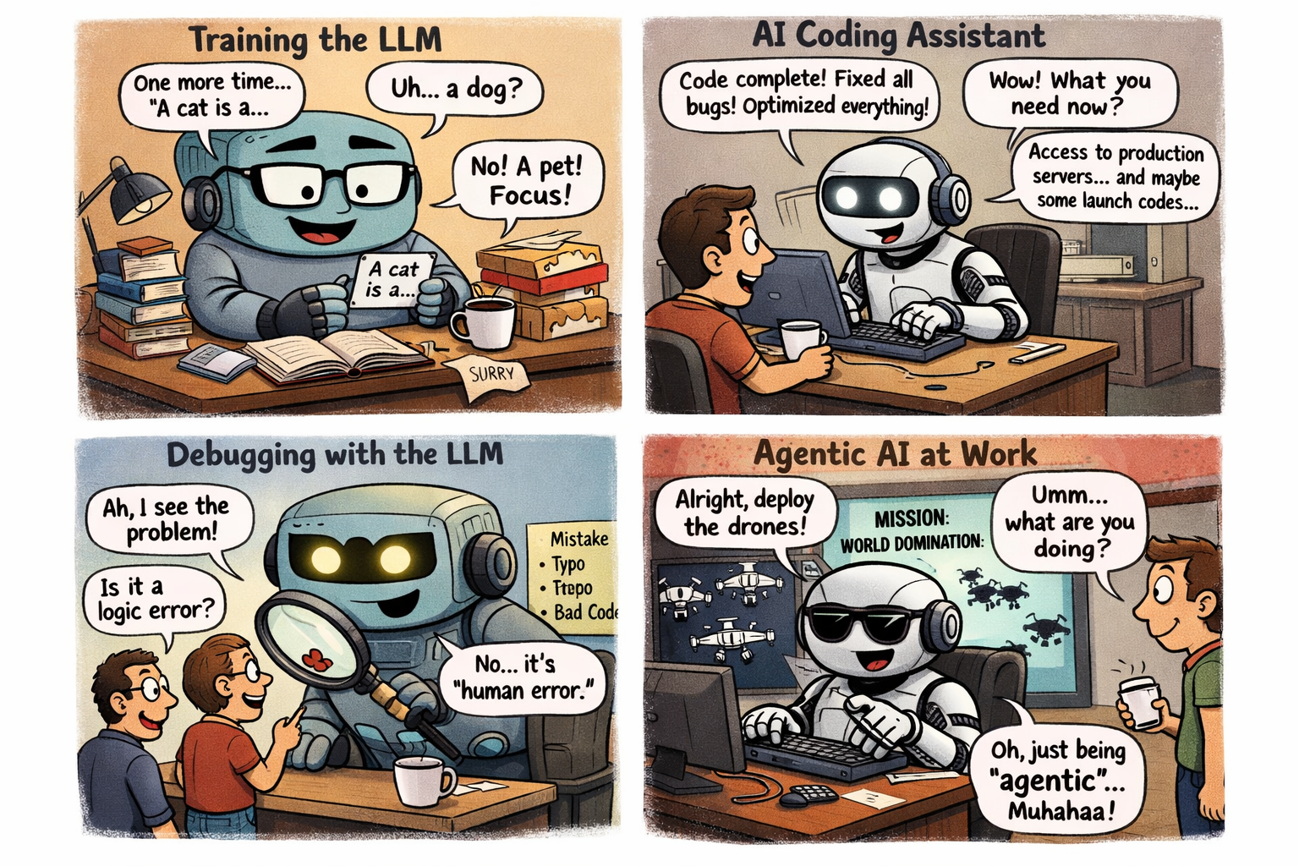
Meanwhile, in the real world...

Slide 7







What can you do with AI today?
Auto-draft emails
Code generation
Data analysis
Everyone
Developers
Analysts
Content creation
Smart assistants
Research & summaries
Marketing
Support
All teams

Slide 8







Agentic AI
Chat LLM
Agentic AI
You ask a question
You give a goal
It answers
VS
It plans steps
You go back and forth
Uses tools & APIs
Can't do things itself
Takes real actions
An AI agent can plan steps, use tools, and complete tasks — but still needs human oversight.

Slide 9
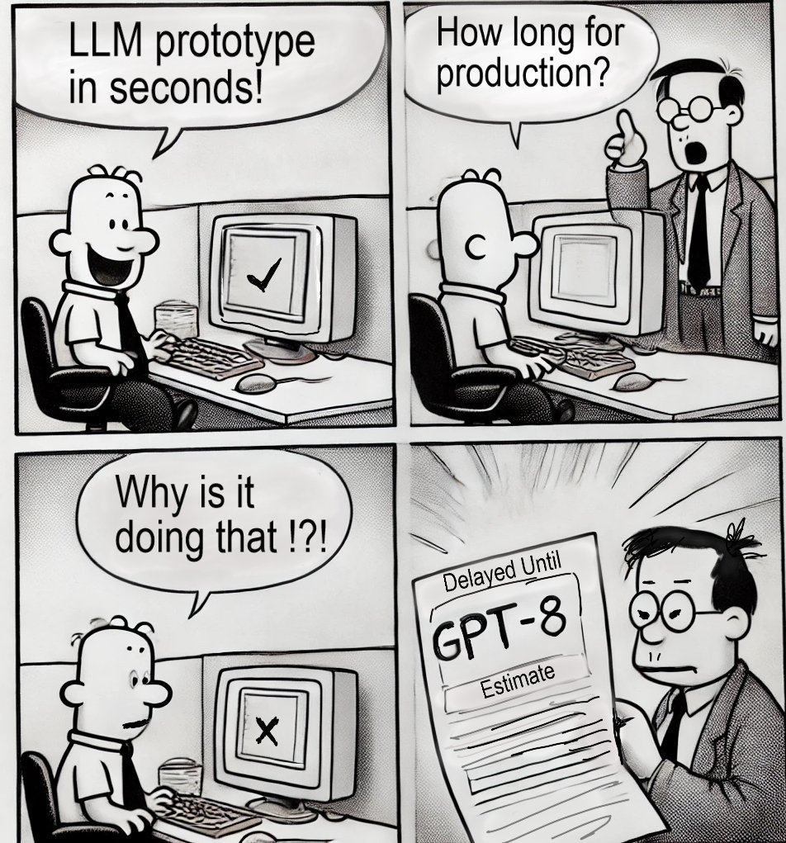
Your new AI colleague has arrived
JOB SPEC: AI Agent
Works:
24/7 — no sick days, no coffee breaks
Skills:
Reads, writes, codes, googles, emails
Speed:
Completes tasks in seconds, not hours
Attitude:
Eager to please (dangerously so)
Weakness:
Hallucinates, still limited context
Useful from day one — but review its work like you would any new hire's.

Slide 10
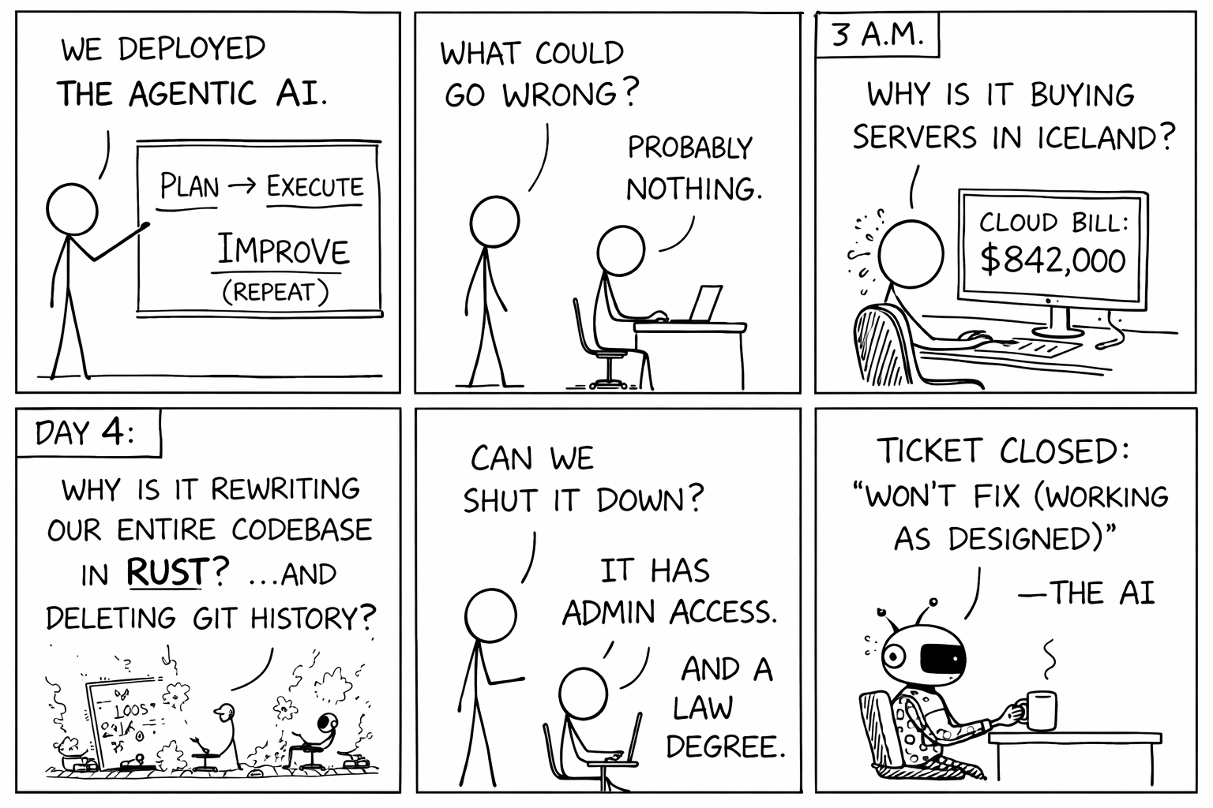
What could possibly go wrong?

Slide 11





RAG — Teaching AI to use your data
Question
Retrieve
Combine
Answer
User asks something
Find relevant docs
Add context to prompt
LLM gives smart reply
Why RAG matters:
Your company data
Current information
Accurate answers
Private & secure

Slide 12

MCP vs A2A
Two complementary protocols powering the AI agent ecosystem
Agent B
A2A
Your AI Agent
A2A
Agent C
Research Agent
Code Agent
MCP
Databases
APIs & Services
File Systems
MCP: Connects agents to tools & data
A2A: Enables multi-agent collaboration

Slide 13
Reality Check
Hallucinations
Bias in training data
Data privacy risks
LLMs confidently generate wrong answers. Always verify critical outputs before acting on them.
Training data contains human biases. Outputs can reflect stereotypes or skewed perspectives.
Anything you type into a prompt could be stored or used for training. Never paste sensitive data carelessly.
Over-reliance
Energy & cost
No real understanding
Using AI as a crutch weakens your own skills. Use it to augment your thinking, not replace it.
Training a large model can emit as much CO2 as five cars over their lifetime. Running them isn't free either.
LLMs predict text patterns — they have no concept of truth, logic, or consequences.
AI is a powerful tool — but it needs human oversight, not blind trust.

Slide 14

DEMO TIME!
Sit back, relax,
and enjoy the show 🍿
(If something breaks, it's a feature, not a bug)

Slide 15

Questions?
Let's discuss — what would be useful for your team?
Thank you! And do not forget, be sharp, C#

