Slide 1
Rigid Body Simulation
PBS Final Project
Ivan Waldboth
Mathias Hölzl
Florian Tischler

Slide 2
Goals
2D rigid body simulation
Real-time
Visualization
Dynamic and static objects
Simple Objects (spheres, boxes)
Editable Environment (adding, moving objects)
Stretch goals
Debug visualization
Arbitrary convex objects
Kinematic objects

Slide 3



Goals
2D rigid body simulation (partial)
Real-time
Visualization
Dynamic and static objects
Simple Objects (spheres, boxes)
Editable Environment (adding, moving objects)
Stretch goals
Debug visualization
Arbitrary convex objects
Kinematic objects

Slide 4
Implementation
Semi-implicit Euler integrator
Simple collision detection
Inside-outside test for points
Line-line intersection test for finding contact point
O(n²)
Impulse-based collision resolution (lecture)
Additionally
Friction
Position correction
Slop
OpenMP parallelization

Slide 5
Problems
Tunneling
Needs continuous collision detection
Instabilities due to no resting contact resolving
Warm starting
Keep contacts of previous iteration and compare with new ones
If new contact point close to old one
Keep previous contact
Mark it persisent
At resolution use previous impulse
Collision detection issues
Expensive (O(n²)
Points not detected when lying on edge/point

Slide 6
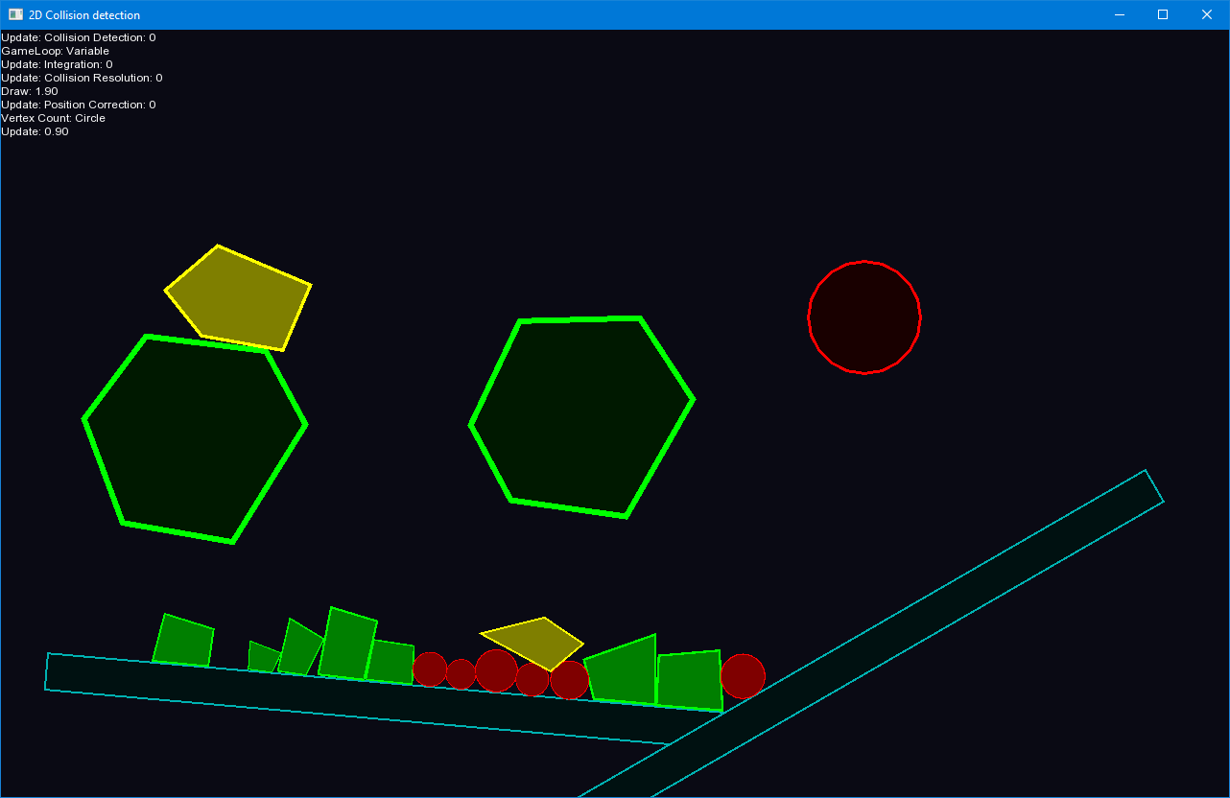
Demo

