Slide 1
Salary Hike Project - Predict Salary

Slide 2
Objective
Predict Salary using Years of Experience.
Solution
Linear Regression model.
Use Experience as Dependent Variable

Slide 3
Business Impact
Helps HR and management understand compensation drivers and forecast salary trends.

Slide 4
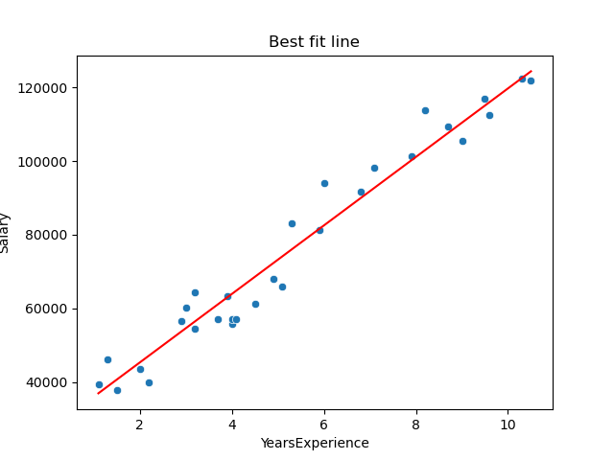
EDA - Salary vs Experience

