Slide 1

React
Teacher: Tal Yaron

Slide 2
SPA – single page application
Page 1

Slide 3
SPA – single page application
Page 1

Slide 4
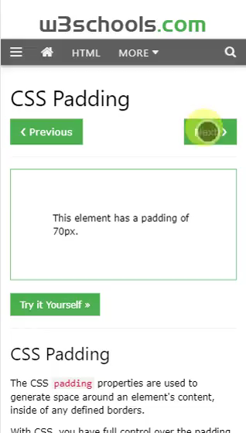
SPA – single page application
Page 2

Slide 5
SPA – single page application
Page 1
SPA
Page 1
Page 1
Page 1
Page 2

Slide 6
SPA – single page application
Router
Page 1
Page 1
Page 1
Page 3
Page 2

Slide 7
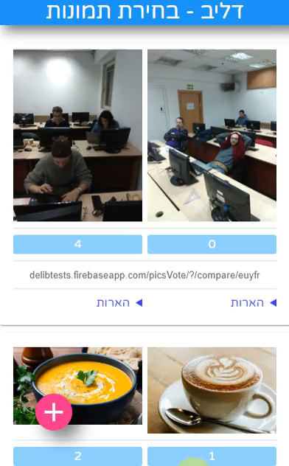
SPA – single page application
Router
Page 1
Page 1
Page 1
Page 3
Page 2

Slide 8
npx create-react-app my-app --template typescript

Slide 9
React - components
Component

Slide 10
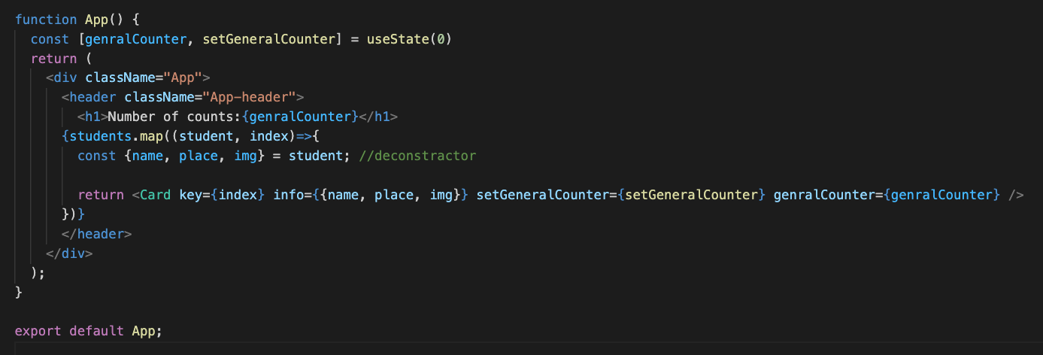
React - components
Component

Slide 11
React – components modularity
Component
props
Component

Slide 12
React – components modularity
Component
props
Component

Slide 13
React – data flow
Component
data
props
Component

Slide 14
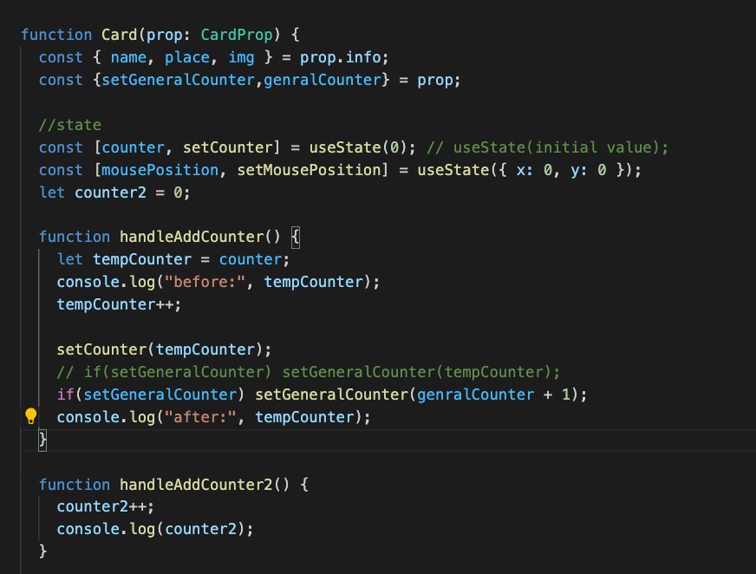
React – data flow
Component
data
props
Component

Slide 15
React - state
Component
Model-view
(state)

Slide 16
React – Lifting state up
Component
data
props
Component

Slide 17
React - state
Component
Model-view
(state)

Slide 18
React - Router
Router
Page 1
Page 1
Page 1
Page 3

Slide 19
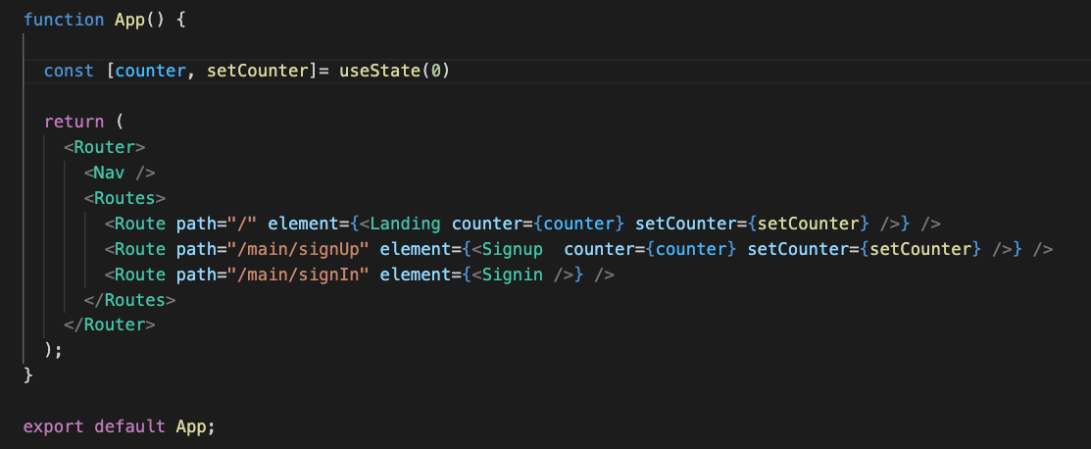
React - Router
Router
Page 1
Page 1
Page 1
Page 3

Slide 20
React - async
DB
async
Page
Components

Slide 21
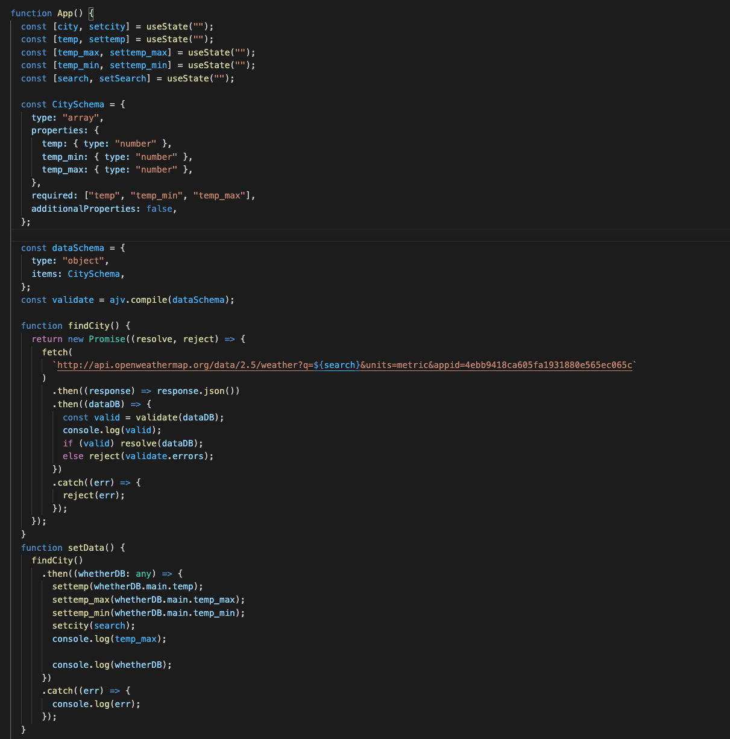
React - async
DB
async
Page
Components

Slide 22
React - async
DB
async
Page
Components

Slide 23
React – app state
app state
JS (Bundle)
Router
Page 1
Local data (state)
Page 1
Page 1
Page 3
Components

Slide 24
React – Lifting state up
app state
Local data (state)
Lifting state up
Page 3
Components

Slide 25
SPA – single page application
DB
Async
app state
Page 1
Local data
(state)
Page 1
Page 1
Page 3
Components
Components

Slide 26
Passing props
<Components title=‘something’ />
Props
Components
<div>{props.title}</div>

Slide 27
Changing component state
Components
const = [color, setColor] = useState(‘initial color’)
The UI will update
setColor(‘new color’)

Slide 28
SPA – single page application
MVC
Model – data (state)
View – DOM (Components)
Controllers - Functions
Page 1
Local data
Page 1
Page 1
Page 3
Components
Components
app state

Slide 29
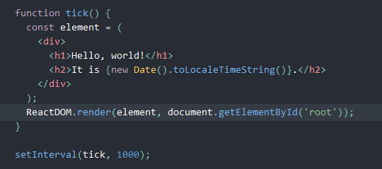
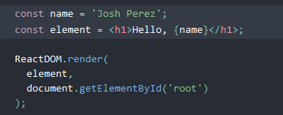
React: elements and JSX
From react tutorial:
Element
JSX

Slide 30

React: components
Function

Slide 31

Install
After installation change directory, and start the app:

Slide 32
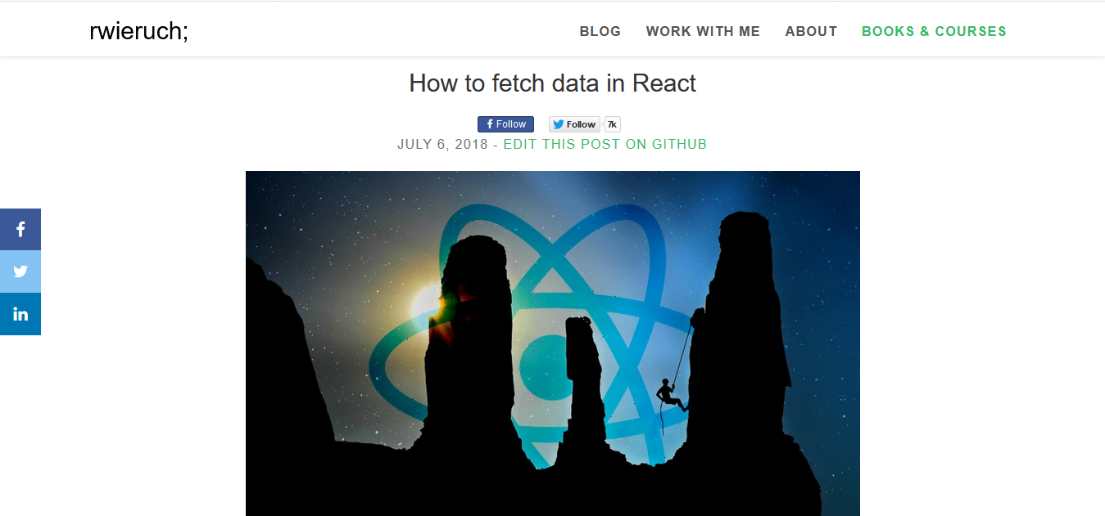
Sample Footer Text
8/10/22
32

Slide 33
React lifecycles
Sharif: advance explanation

Slide 34
Use context and app state
app state
State
(data-ui coupling)
Props
Page 3
Components
Page 1
Page 1
Page 1

Slide 35
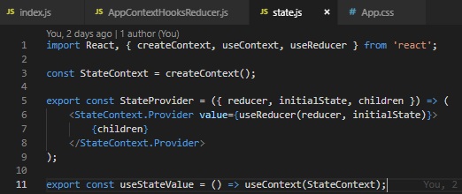
App state – state provider

Slide 36


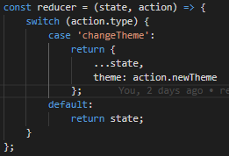
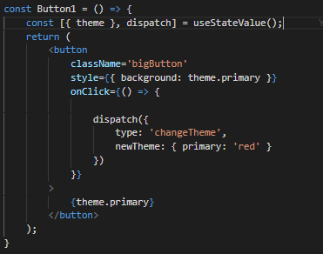
State Provider
Action
Reducer
Payload

