Slide 1




Node JS
REST API & async
הדרכה: טל ירון

Slide 2

Server - client

Slide 3
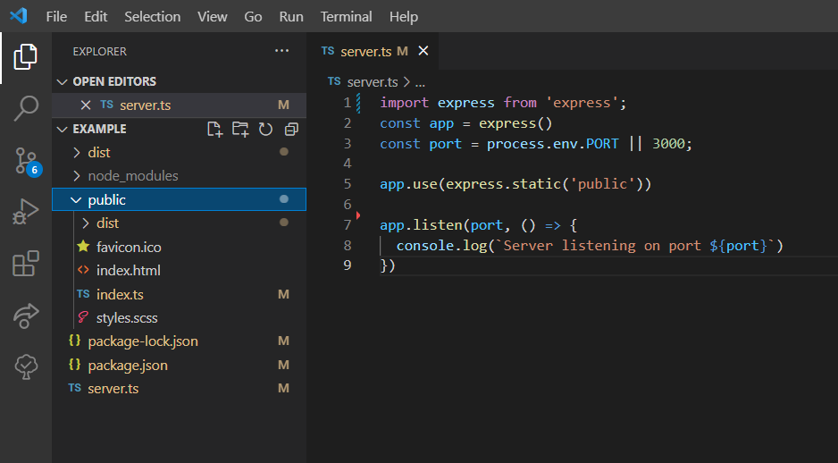
Server - Public

Slide 4



The sever holds information for the clients
How do they communicate?
REST API

Slide 5


Async await functions

Slide 6
Client – server communication
code

Slide 7
Client – server communication
code
Multi thread

Slide 8
Client – server communication
code
Single thread – event loop
Event loop

