Slide 1
UNSW MARKETING ANALYTICS HACKATHON 2026 · FINAL
When Every Story
Sounds the Same
The attention bottleneck is what is live beside it.
Ruiyang Zheng · Ruohan Wang · Hongxin Luo · Yiou Liu · Jingzhi Hu
LIVE MARKET
Notes:
Good morning. Kiva borrowers are often encouraged to tell a more distinctive story. But a story is never seen in isolation. It appears beside other live requests, often using similar recurring language. Our question is: when every story sounds the same, is the bottleneck competition right now, repetition from the recent past, or both? Our answer is more selective—and more useful—than we expected. The most reliable signal is what is live beside a story when that story enters the market.

Slide 2
KIVA NARRATIVE ATTENTION
02
Two candidate channels imply two different tests
CURRENT
RECENT-LISTING PROXY
Many live alternatives
+ similar stories
Similar same-sector posts
35–65 days earlier
Active saturation asks what a lender could choose at the focal loan’s posting moment.
A posting-age lexical proxy tests wear-out without observing exposure, page exit or memory.
TEST
TEST
Listing cadence + exposure mix
Editorial refresh + templates
Research design from the finalist proposal; definitions frozen before outcome modelling.
5 GUYS · 02
Notes:
We separate two candidate channels that can both look like slower funding. Active saturation means many live alternatives with strong focal-to-pool lexical overlap. The recent measure captures similar same-sector language posted 35 to 65 days earlier. It tests a wear-out hypothesis, but it does not observe exposure, page exit or lender memory. The distinction changes what to test: current competition points to timing and exposure; a validated wear-out mechanism would point to editorial refresh.
[Sources]
Research design from the finalist proposal; definitions frozen before outcome modelling.

Slide 3
KIVA NARRATIVE ATTENTION
03
1.23 million training loans reconstruct each listing’s market at posting
2016
2024
2025 HOLDOUT
133,409
FIT
Text IDF · scalers · HDFE
No refit · out-of-time evaluation
1,234,131
600
2 outcomes
UTC
Main training loans
Exact pool identity checks
Funding time + 72 hours
One frozen time basis
Country + activity + week fixed effects · country/week two-way clustered standard errors
Sources: outputs/model_sample_flow.csv; outputs/frozen_spec.csv; outputs/pool_identity_summary.csv
5 GUYS · 03
Notes:
Our main training analysis contains 1,234,131 loans. For each focal listing, current volume is how many alternatives are available and current overlap is the focal story's mean lexical similarity to that active pool. We build a separate posting-age proxy from listings 35 to 65 days earlier. We compare masked and recurring-language-removed text, test time-based windows, and evaluate log one plus funding hours plus 72-hour funding. Every valid record has a raised date, so the analysis is conditional on this raised-only extract. The 2025 holdout is never used to refit preprocessing or the model.
[Sources]
Sources: outputs/model_sample_flow.csv; outputs/frozen_spec.csv; outputs/pool_identity_summary.csv

Slide 4
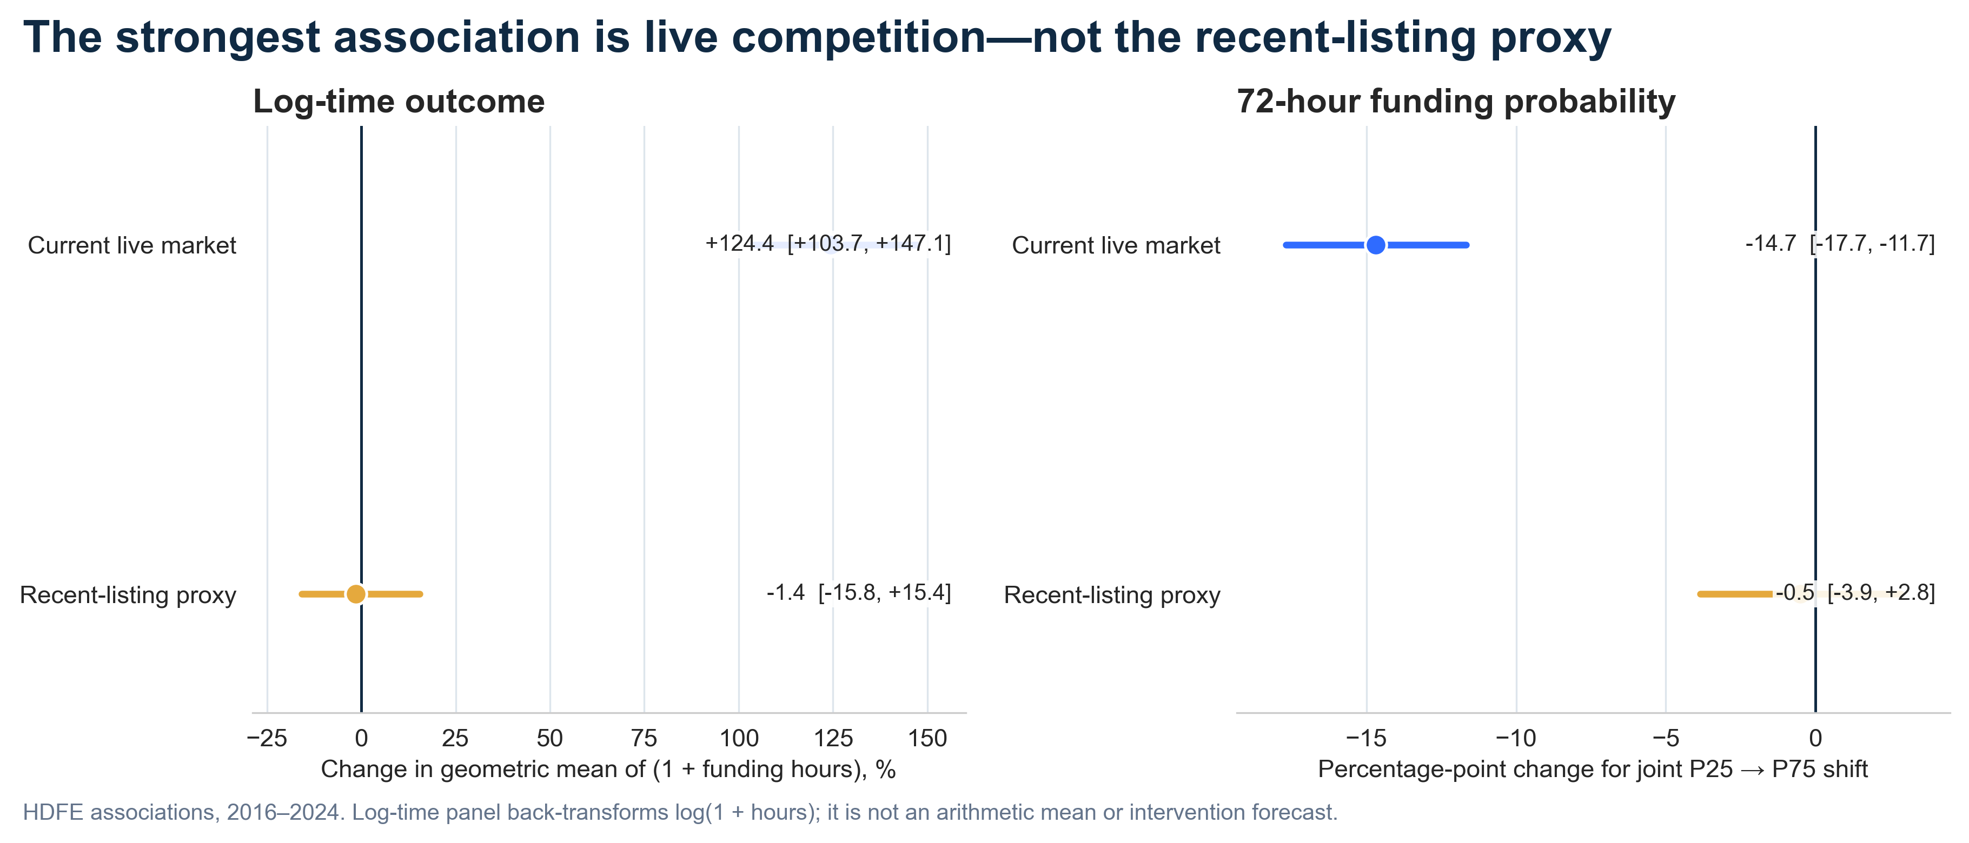
ASSOCIATION · NOT AN INTERVENTION FORECAST
Both scenario endpoints are populated in observed training support.
Source: outputs/scenario_contrasts.csv; outputs/joint_support_summary.csv
5 GUYS · 04
Notes:
This is our strongest diagnostic result. On the log one plus hours outcome, moving the current environment jointly from the 25th to the 75th percentile corresponds to a 124.38 percent higher conditional geometric mean of one plus funding hours, with an interval from 103.74 to 147.11 percent and a ratio of 2.24. This is not an arithmetic mean duration. The independent 72-hour co-outcome is 14.68 percentage points lower, with an interval from minus 17.69 to minus 11.68. Both endpoints are populated, but these remain associations, not intervention forecasts.
[Sources]
Source: outputs/scenario_contrasts.csv; outputs/joint_support_summary.csv

Slide 5
KIVA NARRATIVE ATTENTION
05
The current signal depends partly on how text is represented
CURRENT INTERACTION
What this means
Masked use
.1016
p = .0033
Signal attenuates
Recurring language may contribute to the masked-use association.
Recurring language removed
.0523
p = .129
Not a decomposition
The coefficient difference itself was not formally tested.
Masked description
.1323
p < .001
Shift the burden
Test platform and partner processes—not louder borrower stories.
Sources: outputs/robustness.csv; outputs/description_robustness.csv
5 GUYS · 05
Notes:
Using masked use text, the current interaction is 0.1016 with p 0.0033. After removing recurring language, it falls to 0.0523 with p 0.129. The estimate roughly halves and is no longer distinguishable from zero. That does not prove templates explain half because the coefficient difference itself was not formally tested. Description text gives a significant current interaction of 0.1323, while its recent interaction is not significant. Together, this shifts the managerial focus from borrower rewriting toward platform and partner processes.
[Sources]
Sources: outputs/robustness.csv; outputs/description_robustness.csv

Slide 6
KIVA NARRATIVE ATTENTION
06
The recent-listing proxy shows no detectable joint penalty
LOG-TIME BACK-TRANSFORM
72-HOUR PROBABILITY
−1.43%
−0.51pp
95% CI −15.82% to +15.43%
95% CI −3.86pp to +2.84pp
0
0
Intervals cross zero
A posting-age proxy does not support broad average wear-out—not that wear-out is impossible.
Source: outputs/scenario_contrasts.csv
5 GUYS · 06
Notes:
The recent-listing proxy tells a different story. Its representative P25-to-P75 log-time back-transform is minus 1.43 percent, with a 95 percent interval from minus 15.82 to plus 15.43. The 72-hour contrast is minus 0.51 percentage points, with an interval from minus 3.86 to plus 2.84. Both cross zero. Because the main measure is a posting-age lexical proxy rather than observed exposure, we do not find support for an average wear-out claim. That is not the same as proving wear-out can never occur.
[Sources]
Source: outputs/scenario_contrasts.csv

Slide 7
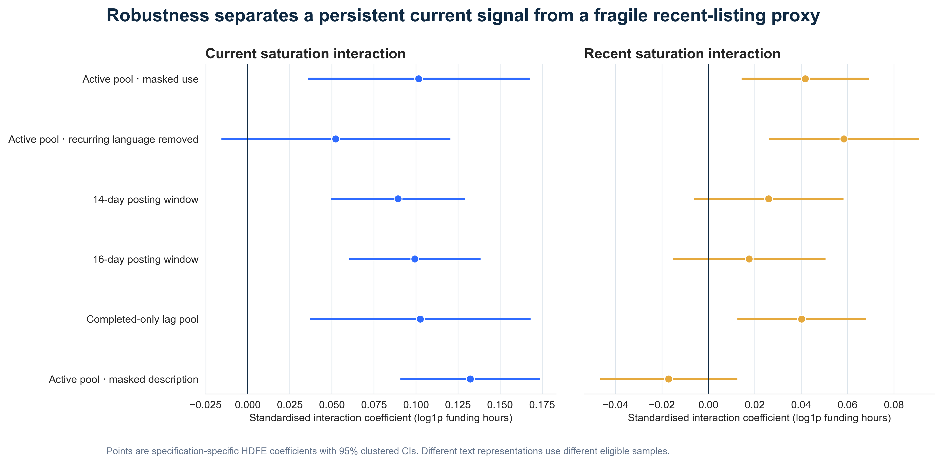
Current survives 14/16-day windows and description. Recent does not survive the time-based or description checks.
Sources: outputs/robustness.csv; outputs/description_robustness.csv
5 GUYS · 07
Notes:
There is an important nuance. The raw recent-listing interaction is statistically positive, but it answers a local conditional question. The joint scenario asks about the net log-time contrast when recent volume and overlap move together. The current interaction remains positive in both 14-day and 16-day posting-window checks and appears again with description text, but it attenuates and crosses zero after recurring-language removal. The recent-listing interaction does not survive the time-based checks or description sensitivity. The honest conclusion is a strong but representation-sensitive current diagnostic association, not a broad wear-out claim.
[Sources]
Sources: outputs/robustness.csv; outputs/description_robustness.csv

Slide 8
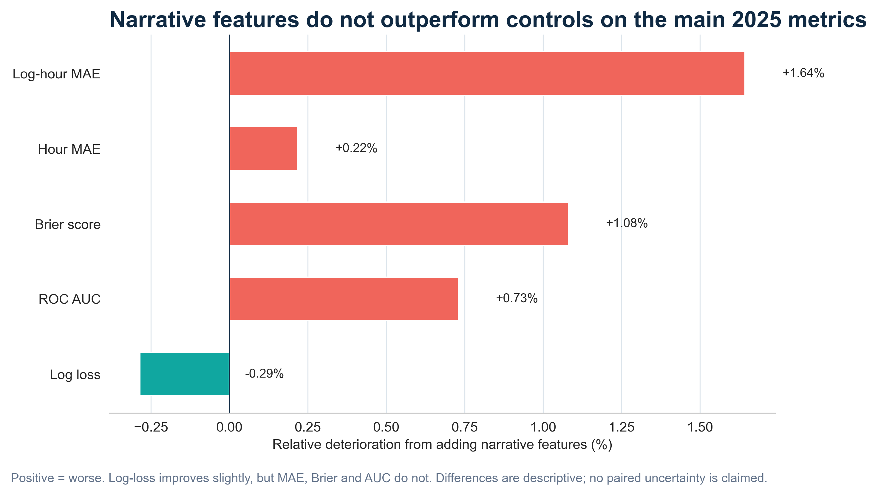
Source: outputs/holdout_validation.csv · Differences are descriptive; paired uncertainty not estimated.
5 GUYS · 08
Notes:
A variable can explain a historical association without improving future prediction. On the 2025 holdout, the narrative-enhanced model does not outperform controls-only on the main operational metrics. Log-hour MAE is 0.9822 versus 0.9663; Brier is 0.1369 versus 0.1354; AUC is 0.8921 versus 0.8987. Log-loss improves slightly. Because we have not estimated paired uncertainty for these metric differences, we say did not outperform, not significantly worsened. These results do not support deploying a scoring engine.
[Sources]
Source: outputs/holdout_validation.csv · Differences are descriptive; paired uncertainty not estimated.

Slide 9
KIVA NARRATIVE ATTENTION
09
The evidence supports experiments on the market—not borrower scoring
PILOT A
PILOT B
Stagger or diversify
live exposure
Test partner-approved
template alternatives
Randomize inside pre-defined high-current-saturation states.
Do not ask borrowers for more sensitive or more burdensome storytelling.
Business as usual
→
Staggered / diversified
Current template
→
Approved variants
PRIMARY
GUARDRAILS
NO SCORE
Funding time · 72-hour probability
Total funding · fairness · borrower workload
Recommendation derived from scenario, robustness and 2025 holdout evidence.
5 GUYS · 09
Notes:
Our recommendation is deliberately narrower. When current saturation is high, test whether staggering similar listings or diversifying exposure improves funding. Separately, test partner-approved template alternatives without adding borrower burden. These should be small randomized pilots. Primary outcomes are time to funding and 72-hour probability; guardrails include total funding, fairness and borrower workload. Saturation identifies a market condition worth testing. It does not measure borrower quality and must not rank or penalize borrowers.
[Sources]
Recommendation derived from scenario, robustness and 2025 holdout evidence.

Slide 10
WHAT WE LEARNED
Change the market
around the story.
01
Current attention pressure is the strongest practical signal.
02
The recent-listing proxy does not support broad wear-out.
03
Test prospectively; do not deploy a borrower score.
5 GUYS · UNSW 2026
Notes:
Our analysis leaves three conclusions. First, the strongest diagnostic signal is current attention pressure, although it is sensitive to text representation. Second, the recent-listing proxy does not support broad wear-out. Third, narrative features do not add reliable 2025 predictive value on the main operational metrics. Our model is not ready to score borrowers—and that is exactly why our recommendation is safer: change the market around the story, test it prospectively, and scale only what improves funding without shifting the burden onto borrowers.
[Sources]
Sources: outputs/scenario_contrasts.csv; outputs/robustness.csv; outputs/holdout_validation.csv

Slide 11
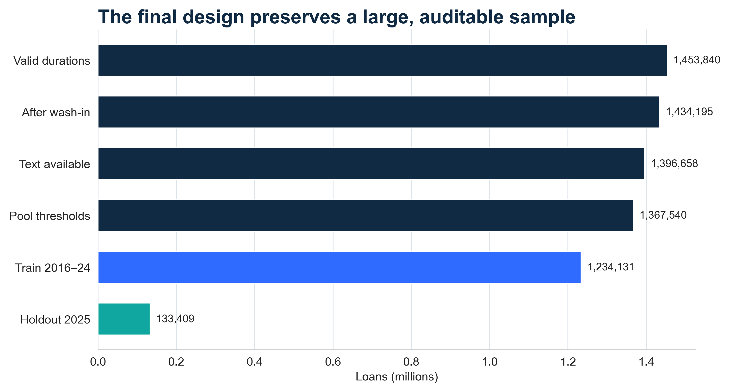
APPENDIX · DATA
Raised-only extract
Every valid row has a raised date; no observable right censoring.
Six invalid durations
Raised timestamp precedes posting; excluded from outcome analysis.
Frozen split
2016–24 fit; 2025 remains out of time.
No private text
Names, exact locations and full descriptions stay outside the final ZIP.
Sources: outputs/model_sample_flow.csv; outputs/data_profile_summary.csv; outputs/status_raised_crosstab.csv
5 GUYS · 11
Notes:
Appendix: the source has 1,453,846 loans; six invalid negative-duration rows are excluded. Every valid row has raisedDate, so a true right-censored AFT model is not supported by this extract. The final package omits raw personal text and exact locations.
[Sources]
Sources: outputs/model_sample_flow.csv; outputs/data_profile_summary.csv; outputs/status_raised_crosstab.csv

Slide 12
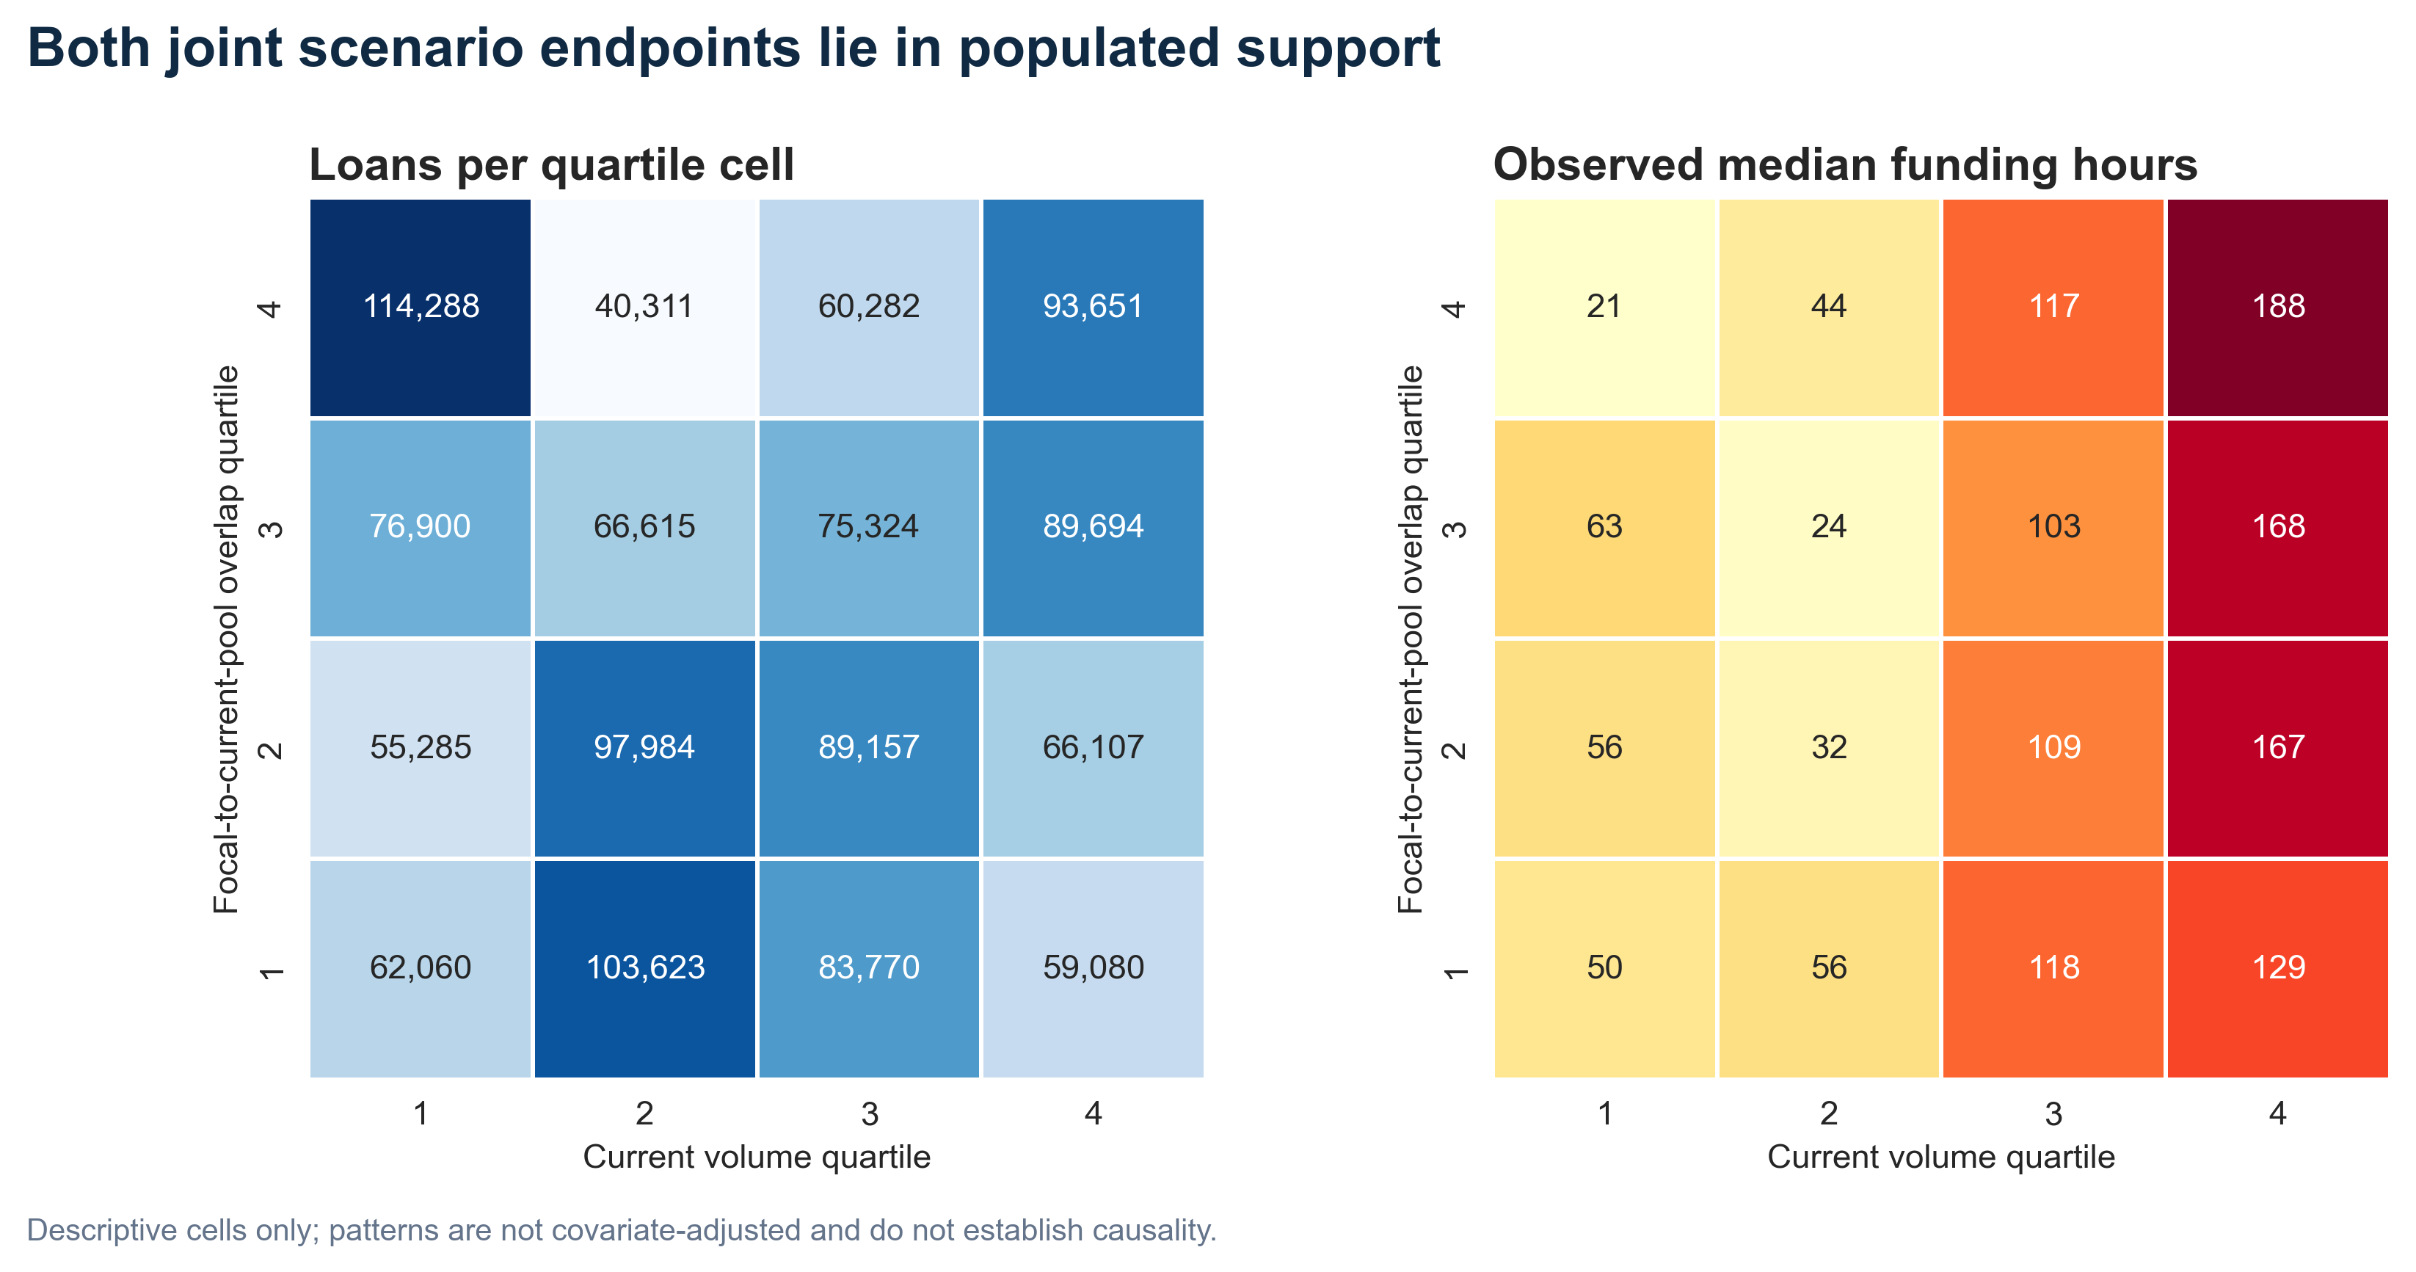
APPENDIX · VALIDATION
600
raw + residual
identity checks
2.89e−14
maximum raw
absolute error
PASS · threshold 1e−9
Support is descriptive—it does not establish causality.
Sources: outputs/pool_identity_summary.csv; outputs/joint_support_summary.csv
5 GUYS · 12
Notes:
Appendix: the rolling vector-sum implementation is verified against exact brute-force similarity for 200 focal loans across three pools, 600 checks total. Maximum raw error is 2.89e-14, well inside the 1e-9 gate. The P25/P75 endpoints have populated local support, but support does not establish causality.
[Sources]
Sources: outputs/pool_identity_summary.csv; outputs/joint_support_summary.csv

Slide 13
APPENDIX · MODEL
13
The model separates current and recent environments within a fixed specification
log(1 + funding hours) ~ C + H + C×H + V + G + V×G + controls | fixed effects
CURRENT
RECENT
CONTROLS + FE
C
log1p active same-sector count
V
log1p [35,65)d decayed posting weight
Loan amount
Borrower count
Repayment term
Platform 7-day volume
H
focal-to-active-pool lexical overlap
G
decayed focal-to-pool lexical overlap
C×H
current saturation interaction
V×G
recent saturation interaction
Country · activity · week
Source: src/fit_main_models.py; outputs/frozen_spec.csv
5 GUYS · 13
Notes:
Appendix: this is the main HDFE specification. C is log one plus active count and H is focal-to-active-pool lexical overlap. V is log one plus decayed posting weight for listings 35 to 65 days earlier and G is the corresponding lexical overlap. The recent pair is a posting-age proxy, not observed exposure or page exit. All components are standardized from 2016 to 2024 before interactions are created. Fixed effects and controls reduce confounding but do not create causal identification.
[Sources]
Source: src/fit_main_models.py; outputs/frozen_spec.csv

Slide 14
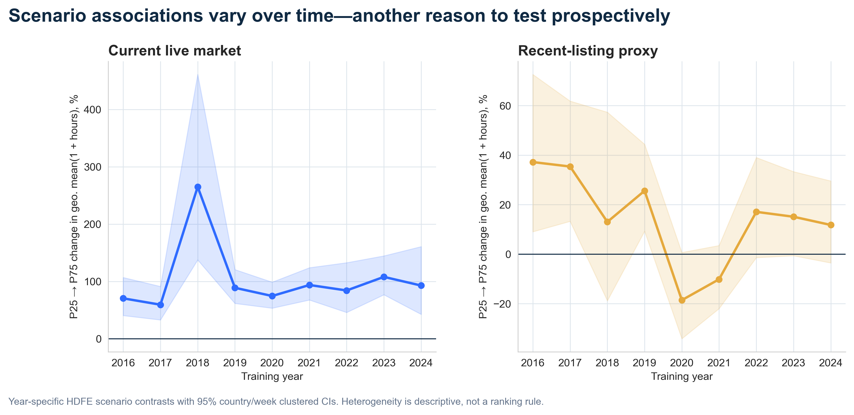
DESCRIPTIVE HETEROGENEITY · NOT A TARGETING RULE
Source: outputs/rq3_year_effects.csv; outputs/rq3_global_tests.csv
5 GUYS · 14
Notes:
Appendix: year-specific scenario associations vary materially. We do not convert this volatility into a year or subgroup ranking. The global heterogeneity screens are descriptive and do not estimate every cross-group covariance induced by shared week shocks.
[Sources]
Source: outputs/rq3_year_effects.csv; outputs/rq3_global_tests.csv

Slide 15
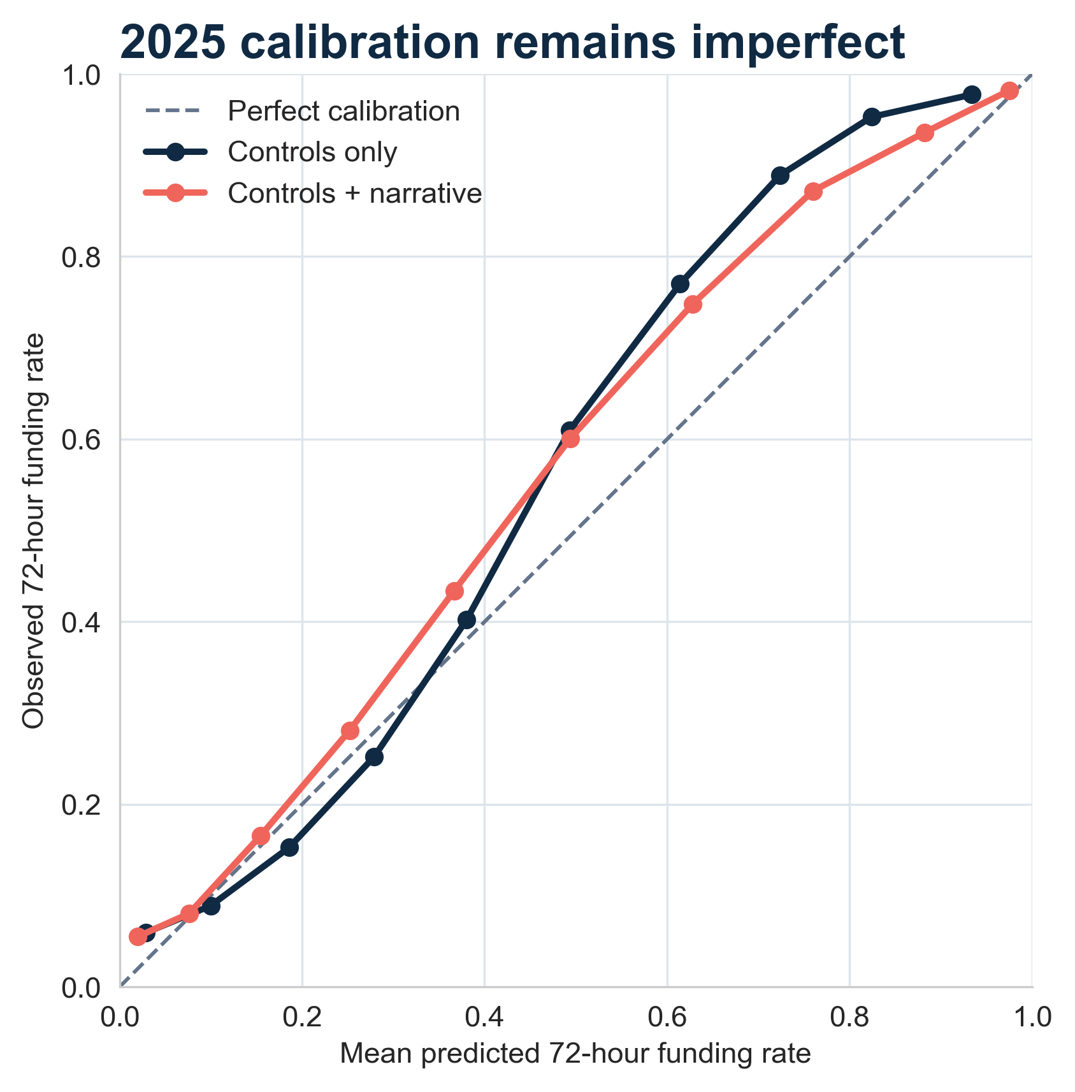
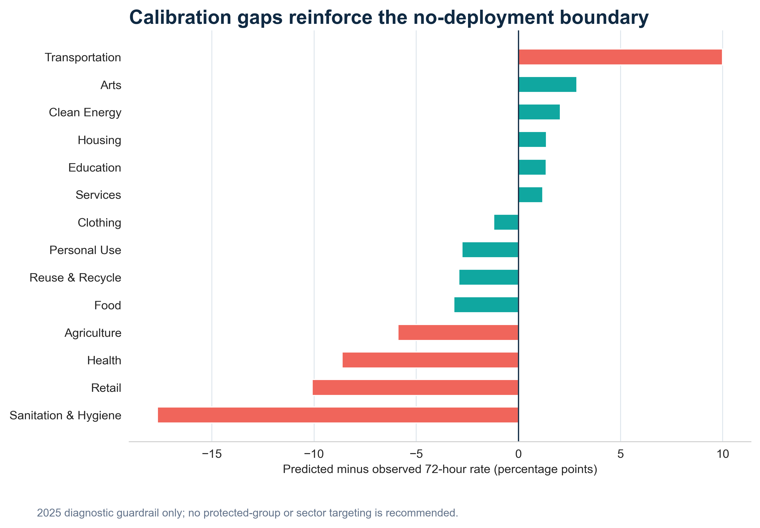
APPENDIX · DEPLOYMENT BOUNDARY
Imperfect calibration + no consistent incremental lift = experiment triage only
Sources: outputs/holdout_calibration.csv; outputs/fairness_diagnostics.csv
5 GUYS · 15
Notes:
Appendix: 2025 calibration remains imperfect, with material gaps in several sectors. These diagnostics reinforce the no-deployment boundary. We do not use group membership for targeting; fairness diagnostics are guardrails for future prospective experiments.
[Sources]
Sources: outputs/holdout_calibration.csv; outputs/fairness_diagnostics.csv

Slide 16
APPENDIX · AUDIT
16
Every headline claim has an explicit evidence gate
STAGE
GATE
STATUS
EVIDENCE
Source intake
Restricted opcode audit
PASS
0 dangerous opcodes
Text leakage
Train-only IDF + scaler
PASS
2016–24 fit; fixed on 2025
Pool algebra
Brute-force identity
PASS
max 2.89e−14
Scenario support
Endpoint neighbourhood
PASS
minimum 4,716 loans
Current signal
14/16d + description + residual
CAVEAT
positive except residual CI crosses 0
Recent claim
Joint + time checks
NO CLAIM
intervals cross zero
Deployment
2025 incremental lift
NO DEPLOY
MAE/Brier/AUC do not win
Full bilingual judge Q&A: JUDGE_QA_BILINGUAL.md
All exact tables: outputs/ · Reproducible notebooks: notebooks/
Sources: audit/ manifests; outputs/ validated CSV tables
5 GUYS · 16
Notes:
Appendix: this summarizes the gates behind the claims. Passing a computation gate does not broaden the claim boundary. The current association is supported by active, posting-window and description specifications but is sensitive to recurring-language removal. Broad wear-out and deployment remain explicitly unsupported.
[Sources]
Sources: audit/ manifests; outputs/ validated CSV tables

