Slide 1
UMD Alumni Events Analysis
Project_0506_14
Team 14
Jinping (Bella) Guo, Siying (Skylar) Li, Tanya Singh, Sowmya Murukuti

Slide 2
Agenda
Introduction: mission statements and objectives
Methods
Findings
Recommendations
Future Work

Slide 3
Introduction
Mission Statements :
To identify the variables that affect first-time
attendees and major gift prospect attendees.
Objectives:
To attract more first time attendees.
To obtain more major prospects.

Slide 4
Method
Descriptive method
Base on historical data (from FY 2013 to FY 2020) in order to identify patterns
Reason:
Categorical variables
Providing basic information about variables in a dataset
Highlighting potential relationships between variables

Slide 5
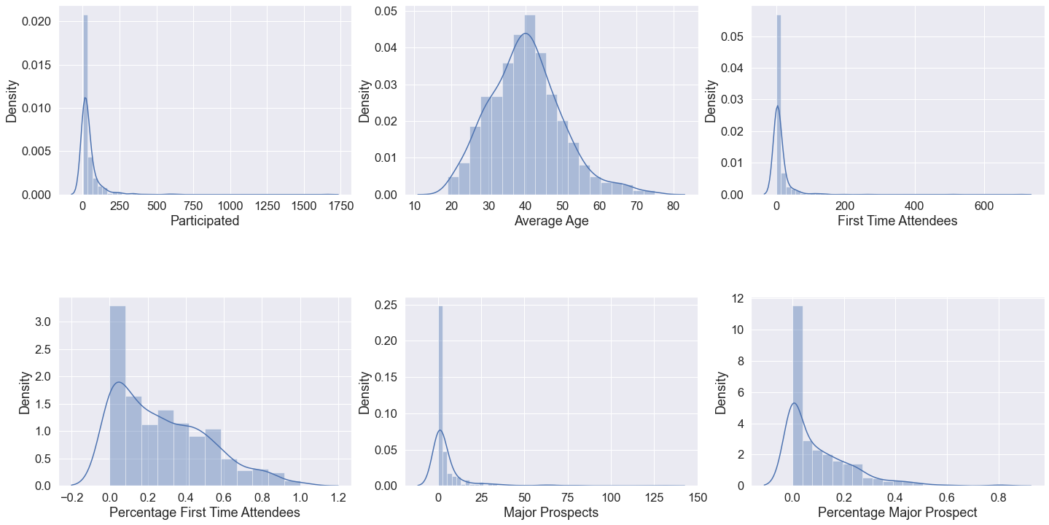
Method (Cont)
Data Preparation
Merge Data
Check Data
Check Missing Value
Descriptive Statistics
Variables Distribution

Slide 6
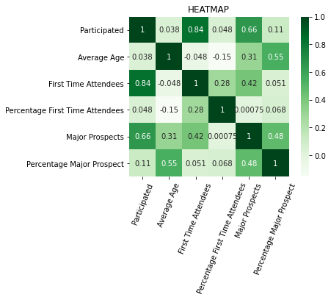

Method (Cont)
Correlation Matrix:
Major Prospects vs Participated
First Time Attendees vs Participated
Percentage of Major Prospect and Average age

Slide 7
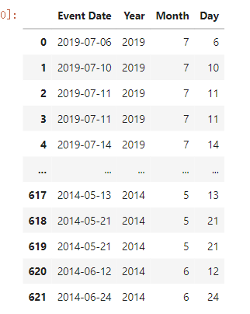
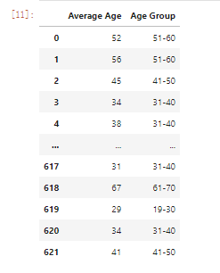
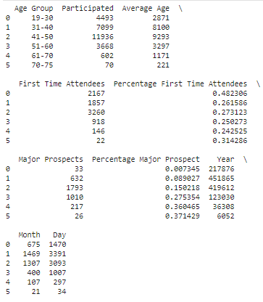
Method (Cont)
Analyze Variables:
Variable Data Preparation
Segmented ‘ Average Age’
Calculated the percentage
of
major prospects/ first-time attendees
Added Column ‘Month’

Slide 8
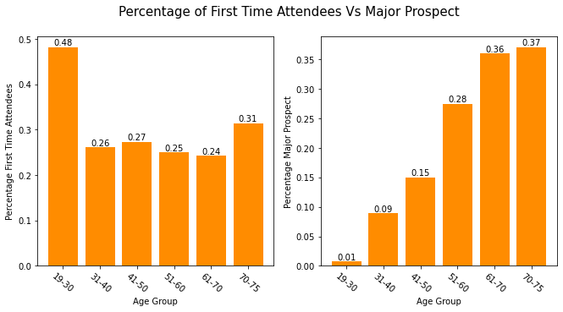
Findings - Age

Slide 9
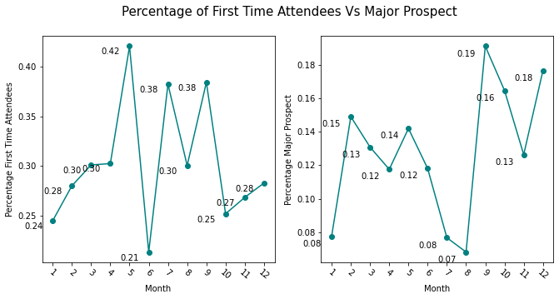
Findings - Event Date

Slide 10
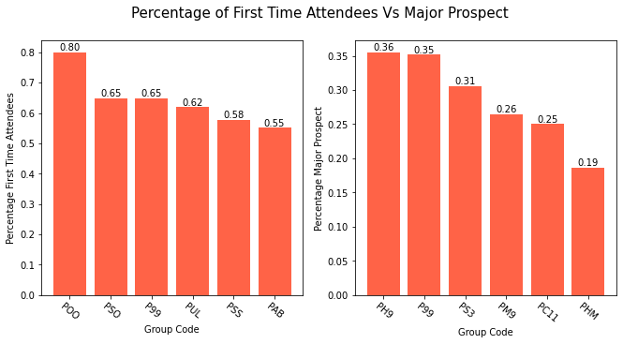
Findings - Group
P99 : CP Social-General

Slide 11
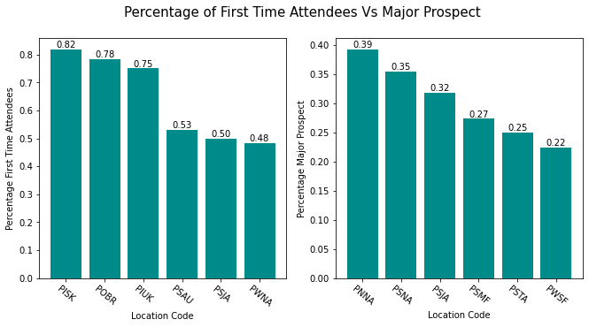
Findings - Location
CP International- South Korea
CP Northeast- General

Slide 12
Recommendations
Based on First Time Attendees Data
Target marketing can be done for age groups 19-30.
More events can be planned around May and least during June.
Organize more events on CP International- South Korea
Target marketing can be done for Group code POO.
Notes:
First time attendees vs Age
First time attendees vs Month
First time attendees vs Location
First time attendees vs Group code

Slide 13
Recommendations
Based on Major Gift Prospects
Age groups 70-75 can be made our target market.
More events in September and less events in August.
Gifting prospects are highest in Location code of CP Northeast- General.
More marketing among group codes PH9 and P99 for higher donation prospects.
Notes:
First time attendees vs Age
First time attendees vs Month
First time attendees vs Location
First time attendees vs Group code

Slide 14
Future Work
1. Use Machine Learning for better strategy formation.
2. Use Cloud Storage and availability of Long - term Data Structure.
3. Gather More Demographic Details

Slide 15
Thanks!
Any questions?

