Slide 1
Machine Learning, Deep Learning, and Security.

Slide 2
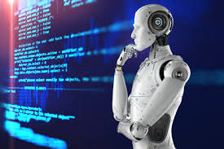
1.1.1 Artificial Intelligence Refers to the simulation of human intelligence
1. Machine Learning (ML).
Mimicking the intelligence or behavioral pattern of humans or any other living entity.
تقليد نمط الذكاء أو السلوك البشري أو أي كائن حي اخر.
Artificial Intelligence

Slide 3
What is ML?

Slide 4
Machine learning
تعلــــــــــــــــــــــــــــم الالــــــــــة
ML Enables computers to learn from data
ML is a branch of artificial intelligence (AI) that allows computers to automatically learn from data.
A technique by which a computer can “learn” from data without using a complex set of rules.
Mainly based on training a model from datasets.
Artificial Intelligence
Machine Learning is the field of study that gives computers the ability to learn without being explicitly programmed.
Arthur Samuel, 1959
Machine Learning
ML teaches the systems to think and understand like humans by learning from the data.

Slide 5
Machine learning تعلــــــــــــــــــــــــــــم الالــــــــــة
An algorithm is a set of mathematical instructions or rules that directs a computer program to solve a specific problem or perform a task.
In machine learning, an algorithm enables a model to process data, identify patterns, and make predictions.
Figure 1.1 The meaning of machine learning.

Slide 6
Machine learning تعلــــــــــــــــــــــــــــم الالــــــــــة
How does ML work ?
1- ML algorithm is trained using a training dataset to create a model.
2- When new input data is introduced to the ML algorithm, it makes a prediction on the basis of the model.
3- The prediction is evaluated for accuracy, and if the accuracy is acceptable, the ML algorithm is deployed.
4- If the accuracy is not acceptable, the ML algorithm is trained again with an augmented raining data set.

Slide 7
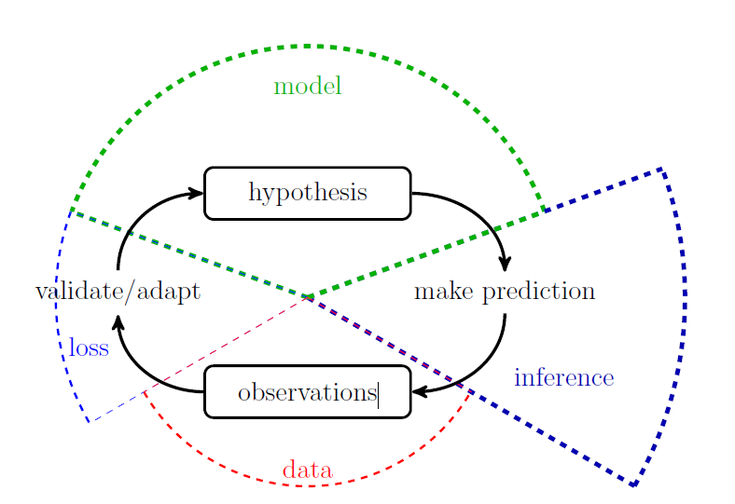
Machine learning تعلــــــــــــــــــــــــــــم الالــــــــــة
Machine learning combines three main components: model, data and loss.
Machine learning methods implement the scientific principle of \trial and error.
These methods continuously validate and refine a model based on the loss incurred by its predictions about a phenomenon that generates data.

Slide 8
Real-World Applications of Machine Learning Machine Learning is widely being applied and used in the real world today to solve complex problems that would otherwise have been impossible to solve based on traditional approaches and rule-based systems. The following list depicts some of the real-world applications of Machine Learning.
• Product recommendations in online shopping platforms
• Sentiment and emotion analysis
• Anomaly detection
• Fraud detection and prevention
• Content recommendation (news, music, movies, and so on)
• Weather forecasting
• Stock market forecasting
• Market basket analysis
• Customer segmentation
• Object and scene recognition in images and video
• Speech recognition
• Churn analytics
• Click through predictions
• Failure/defect detection and prevention
• E-mail spam filtering

Slide 9
Machine learning تعلــــــــــــــــــــــــــــم الالــــــــــة
Main Challenges of Machine Learning
Since your main task is to select a learning algorithm and train it on some data, the two things that can go wrong are “bad algorithm” and “bad data.”
Insufficient Quantity of Training Data : كمية بيانات التدريب غير كافية
The Unreasonable Effectiveness of Data: فعالية البيانات غير المعقولة
Nonrepresentative Training Data: بيانات تدريب غير تمثيلية
Poor-Quality Data. بيانات رديئة الجودة
Irrelevant Features. ميزات غير ذات صلة
Overfitting the Training Data الإفراط في ملاءمة بيانات التدريب
Underfitting the Training Data عدم ملاءمة بيانات التدريب

Slide 10
Necessary tools for practicing Machine Learning on your own data.
To practice machine learning on your own data, you'll need a few essential tools and libraries.
1. Programming Language: Python
Python is the go-to language for most machine learning tasks. It has a rich ecosystem of libraries,
frameworks, and community support.
2. Development Environment
IDE/Code Editor: You can use tools like:
Jupyter Notebook (great for experimentation and visualization)
VSCode or PyCharm (ideal for larger projects)
Google Colab (cloud-based and free, no setup required)
Python Environment Management:
Anaconda (for managing Python environments and packages easily)
Virtualenv or Conda (to create isolated environments)

Slide 11
3. Libraries and Frameworks
You’ll need the following libraries for preprocessing data, building models, and evaluating them:
a) Data Handling & Processing
Pandas: For handling structured data (like CSV, Excel files, databases)
NumPy: For numerical operations and arrays
Scikit-learn: A powerful library for standard machine learning tasks (classification, regression, clustering, etc.)
Matplotlib/Seaborn: For data visualization and plotting
OpenCV: For image processing tasks (if you're working with image data)
b) Deep Learning
TensorFlow or Keras: For building neural networks and deep learning models.
PyTorch: Another popular deep learning framework, known for dynamic computation graphs.
c) Model Evaluation & Validation
Scikit-learn: Also provides tools for model evaluation (cross-validation, accuracy, precision, recall, etc.)
XGBoost or LightGBM: For gradient boosting models, which perform well in structured/tabular data tasks.
d) Data Augmentation & Preprocessing (for specific data types)
Augmentor or ImageDataGenerator (for image data augmentation)
NLTK or SpaCy (for Natural Language Processing tasks)

Slide 12
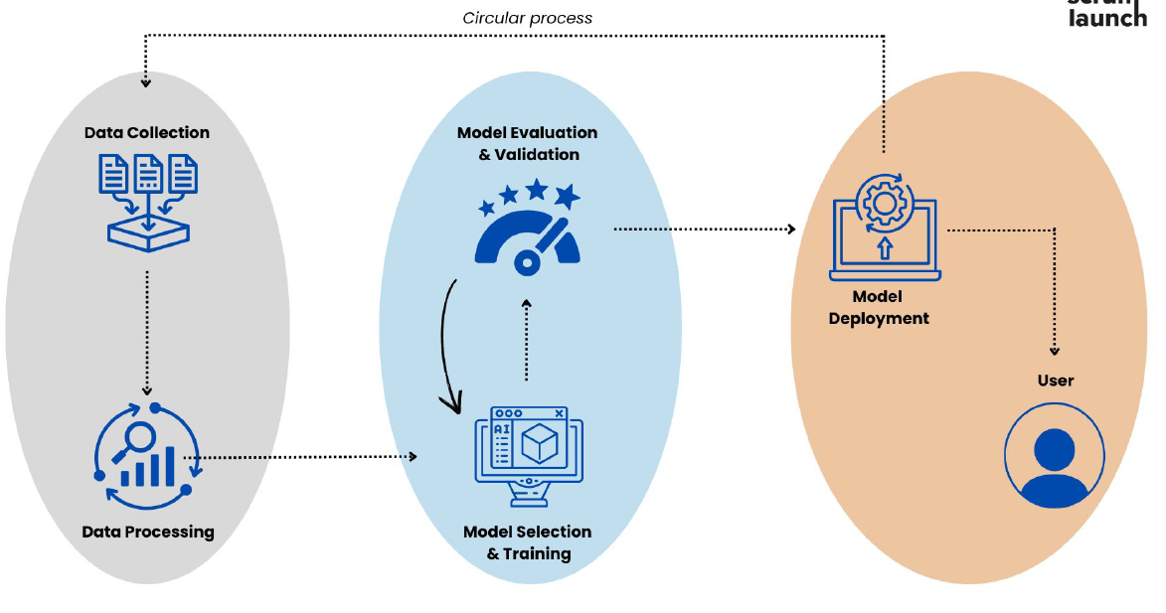
Machine Learning workflow steps

Slide 13
1. Data Collection & Preprocessing
Data collection and processing are essential parts of the ML process. They will determine how precise and effective the model will be.
Step 1: Data collection
The first step in the machine learning process is data collection. Data is the lifeblood of machine learning - the quality and quantity of your data can directly impact your model's performance. Data can be collected from various sources such as databases, text files, images, audio files, or even scraped from the web.
Once collected, the data needs to be prepared for machine learning. This process involves organizing the data in a suitable format, such as a CSV file or a database, and ensuring that the data is relevant to the problem you're trying to solve.
CSV (Comma Separated Values)

Slide 14


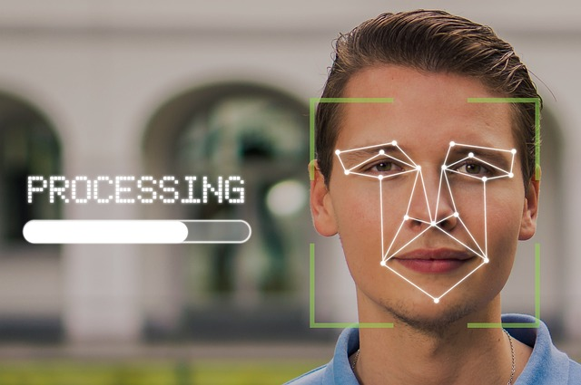

Fingerprints.
Handwriting,

Slide 15


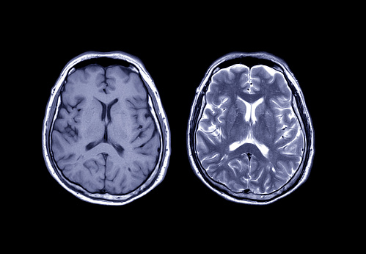

Slide 16
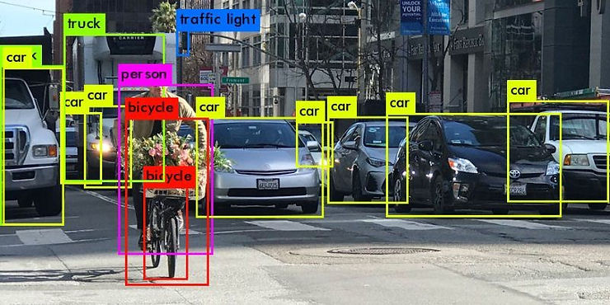

Slide 17
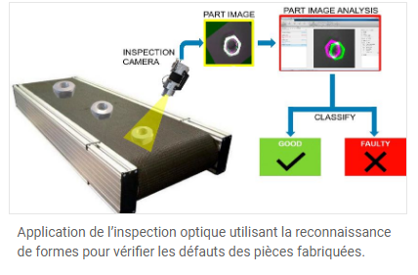

Slide 18
Step 2: Data preprocessing
Data preprocessing is a crucial step in the machine learning process. It involves cleaning the data (removing duplicates, correcting errors), handling missing data (either by removing it or filling it in) and normalizing the data (scaling the data to a standard format).
Preprocessing improves the quality of your data and ensures that your machine learning model can interpret it correctly.
This step can significantly improve the accuracy of your model.

Slide 19
Data preprocessing
Data preprocessing follows data collection and involves preparing the data for training the model. It consists of numerous crucial processes:
Data cleaning
Data transformation: Data transformation ensures that the data obtained is in an easily handled format to analyze. It may include:
1. Normalization
2. Encoding categorical features is done by converting such features into a numerical form that
machine learning algorithms can process.
Data augmentation: Data augmentation techniques can be used to increase the size and diversity of a data set. This is especially useful when data is limited, such as in image or text classification tasks. Generating additional data points from existing data can make the model more reliable and generalizable.
In summary, the data collection and processing phase is crucial for laying the groundwork for successful machine learning projects. By focusing on clear objectives, identifying quality data sources, and implementing robust processing techniques, you can significantly enhance the performance and reliability of your ML models.

