Slide 1
Step 3. Model Selection, Training & Validation
Model training, testing, and evaluation are the next steps in the machine learning process, which focuses on developing an accurate model to solve a specific problem. This stage involves selecting a suitable algorithm, training the model on the prepared data, and thoroughly evaluating its performance.
Choosing a model: The first step is to understand the nature of your problem.
Is it about sorting things into categories (classification), predicting numbers (regression), or grouping similar items (clustering)?
Determining the type of issue helps in choosing the right candidate models. Using your domain knowledge, you can identify proven effective models for similar tasks. The most common options include:
- Linear models.
- Tree models.
- Neural networks.

Slide 2
Step 4: Training the model
After choosing a model, the next step is to train it using the prepared data. Training involves feeding the data into the model and allowing it to adjust its internal parameters to better predict the output.
During training, it's important to avoid overfitting (where the model performs well on the training data but poorly on new data) and underfitting (where the model performs poorly on both the training data and new data).
Step 5: Evaluating the model
Once a model is trained, evaluating its performance on unseen data is essential before deployment. Common metrics for evaluating a model's performance include accuracy (for classification problems), precision and recall (for binary classification problems), and mean squared error (for regression problems).

Slide 3
Step 6: Hyperparameter tuning and optimization
Hyperparameter tuning is the process of selecting the optimal values for a machine learning model's hyperparameters. These are typically set before the actual training process begins and control aspects of the learning process itself. They influence the model's performance its complexity and how fast it learns.
Step 7: Predictions and deployment
Deploying a machine learning model involves integrating it into a production environment, where it can deliver real-time predictions or insights. MLOps (Machine Learning Operations) has emerged as a standard practice to streamline this process. It encompasses version control, monitoring, and automated testing to ensure models are reproducible, reliable, and robust. MLOps frameworks like MLflow or Kubeflow support these goals by providing seamless workflows for deployment, retraining, and model rollback if issues arise.

Slide 4
Example Workflow:
Data Collection/Preprocessing: Use Pandas and NumPy for data cleaning and preparation.
Exploratory Data Analysis (EDA): Visualize the data with Matplotlib/Seaborn.
Model Building: Use Scikit-learn, TensorFlow, or PyTorch.
Model Evaluation: Validate the model using Scikit-learn’s metrics.
Hyperparameter Tuning: Use grid search or randomized search for hyperparameter tuning.
Deployment: Use Flask/Docker for API-based deployment or cloud services for scaling.

Slide 5
Understanding Input and Attributes in Machine Learning
In machine learning, the concept of “input” refers to the data provided to the model to analyze and learn from. Inputs are the essential building blocks of machine learning models, as they represent the features or attributes of each data point that the model uses to make predictions or classifications.
Attributes or features are the characteristics or properties of the data. In a dataset, each row represents an instance (or example), and each column represents a feature of that instance.
Characteristics of Features
Measurable: Features are quantifiable properties that can be measured and recorded.
Independent: Each feature should ideally be independent of the others, providing unique information to the model.
Varied Types: Features can be numerical (e.g., age, height), categorical (e.g., gender, color), or even text-based (e.g., reviews, comments).

Slide 6
Features |  |  | Label
Temperature | Humidity | Pressure | Test score
15 | 47 | 998 | Good
19 | 34 | 1020 | Excellent
18 | 92 | 1012 | Poor

Slide 8
What is Data Visualization and Why is It Important?
Data visualization is an important aspect of machine learning (ML) as it helps to analyze and communicate patterns, trends, and insights in the data. Data visualization involves creating graphical representations of the data, which can help to identify patterns and relationships that may not be apparent from the raw data.
Data visualization uses charts, graphs and maps to present information clearly and simply. It turns complex data into visuals that are easy to understand.

Slide 9
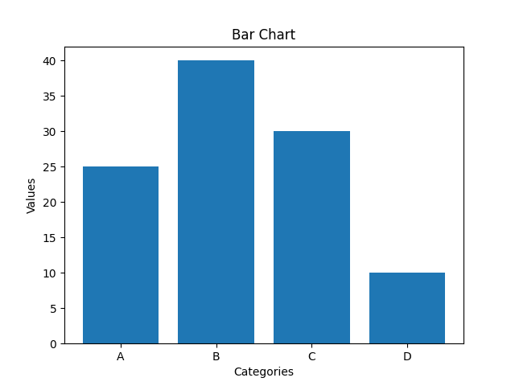
Types of Data Visualization Charts
1. Bar Charts
Bar charts are used to compare values across different categories using rectangular bars. X-axis shows categories while Y-axis represents values. Common types include horizontal, stacked and grouped bar charts.

Slide 10
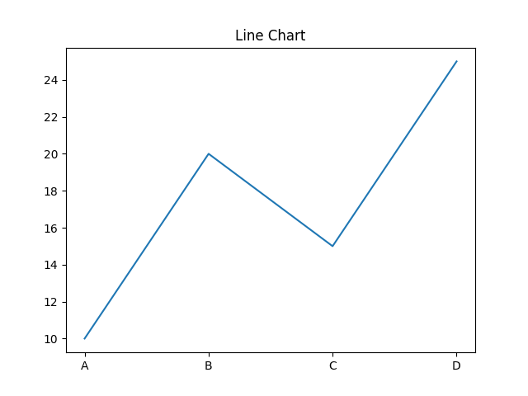
2. Line Charts
Line charts show how values change over time by connecting data points with lines. They help visualize trends like increases, decreases or stability.

Slide 11
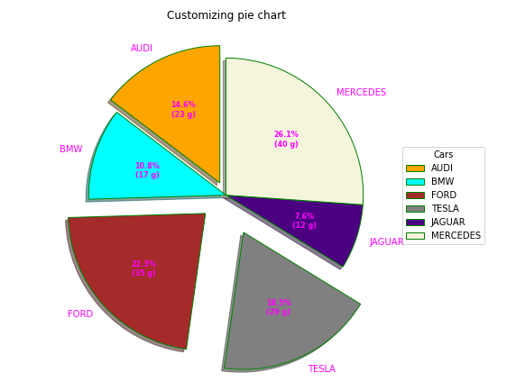
3. Pie Charts
Pie charts are round charts divided into slices, where each slice shows a part of the whole. The size of each slice represents its percentage.

Slide 12
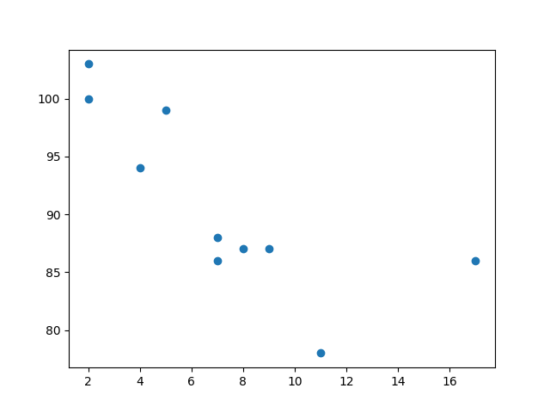
4. Scatter Chart (Plots)
Scatter charts use dots to show relationship between two numerical variables. X-axis shows the independent variable and Y-axis shows the dependent variable.

Slide 13
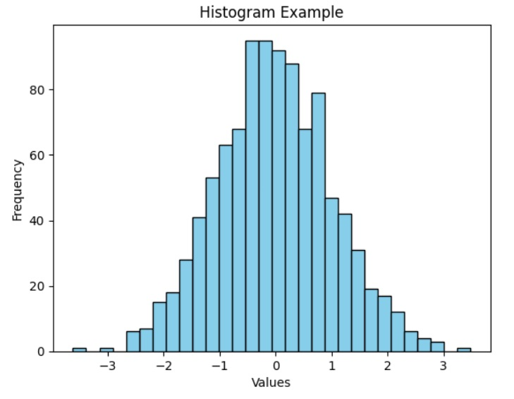
5. ﻿Histogram
A histogram displays the distribution of numerical data by grouping values into intervals (bins) and showing their frequency as bars. It helps reveal the shape, spread and patterns in the data.

Slide 14
Terminology
Sample (Observation or Data): item to process (e.g., classify).
Example: an individual, a document, a picture, a sound, a video. . .
Features (Input): set of distinct traits that can be used to describe each sample in a quantitative manner. Represented as a multi-dimensional vector usually denoted by x. Example: size, weight, citizenship, . . .
Label (Output): The class or outcome assigned to a sample.
Training set: Set of data used to discover potentially predictive relationships.
Validation set: Set used to adjust the model hyperparameters.
Testing set: Set used to assess the performance of a model.
prediction is often denoted by y and the desired/targeted class by d or t. Example: man/woman, wealth, education level,

Slide 15
Training the model : Once a model is selected, it is time to start training it. The first step involves preparing the appropriate algorithms for the task at hand.
There are several machine learning models, most commonly supervised and unsupervised learning.
Supervised learning is possible when training data contains input and output values. Each data set with input and target output is known as a training signal. Training is based on the discrepancy between the processed and captured results when input data is presented to the model.
Unsupervised learning is applied to discover patterns in the data. Additional data is used to find out matches for the patterns or clusters. It is also an iterative process that gets more refined with correlation against expected patterns or clusters. There is no initial reference dataset in this method.

Slide 16
Example
Consider the following data regarding patients entering a clinic. The data consists of the gender
and age of the patients and each patient is labeled as “healthy” or “sick”.

Slide 17
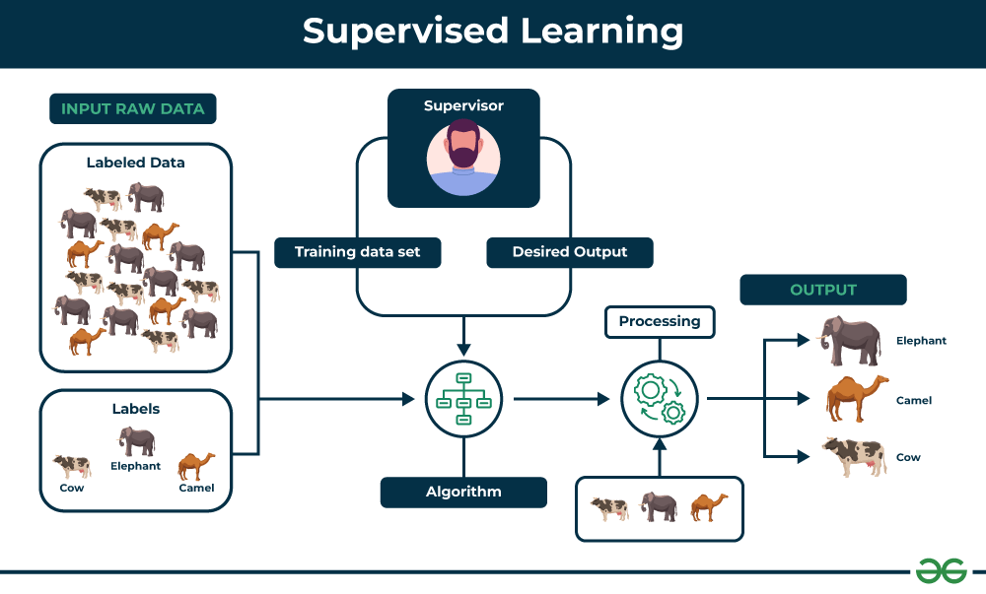

Slide 18
Some examples of supervised learning are
Predicting the results of a game
Predicting whether a tumour is malignant or benign
Predicting the price of domains like real estate, stocks, etc.
Classifying texts such as classifying a set of emails as spam or non-spam

Slide 19
There are two main categories of supervised learning that are mentioned below:
Classification
Regression

Slide 20
Regression: This is a type of problem where we need to predict the continuous-response value (ex : above we predict number which can vary from -infinity to +infinity)
Some examples are :
• what is the price of house in a specific city?
• what is the value of the stock?
• how many total runs can be on board in a cricket game?etc… There are tons of things we can predict if we wish.

Slide 21
Classification: This is a type of problem where we predict the categorical response value where the data can be separated into specific “classes” (ex: we predict one of the values in a set of values).
Some examples are :
• this mail is spam or not?
• will it rain today or not?
• is this picture a cat or not?
Basically ‘Yes/No’ type questions called binary classification.
Other examples are :
• this mail is spam or important or promotion?
• is this picture a cat or a dog or a tiger?
This type is called multi-class classification.

Slide 22
Classification separates the data, Regression fits the data

