Slide 1
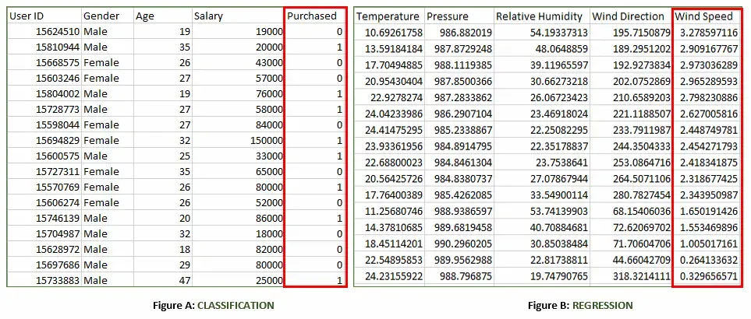
Example of a classification and a regression dataset

Slide 2
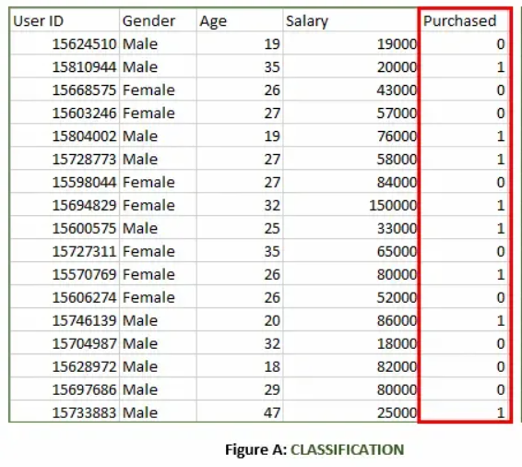
Figure A: It is a dataset of a shopping store that is useful in predicting whether a customer will purchase a particular product under consideration or not based on his/her gender, age and salary.
Input: Gender, Age, Salary
Output: Purchased i.e. 0 or 1; 1 means yes the customer will purchase and 0 means that the customer won't purchase it.

Slide 3
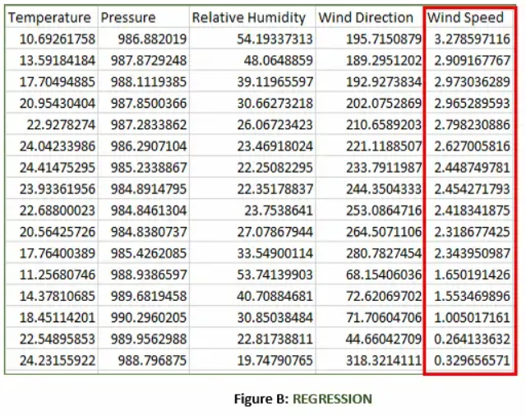
Figure B: It is a Meteorological dataset that serves the purpose of predicting wind speed based on different parameters.
Input: Temperature, Pressure, Relative Humidity, Wind Direction
Output: Wind Speed

Slide 4
Working of Supervised Machine Learning
The working of supervised machine learning follows these key steps:
1. Collect Labeled Data
Gather a dataset where each input has a known correct output (label).
Example: Images of handwritten digits with their actual numbers as labels.
2. Split the Dataset
Divide the data into training data (about 80%) and testing data (about 20%).
The model will learn from the training data and be evaluated on the testing data.
3. Train the Model
Feed the training data (inputs and their labels) to a suitable supervised learning algorithm (like Decision Trees, SVM or Linear Regression).
The model tries to find patterns that map inputs to correct outputs.
4. Validate and Test the Model
Evaluate the model using testing data it has never seen before.
The model predicts outputs and these predictions are compared with the actual labels to calculate accuracy or error.
5. Deploy and Predict on New Data
Once the model performs well, it can be used to predict outputs for completely new, unseen data.

Slide 5
2. Split the Dataset
Splitting data into training, validation and testing dataset: For training a model, we initially split the model into 2 two or 3 three sections which are :
- Training data – Testing data.
- The training dataset (80%) is used to fit our models
- The Testing dataset (20%) is used to test our models
- Training data – Validation data – Testing data.
- The training dataset (60%) is used to fit our models
- The Validation dataset (20%) is used to validate our models
- The Testing dataset (20%) is used to test our models
You train the classifier or algorithm using Training data set, tune the parameters using validation data set
and then test the performance of your classifier on unseen test dataset.
Note: During training the classifier only the training and/or validation set is available.
The test set will only be available during testing the classifier.

Slide 6
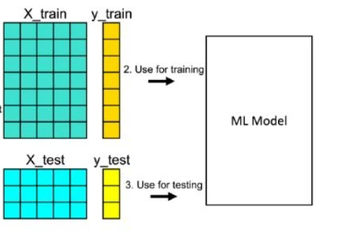
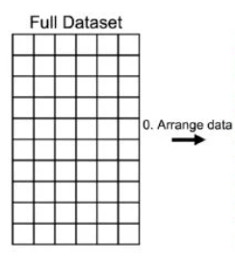
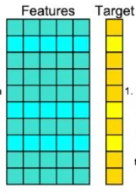
Application of train_test_split()
You need to import train_test_split() and NumPy before you can use them.
You can split both input and output datasets with a single function call:

Slide 7
Data Splitting in Machine Learning
Data splitting is a crucial process in machine learning, involving the partitioning of a dataset into different subsets, such as training, validation, and test sets.
In python:
train_test_split() method returns us the training data, its labels, validation data, its labels and also the testing data and its labels.
from sklearn.model_selection import train_test_split
X_train, X_temp, y_train, y_temp = train_test_split(X, y, test_size=0.2, random_state=42) (1)
X_val, X_test, y_val, y_test = train_test_split(X_temp, y_temp, test_size=0.5, random_state=42) (2)
The function (1) divides the data into a training set (X_train, y_train) and a temporary set (X_temp, y_temp), allocating 20% (test_size=0.2 )of the data to the temporary set.
The random_state=42 parameter ensures reproducibility of the random splitting results
(نفس المعلومات في حالة اعادة التقسيم).
Subsequently, the temporary set is further split into a validation set (X_val, y_val) and a test set (X_test, y_test), with each set containing 50% of the data, using the function (2).

Slide 8
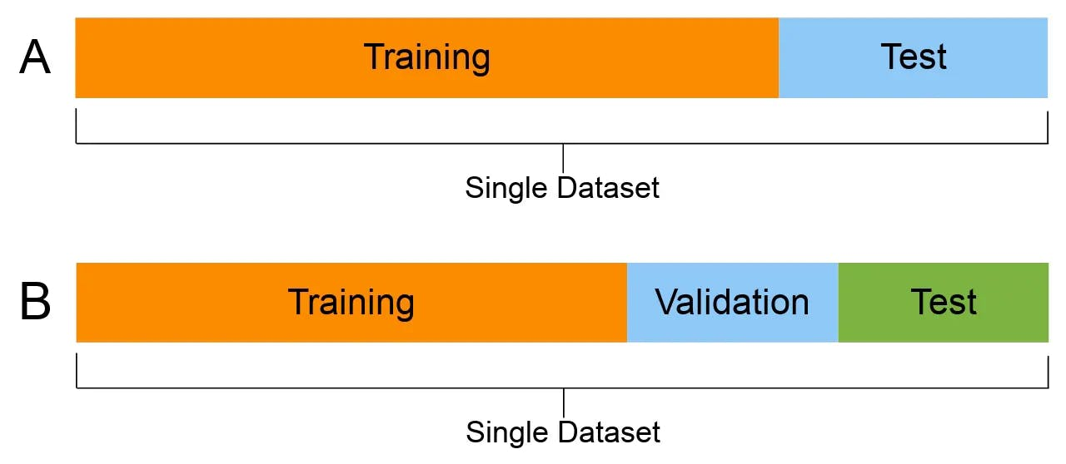
Data Splitting in Machine Learning
If you choose to split the data into two groups : Training and testing set:
In python:
train_test_split() method returns us the training data, its labels and also the testing data and its labels.
from sklearn.model_selection import train_test_split
X_train, X_test, y_train, y_test = train_test_split(X, y, test_size=0.2, random_state=42) (1)

Slide 9
Supervised learning
KNN Algorithm – K-Nearest Neighbors Classifiers and Model Example
The K-Nearest Neighbors (K-NN) algorithm is a popular Machine Learning algorithm used mostly for solving classification problems.

Slide 10
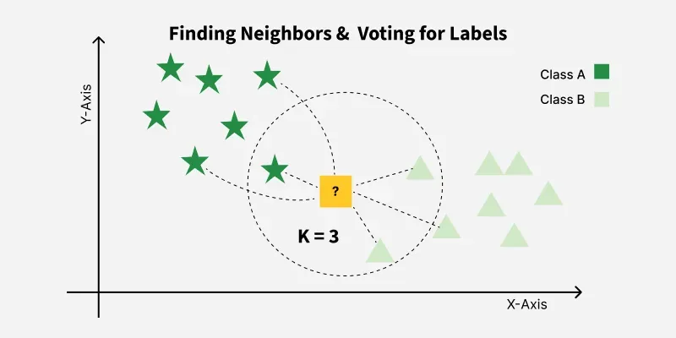
What is the KNN algorithm?
K-Nearest Neighbors (KNN) is a supervised machine learning algorithm generally used for classification but can also be used for regression tasks. It works by finding the "k" closest data points (neighbors) to a given input and makes a predictions based on the majority class (for classification) or the average value (for regression).

Slide 11
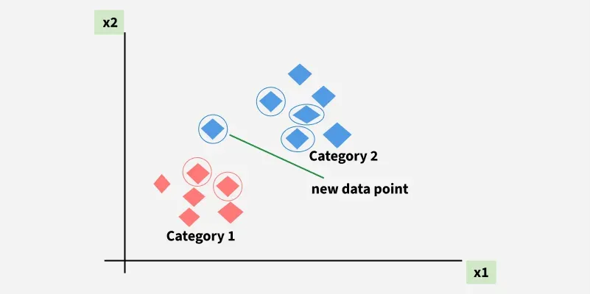
For example, consider the following table of data points containing two features:

Slide 12



Distance Metrics Used in KNN Algorithm
KNN uses distance metrics to identify nearest neighbor, these neighbors are used for classification and regression task. To identify nearest neighbor we use below distance metrics:
1. Euclidean Distance
2. Manhattan Distance
3. Minkowski Distance

Slide 13
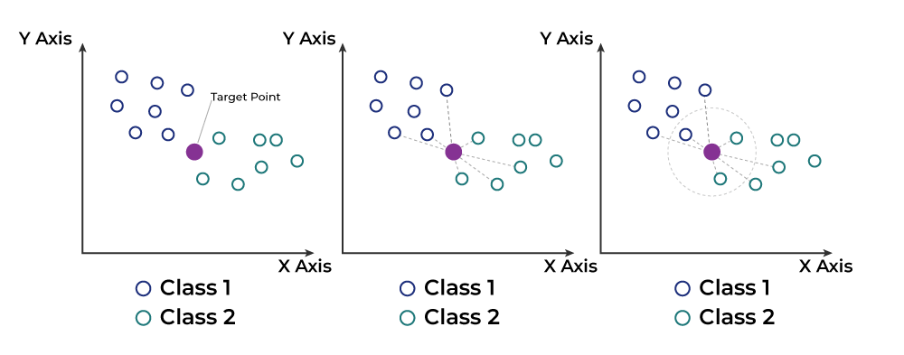
Working of KNN algorithm
Thе K-Nearest Neighbors (KNN) algorithm operates on the principle of similarity where it predicts the label or value of a new data point by considering the labels or values of its K nearest neighbors in the training dataset.

Slide 14
Based on its closeness or similarities in a given range (K) of neighbours, the algorithm assigns the new data to a class or category in the data set (training data).
Step #1 - Assign a value to K.
Step #2 - Calculate the distance between the new data entry and all other existing data entries (you'll learn how to do this shortly). Arrange them in ascending order.
Step #3 - Find the K nearest neighbors to the new entry based on the calculated distances.
Step #4 - Assign the new data entry to the majority class in the nearest neighbors. This called the majority voting.

Slide 15
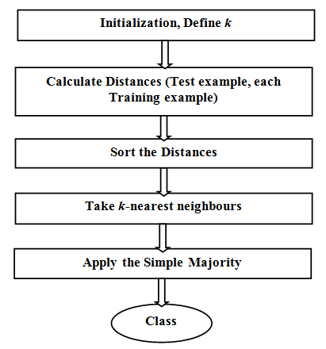
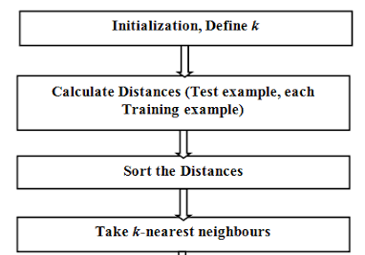

Slide 16
Advantages of KNN
Simple to use: Easy to understand and implement.
No training step: No need to train as it just stores the data and uses it during prediction.
Few parameters: Only needs to set the number of neighbors (k) and a distance method.
Disadvantages of KNN
Slow with large data: Needs to compare every point during prediction.
Struggles with many features: Accuracy drops when data has too many features.
Can Overfit: It can overfit especially when the data is high-dimensional or not clean.

Slide 17
Example: The table represents our data set. We have two columns — Brightness and Saturation. Each row in the table has a class of either Red or Blue.
Before we introduce a new data entry, let's assume the value of K is 5.
Brightness | Saturation | Class
40 | 20 | Red
50 | 50 | Blue
60 | 90 | Blue
10 | 25 | Red
70 | 70 | Blue
60 | 10 | Red
25 | 80 | Blue
Training set
Brightness | Saturation | Class
20 | 35 | ?
Testing set

Slide 18
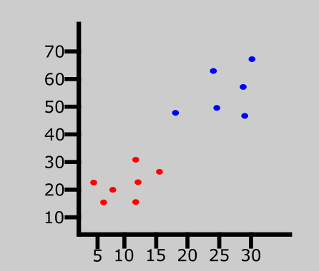
The graph represents a data set consisting of two classes: red and blue.

Slide 19
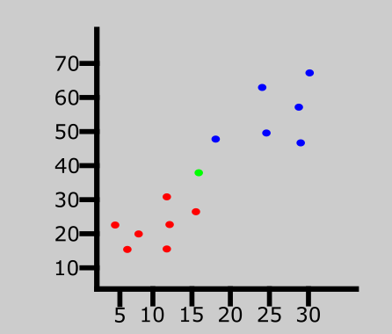
A new data entry has been introduced to the data set. This is represented by the green point in the graph.

Slide 20
We have a new entry but it doesn't have a class yet. To know its class, we have to calculate the distance from the new entry to other entries in the data set using the Euclidean distance formula.
Distance #1
For the first row, d1:
d1 = √(20 - 40)² + (35 - 20)² = √400 + 225 = √625 = 25
Brightness | Saturation | Class | Distance
40 | 20 | Red | 25
Distance #2
For the second row, d2:
Brightness | Saturation | Class | Distance
50 | 50 | Blue | 33.54
d2 = √(20 - 50)² + (35 - 50)² = √900 + 225 = √1125 = 33.54

Slide 21
Here's what the table will look like after all the distances have been calculated:
Brightness | Saturation | Class | Distance
40 | 20 | Red | 25
50 | 50 | Blue | 33.54
60 | 90 | Blue | 68.01
10 | 25 | Red | 10
70 | 70 | Blue | 61.03
60 | 10 | Red | 47.17
25 | 80 | Blue | 45

Slide 22
Let's rearrange the distances in ascending order:
Brightness | Saturation | Class | Distance
10 | 25 | Red | 10
40 | 20 | Red | 25
50 | 50 | Blue | 33.54
25 | 80 | Blue | 45
60 | 10 | Red | 47.17
70 | 70 | Blue | 61.03
60 | 90 | Blue | 68.01
Since we chose 5 as the value of K, we'll only consider the first five rows. That is:
Brightness | Saturation | Class | Distance
10 | 25 | Red | 10
40 | 20 | Red | 25
50 | 50 | Blue | 33.54
25 | 80 | Blue | 45
60 | 10 | Red | 47.17
As you can see, the majority class within the 5 nearest neighbors to the new entry is Red. Therefore, we'll classify the new entry as Red.

Slide 23


Slide 24
How to Choose the Value of K in the K-NN Algorithm
There is no particular way of choosing the value K, but here are some common conventions to keep in mind:
Choosing a very low value will most likely lead to inaccurate predictions.
The commonly used value of K is 5.
Always use an odd number as the value of K.

