Slide 1
4ING-CS
2025-2026
Computer Systems Security
Part I
Principles and practice of building and administering secure systems.
Plan
Introduction
Definitions
Main Concepts
Objectives
Types of CS
Flaws
Risk Management Process
Typology of R & PS

Slide 2



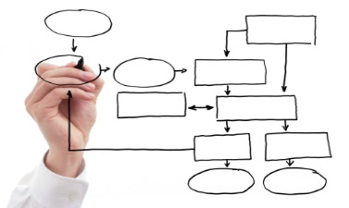
Introduction
Definitions
Main Concepts
Objectives
Financial impacts
Impacts on reputation
CSS
Legal and regulatory impacts
Organizational impacts

Slide 3
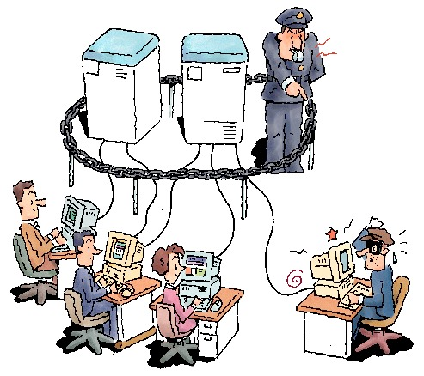
Introduction
Definitions
Main Concepts
Objectives
Security ?
A set of techniques that ensure that data and resources (hardware or software) are used only in the context in which they are intended.
Information system security
=
Computer system security.
Information System?
Set of activities consisting of managing information: acquiring, storing, transforming, distributing, exploiting… often functions using a computer system.

Slide 4
Introduction
Definitions
Main Concepts
Objectives
Vulnerability
Threat
Attack
A defect or weakness in a system's design, implementation, or internal control that may lead to a security breach or violation of its security policy.
The possibility that a vulnerability could be exploited accidentally or by a malicious agent.
Malicious action exploiting vulnerabilities in a system, used to break security services by hijacking mechanisms.
These are the procedures or techniques used to resolve a vulnerability or counter a specific attack.
This is the probability that a threat will exploit a vulnerability.
Countermeasures
Risk
Risk Matrix

Slide 5
Introduction
Definitions
Main Concepts
Objectives
Determine the value of equipment, software and especially information,
Determine the cost and time of replacement,
Perform a vulnerability analysis of the information contained on networked computers (packet analysis programs, logs, etc.),
Determine the impact of company computer hacks on customers
Risk Level = Severity * Probability of Production
Calculation of a risk = Threat X Vulnerability/Countermeasure

Slide 6
Introduction
Definitions
Main Concepts
Objectives
Vulnerability
Threat
Attack
(probability, assessment or impact) is a risk analysis tool that assesses the severity of a risk in a system based on the likelihood of it occurring.
Countermeasures
Risk
Risk Matrix

Slide 7
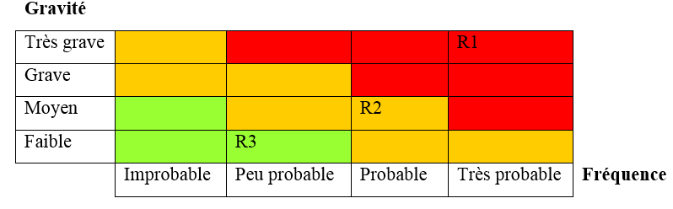
Introduction
Definitions
Main Concepts
Objectives
Critical
Major
Minor

Slide 8
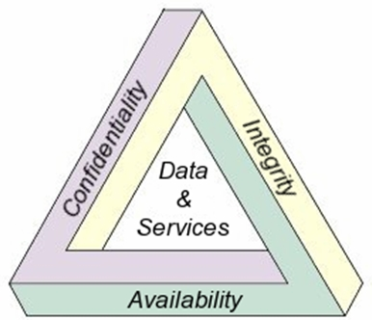
Introduction
Definitions
Main Concepts
Objectives
Refers to the protection of sensitive data from unauthorized access or disclosure. (encryption, access controls, ….
ensures that data is not tampered with or altered in any way. This can be achieved through the use of digital signatures, hashing, and other cryptographic methods, …
Confidentiality
The ability to access data and resources when needed. This can be achieved using redundant systems, backups, and disaster recovery plans, ...
Integrity
An actor cannot deny having taken a particular action (digital signature, ACK, ...)
Authentiication
Availability
Refers to the verification of identity (Access control, …).
Non-repudiation

Slide 9
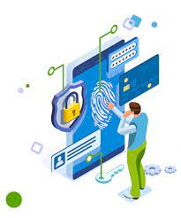

Types of CS
Flaws
RMP
Typology of R & PS
Internal security
It involves securing the IT infrastructure. Security at the level of physical infrastructure: secure rooms, places open to the public, common areas. Internet connectivity, wired local networks, wireless networks, telephony and remote networks.
§
!
!
!
External security
!
!
This type of security is linked to the content of the IT infrastructure. It consists of securing: data (logical security), applications and services.

Slide 10
Types of CS
Flaws
RMP
Typology of R & PS
Default software and hardware installation;
Updates not performed;
Nonexistent or default passwords
No separation of operational flows from system administration flows;
Outdated security procedures;
Weak authentication;
……………

Slide 11
Types of CS
Flaws
RMP
Typology of R & PS
1
2
Determining security concepts
3
Risk analysis (assessment) Identification and estimation of each risk component (threat/vulnerability/impact)
Identifying the Environment
The organization (computer system), ..
CIA, ….
4
Defining Security Requirements (concepts)
5
Selecting security countermeasures
6
Implementation
To reduce the risks identified above, security requirements must be identified with the assistance of system/security experts.
The tool that meets the security requirements of the system
The final step in this process is testing and evaluating the selected tools.

Slide 12
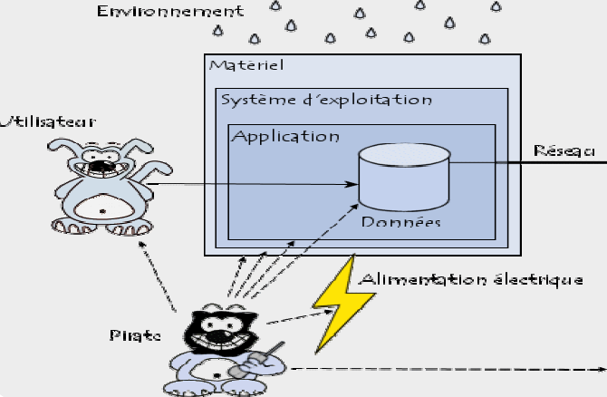
Types of CS
Flaws
RMP
Typology of R & PS

Slide 13
SS Design
Authentication
Access ctrl
OS Security
• Avoid single point of failure by building of defenses in multiple layers that back each other up thereby forcing attackers to defeat independent layers.
• Defense in depth execution must balance complexity, manageability, performance, and overall implementation cost.
• Capital and resource expenditures should never exceed the cost of the asset or the projected loss if there is a compromise.
Defense-in-depth
Least privilege is the principle of providing users with the minimum level of access required to perform a task. This can help to limit the impact of any security breaches or attacks.
Least Privilege
Give a program the set of access privileges that it legitimately requires to execute its a certain operation. Trying to minimize the level of privileges given each program and system component.

Slide 14
SS Design
Authentication
Access ctrl
OS Security
Separation of duties is the idea that no one person should have too much power or influence over a system, hence it divides responsibilities among several people. By doing so, fraud, mistakes, and other security problems may be avoided. For instance: The person in charge of making sales may also approve discounts in a financial system. That person would have an incentive to discount the software and may make poor discount decisions to increase sales. Instead, someone else with superior priority like a manager, may be assigned to approve a discount before the sale can be completed.
Separation of Duties

Slide 15
SS Design
Authentication
Access ctrl
OS Security
Secure by default aims to ensure that all security features of a
system are enabled by default, rather than requiring users to
activate them manually.
Secure by Default
Two-factor authentication (2FA)
Encryption
Firewall
Secure boot

Slide 16
SS Design
Authentication
Access ctrl
OS Security
The design principle of modularity involves breaking down a system into smaller, independent components or modules to improve security.
Modularity
Microservices architecture can support security practices by reducing the attack surface, limiting the impact of an attack, and promoting isolation.
Modularity in hardware design can be used to minimize the impact of vulnerabilities by constraining their effect to a limited part of the system
Virtualization provides a level of isolation that can limit the impact of a compromise or prevent a successful attack from spreading.

Slide 17
SS Design
Authentication
Access ctrl
OS Security
Even the most secure systems can fail. It is important to prepare for this possibility to minimize the impact, this principle is a crucial component of any successful cybersecurity strategy. No system can be totally secure, hence it's crucial to prepare for failure to lessen its effects. The principle of failing securely is a critical concept in cybersecurity that emphasizes the need for systems and applications to be designed in a way that minimizes the impact of security breaches and other failures.
Secure Failure
Fail gracefully
Limit access
Regularly test and update
Encryption

Slide 18
SS Design
Authentication
Access ctrl
OS Security
separating various parts of a system or network to prevent unwanted access or malware distribution.
Organizations can limit the harm caused by security breaches and lower the danger of unauthorized access or data loss by isolating distinct components of a system or network.
Isolation
Data Isolation
Process Isolation
Network Isolation
Separating sensitive data from the rest of the system or network to prevent unauthorized access or data loss. Through data encryption, access control, and secure storage. Example: a company might use encryption to protect sensitive customer data stored on their servers and restrict access to that data only to authorized personnel.
Separating different processes or applications running on a computer to prevent malware or other malicious code from spreading between them. Through (containerization and sandboxing). Example: a company might use containerization to isolate different applications running on a server to prevent a security breach in one application from spreading to others.
Separating different parts of a network to prevent unauthorized access or the spread of malware (through firewalls, VPNs, and network segmentation.
Example: a company might use network segmentation to separate their finance department's network from the rest of the organization's network to protect sensitive financial information from unauthorized access.

Slide 19
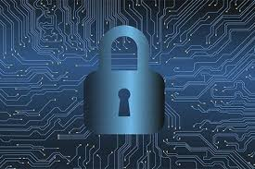
Access control

Slide 20
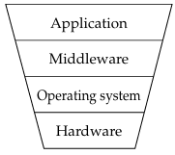
Introduction
Princ.&Tech.
Physical Access
Network Access
Control which principals (persons, processes, machines, ...) have access to which resources in the system — which files they can read, which programs they can execute, how they share data with other principals, and so on.
Figure: Access controls at different
levels in a system

Slide 21
Introduction
Princ.&Tech.
Physical Access
Network Access
Access controls seek to provide tools for identification, authentication, authorization, and accounting with regard to a particular resource (asset).
Identification
The act of identifying an actor or something that is used to identify an actor.
Authentication
This step occurs when an identity is confirmed through the use of a specific process.
Authorization
Authorization is when an actor is given permission to access a resource.
Accounting
Finally accounting is the process through which a record of access to the resource is recorded.

Slide 22
Introduction
Princ.&Tech.
Physical Access
Network Access
Least Privilege
An actor should only be given access to resources as necessary and with the permissions necessary to complete their task. These resources may be processes, programs, or even user accounts.
Reduce an attack surface and helps stop the spread of malware as a single compromised account will not have access to all of the resources.
Multi-factor Authentication (MFA)
A technique that requires actors to provide two or more pieces of information to be used as identification. Example: usernames and passwords, token codes, a physical token, or biometric data. Typically it is suggested to use "something you have and something you know" for example the code in an SMS message to your phone (you have your phone) and a password (you know your password).
Authorization models
MAC, DAC, RBAC, and ABAC

Slide 23
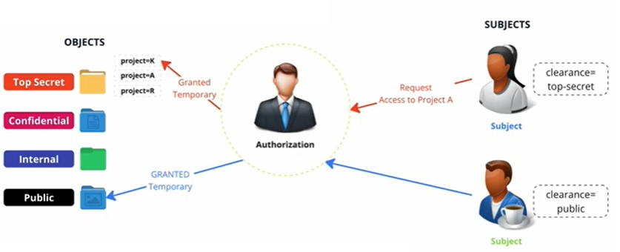
Introduction
Princ.&Tech.
Physical Access
Network Access
Mandatory Access Control (MAC)
Requires all objects (files, directories, devices, etc.) to have a security label that identifies who can access it and how. This is a particularly stringent form of access control which requires a great deal of effort to implement and maintain, but results in a high level of security.

Slide 24
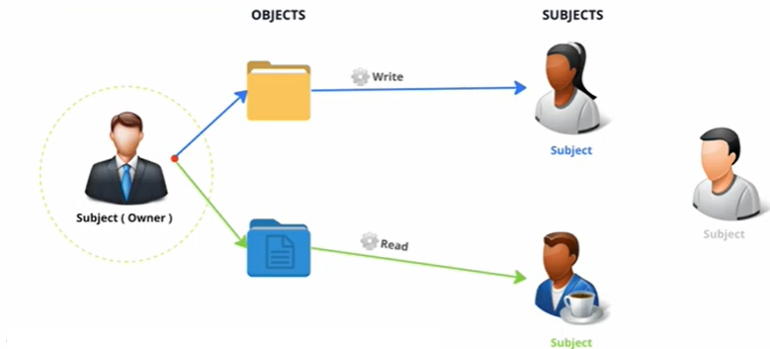
Introduction
Princ.&Tech.
Physical Access
Network Access
Discretional Access Control (DAC)
Simplifies things by allowing owners of objects to determine which permissions groups/users should be given to that object. This offers great flexibility and ease of implementation, but can result in a less secure environment if the owner of the object is compromised

Slide 25
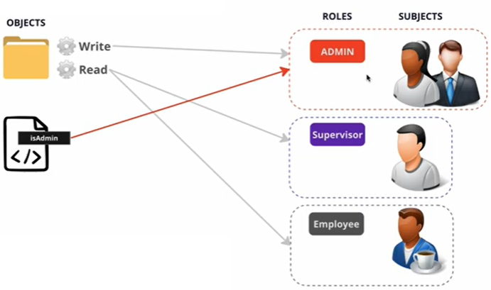
Introduction
Princ.&Tech.
Physical Access
Network Access
Role-Based Access Control (RBAC) builds off of DAC uses a core set of roles within a system to determine who has different levels of access to objects. RBAC is a common and flexible model which can be intelligently used to implement DAC or MAC.

Slide 26
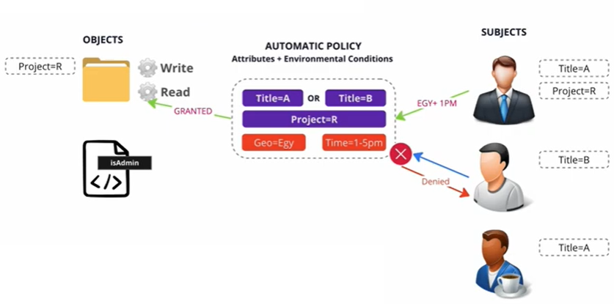
Introduction
Princ.&Tech.
Physical Access
Network Access
Attribute-Based access control (ABAC)
A newer model that builds off of RBAC and uses more general attributes instead of just roles. ABAC can determine who has different levels of access to objects based on the attributes of the object, the user, the action, or even an external context. These attributes can be used together in any way that can be codified into a rule. For example, "Give Fred read access to non-classified documents in this folder from 9:00AM to 5:00PM."

Slide 27
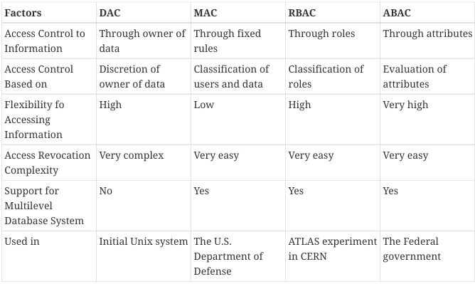
Introduction
Princ.&Tech.
Physical Access
Network Access
Table : Comparison between different authorization models

Slide 28
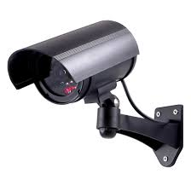




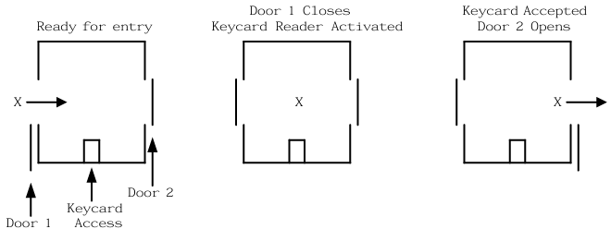
Introduction
Princ.&Tech.
Physical Access
Network Access
Gates
Biometrics
Key Cards
Security Guards
Cameras
Mantraps

Slide 29
Introduction
Princ.&Tech.
Physical Access
Network Access
Active Directory (AD)
A directory service typically used in Windows networks to control and track resources. It is a Microsoft technology that enables centralized network management.
Privileged Identity Management (PIM)
A method of managing access to resources such as locations, commands, audit reports, and services. It aims to provide more granular access control. By recording more information about access it allows for better reporting regarding suspicious behavior and anomalies.
Privileged Access Management (PAM)
A framework for safeguarding identities with advanced capabilities. It is common in the Linux world, where it is used to control how administrators log in. PAM supports many more features than the older "become root and perform admin tasks" model. With PAM passwords can be set to expire, better auditing can be put in place, and privilege escalation can be made temporary.

Slide 30
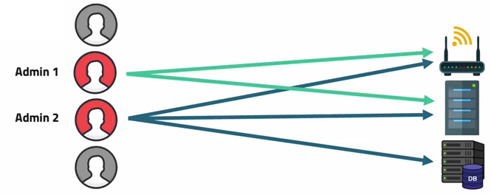
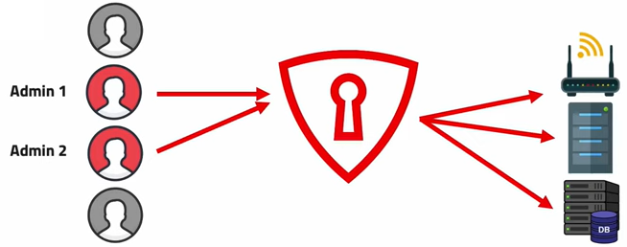
Introduction
Princ.&Tech.
Physical Access
Network Access

Slide 31

Introduction
Princ.&Tech.
Physical Access
Network Access
Privileged Identity Management (PIM)
A method of managing access to resources such as locations, commands, audit reports, and services. It aims to provide more granular access control. By recording more information about access it allows for better reporting regarding suspicious behavior and anomalies.
Identity and Access Management
A framework for managing digital identities. It manages the user database, logs when users sign in and out, manages the creation of groups or roles, and allows for the assignment and removal of access privileges. IAM often makes use of PIM and PAM to accomplish these goals.
Unix File Permissions
7 7 7

Slide 32
Introduction
Princ.&Tech.
Physical Access
Network Access
Access Control Lists (ACL)
Are used to permit or deny access based on a characteristic.
Allowlist: deny access to anyone not on the list.
Denylist : deny access to anyone who is on the list.
SSH Keys
Secure Shell Server (SSH) supports the use of asymmetric encryption keys for authentication.
Single Sign On (SSO)
Kerberos
Tokenization
Used to protect sensitive information. Information that would be highly valuable if compromised is replaced with a random token known to the parties involved in the transaction. In a typically scenario once the tokens have been established, only the token is sent out over an untrusted network.

Slide 33
Introduction
Princ.&Tech.
Physical Access
Network Access
Access Control Matrix
who can do what?

Slide 34
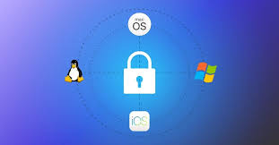
OS Security

Slide 35
Introduction
Princ.&Tech.
Sec.Reqs
Trusted OS
Computer programs are not trustworthy in general Software may be grouped into three categories of trust:
Trusted: The software is responsible for enforcing security
Benign: The software is not responsible for enforcing security but uses special privileges, so it must be trusted not to violate the rules intentionally
Malicious: The software is of unknown origin and must be treated as malicious and likely to attempt actively to subvert the system
Classifying software
Most software is benign, whether it is written by a good or an incompetent programmer
Software is often not trusted, because it is not responsible for enforcing security of the system
In environments with extremely sensitive information the benign and malicious software are assigned to a single group: untrusted

Slide 36
Introduction
Princ.&Tech.
Sec.Reqs
Trusted OS
Why need security at the OS level?
• No more standalone computer system environments.
• Any system can be globally accessible through a set of vast inter and intra-network connections.
• Transition motivated by the need to work remotely,
– convenience in accessing personal records, online shopping etc.
• A single security loophole in the OS design and implementation known to a malicious attacker could do serious damage.
Security in Operating System
• Security refers to providing a protection system to computer system resources such as:
– CPU, memory, disk
– software programs and
– most importantly data/information stored in the computer system.
• So a computer system must be protected against
– unauthorized access by users and
– malicious access to system including viruses, worms etc…
Notes:
Fail gracefully: Systems and applications should be built to fail gracefully, which means that they should work as much as feasible even if they fail. For example, a food website may temporarily disable customers the ability to place orders during a security breach, but customers can still be allowed to browse and check food menu. • Limit access: Access to sensitive data and systems should be limited to only those who need it to perform their job duties. This helps to minimize the impact of any potential security breaches. • Regularly test and update: Systems and apps should be tested and updated regularly to identify and address vulnerabilities. This includes performing frequent penetration testing and vulnerability scanning, as well as updating software and systems with the most recent security patches. • Encryption: Sensitive data should be encrypted both on transit and at rest to protect it from unauthorized access in the event of a security breach.

Slide 37
Introduction
Princ.&Tech.
Sec.Reqs
Trusted OS
OS vulnerabilities?
• Physical : Computer can be stolen
• Natural : Earthquake
• Hardware and Software : Failures
• Media : Hard disks can be stolen
• Communication : Wires can be tapped
• Human : Insiders
• Poorly chosen passwords
• Software bugs (non reliability of software)
• Automatically running active content: active-x, scripts, Java programs (applet)
• Open ports: telnet, mail
• Incorrect configuration:– file permissions – administrative privileges
• Untrained users/system administrators
• Trap doors (intentional security holes)
• Unencrypted communication
• Limited Resources (i.e. TCP connections)
Notes:
Fail gracefully: Systems and applications should be built to fail gracefully, which means that they should work as much as feasible even if they fail. For example, a food website may temporarily disable customers the ability to place orders during a security breach, but customers can still be allowed to browse and check food menu. • Limit access: Access to sensitive data and systems should be limited to only those who need it to perform their job duties. This helps to minimize the impact of any potential security breaches. • Regularly test and update: Systems and apps should be tested and updated regularly to identify and address vulnerabilities. This includes performing frequent penetration testing and vulnerability scanning, as well as updating software and systems with the most recent security patches. • Encryption: Sensitive data should be encrypted both on transit and at rest to protect it from unauthorized access in the event of a security breach.

Slide 38
Introduction
Princ.&Tech.
Sec.Reqs
Trusted OS
Principles of Operating System Security
Least Privilege
Defense in Depth
Fail-Safe Defaults
Economy of Mechanism
Complete Mediation
• This principle emphasizes the importance of defaulting to a secure state in case of errors or unexpected situations.
• Access decisions should deny by default, and permissions should be explicitly granted only when necessary.
• This approach ensures that security is maintained even in the event of system failures or misconfigurations.
This principle mandates that every access attempt to any resource must be verified for authorization. • This prevents attackers from circumventing security controls and gaining unauthorized access to sensitive information. • Complete mediation requires continuous monitoring and enforcement of access control policies. • For example, even if a user has previously accessed a file, the system should revalidate their permissions every time they attempt to access it again
• Security mechanisms should be designed with simplicity and minimality in mind.
• Complex systems are inherently more difficult to secure due to increased potential for vulnerabilities and unforeseen interactions.
• A simpler design facilitates easier understanding, implementation, and verification of security properties. • For instance, a straightforward access control model is easier to audit and maintain compared to a convoluted system with numerous exceptions and special cases
Saltzer & Schroeder’s security principles
Notes:
Fail gracefully: Systems and applications should be built to fail gracefully, which means that they should work as much as feasible even if they fail. For example, a food website may temporarily disable customers the ability to place orders during a security breach, but customers can still be allowed to browse and check food menu. • Limit access: Access to sensitive data and systems should be limited to only those who need it to perform their job duties. This helps to minimize the impact of any potential security breaches. • Regularly test and update: Systems and apps should be tested and updated regularly to identify and address vulnerabilities. This includes performing frequent penetration testing and vulnerability scanning, as well as updating software and systems with the most recent security patches. • Encryption: Sensitive data should be encrypted both on transit and at rest to protect it from unauthorized access in the event of a security breach.

Slide 39
Introduction
Princ.&Tech.
Sec.Reqs
Trusted OS
Access Control
◦Regulates user access to system components, subsystems, and data.
◦Employs authentication, authorization, and auditing to enforce access policies.
◦Mechanisms include access control lists (ACLs), role-based access control (RBAC), and mandatory access control (MAC).
Information Flow Control
◦Governs the movement of data within the system and its dissemination to users.
◦Ensures that information flows only through authorized channels and adheres to confidentiality and integrity constraints.
◦Techniques include taint analysis, information flow tracking, and secure multi-execution environments.
Certification
◦Focuses on formally verifying the correctness and effectiveness of security mechanisms.
◦Involves rigorous testing, formal analysis, and code reviews to ensure compliance with security policies.
◦Certification provides assurance that the implemented security measures function as intended and enforce the desired protection levels.
…….

Slide 40
Introduction
Princ.&Tech.
Sec.Reqs
Trusted OS
Confidentiality: preventing unauthorized access to information
Mechanisms: ACL, MAC, ..
Challenges: insider threats, sophisticated malware, and the increasing use of cloud storage and mobile devices.
Integrity: ensures that only authorized parties can modify system assets, writing, changing, deleting, and creating data or resources.
Mechanisms: Access controls, data validation techniques, version control systems (VCS), and digital signatures, …
Challenges: malware attacks, software bugs, and accidental data corruption requires robust error detection and correction mechanisms, secure backup and recovery procedures, and comprehensive data validation routines.

Slide 41
Introduction
Princ.&Tech.
Sec.Reqs
Trusted OS
Availability: guarantees that authorized users have timely and reliable access to system resources.
Mechanisms: redundancy (e.g., RAID for storage, failover clusters for servers), disaster recovery planning, load balancing, and robust network infrastructure.
Challenges: denial-of-service attacks, hardware failures, natural disasters, and the growing complexity of distributed systems.
Authenticity: verifying the identity of users and the origin of information.
Mechanisms: passwords, biometrics, multi-factor authentication, and digital certificates.
Challenges: Ensuring authenticity in the face of sophisticated phishing attacks, identity theft, and social engineering requires robust authentication protocols, user awareness training, and continuous monitoring for suspicious activities.

Slide 42
Introduction
Princ.&Tech.
Sec.Reqs
Trusted OS
Enhancing Operating System Security: A Multi-Layered Approach
Data Backup and Recovery
Secure User Practices
Robust Access Control
Network Security
Malware Protection
Application Control
Firewall Implementation
Data Encryption

Slide 43
Introduction
Princ.&Tech.
Sec.Reqs
Trusted OS
◦Foundations of a Trusted Operating System
Memory Protection: virtual memory, address space layout
randomization (ASLR), …
File Protection: ACL, …
General Object Access Protection: semaphores, shared memory segments, and I/O devices.
User Authentication
A well-defined security policy outlines the rules and regulations governing access to system resources and information. It establishes the security goals and the permissible actions within the system.
Policy
Model
Design
Trust
A security model provides a formal representation of the security policy, enabling rigorous analysis and verification of its properties. Common models include Bell-LaPadula, Biba, and Clark-Wilson.
The OS design should incorporate security considerations from the outset, integrating security mechanisms seamlessly into its architecture. This includes secure coding practices, minimized attack surfaces, and defense-in depth strategies.
Trustworthiness is built upon a foundation of assurance, demonstrating that the OS has been rigorously evaluated and certified to meet its security requirements.
This involves formal verification, penetration testing, and code audits

Slide 44

Thank U
For your attention

