Slide 1
4ING-CS
2025-2026
Computer Systems Security
Part I
Principles and practice of building and administering secure systems.
Plan
Introduction
Definitions
Main Concepts
Objectives
Types of CS
Flaws
Risk Management Process
Typology of R & PS

Slide 2



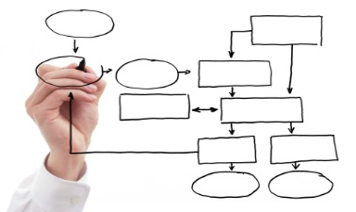
Introduction
Definitions
Main Concepts
Objectives
Financial impacts
Impacts on reputation
CSS
Legal and regulatory impacts
Organizational impacts

Slide 3
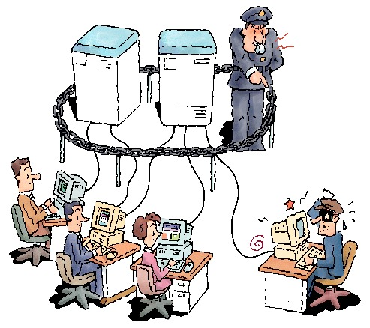
Introduction
Definitions
Main Concepts
Objectives
Security ?
A set of techniques that ensure that data and resources (hardware or software) are used only in the context in which they are intended.
Information system security
=
Computer system security.
Information System?
Set of activities consisting of managing information: acquiring, storing, transforming, distributing, exploiting… often functions using a computer system.

Slide 4
Introduction
Definitions
Main Concepts
Objectives
Vulnerability
Threat
Attack
A defect or weakness in a system's design, implementation, or internal control that may lead to a security breach or violation of its security policy.
The possibility that a vulnerability could be exploited accidentally or by a malicious agent.
Malicious action exploiting vulnerabilities in a system, used to break security services by hijacking mechanisms.
These are the procedures or techniques used to resolve a vulnerability or counter a specific attack.
This is the probability that a threat will exploit a vulnerability.
Countermeasures
Risk
Risk Matrix

Slide 5
Introduction
Definitions
Main Concepts
Objectives
Determine the value of equipment, software and especially information,
Determine the cost and time of replacement,
Perform a vulnerability analysis of the information contained on networked computers (packet analysis programs, logs, etc.),
Determine the impact of company computer hacks on customers
Risk Level = Severity * Probability of Production
Calculation of a risk = Threat X Vulnerability/Countermeasure

Slide 6
Introduction
Definitions
Main Concepts
Objectives
Vulnerability
Threat
Attack
(probability, assessment or impact) is a risk analysis tool that assesses the severity of a risk in a system based on the likelihood of it occurring.
Countermeasures
Risk
Risk Matrix

Slide 7
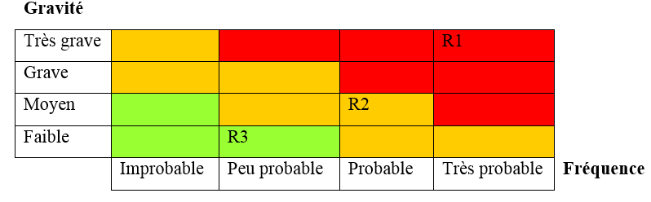
Introduction
Definitions
Main Concepts
Objectives
Critical
Major
Minor

Slide 8
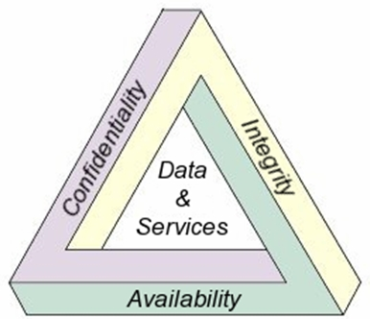
Introduction
Definitions
Main Concepts
Objectives
Refers to the protection of sensitive data from unauthorized access or disclosure. (encryption, access controls, ….
ensures that data is not tampered with or altered in any way. This can be achieved through the use of digital signatures, hashing, and other cryptographic methods, …
Confidentiality
The ability to access data and resources when needed. This can be achieved using redundant systems, backups, and disaster recovery plans, ...
Integrity
An actor cannot deny having taken a particular action (digital signature, ACK, ...)
Authentiication
Availability
Refers to the verification of identity (Access control, …).
Non-repudiation

Slide 9

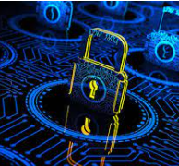
Types of CS
Flaws
RMP
Typology of R & PS
Internal security
It involves securing the IT infrastructure. Security at the level of physical infrastructure: secure rooms, places open to the public, common areas. Internet connectivity, wired local networks, wireless networks, telephony and remote networks.
§
!
!
!
External security
!
!
This type of security is linked to the content of the IT infrastructure. It consists of securing: data (logical security), applications and services.

Slide 10
Types of CS
Flaws
RMP
Typology of R & PS
Default software and hardware installation;
Updates not performed;
Nonexistent or default passwords
No separation of operational flows from system administration flows;
Outdated security procedures;
Weak authentication;
……………

Slide 11
Types of CS
Flaws
RMP
Typology of R & PS
1
2
Determining security concepts
3
Risk analysis (assessment) Identification and estimation of each risk component (threat/vulnerability/impact)
Identifying the Environment
The organization (computer system), ..
CIA, ….
4
Defining Security Requirements (concepts)
5
Selecting security countermeasures
6
Implementation
To reduce the risks identified above, security requirements must be identified with the assistance of system/security experts.
The tool that meets the security requirements of the system
The final step in this process is testing and evaluating the selected tools.

Slide 12
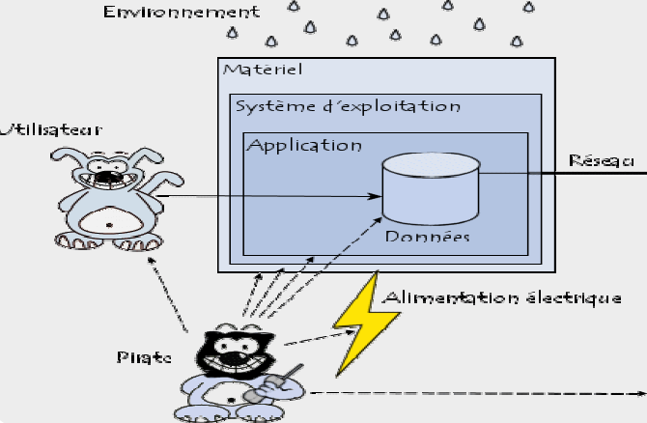
Types of CS
Flaws
RMP
Typology of R & PS

Slide 13

Thank U
For your attention

