Slide 1
Introduction to Business Intelligence (BI) Unit-1
By: Prof. K.V. PAVAN KUMAR,
Methodist College of Engg & Tech.,
Abids, Hyd.

Slide 2
1. Business Intelligence - Definition:
The term Business Intelligence (BI) refers to technologies, applications and practices for the collection, integration, analysis, and presentation of business information.
The purpose of Business Intelligence is to support better business decision making.

Slide 3
History and Evolution of Business Intelligence:
At the very beginning, historical data mining methods and tools were used for strategic managerial reporting purposes.
The second evolutionary stage is characterized by On-Line Analytic Processing (OLAP) technologies and dimensional analysis of data stored in data warehouses and data marts.

Slide 4
In the third stage Balanced Scorecard methodology is used as a means of Business Intelligence creation.
With the emergence and growing popularity of EBusiness and other Internet applications and services the new stage of BI appeared since Web analytics and Web mining as a form of BI began to attract the wide professional attention.

Slide 5
The fifth development stage started when usage of Business Dashboard technology became a core component of alerting and alarming systems in business decision-making supported by BI.
Finally, nowadays we are witnessing the era of Mobile and location-based Business Intelligence founded on appropriate mobile and location-aware technologies.

Slide 6
BI Questions
What happened?
What were our total sales this month?
What’s happening?
Are our sales going up or down, trend analysis
Why?
Why have sales gone down?
What will happen?
Forecasting & What If Analysis
What do I want to happen?
Planning & Targets

Slide 7
Where is Business Intelligence applied?
Operational Efficiency
Customer Interaction
ERP Reporting
KPI Tracking
Product Profitability
Risk Management
Balanced Scorecard
Activity Based Costing
Global Sourcing
Logistics
Sales Analysis
Sales Forecasting
Segmentation
Cross-selling
CRM Analytics
Campaign Planning
Customer Profitability

Slide 8
2. Styles of Business Intelligence:
There are 5 Styles of BI, which are presented below:
1) Enterprise Reporting - Broadly deployed pixel-perfect report formats for operational reporting and scorecards/dashboards targeted at information consumers and executives.

Slide 9
2) Cube Analysis - OLAP slice-and-dice analysis of limited data sets, targeted at managers and others who need a safe and simple environment for basic data exploration within a limited range of data.
3) Ad Hoc Query and Analysis - Full investigative query into all data, as well as automated slice and-dice OLAP analysis of the entire database - down to the transaction level of detail if necessary. Targeted at information explorers and power users.

Slide 10
4) Statistical Analysis and Data Mining - Full mathematical, financial, and statistical treatment of data for purposes of correlation analysis, trend analysis, financial analysis and projections. Targeted at the professional information analysts.
5) Alerting and Report Delivery - Proactive report delivery and alerting to very large populations based on schedules or event triggers in the database. Targeted at very large user populations of information consumers, both internal and external to the enterprise.

Slide 11
3. Types of Business Intelligence Tools:
The following are the types of Business Intelligence Tools:
a) Spreadsheets – These interactive Computer Applications manage information in a visual format.
b) Reporting and Querying Software – These tools extract, sort and summarize data. There is a variety of software programs used to present this data, including open-source and commercial software types.

Slide 12
c) Online Analytical Processing – This processing approach quickly answers queries that are multi-dimensional. The types of applications included in this processing include business reporting, marketing, budget and forecasting.
d) Data Mining – Data mining is the bridge between statistics and computer science. It is used to uncover patterns in large sets of data.

Slide 13
e) Data Warehousing – This comprehensive database is used for reporting and data analysis. The information is uploaded from a separate operational system.
f) Process Mining – This process management technique logs various events to determine business processes. Process mining provides techniques and tools that will discover control data, process and social structures from event logs.

Slide 14
g) Digital Dashboards – A single page interface in real-time that show at-a-glance information.
h) Decision Engineering – A frameword that utilizes the best practices for organizational decisional making. It helps businesses make decisions based on a variety of business approaches.
i) Business Performance Management – Management and Analytic Processes that manage a business’ performance to achieve short and long-term goals.

Slide 15
4. Benefits of Business Intelligence:
The following are the benefits of Business Intelligence:
Faster reporting, analysis or planning
More accurate reporting, analysis or planning
Better business decisions
Improved data quality
Improved employee satisfaction
Improved operational efficiency
Improved customer satisfaction
Increased competitive advantage
Reduced costs
Increased revenues
Saved headcount

Slide 16

Bi Applications & technologies can help companies analyse:
Changes trends in Shares
Changes in customer behavior and spending patterns
Customers' preferences
Company capabilities
Market conditions

Slide 17
Significance of Bi:
Companies need to have accurate, up-to-date information on customer preferences .
So that company can quickly adapt to their changing demands.
BI applications can also help managers to be better informed about actions that a company’s competitors are taking.

Slide 18
It helps analysts and managers to determine which adjustments are most likely to respond to changing trends.
IT can help companies develop a more consistent, data-based decision, which can produce better results than making business decisions by “guesswork”.

Slide 19

Dashboards
Key Performance Indicators
Graphical OLAP
Forecasting
Graphical Reporting

Slide 20

BI DASH BOARDS:
BI dashboards can provide a customized snapshot of daily operations, and assist the user in identifying problems and the source of those problems, as well as providing valuable, up-to-date information about financial results, sales and other critical information – all in one place

Slide 21
○ Key Performance Indicators
○ BI provides simplified KPI management and tracking with powerful features, formulae and expressions, and flexible frequency, and threshold levels. This module enables clear, concise definition and tracking of performance indicators for a period, and measures performance as compared to a previous period.
Intuitive, color highlighters ensure that users can see these indicators in a clear manner and accurately present information to management and team members. Users can further analyse performance with easy-to-use features like drill down, drill through, slice and dice and graphical data mining

Slide 22
GRAPHICAL BI:
Graphical Business Intelligence (BI) OLAP technology makes it easy for the users to find, filter and analyse data, going beyond numbers, and allowing users to visualize the information with eye-catching, stunning displays, and valuable indicators and gauges, charts, and a variety of graph types from which to choose

Slide 23
inFORECASTING & PREDICTIVE ANALYSIS:
Predictive analysis uses historical product, sales, pricing, financial, budget and other data, and forecasts the measures with numerous time series options,
Ex: year, quarter, month, week, day, hour or even second to improve your planning process.

Slide 24
BI REPORTS:
BI Reports delivers web-based BI reports to anyone (or everyone) in the organization within minutes!
The BI suite is simple to
use, practical to implement and affordable for every organization. With our BI reporting and performance reporting module, you just point- and-click and drag-and-drop and you can instantly create a report to summarize your performance metrics, or operational data

Slide 25
5. Real-time Business Intelligence:
Real-time business intelligence (RTBI) is a concept describing the process of delivering business intelligence (BI) or information about business operations as they occur.
Real time means near to zero latency and access to information whenever it is required.

Slide 26
Data latency
1. Data latency is the time it takes for data Packets to be stored or retrieved.
2. In business intelligence (BI), data latency is how long it takes for a business user to retrieve source data from a data warehouse or business intelligence dashboard.

Slide 27
How Many Matches?

Slide 28
How Many Matches Now?

Slide 29
BI in Decision-Making:
With high consumer expectations in the competitive market, decisions that are based on the most current data available improve customer relationships, increase revenue, maximize operational efficiency.
Real-time business intelligence systems mainly provide the information necessary to tactical take advantage of events as they occur.

Slide 30
Significance of Latency in BI:
All real-time business intelligence systems have some latency, but the goal is to minimize the time from the business event happening to a corrective action or notification being initiated.
Analyst Richard Hackathorn describes three types of latency:
Data latency: the time taken to collect and store the data
Analysis latency: the time taken to analyze the data and turn it into actionable information
Action latency: the time taken to react to the information and take action

Slide 31
Real-time business intelligence technologies are designed to reduce all three latencies to as close to zero as possible, whereas traditional business intelligence only seeks to reduce data latency and does not address analysis latency or action latency since both are governed by manual processes.
Some commentators have introduced the concept of right time business intelligence which proposes that information should be delivered just before it is required, and not necessarily in real-time.

Slide 32
6) Business Intelligence Value Chain:
In Competitive Market place, it is vital for every business enterprise whether small or big to cope with the pace of the market growth.
This is why organizations are becoming more dependent on data or information for improving development of product and services that can outsell their competitors.

Slide 33
Organizations are primarily relying on analytical database solutions like data warehouses. However, in the entire process this information and later applying them in action describes a chain of methods called value chain.
Value chain is the process that converts data into information and then applies that knowledge in taking productive business decision, and the outcome is the ultimate value.

Slide 34
What is the primary objective of most analytic decision support systems?
Monitor the performance results of Key Business Processes.
Each business Process produces unique metrics at unique time intervals with unique granularity and dimensionality.
Each process typically spawns one or more fact tables
Value chain provides high-level insight into the overall enterprise data warehouse.

Slide 35
Concept of a Cube or Pivot Table
Product – Chocolate
Month – May 2017
Region – Hyderabad
Measure – Sales
Month
Region
Product
How much Chocolate did we sell in the Hyderabad in May 2017?

Slide 36
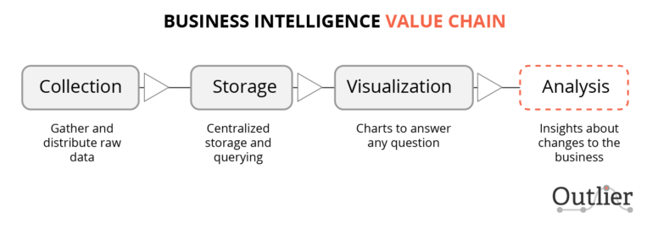
BUSINESS INTELLIGENCE VALUE CHAIN:

Slide 37
7) Architecture Business Intelligence:
A business intelligence architecture is a framework for organizing the data, information management and technology components that are used to build business intelligence (BI) systems for reporting and data analytics.
The underlying BI architecture plays an important role in business intelligence projects because it affects development and implementation decisions.

Slide 38
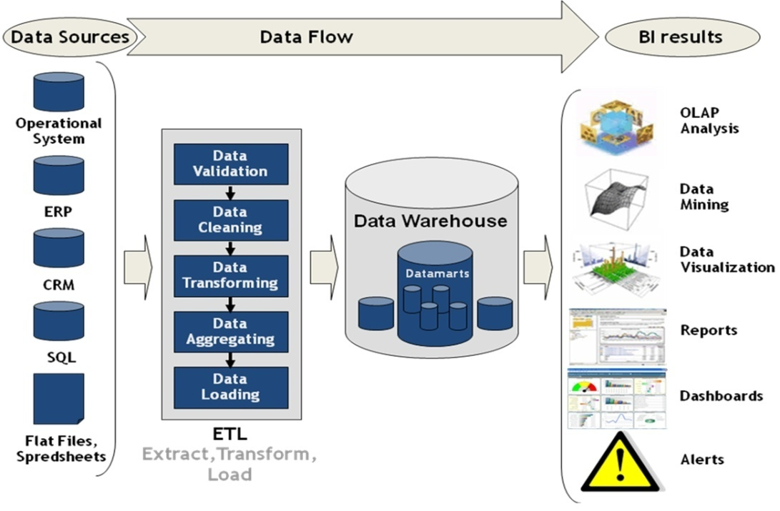

Slide 39
The data components of a BI architecture include the data sources that corporate executives and other end users need to access and analyze to meet their business requirements.

Slide 40
Important criteria in the source selection process include data currency, data quality and the level of detail in the data.
Both structured and unstructured data may be required as part of a BI architecture, as well as information from both internal and external sources.

Slide 41
END OF UNIT-1

