Slide 1
Targeting CLIMATE CHANGE EFFORTS
Sam Loyd|January 2021

Slide 2
A LOOK AT GASES

Slide 3
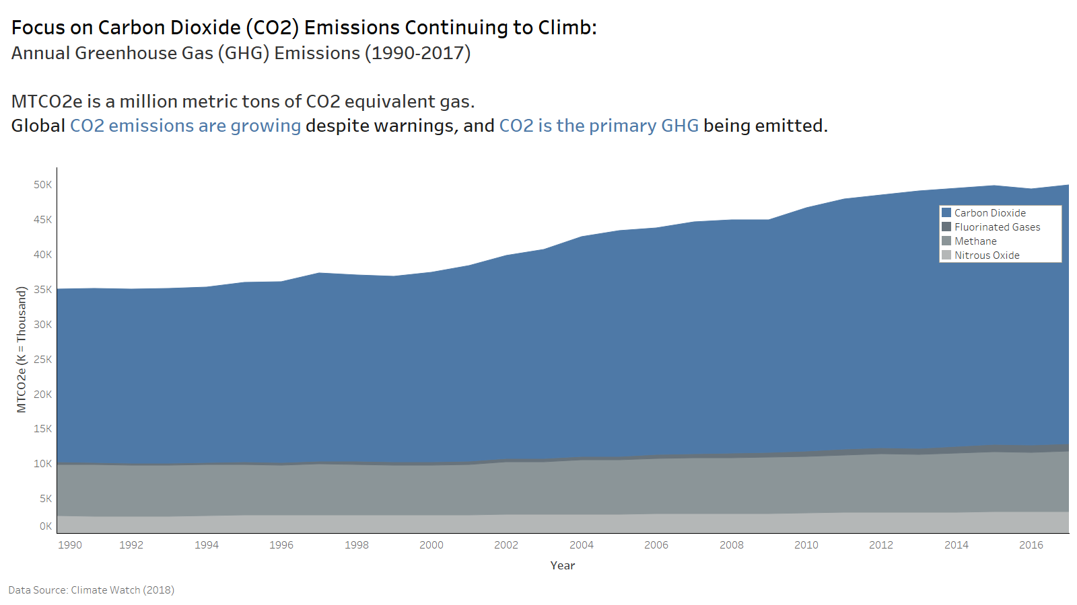

Slide 4
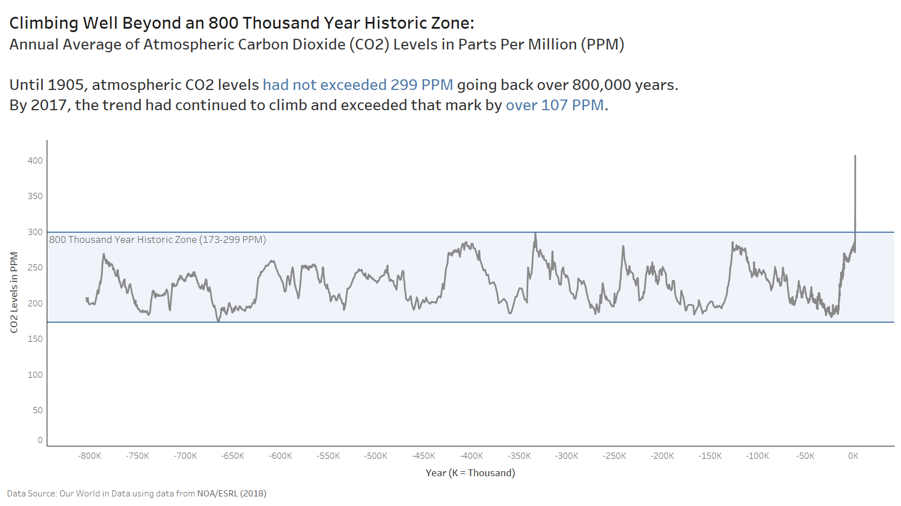

Slide 5
IMPACT FROM ECONOMIC SECTORS

Slide 6
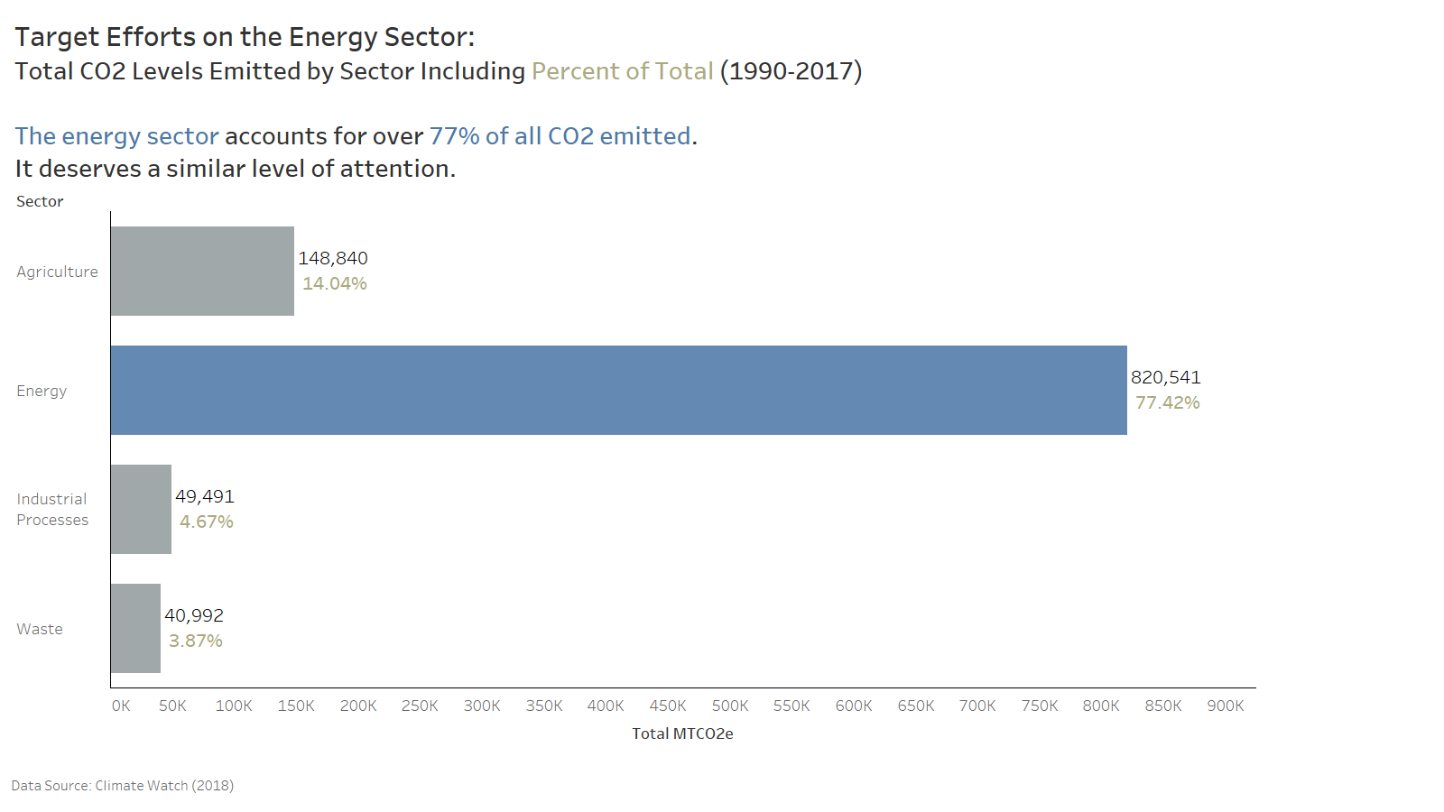

Slide 7
COMPARING NATIONS

Slide 8
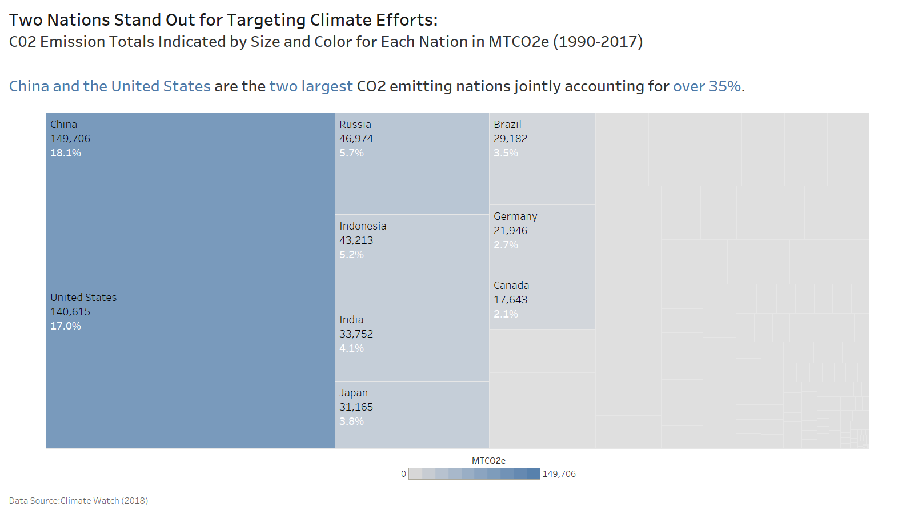

Slide 9
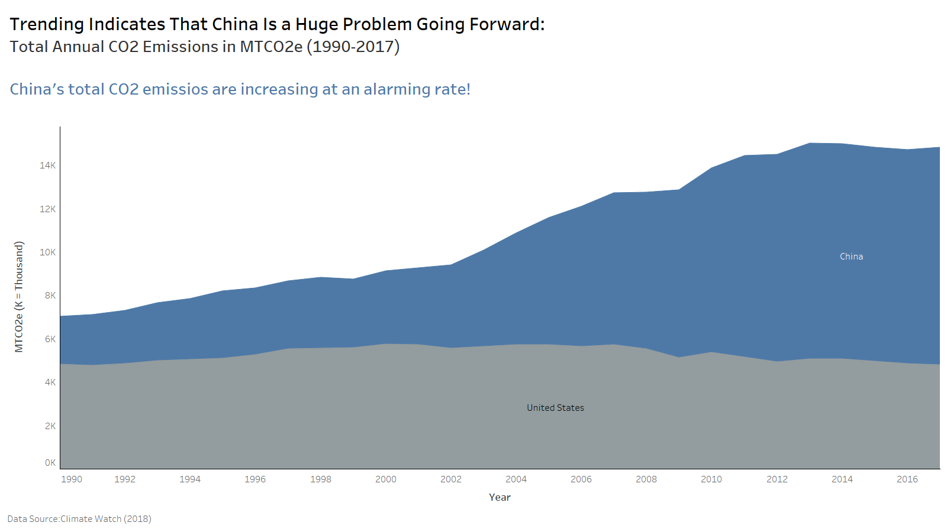

Slide 10
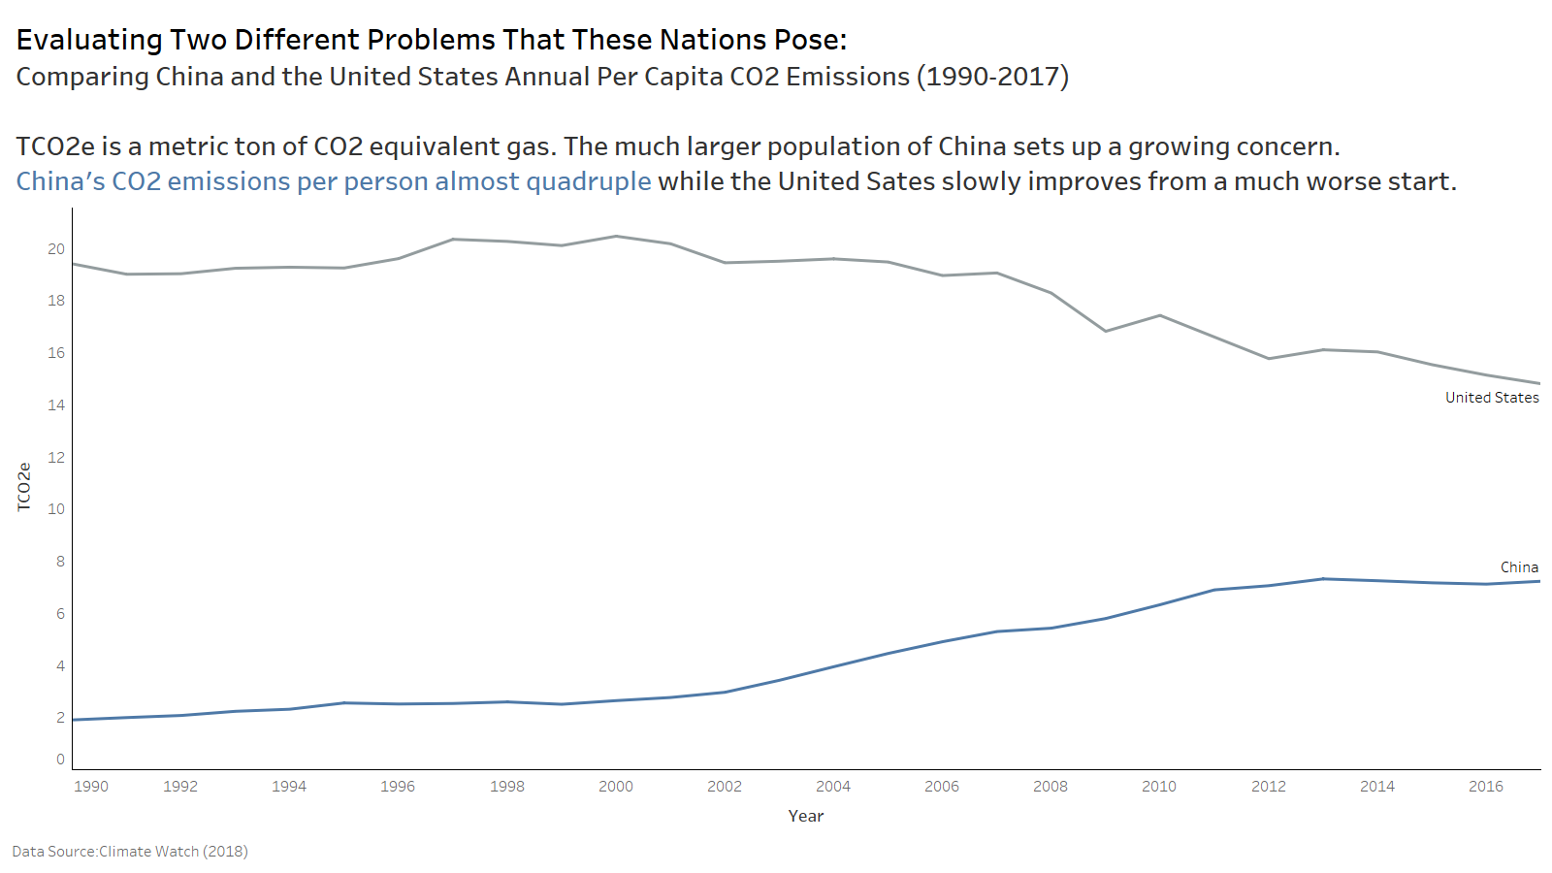

Slide 11
FOCUS
Reducing unprecedented CO2 levels
PRIMARY TARGETS
Reducing CO2 emissions from the energy sector
Reversing the rapidly increasing CO2 emissions trend in China
Accelerating the CO2 emissions reduction trend in the United States

