Slide 1
Targeting CLIMATE CHANGE EFFORTS
Sam Loyd|January 2021

Slide 2
A LOOK AT GASES

Slide 3
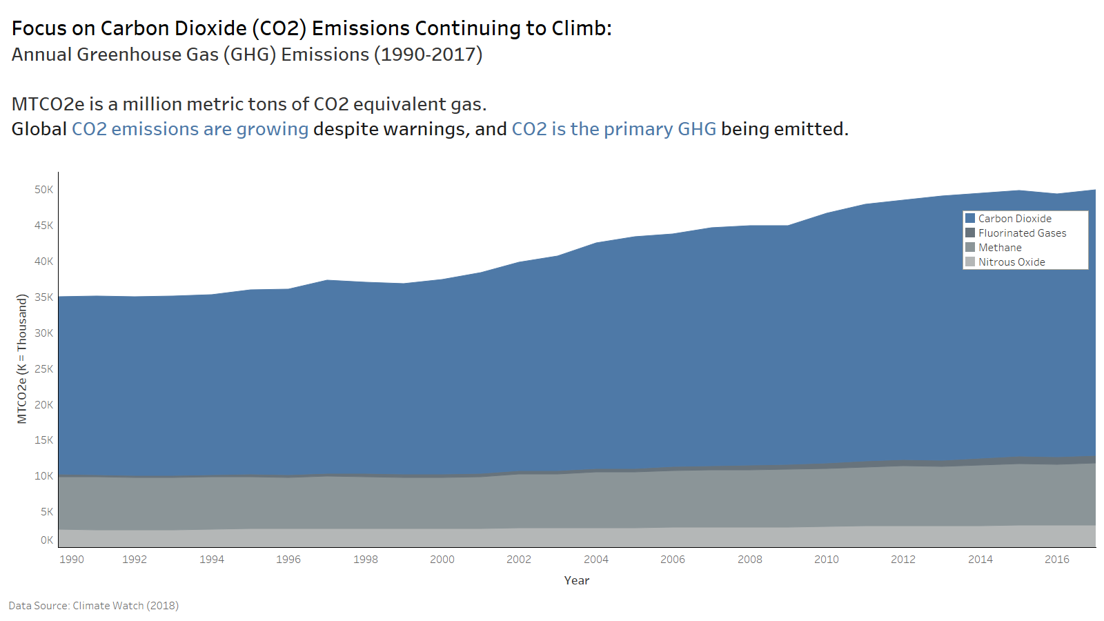

Slide 4
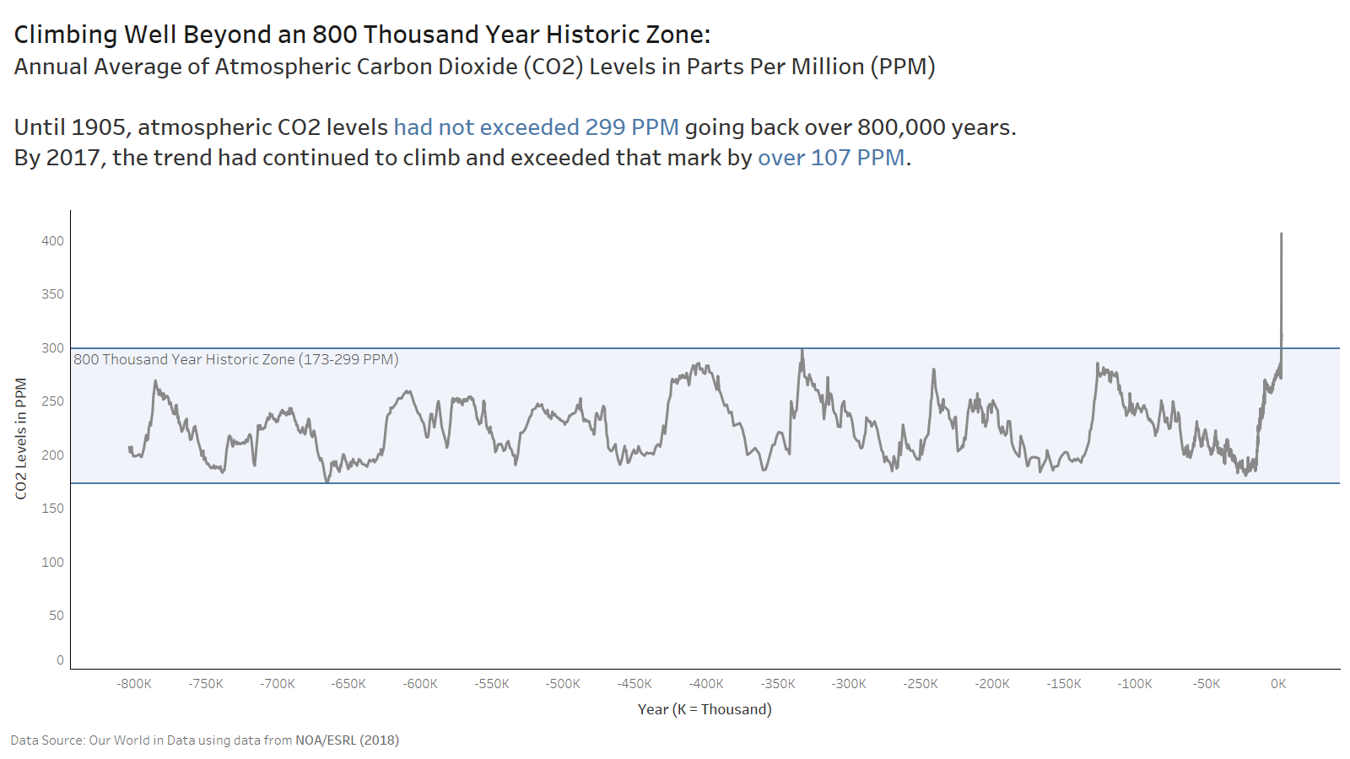

Slide 5
IMPACT FROM ECONOMIC SECTORS

Slide 6
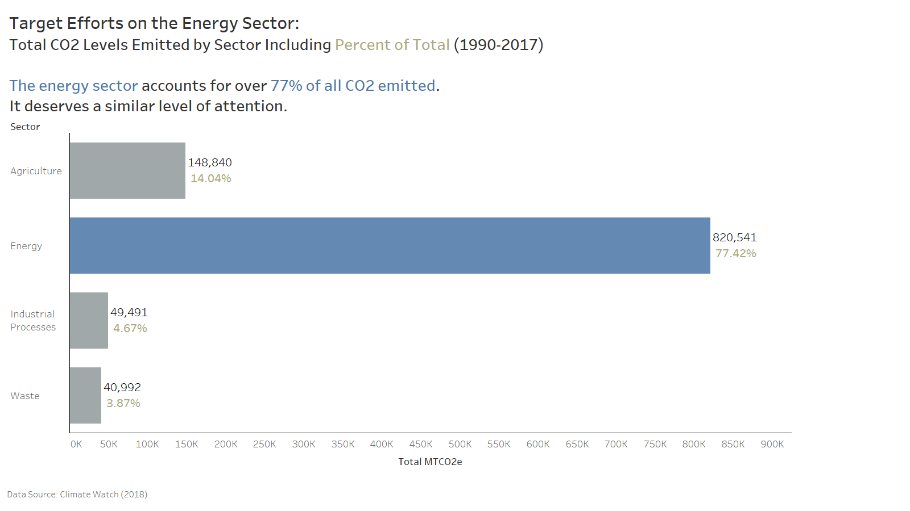

Slide 7
COMPARING NATIONS

Slide 8
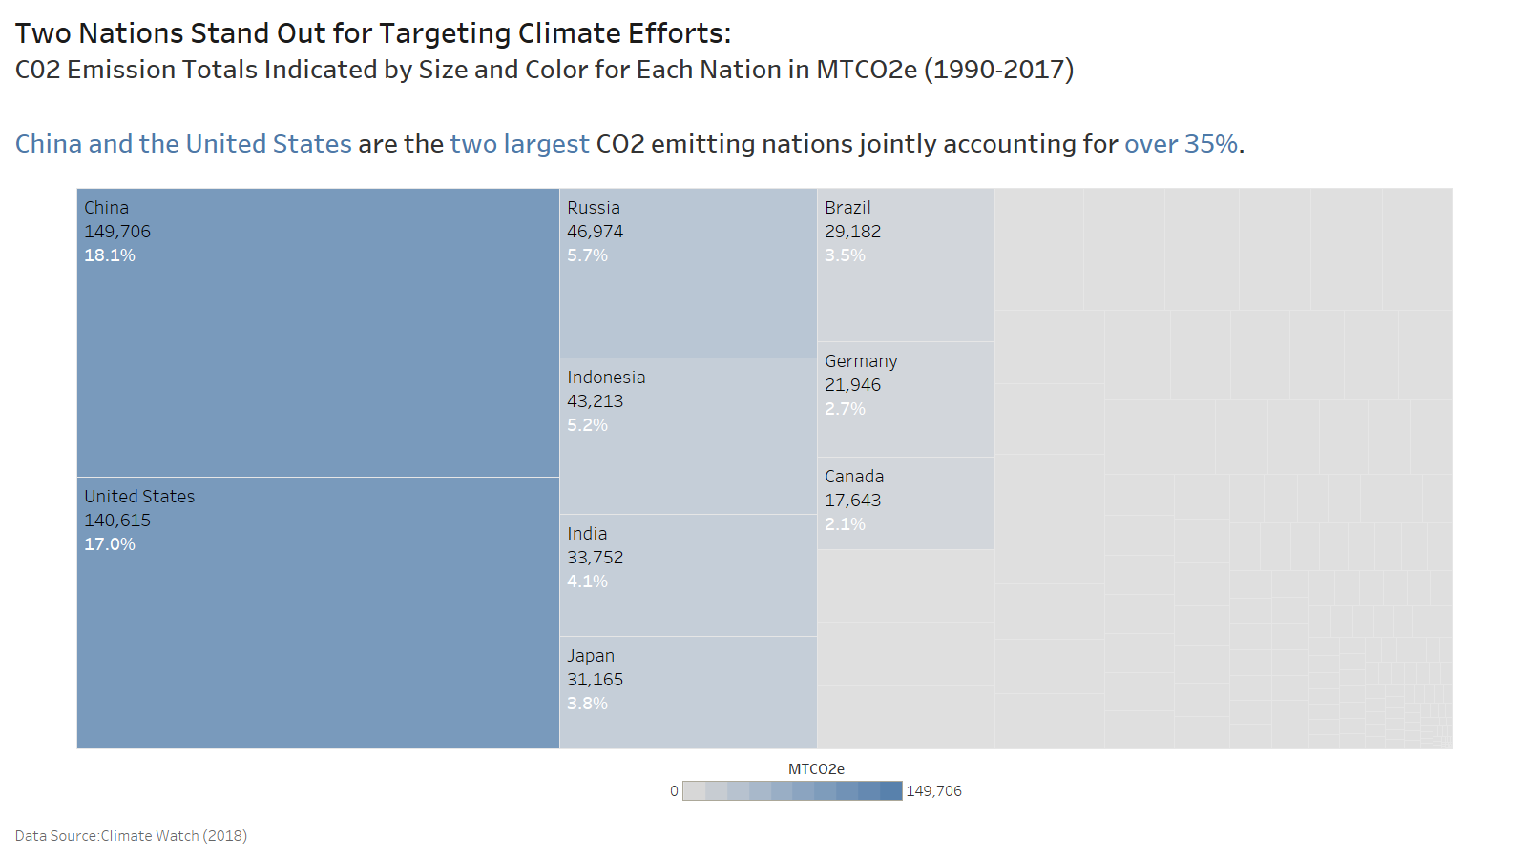

Slide 9
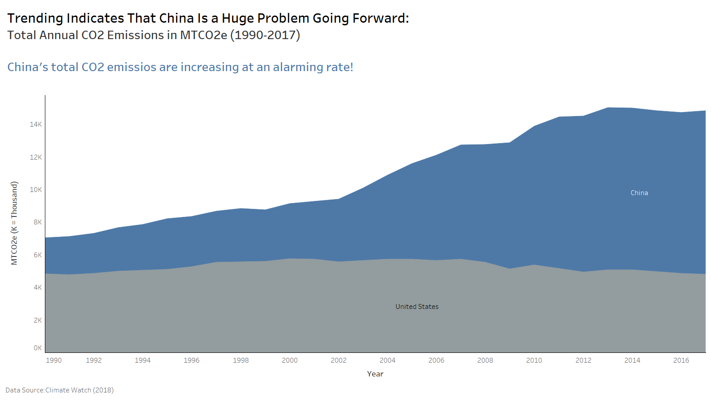

Slide 10
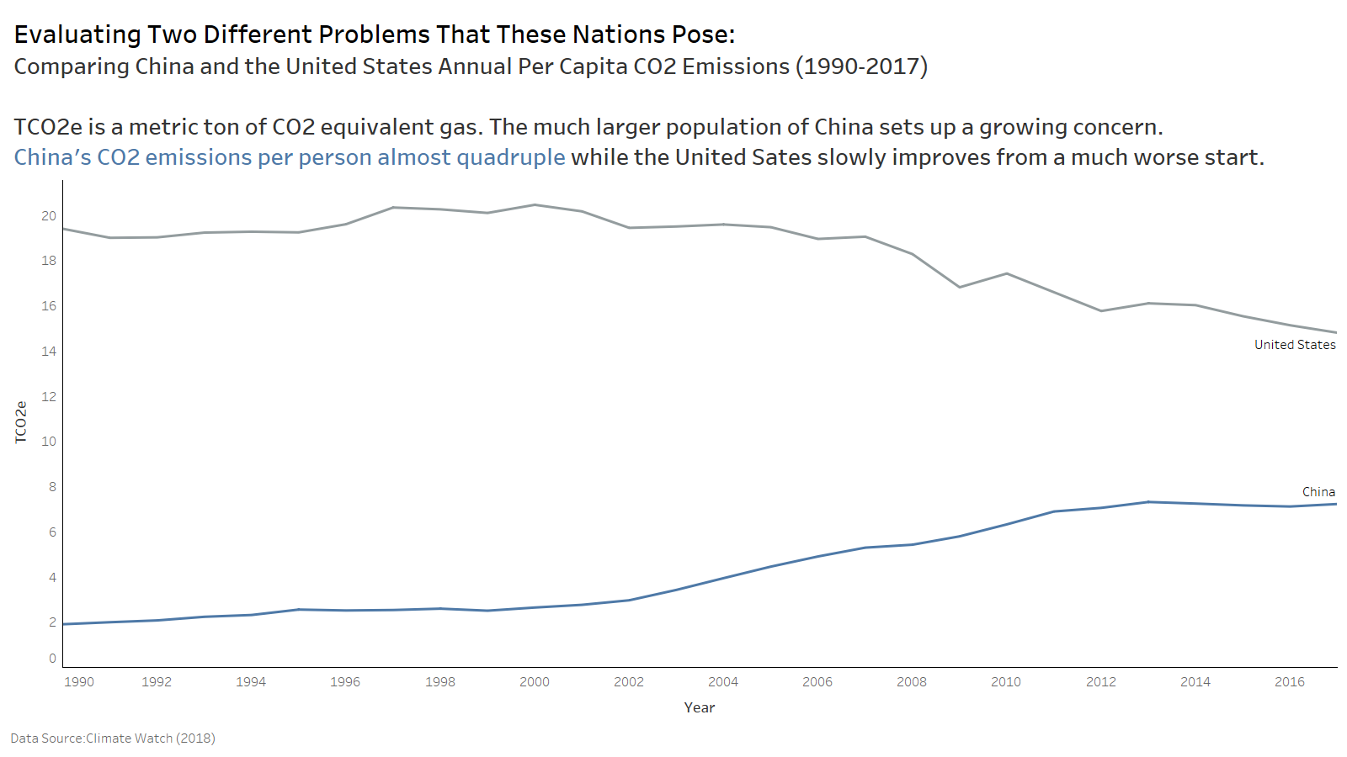

Slide 11
FOCUS
Reducing unprecedented CO2 levels
PRIMARY TARGETS
Cleaning up CO2 emissions from the energy sector
Reversing the increasing trajectory of CO2 emissions in China
Increasing the pace of CO2 reduction in the United States

