Slide 1

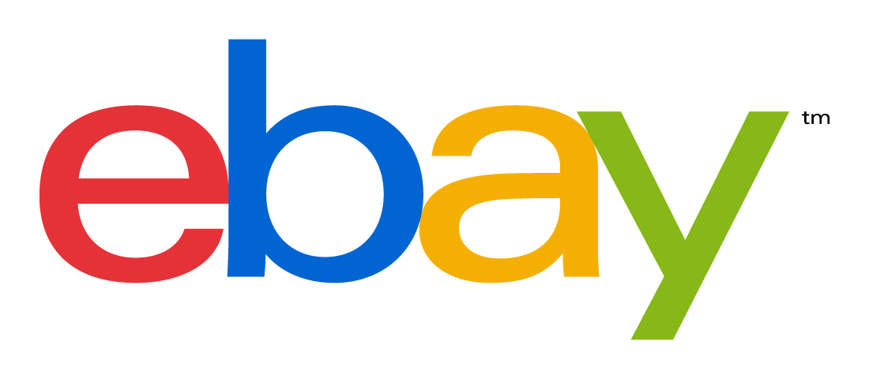
Getting Adoption of an Open Source Project
BellevueJS - jquery-ui-rotatable
Aidan Rogers (@godswearhats)
Geek Wrangler, eBay Partner Network

Slide 2
Getting Adoption of an Open Source Project
First, a warning ...
JavaScript
Open Source
Public Speaking
Notes:
I am not an expert in any of these things

Slide 3
Getting Adoption of an Open Source Project
... and then:
demo

Slide 4
Getting Adoption of an Open Source Project
Principle #1
Solve an actual problem
(One that isn’t already solved)
Notes:
Check github, google, stack overflow. Make sure this problem hasn’t been solved in the way you’re going to solve it. Are you faster, lighterweight, more secure? Or is it something that just doesn’t exist? If it’s already solved, can you contribute there? The unix principle - do one thing, do it really well.

Slide 5
Getting Adoption of an Open Source Project
Principle #2
Choose the right name
(Get feedback on it too)
Notes:
rotatable vs rotate vs rotation. jquery vs jquery-ui. The namespace can be as important as the name. Uniqueness leads to memorability as well as searchability.

Slide 6
Getting Adoption of an Open Source Project
Principle #3
Documentation
(Make it pastable)
Notes:
Your code should be readable, but most people will read a README and make a decision faster than looking in your source code. Docs show that someone cares about your code.

Slide 7
Getting Adoption of an Open Source Project
Principle #4
Make a demo
(Keep it simple)
Notes:
If it’s something demoable, make it so. People love to tinker with new stuff. Keep it simple so as not to overwhelm.

Slide 8
Getting Adoption of an Open Source Project
Principle #5
Try to help
(Be shameless, but own it)
Notes:
Look for people with the same problem that you had, and help them solve it. Stack Overflow. Tell people you’re being shameless about plugging your own stuff.

Slide 9
Getting Adoption of an Open Source Project
Principle #6
Share the burden
(Geeks like to help)
Notes:
Encourage pull requests. Open issues. Be positive. Incorporate stuff as best you can.

Slide 10
Getting Adoption of an Open Source Project
Principle #7
Keep an eye on things
(You are now in marketing)
Notes:
Google / github analytics. Google alerts. Stack overflow. Activity in your project shows health and encourages adoption.

Slide 11
Getting Adoption of an Open Source Project
Thanks!
Q & A
(Are you hiring? Yes, yes I am - airogers@ebay.com)
Notes:
Google / github analytics. Google alerts. Stack overflow. Activity in your project shows health and encourages adoption.

