Slide 1
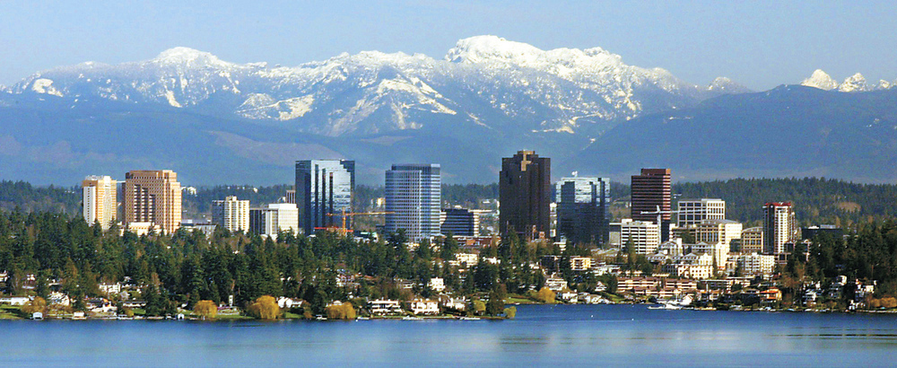


BellevueJS
Welcome to the start!

Slide 2
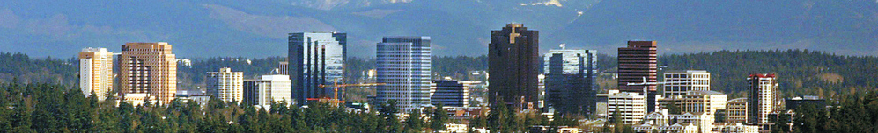

Self determination
surveymonkey.com/r/Q7WQTM8
BellevueJS 9/24/2015
sponsored by

Slide 3
We’re hiring!
(but we bought you food and beer just because we like you)
surveymonkey.com/r/Q7WQTM8
sponsored by

Slide 4
Who am I?
linkedin.com/in/sameubank
github.com/zerious
lighter.io
surveymonkey.com/r/Q7WQTM8
sponsored by

Slide 5
Who are we?
bellevuejs@gmail.com
github.com/BellevueJS
surveymonkey.com/r/Q7WQTM8
sponsored by

Slide 6
Why are we here?
Meet Talk Learn
Teach Build Hack
???
surveymonkey.com/r/Q7WQTM8
sponsored by

Slide 7
BellevueJS
<3
SeattleJS
surveymonkey.com/r/Q7WQTM8
sponsored by

Slide 8
Thank you!
surveymonkey.com/r/Q7WQTM8
sponsored by

Slide 9
Promote BellevueJS
Tweet. Tell your friends.
Record video? Design a logo?
Submit a talk: github.com/BellevueJS/BellevueJS-talks
surveymonkey.com/r/Q7WQTM8
sponsored by

Slide 10
Drinks!
Tap House Grill
surveymonkey.com/r/Q7WQTM8
sponsored by

