Slide 1
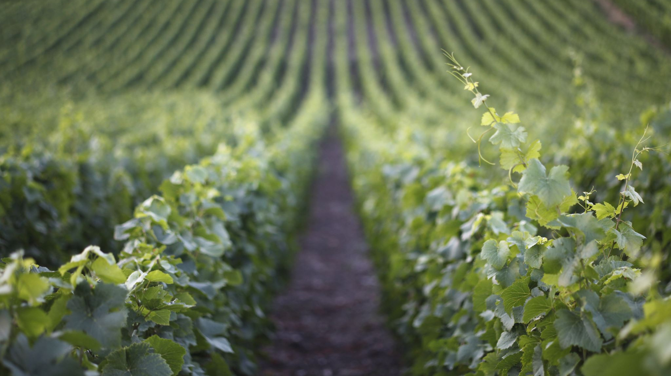
Bacchus Winery
Milestone #4 – CSD-310
Gold Team
By
Jeffrey Crossdale
Isaac Ellingson
Patrice Moracchini
Jose Velazquez Saenz

Slide 2
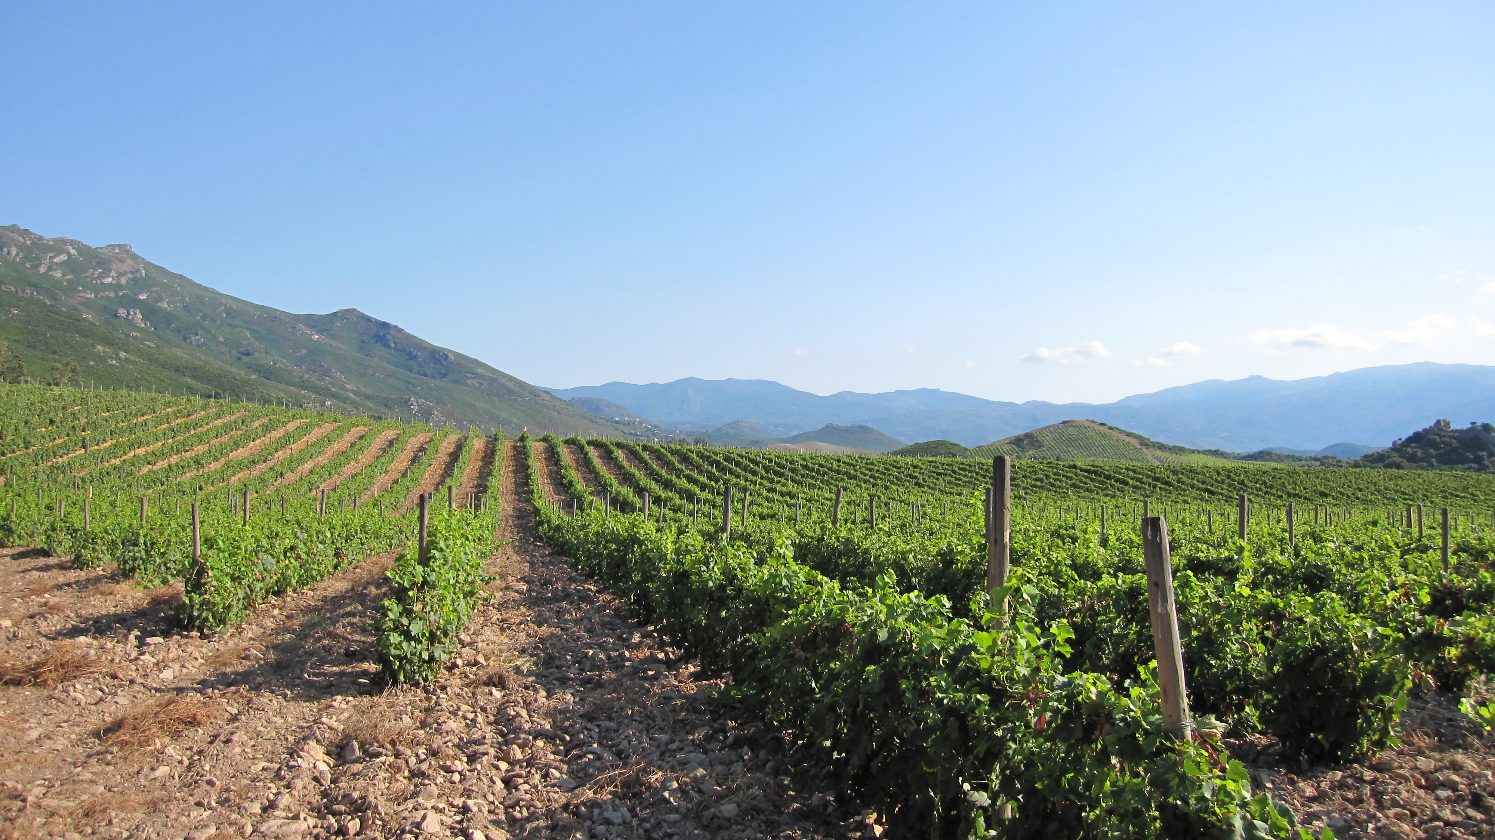
INTRODUCTION
Bacchus Winery is undergoing a significant transformation as it passes from its founder to his heirs. They want to implement numerous changes, manage their employees, facilitate their distributor orders, and track deliveries and inventory.
Our Gold Team of four developers (Isaac, Jose, Patrice and Jeff) will help them create the database they need to fulfill these goals, including the creation of reports that highlight employee work hours, distributor order tracking, and underperforming wines.
These new processes will help them manage employees and material resources and resolve issues to bring Bacchus Winery into a new era of expansion.

Slide 3

Case Study
Bacchus Winery is a small business run by Stan and Davis Bacchus. They employ roughly 25 people and face a number of challenges which require data collection and analysis.
Challenges and Questions
How many hours did employees work each quarter?
Are suppliers delivering on time?
Which distributors carry which wines?
Are some wines underperforming?

Slide 4
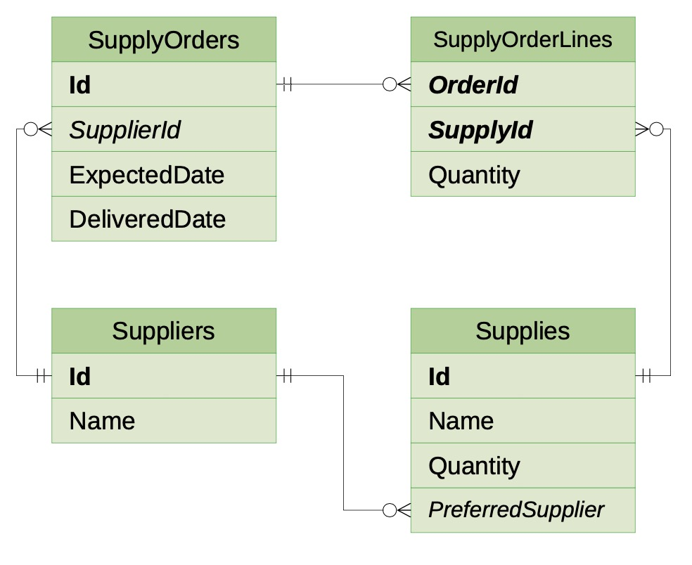
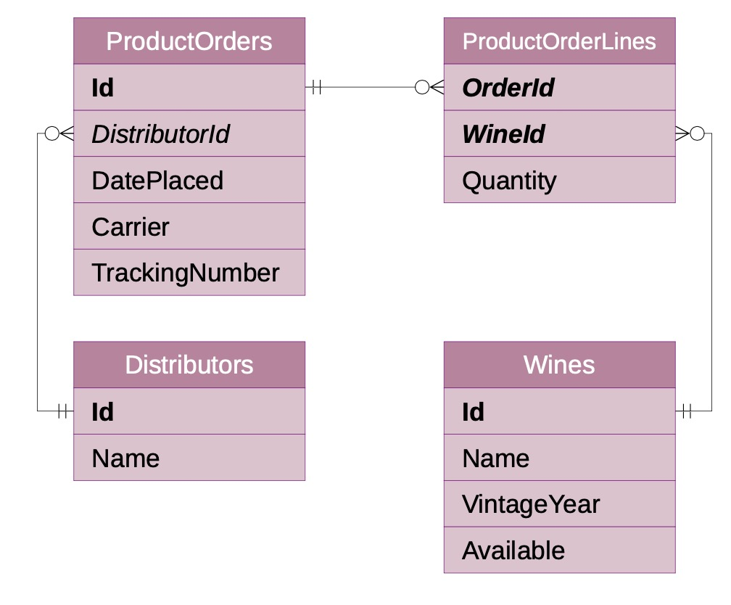
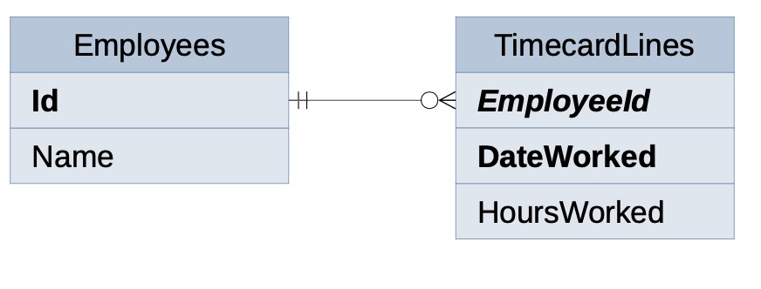
ERD

Slide 5
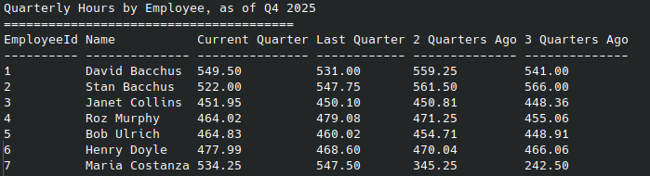
REPORTS
Quarterly Hours by Employee
This report shows a summary of hours worked per employee. It covers a whole year divided in quarters. This allows the managers to have an accurate representation of total hours each employee worked during the last four quarters.

Slide 6
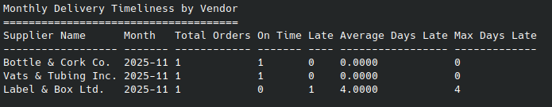
REPORTS
Monthly Delivery Timeliness by Vendor
This report is an overview of the supply orders this month. It highlights which suppliers are delivering on time, which are delivering late, and how late they are on average. With this, the winery will be able to tell at a glance if there are large gaps between expected delivery and actual delivery.

Slide 7
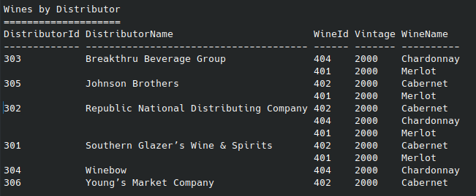
REPORTS
Wines by distributor
This report focuses on the distributor’s orders. It shows which wine has been ordered and assigns it to the distributor according to their ID in the database.

Slide 8


REPORTS
Underperforming Wines
This report lists any wines that fall below a predetermined sales volume, so that the winery can discover if any wines are not selling as expected. This "acceptable sales volume" is adjustable and can grow as the company expands.

Slide 9

ASSUMPTIONS, UNCERTAINTIES
Timekeeping Assumptions
The winery does not need a computer system to track employee departments, wages, etc. - only hours worked.
There is no need to track hours very closely; only the total worktime each day is needed.
Wine Assumptions
The wines and distributors list could grow quite large, so we rejected some more compact report formats
Wine sales can be tracked using one uniform unit of sale (such as bottles) across the entire catalogue.
Shipping and Supply Assumptions
Each ingredient has only one preferred supplier
A shipment to or from the winery is small enough that
it can all be shipped at once
on the same carrier
and needs only one tracking number.
Stockkeeping Assumptions
We do not need to keep track of supply or product locations
Supplies come in some trackable unit, and each item of supply is indistinguishable from another item.
Stock does not spoil, and it's not necessary to track freshness.

Slide 10
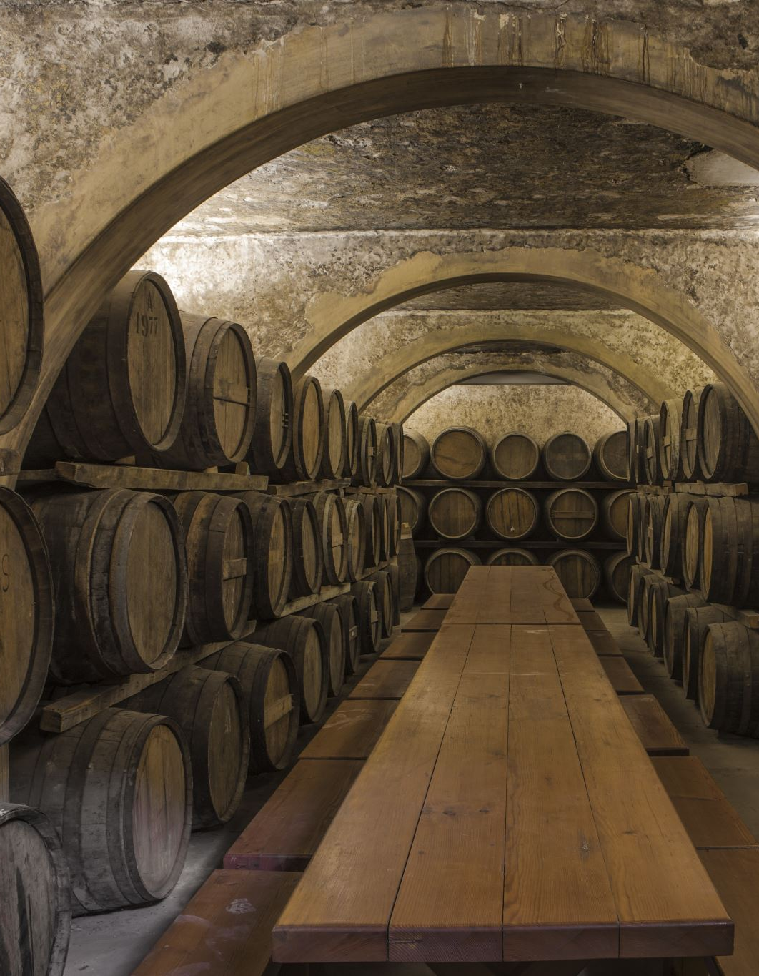
CONCLUSION
The newly implemented database provides Bacchus Winery with a centralized and reliable way to track suppliers, wine sales, distribution, and employee hours. It enables Stan and Davis to generate accurate reports showing supplier delivery performance, monthly sales trends by wine and distributor, and employee hours worked over the last four quarters.
By replacing manual tracking with relational data, the winery can now produce a clear yearly snapshot of the business, make informed decisions, and improve efficiency. This system also creates a strong foundation for future growth.

Slide 11
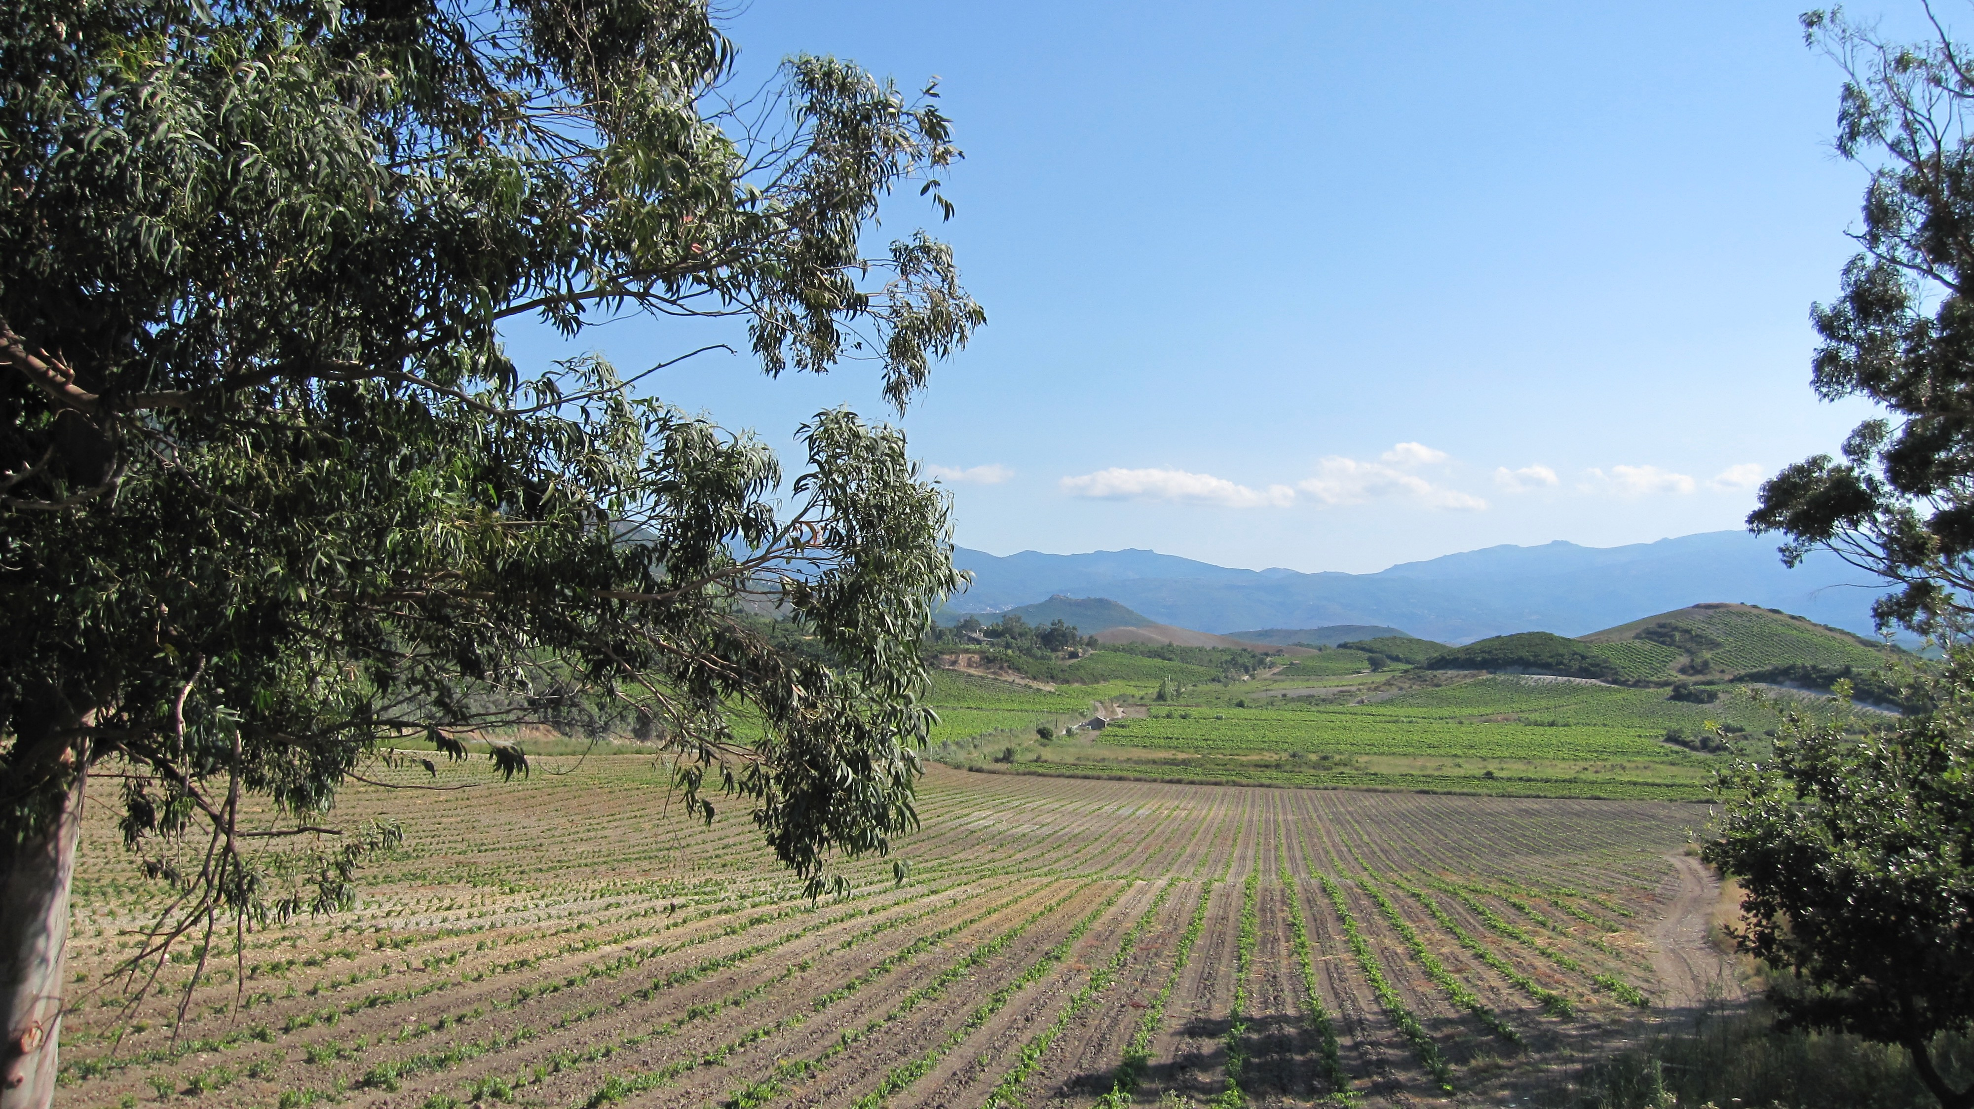
THANK YOU

