Slide 1






Design Patterns
Polina Shlepakova
Reviewer
GitHub: @PolinaShlepakova
Volodymyr Boublik
Teacher
Email: vboublik@gmail.com
Singleton
Kyrylo Vasylenko
Author
GitHub: @Bellkross
Notes:
Geneva lake source:
http://wallpaperswide.com/lake_geneva_switzerland-wallpapers.html

Slide 2
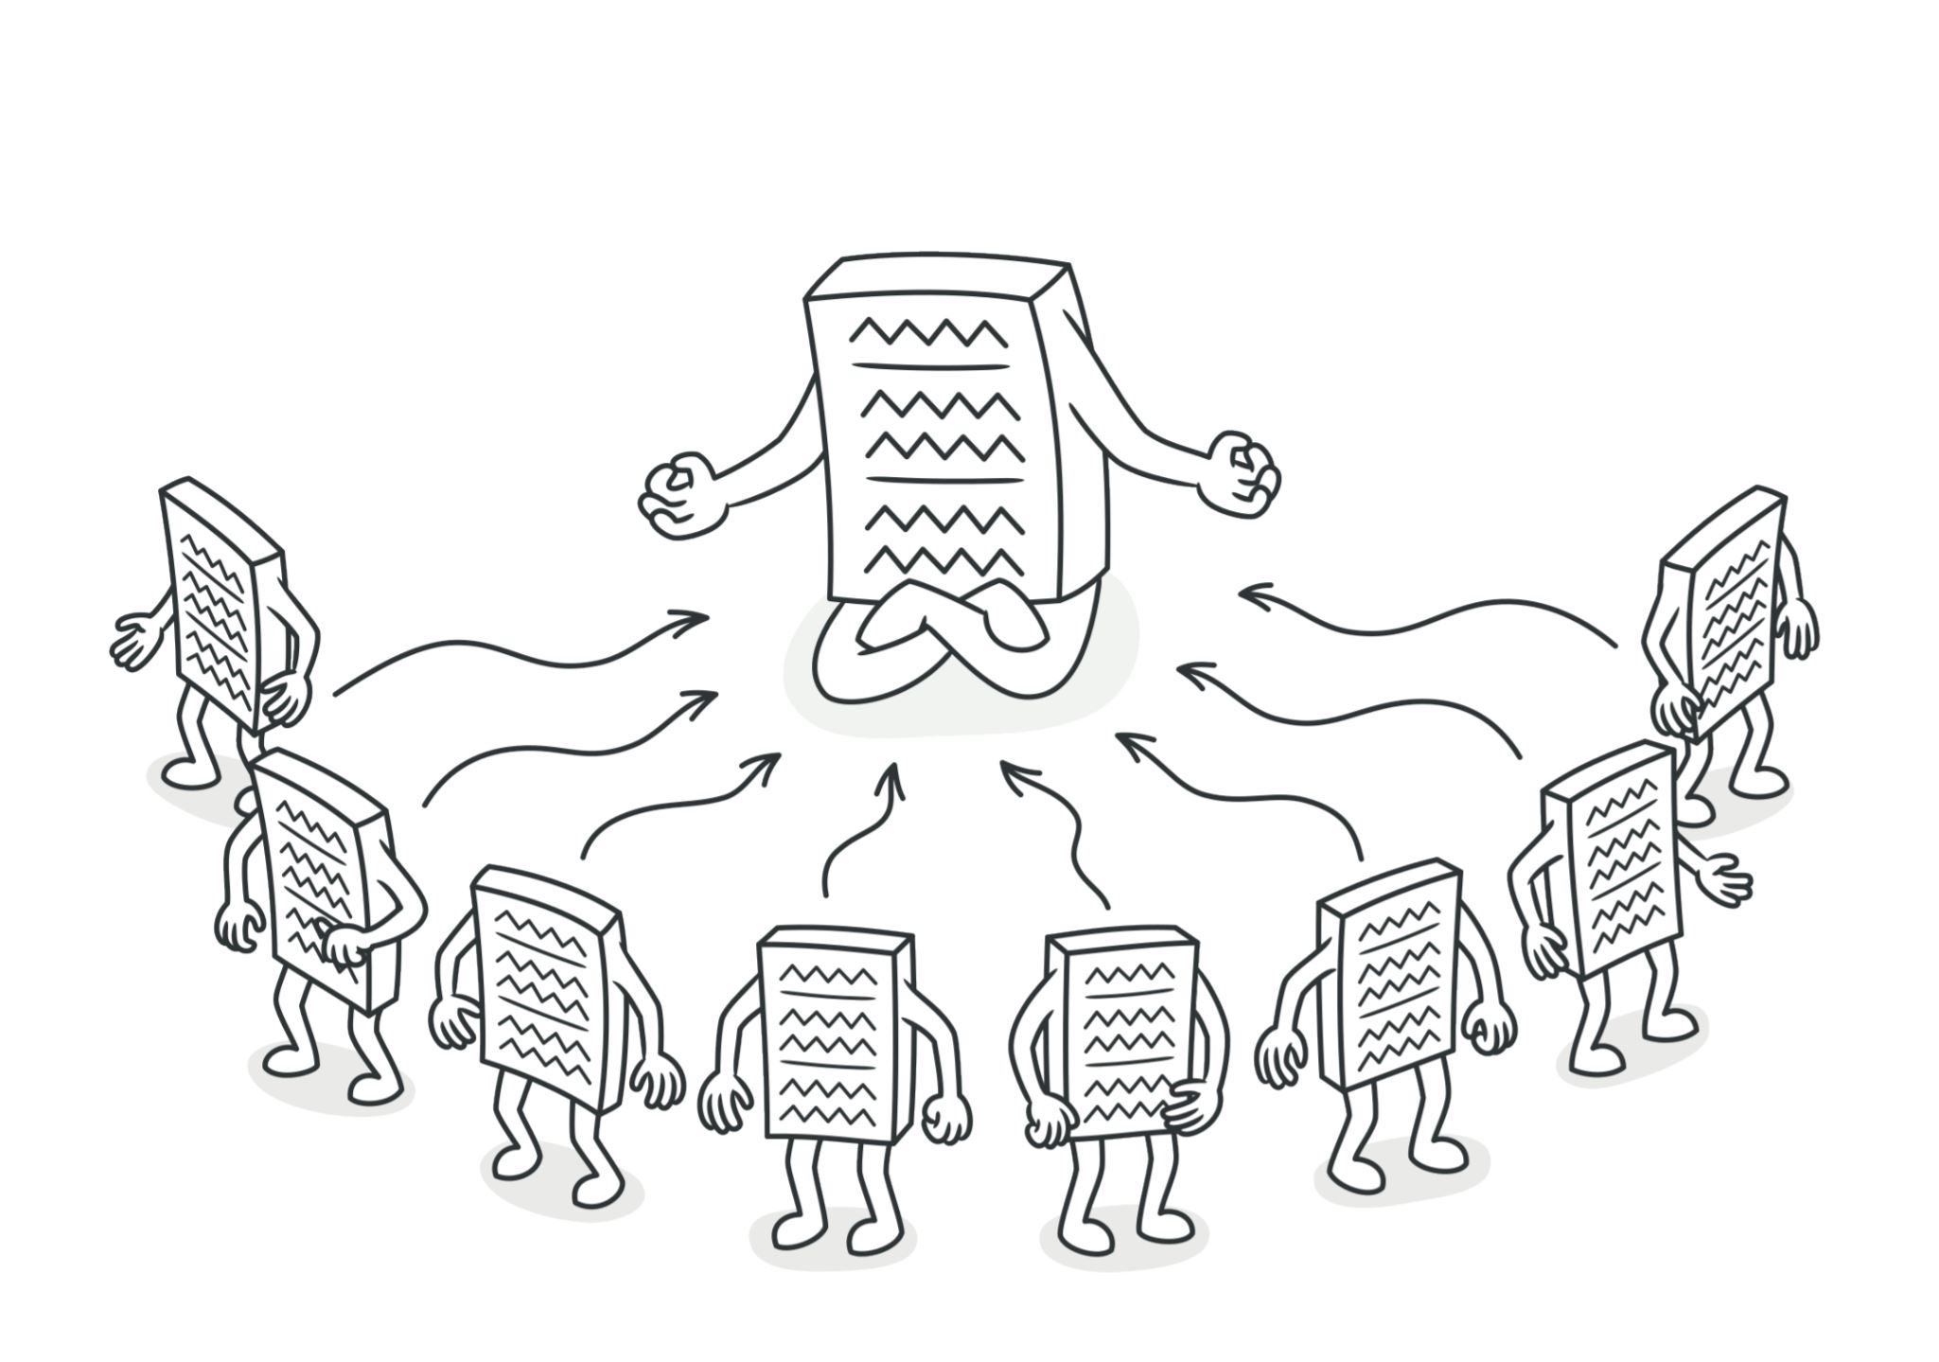
Main idea
Single instance
Global access point
Image source: Design Patterns Explained Simply by Alexander Shvets, pg. 133

Slide 3
Pattern relationships
Abstract factory
Facade
Singleton
Builder
Object pool

Slide 4
Antipatterns

Slide 5

Singleton + Prototype

Slide 6
Implementation

Slide 7
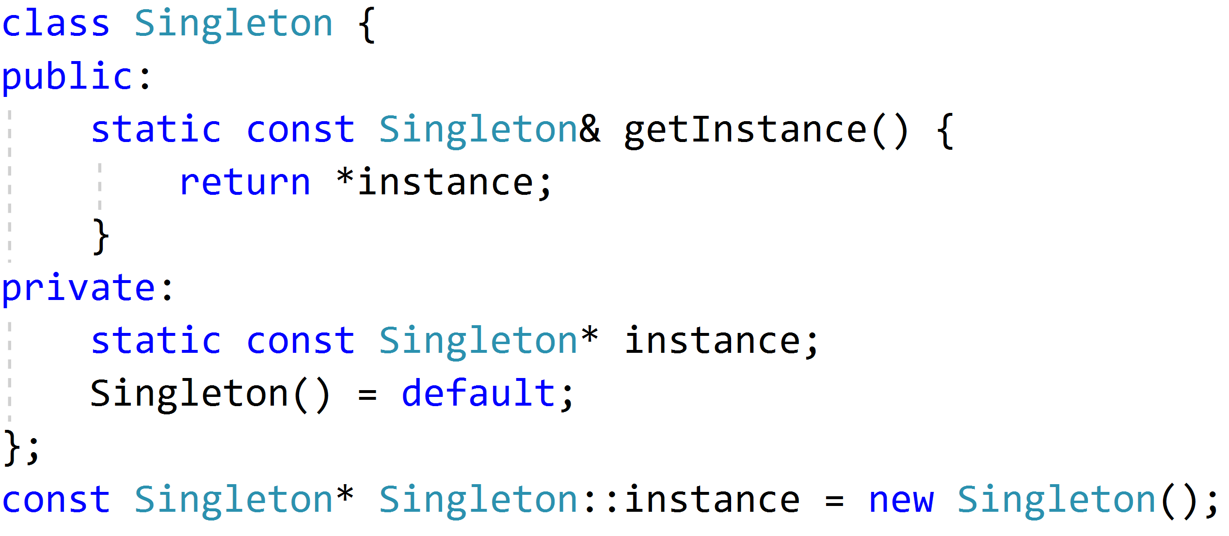
Eager initialization
Too confident instantiation
Doesn’t provide exception handling
Notes:
If your singleton class is not using a lot of resources, this is the approach to use.
But in most of the scenarios, Singleton classes are created for resources such as File System, Database connections etc.
Preferable to avoid the instantiation until client calls the getInstance method.

Slide 8
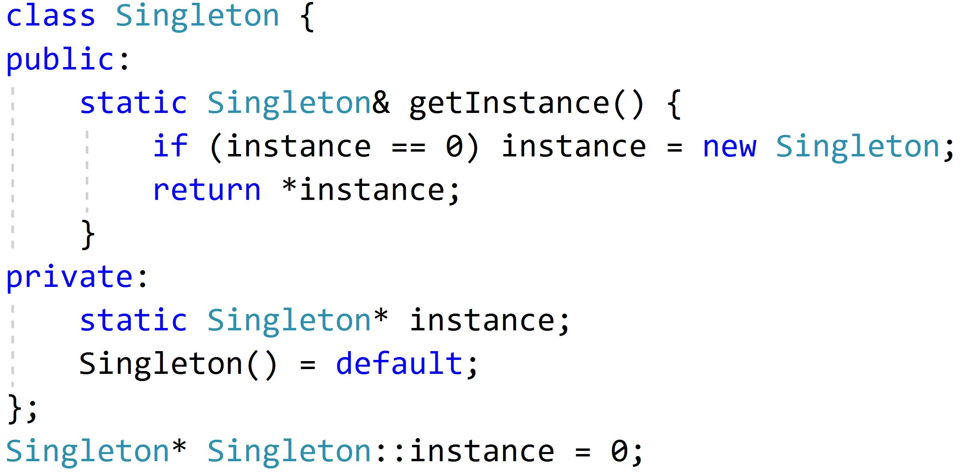
Lazy instantiation
Lazy initialization
Fine for single-threaded environment
Notes:
The above implementation works fine in case of the single-threaded environment but when it comes to multithreaded systems, it can cause issues if multiple threads are inside the if condition at the same time.
It will destroy the singleton pattern and both threads will get the different instances of the singleton class.

Slide 9
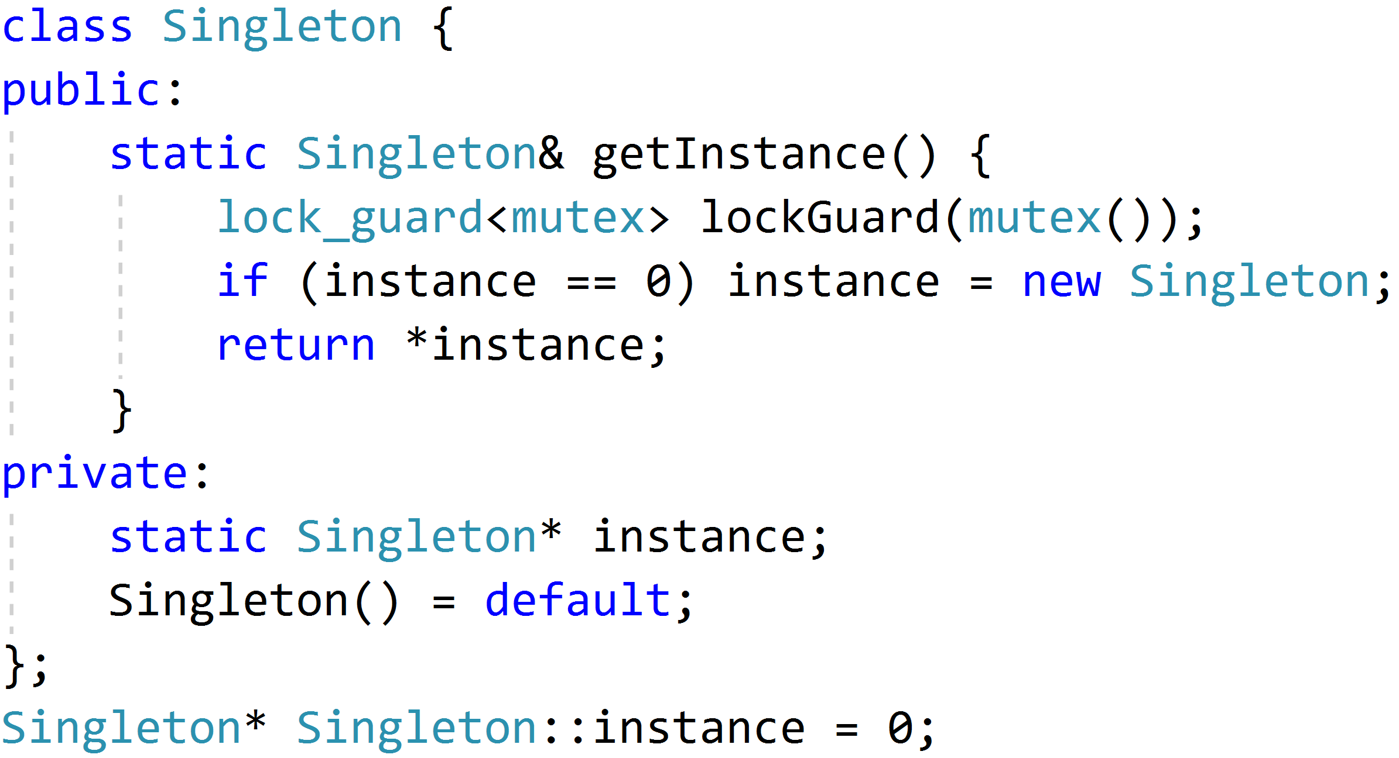
Thread safe implementation
Lazy
Thread safe
Perfect
(No)
Too slow
Notes:
Almost good, but guard locks every thread

Slide 10
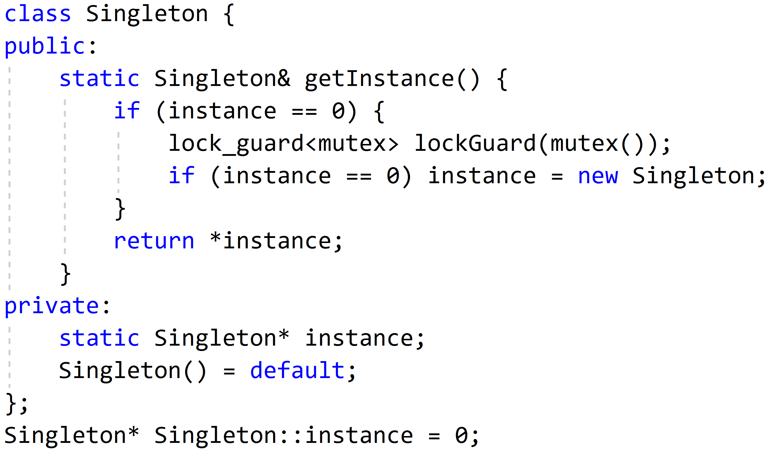
Double checked locking
Lazy
Thread safe
Fast
Notes:
Guard works properly

Slide 11

Mistakes
Notes:
Image resource: https://www.shutterstock.com/cs/video/clip-6419210-savior-salvation-religion-concept-mountain-man-snow

Slide 12
How to destroy your architecture
Forget about Single Responsibility principle
Stuff up your singleton with “helpful” functionality
When almost every class knows about your singleton:
Congratulation, you have a God object
How about creating non-thread safe implementation?

Slide 13
Applicability and relationships

Slide 14
Singleton minor applicability
In most cases Facade could be Singleton
Also you could use with singleton:
Abstract factory
Builder
Prototype

Slide 15
Singleton and Object pool
The real reason for using singleton is resource contention
You need singleton if you have resource that:
Can only have a single instance
Has to be managed
For example: Log file, Database, Object Pool

Slide 16
Resources
https://www.aristeia.com/Papers/DDJ_Jul_Aug_2004_revised.pdf
http://www.modernescpp.com/index.php/prefer-locks-to-mutexes
https://www.journaldev.com/1377/java-singleton-design-pattern-best-practices-examples
https://stackoverflow.com
Design Patterns Explained Simply by Alexander Shvets

Slide 17
Thank you for your attention

