Slide 1






Design Patterns
Polina Shlepakova
Reviewer
GitHub: @PolinaShlepakova
Volodymyr Boublik
Teacher
Email: vboublik@gmail.com
Object pool
Kyrylo Vasylenko
Author
GitHub: @Bellkross
Notes:
Today we’re going to talk about amazingly powerful data structure known as an Object Pool

Slide 2
Pattern relationships

Slide 3
Pattern relationships
Singleton
Object pool

Slide 4
Main idea

Slide 5
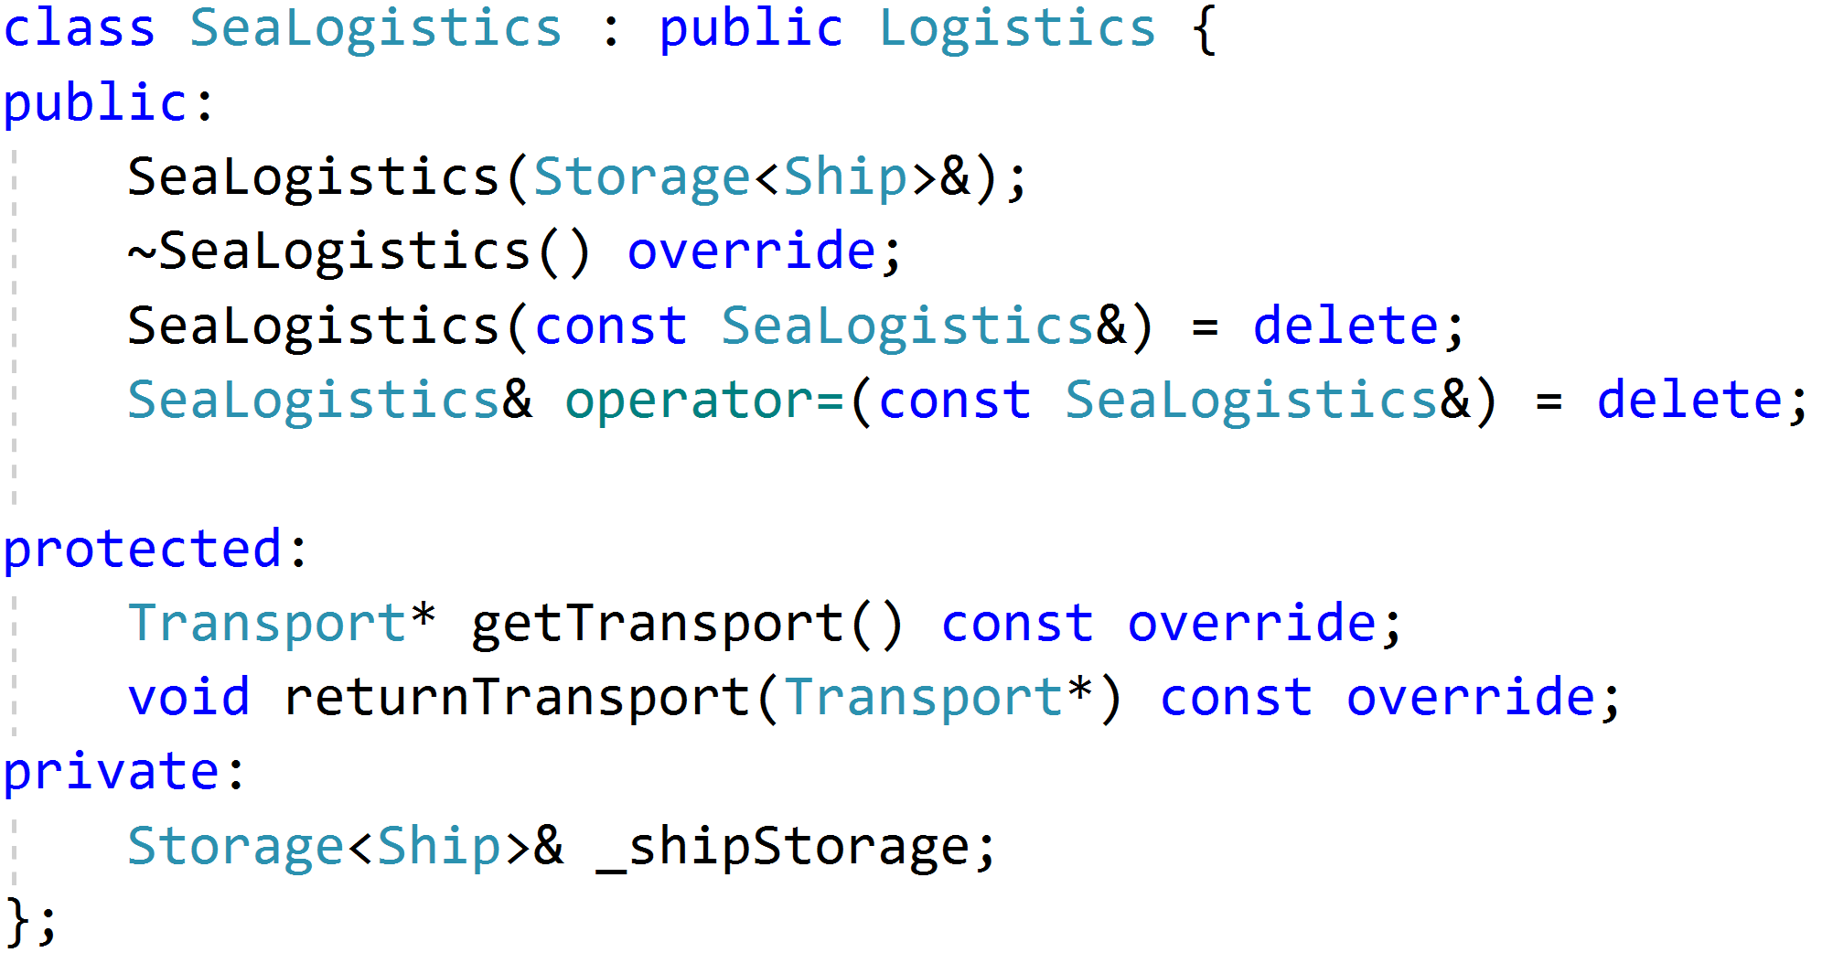
Logistics program
Most interesting part
Notes:
Lets talk about transport management in logistics application

Slide 6
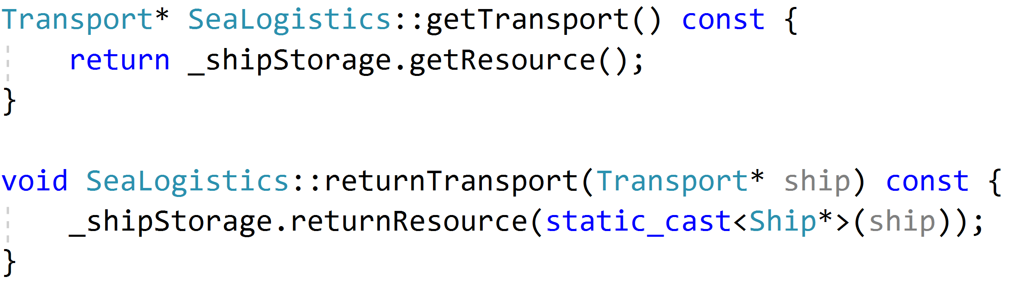
Logistics program
What about storage implementation?
Stop
Simple
No responsibility for resource management
Notes:
Lets talk about transport management in logistics application

Slide 7
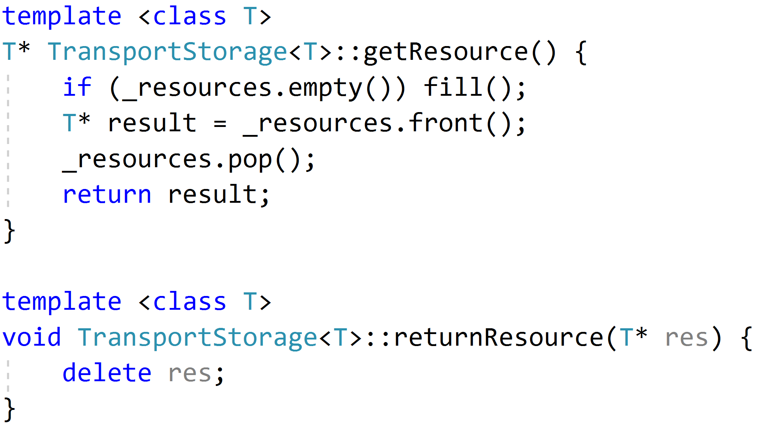
Storage implementation
It is terrible and produces memory churn problem
Notes:
Lets talk about transport management in logistics application

Slide 8
Memory churn problem
Comes from creating the whole group of similar objects
Images, other similar resources
Database connections
Ships, Trucks for logistic

Slide 9
Memory churn problem
Free
Create
EXECUTING PROGRAM
MEMORY HEAP
Notes:
They repeatedly get created, exists for little while, and then are freed
This actions are polluting a memory heap in a very short amount of time

Slide 10
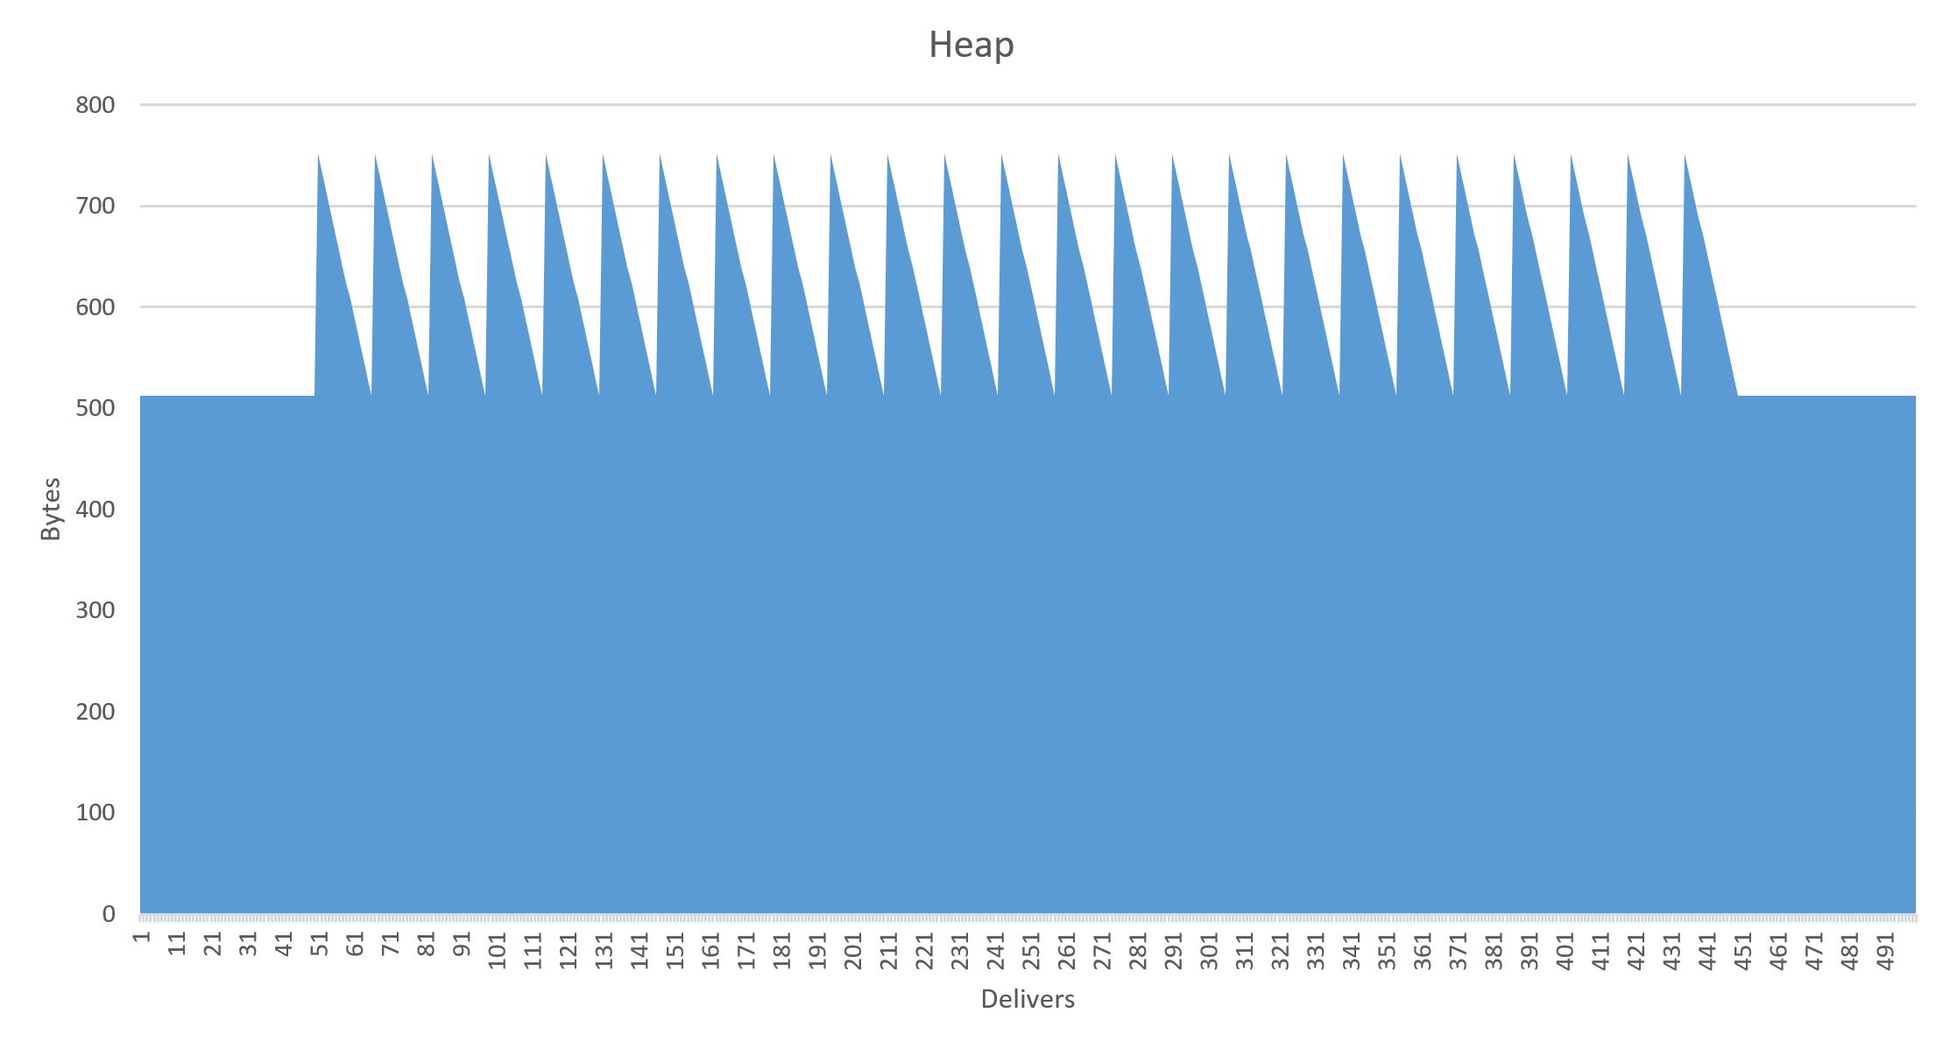
Memory churn problem
Flood
Memory management events
Timeframe
In delivers
Notes:
When this happens on a regular basis you’re ending up in a great deal of memory allocation and releasing events

Slide 11
Object pool
Create
Pool
MEMORY HEAP
EXECUTING PROGRAM
Object Pool
Notes:
Effectively, when you’re done with an object, rather than freeing it back to the memory heap, you keep a reference to it in a queue of available objects.
The next time you need to allocate an object of that type, you can repurpose an existing object from the pool rather than grabbing a new one from the memory heap.
And only when your pool is empty does it make sense to go back to the heap to allocate new objects, which will eventually ve freed back to the pool, growing its potential size over time.

Slide 12
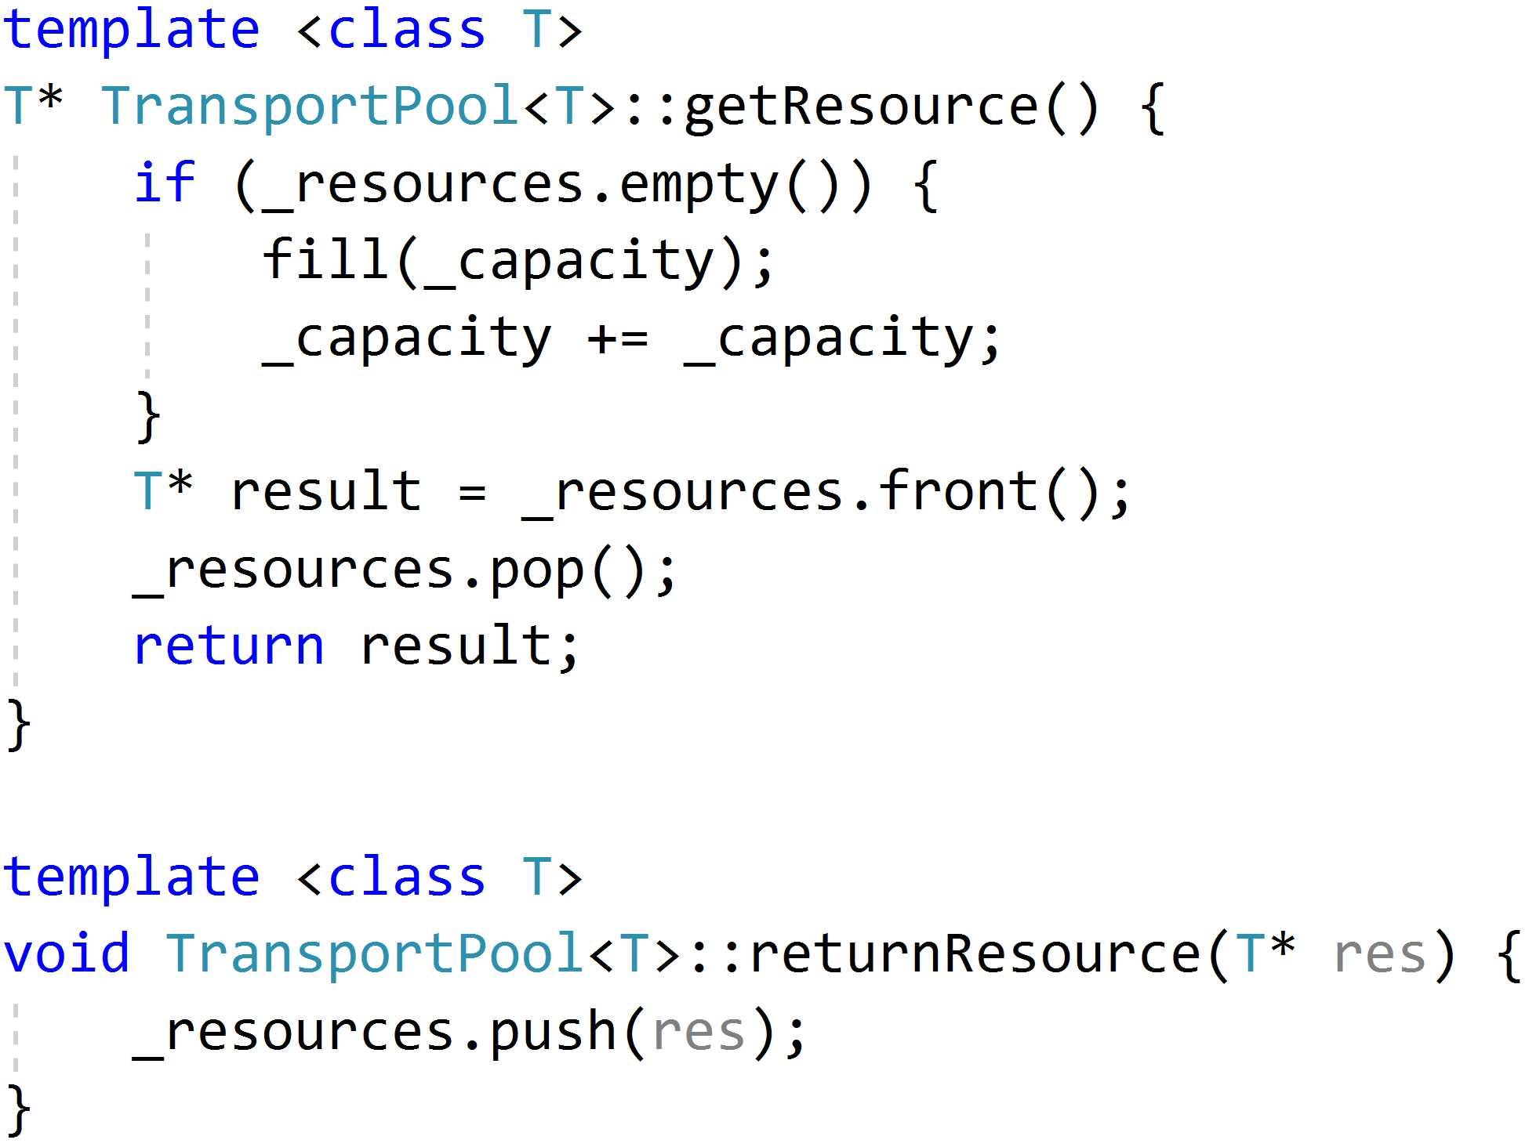
Implementation
Allocation management
Optimization
Reuse

Slide 13
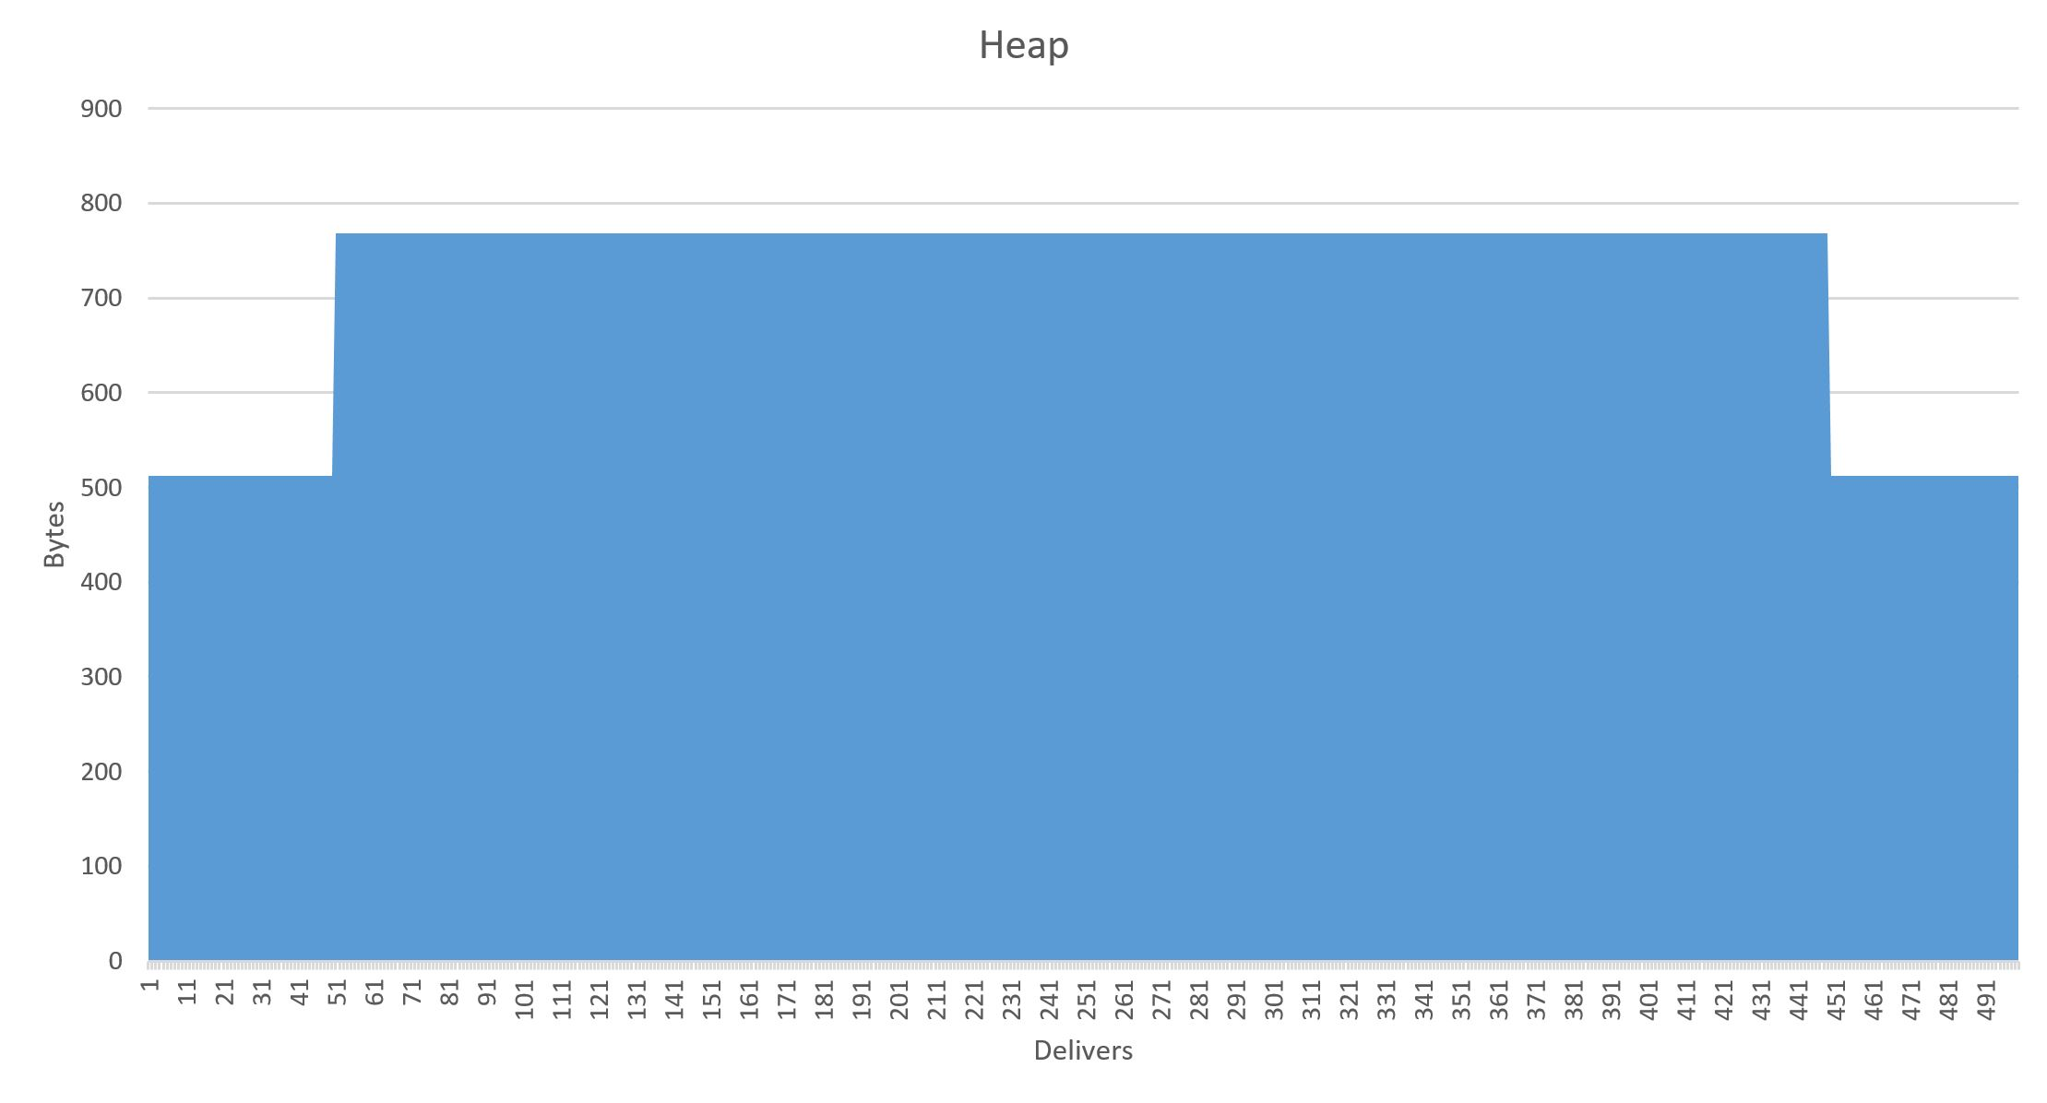
Result
Notes:
The end result of using an object pool is that instead of ton of heap fluctuation, you’ll end up with stable allocations or small growths
So this is helping you save precious

Slide 14
Best practices

Slide 15
Allocation in groups
Object Pool
1x
MEMORY HEAP
1x
6x
Notes:
Remember that there’s an overhead involved each time the object pool needs to go back to the main heap to allocate memory.
Rather than allocating an object each time one is needed, it makes more sence to allocate a group of free objects at one time.

Slide 16
Pre-allocate
Object Pool
MEMORY HEAP
EXECUTING PROGRAM
Notes:
In addition, rather than waiting for each empty pool request to make a new heap allocation, instead fill your pool at application load time
So the first group of objects you’re grabbing from the pool are as fast as possible.
You could even figure out the ideal preallocation amount so you could fill your pool ahead of time minimizing the number of times you have to go back to the heap.

Slide 17
Clear object references
Object Pool
Clean up member variables
Attention
So they doesn’t contain any references to any objects in memory
EXECUTING PROGRAM
Don’t try to use already returned object
Or you will end up with memory leaks
Notes:
In order to make sure that all of your objects are returned to the pool properly, make sure that member variables of these objects are cleaned up. So they doesn’t contain any references to any other objects in memory.
If you are not careful you can end up creating a lot of persistent memory leaks for this objects in your pools

Slide 18
Resources
https://www.youtube.com/watch?v=bSOREVMEFnM
@PolinaShlepakova
https://www.journaldev.com/1377/java-singleton-design-pattern-best-practices-examples
https://stackoverflow.com
Design Patterns Explained Simply by Alexander Shvets

Slide 19
Thank you for your attention

