Slide 1






Design Patterns
Polina Shlepakova
Reviewer
GitHub: @PolinaShlepakova
Volodymyr Boublik
Teacher
Email: vboublik@gmail.com
Object pool
Kyrylo Vasylenko
Author
GitHub: @Bellkross
Notes:
Today we’re going to talk about amazingly powerful data structure known as an Object Pool

Slide 2
Main idea

Slide 3
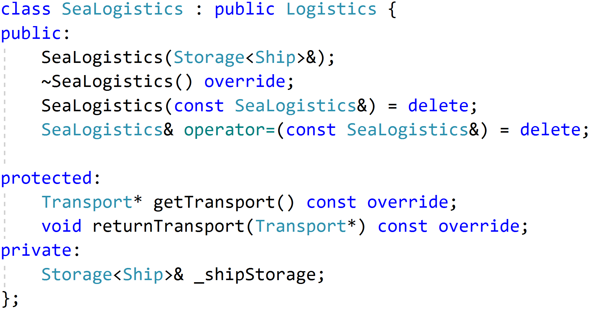
Logistics program
Most interesting part
Notes:
Lets talk about transport management in logistics application

Slide 4
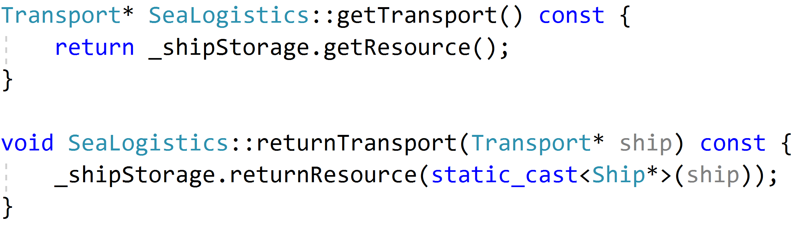
Logistics program
What about storage implementation?
Stop
Simple
No responsibility for resource management
Notes:
Lets talk about transport management in logistics application

Slide 5
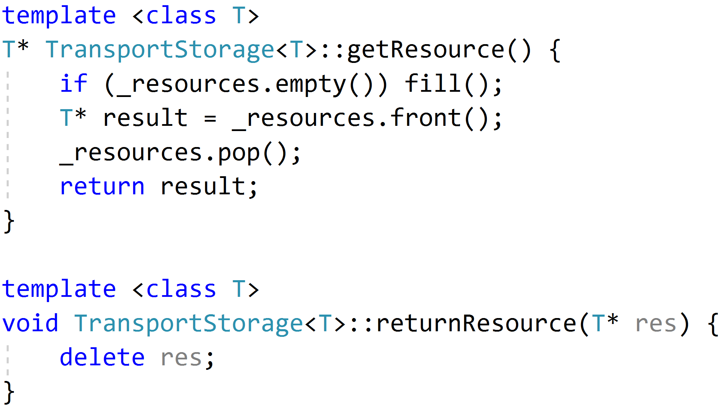
Storage implementation
It is terrible and produces memory churn problem
Notes:
Lets talk about transport management in logistics application

Slide 6
Memory churn problem
Comes from creating the whole group of similar objects
Images, other similar resources
Database connections
Ships, Trucks for logistic

Slide 7
Memory churn problem
Free
Create
EXECUTING PROGRAM
MEMORY HEAP
Notes:
They repeatedly get created, exists for little while, and then are freed
This actions are polluting a memory heap in a very short amount of time

Slide 8
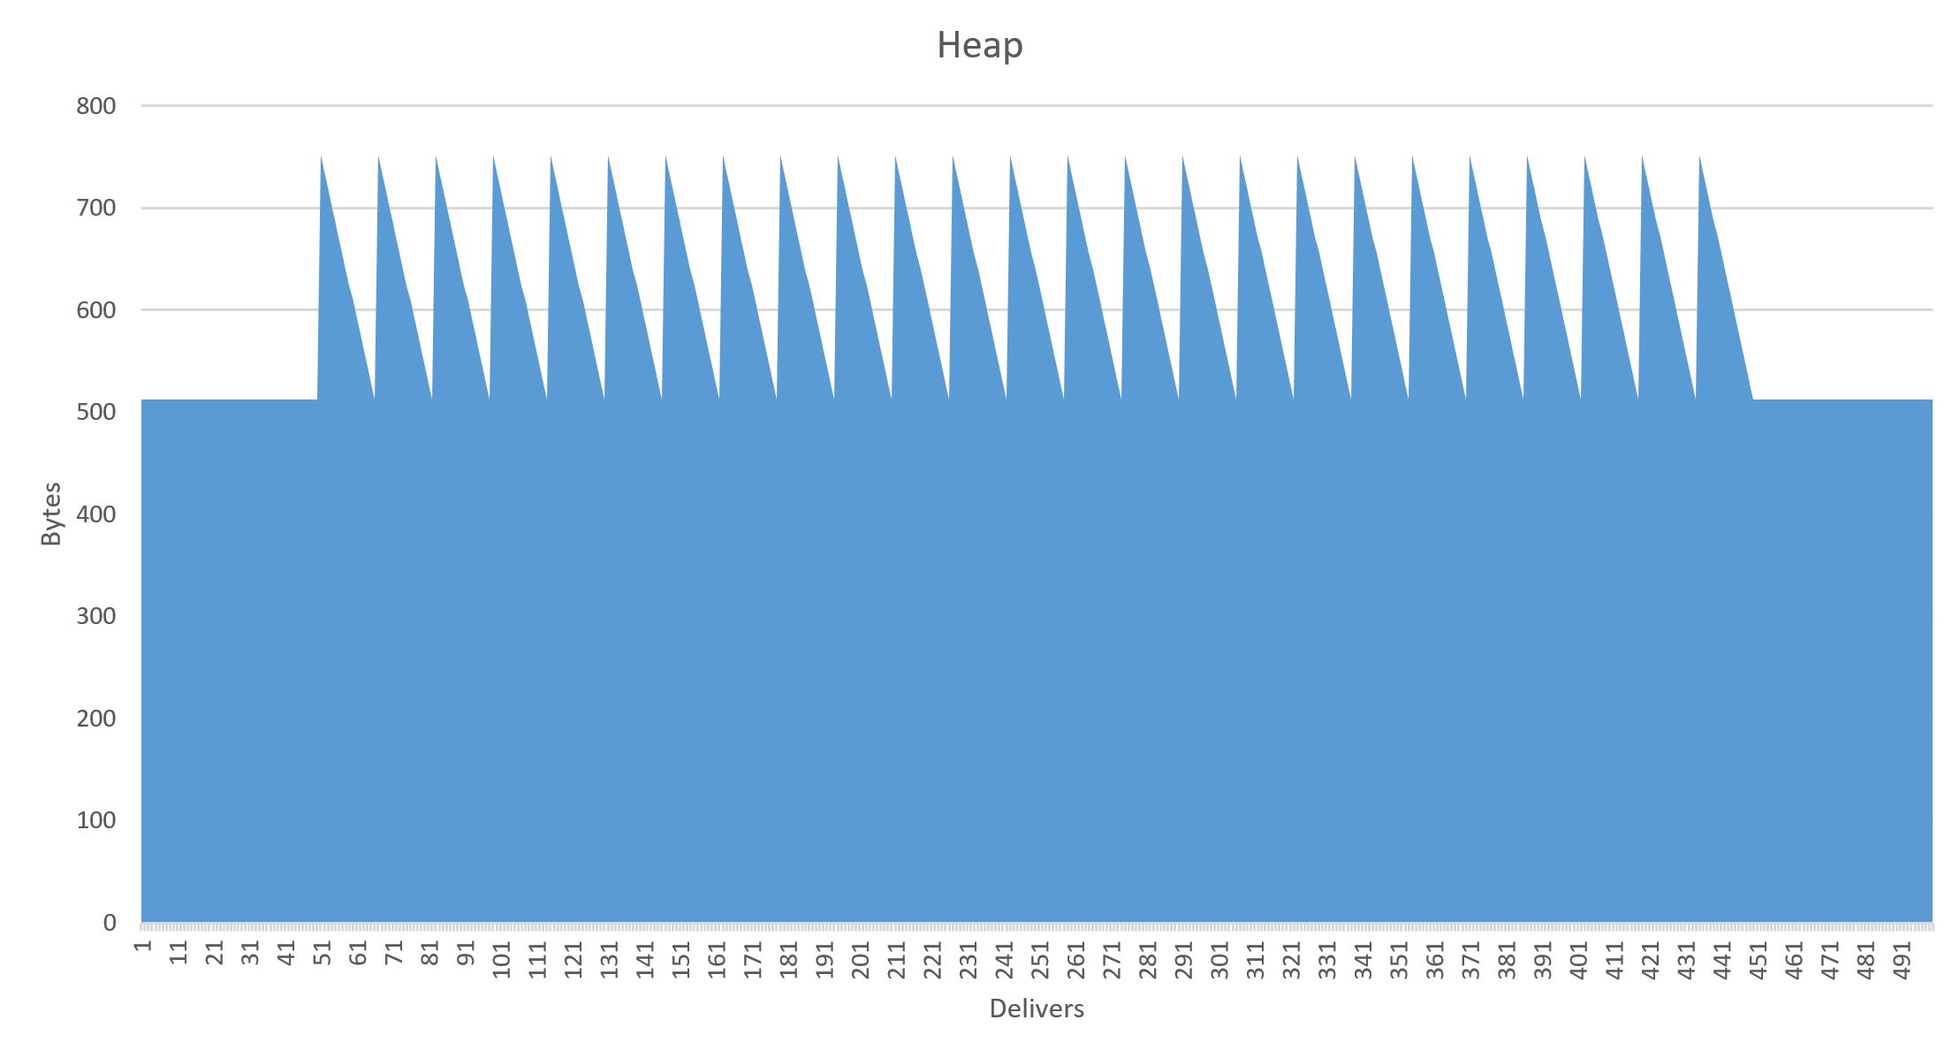
Memory churn problem
Flood
Memory management events
Timeframe
In delivers
Notes:
When this happens on a regular basis you’re ending up in a great deal of memory allocation and releasing events

Slide 9
Object pool
Create
Pool
MEMORY HEAP
EXECUTING PROGRAM
Object Pool
Notes:
Effectively, when you’re done with an object, rather than freeing it back to the memory heap, you keep a reference to it in a queue of available objects.
The next time you need to allocate an object of that type, you can repurpose an existing object from the pool rather than grabbing a new one from the memory heap.
And only when your pool is empty does it make sense to go back to the heap to allocate new objects, which will eventually ve freed back to the pool, growing its potential size over time.

Slide 10
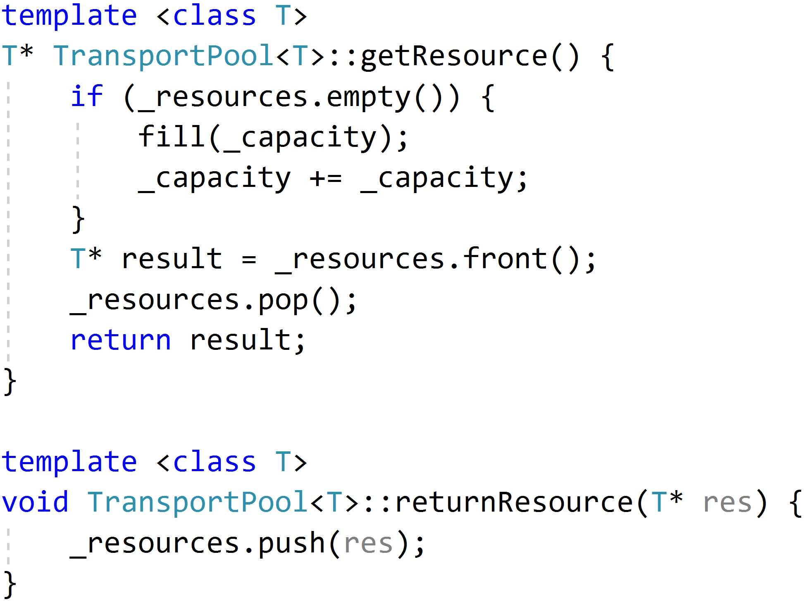
Implementation
Allocation management
Optimization
Reuse

Slide 11
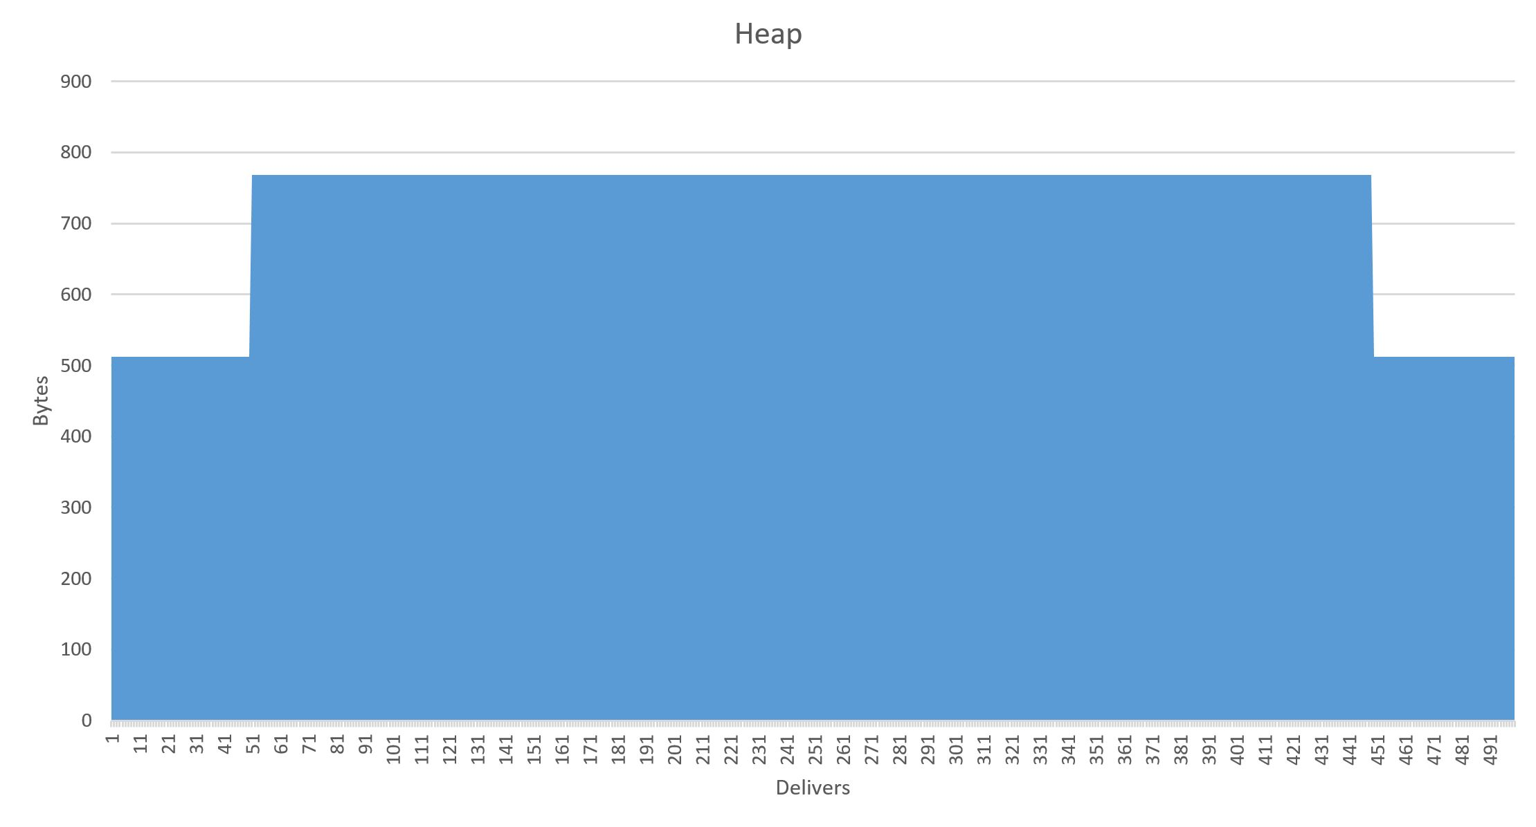
Result
Notes:
The end result of using an object pool is that instead of ton of heap fluctuation, you’ll end up with stable allocations or small growths
So this is helping you save precious

Slide 12
Pattern relationships
Singleton
Object pool

Slide 13
Thank you for your attention

