Slide 1

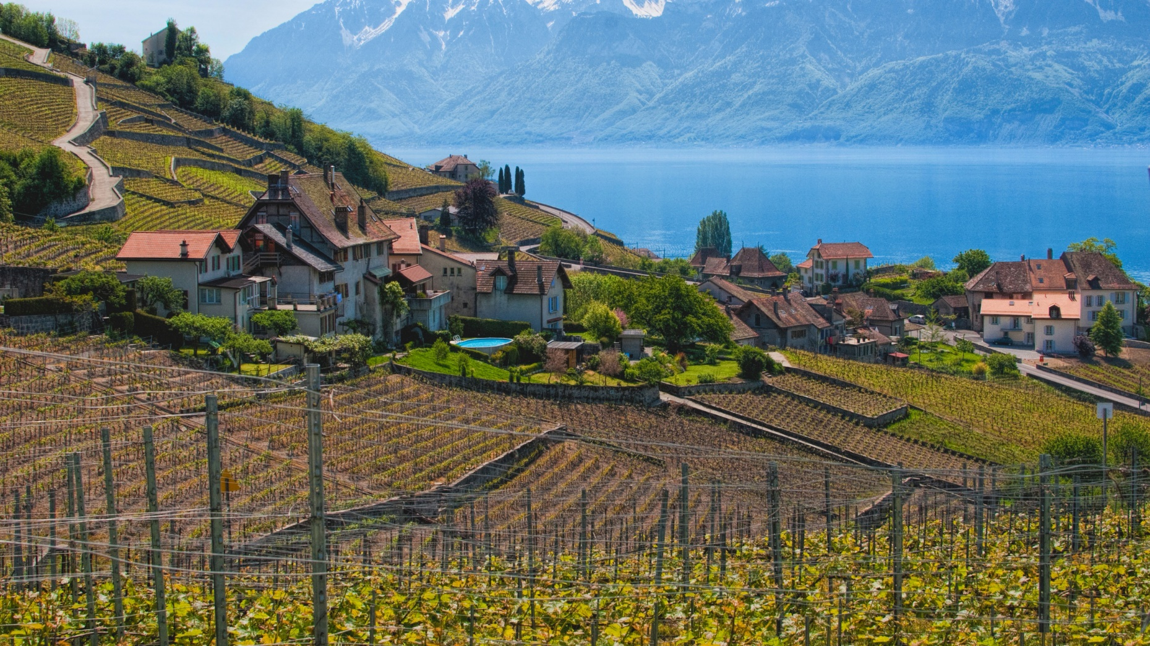



Design Patterns
Polina Shlepakova
Reviewer
GitHub: @PolinaShlepakova
Volodymyr Boublik
Teacher
Email: vboublik@gmail.com
Singleton
Kyrylo Vasylenko
Author
GitHub: @Bellkross
Notes:
Geneva lake source:
http://wallpaperswide.com/lake_geneva_switzerland-wallpapers.html

Slide 2
Pattern relationships
Abstract factory
Singleton
Facade
Object pool

Slide 3
Typical Implementation

Slide 4
Advantages

Slide 5
Disadvantages

Slide 6
Antipatterns

Slide 7
Relationships

