Slide 1
DECODELABS · INTERNSHIP SUBMISSION
Iris Flower
Classification Using AI
An end-to-end supervised learning pipeline built as an AI Engineer project.
PROJECT 02
Data
Classification
K-Nearest Neighbors · StandardScaler · Python
Verified test accuracy: 93.33%
2026 · Portfolio presentation

Slide 2
01 · FRAMING THE TASK
Problem & Objective
THE QUESTION
PROJECT OBJECTIVE
Can a machine learn to identify an Iris species from flower measurements?
Load and understand a labeled dataset
Split data into training and testing sets
Input: 4 numerical measurements
Output: 1 of 3 species classes
Apply a simple supervised algorithm
Validate the model with multiple metrics
Outcome: a reproducible, reviewable ML pipeline.
02 / 08

Slide 3
02 · DATA UNDERSTANDING
Dataset: Iris Benchmark
150
4
3
0
SAMPLES
FEATURES
CLASSES
MISSING VALUES
FEATURES USED
CLASS BALANCE
Sepal length
cm
Setosa
50
Sepal width
cm
Versicolor
50
Petal length
cm
Virginica
50
Petal width
cm
Balanced classes support fairer evaluation.
03 / 08

Slide 4
03 · ENGINEERING WORKFLOW
From Raw Data to Predictions
01
02
03
04
05
Load
→
Split
→
Scale
→
Train
→
Evaluate
Iris dataset
80 / 20 stratified
StandardScaler
KNN, k=5
Metrics + matrix
Design principle: keep preprocessing inside the model pipeline so the same transformation is applied consistently at training and inference time.
04 / 08

Slide 5
04 · MODEL DESIGN
Scaled K-Nearest Neighbors
WHY KNN?
TUNING K
Similar flowers tend to occupy nearby points in feature space.
The project tests odd k values from 1 to 15.
k=1
3.3%
Simple and interpretable
k=3
6.7%
Strong fit for a small numerical dataset
k=5
6.7%
Scaling prevents large-unit features from dominating
k=7–15
3.3%
Final configuration: StandardScaler → KNN(k=5)
05 / 08

Slide 6
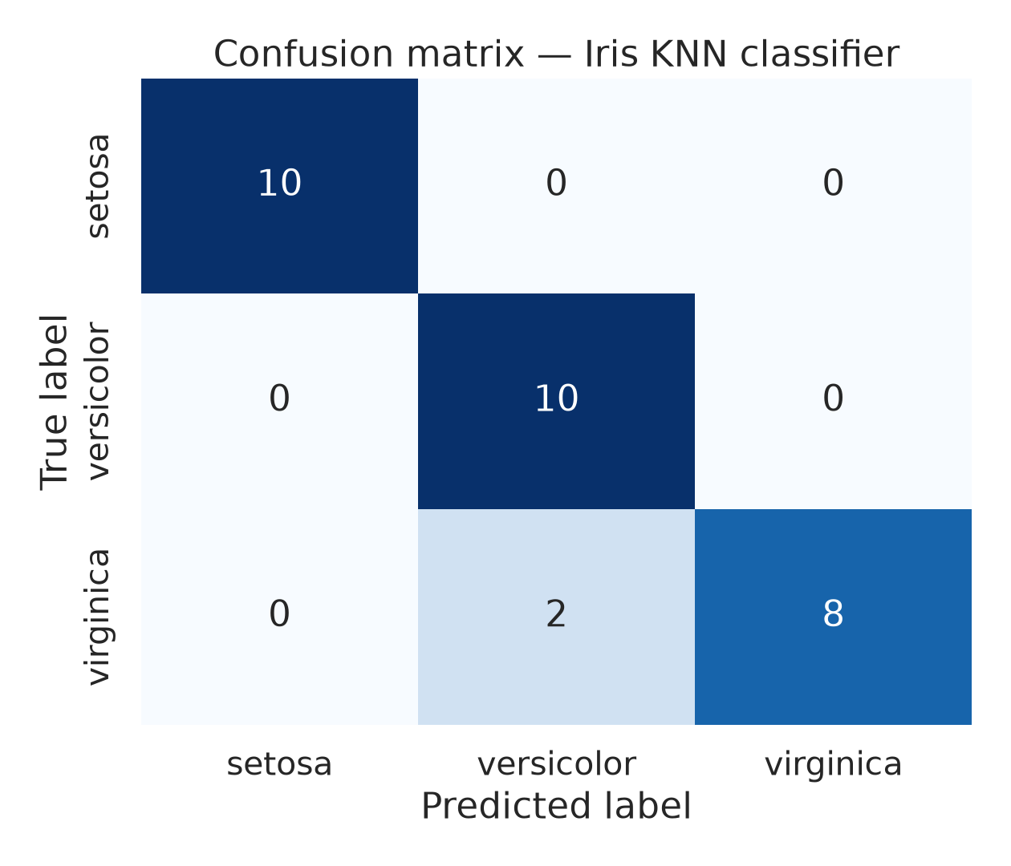
05 · ERROR ANALYSIS
Evaluation: What Did the Model Miss?
READING THE MATRIX
Setosa was classified perfectly.
The only errors were two Virginica flowers predicted as Versicolor. This is the expected harder boundary between these visually similar classes.
28 / 30 test samples correct
Source: executed project artifact · confusion_matrix.png
06 / 08

Slide 7
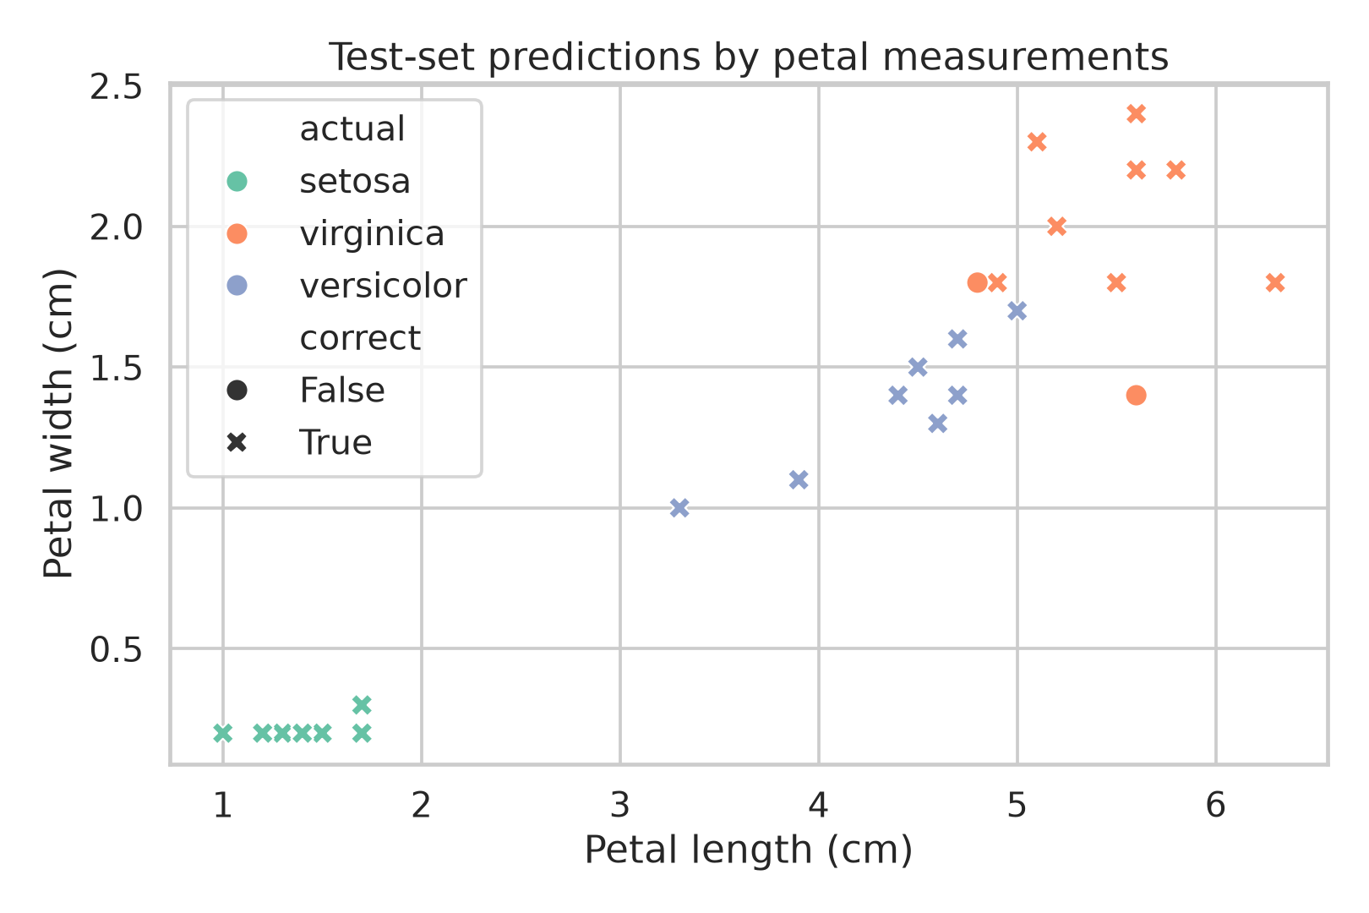
06 · VERIFIED OUTCOME
Results & Evidence
93.33%
94.44%
93.33%
93.27%
ACCURACY
PRECISION
RECALL
WEIGHTED F1
WHAT THIS DEMONSTRATES
Reproducible data preparation
Distance-aware model selection
Multi-metric model validation
Clear error interpretation
Source: executed project artifacts · metrics.json and prediction_scatter.png
07 / 08

Slide 8
07 · CLOSE
A small model, built like a professional system.
This project bridges theory and practice: data understanding, supervised learning, reproducible evaluation, and communication of results.
NEXT PRODUCTION STEPS
Thank you
Cross-validation and experiment tracking
By Muhammad Bello Abdussalam
AI Engineer
API deployment and monitoring
Data drift and model governance
08 / 08

