Slide 1
MEL GOVERNANCE TOOL
Consortium Indicator
Review Tool
A Google Sheets workflow for multi-partner MEL indicator harmonization
Burgen Bell-Tawn

Slide 2



THE PROBLEM
Consortium MEL is hard to harmonize
Partners submit different indicators for the same program — creating reporting risk, audit exposure, and fragmented data.
Incomparable data
No structured review
No decision trail
Different numerators, denominators, or definitions make cross-partner aggregation unreliable
Differences are caught late — often at reporting time — rather than during design
Harmonization decisions are undocumented, leaving programs exposed in audits and evaluations

Slide 3
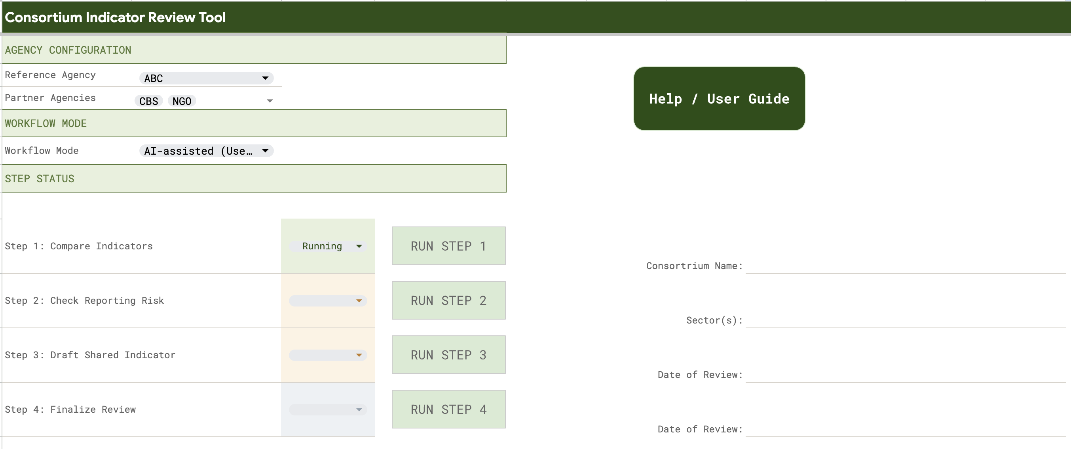
THE SOLUTION
What the CIR Tool does
The Consortium Indicator Review Tool is a Google Sheets + Apps Script workflow that:
Compares each partner's indicator submissions field-by-field against a designated Reference agency
Flags meaningful differences for governance review
Assesses reporting risk (comparability, validity, auditability)
Drafts harmonized positions using the Reference agency as the authoritative baseline
Produces a documented decision trail for audits and donor reporting

Slide 4


MODES
Manual mode vs AI-assisted mode
Choose the right mode for your team's capacity and context.
MANUAL MODE
AI-ASSISTED MODE
Tool structures and moves data through each step
You fill in all risk assessments, harmonized positions, and decisions
No API key required
Full control — appropriate when AI analysis needs to be auditable or when working with sensitive program data
Step 1 always runs automatically regardless of mode
Tool drafts risk assessments, harmonized positions, and decision framing
You review, correct, and finalize all AI output
Requires an API key from your chosen LLM provider
AI output is always a draft — bracket flags [FLAG:] [UNCERTAIN:] [ASSUMPTION:] mark items requiring human review
Works with any LLM provider (Anthropic, OpenAI, Gemini, etc.)
vs

Slide 5
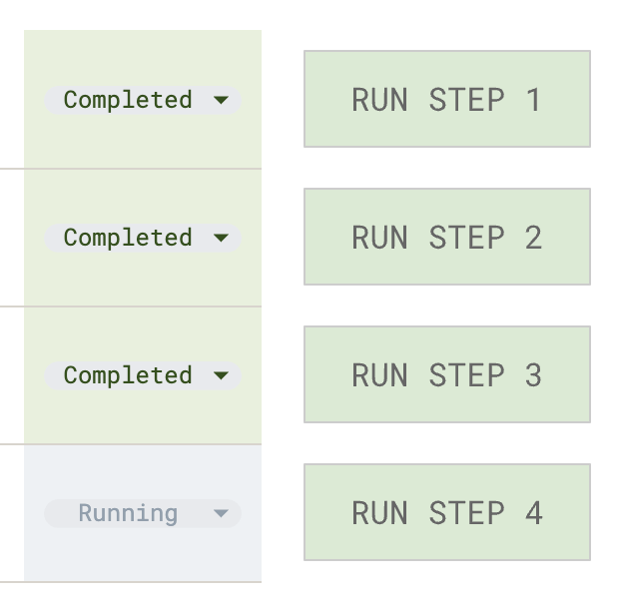
WORKFLOW
A four-step sequential workflow
Each step reads from the previous. Run in order from the Indicator Tool menu.
1
Compare Indicators
Always automated
Reads intake data and diffs every field against the Reference agency. Always automated.
2
Check Reporting Risk
AI-assisted or Manual
Assesses each difference for comparability, validity, and audit risk.
3
Draft Harmonized Position
AI-assisted or Manual
Drafts a shared field-level position starting from Reference agency text.
4
Final Decision Gate
Human decision
Governance sign-off. You set the final status for each field.

Slide 6
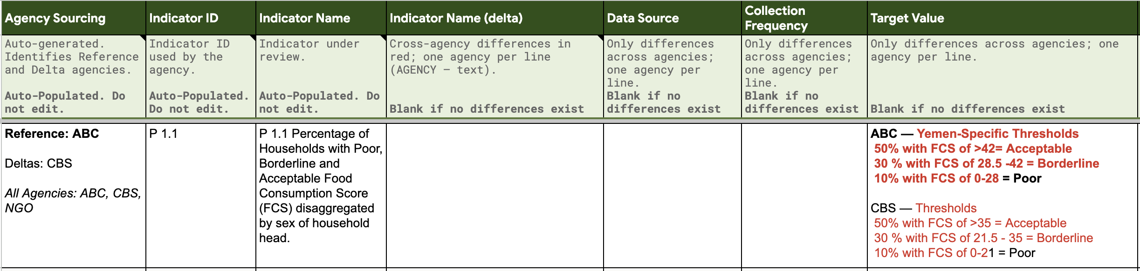
STEP 1
Step 1 — Compare Indicators
Always runs automatically. No AI. No manual option.
The INDICATOR_INTAKE sheet — one row per agency per indicator. All partner submissions.
One row per flagged field difference. Fields with no difference are left blank.
Review output. Do not edit system cells. Add Reviewer Notes if needed.
Indicators with no Reference agency row are skipped with a warning — not an error. Check RUN_LOG.
What it reads
What it produces
What you do
If partners differ

Slide 7
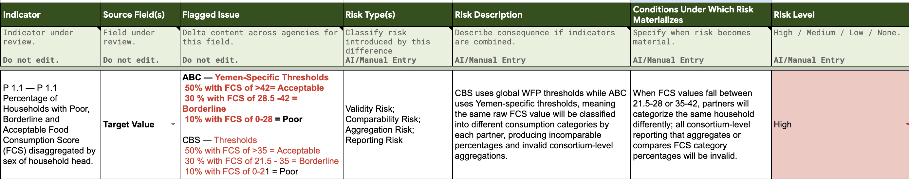
STEP 2
Step 2 — Check Reporting Risk
AI drafts the analysis. You set the final Risk Level.
Script creates one row per flagged difference from Step 1
In AI mode, drafts Risk Type, Description, and Conditions for each row
You set the final Risk Level: High / Medium / Low / None
Your Risk Level edits carry forward into Step 3
How it works

Slide 8
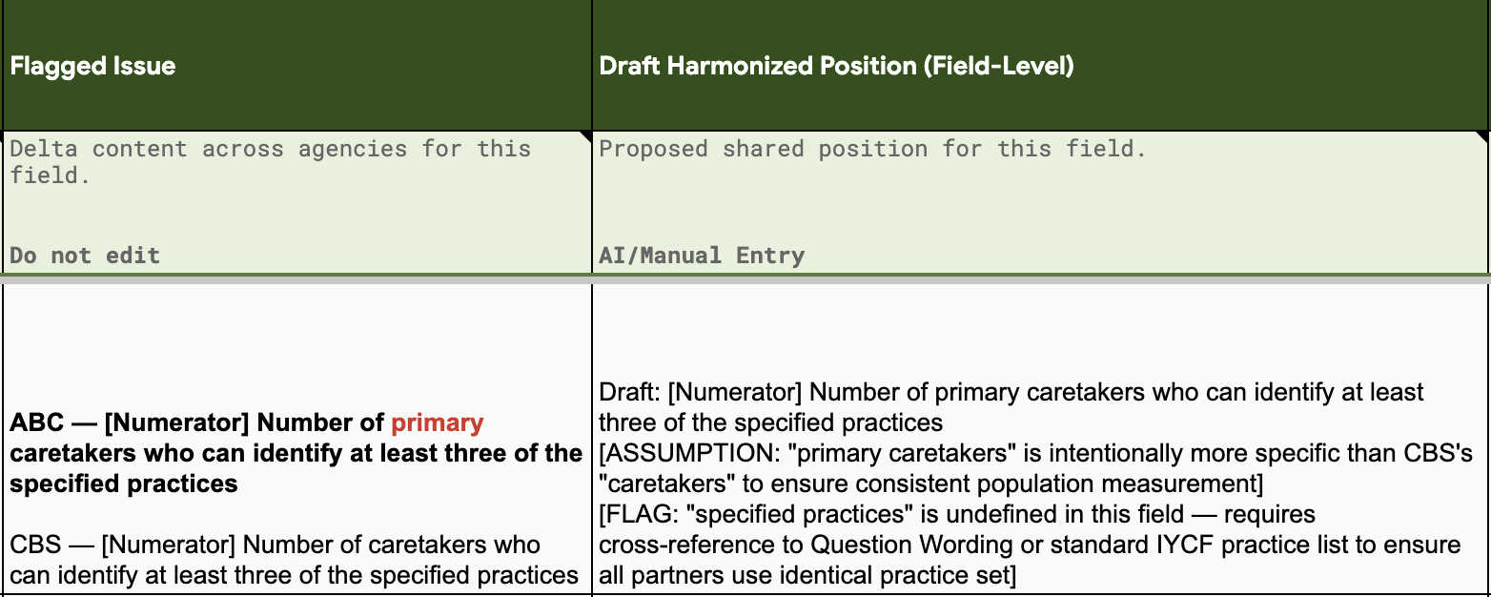
STEP 3
Step 3 — Draft Harmonized Position
AI drafts starting from the Reference agency's exact text.
How AI drafts the harmonized position
Starts from the Reference agency's exact text — not a synthesis of all partners
Only deviates when a partner difference reveals a specific technical problem
You filter by risk level — focus on High/Medium rows first
All drafts are prefixed DRAFT: and require human review before finalizing
Bracket flags require human review
[FLAG:]
A specific risk or issue the AI is flagging
[UNCERTAIN:]
AI lacks sufficient information to be confident
[ASSUMPTION:]
AI made an assumption that needs verification

Slide 9
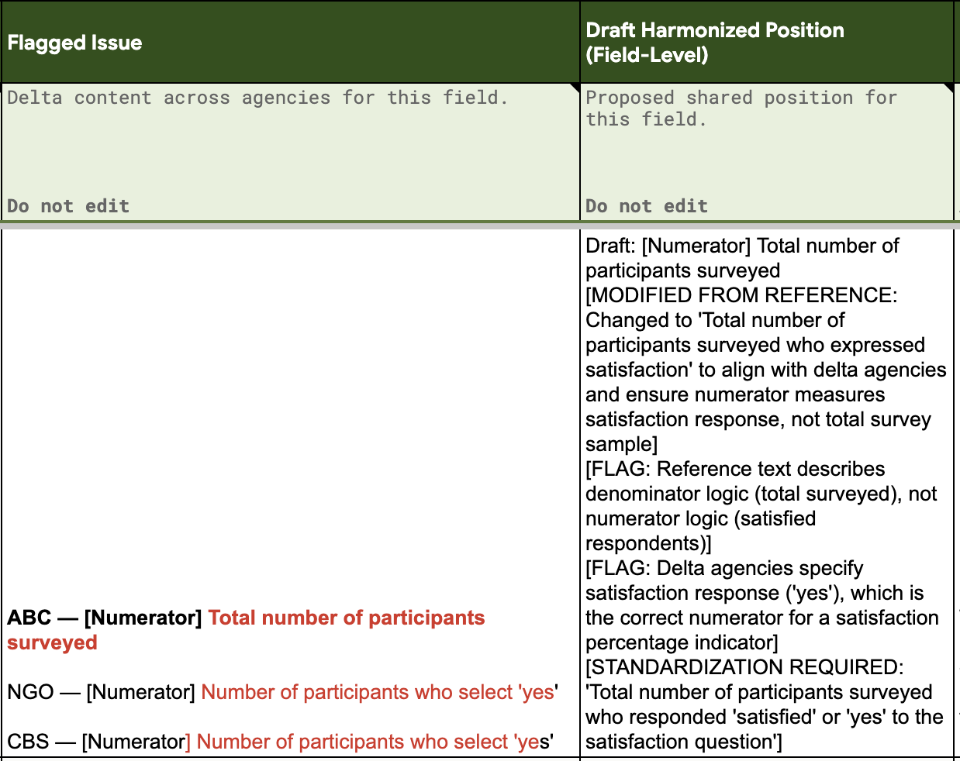
STEP 4
Step 4 — Final Decision Gate
Governance sign-off. AI frames the decision; you make it.
Residual Risk Decision
Accept / Accept with Conditions / Escalate / Defer
Governance Notes
Document your rationale — creates the audit trail
Final Status
Approved / Approved with Conditions / Revise / Do Not Standardize
Every decision is logged in the RUN_LOG and TOKEN_LOG sheets — creating a full audit trail.

Slide 10



AI MODE
How AI-assisted mode works
The tool calls your chosen LLM's API. You bring your own key.
Your data
(Intake Sheet)
CIR Tool
(Apps Script)
Your LLM
(API call)
Draft output
(Sheet cells)
→
→
→
API key stored in Google Apps Script properties — never in the spreadsheet
Compatible with any LLM provider: Anthropic, OpenAI, Google Gemini, and others
AI training data has a knowledge cutoff — outdated donor/org references may appear. Always review.
TOKEN_LOG sheet tracks API usage and estimated cost per step run

Slide 11
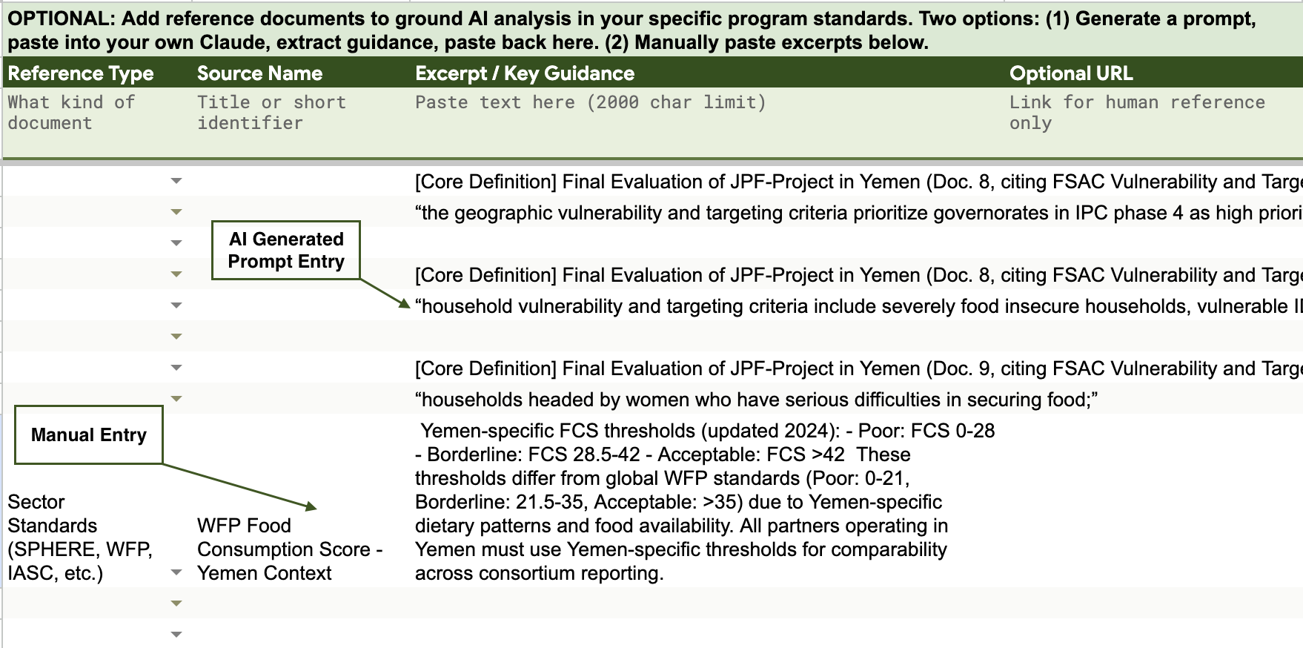
REFERENCE DOCUMENTS
Reference Documents — optional but recommended
Ground AI analysis in your program's actual standards, not generic best practice.
What to add
Donor reporting requirements
Sector standards and thresholds (e.g. SPHERE, WFP FCS weights)
Consortium MEL framework
Country or program-specific definitions
How to add them
Generate Extraction Prompt → paste into any external AI → paste output back into the sheet
Or Add Manual Row and paste excerpts directly
Max 2,000 characters per excerpt
Use Show Token Estimates before running AI steps

Slide 12
SETUP
Getting started
The tool runs inside Google Sheets using built-in scripting — no installs required.
1
Copy the workbook in Google Drive
File -> Make a copy. This gives you your own version to configure and use.
2
Look for the Indicator Tool menu in the spreadsheet menu bar
When you open your copy, a custom menu called Indicator Tool should appear next to Help in the menu bar. If it doesn't appear, go to Extensions -> Apps Script, select onOpen from the function dropdown at the top, and click Run once. The menu will then appear every time you open the sheet.
3
Run Indicator Tool -> Setup / Repair Workbook
Creates all required sheets, headers, and formatting. Safe to re-run at any time — never overwrites your data.
4
Add your API key (AI mode only)
5
Configure the Control Panel
Extensions -> Apps Script -> Project Settings -> Script Properties. Add your LLM provider key.
Set Reference Agency, Partner Agencies, and Workflow Mode. You're ready to run Step 1.

Slide 13
Built for MEL practitioners.
The Consortium Indicator Review Tool was designed to support indicator harmonization structured, transparent, and auditable — without requiring deep technical expertise.
Burgen Belltawn
MEL Specialist · https://belltawnb.github.io |https://www.linkedin.com/in/burgen/
Google Sheets + Apps Script
AI-assisted MEL

