Slide 1
Reinforcement Learning to Enhance Spatial Reuse in Dense Wireless Networks
a Thesis Proposal

Slide 2
Motivation

Slide 3
Explain main goal: move WNs to RL/AI
Explain the issues in dense WN
Explain possibilities (time, frequency, space)
Characterize scenarios (IEEE 802.11ax)

Slide 4
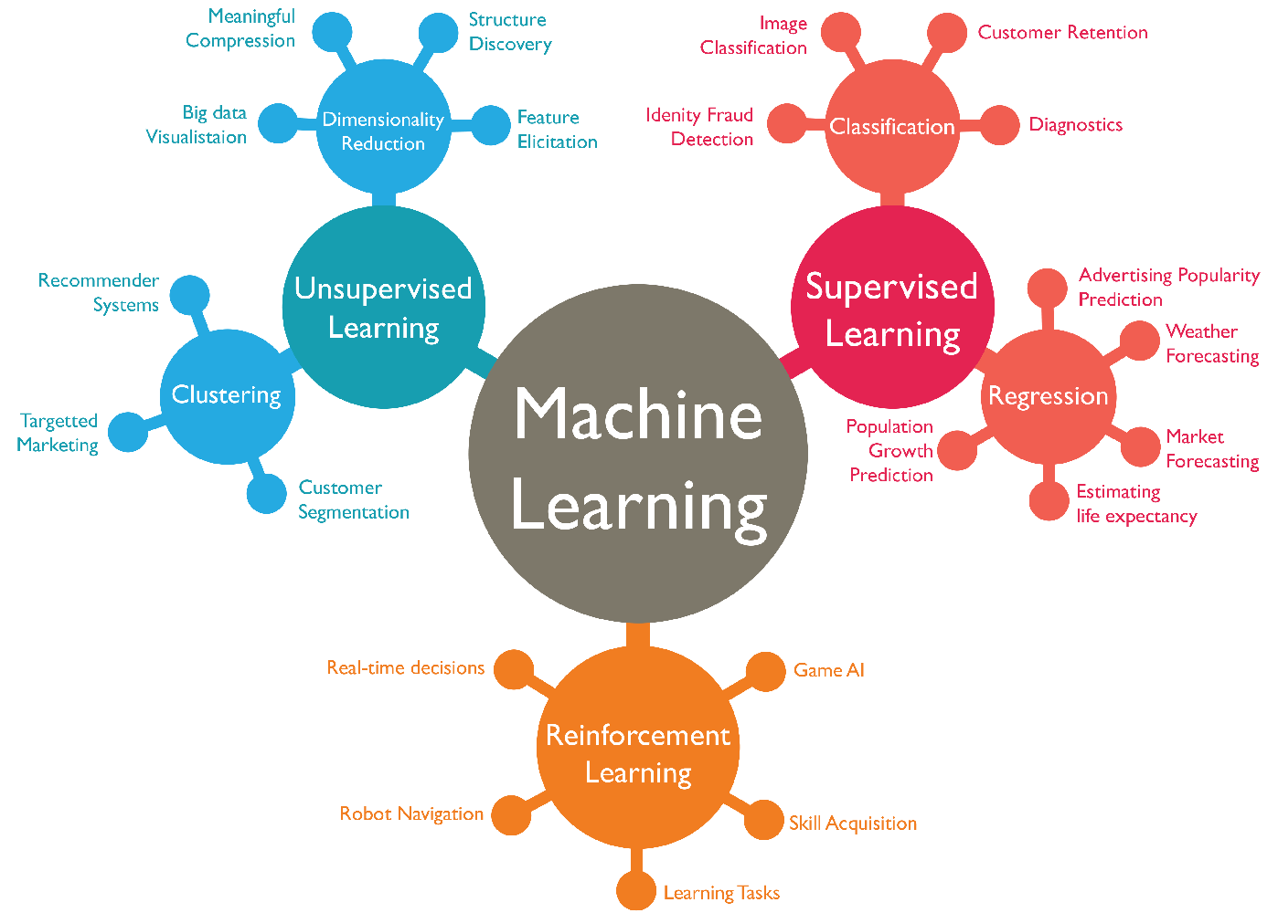

Slide 5
Main Problem
Easiness of deployments
Coexistence issues in WNs
Computational power moving to the cloud (more communication)
New BW requirements of new apps
Heterogeneous deployments
…

Slide 6
Main Solutions
Frequency
DSA
DCA
Coexistence issues in WNs
Space
TPC
CST adjustment
Beamforming
Time
Scheduling
FT-CSMA/CA

Slide 7
IEEE 802.11 WLANs
CSMA/CA is sub-optimal -> suffers from problem nodes
Explain topologies, future scenarios, DCF operation…

Slide 8
Motivation - Recap
Coexistence issues in WNs
CSMA/CA is sub-optimal -> suffers from problem nodes
Moving into AI

Slide 9
Spatial Reuse in Wireless Networks

Slide 11
Problem Formulation

Slide 13
Reinforcement Learning in WNs

Slide 14
RL in WNs – State-of-the-Art
Many categorizations: learner (passive/active), environment (known/unknown), model (with/without states)…
+ tabular (Monte-Carlo and TD(λ))
+ Function approximation (large states space)
Prediction
Control
* gradient descend (GTD2 and TDC)
* least-squares methods (LSTD(λ) and λ-LSPE)
+ optimizing online performance (bandit problems and MDPs)
+ methods that aim at developing methods that can be used in large-scale applications
* Direct methods (estimate
the optimal action-values directly)
* Actor- critic methods
based on direct policy improvement and policy gradient

Slide 15
RL in WNs – Feasibility & Considerations

Slide 16
Current Contributions & Ongoing Work

Slide 18
Future Work

Slide 20
Reinforcement Learning to Enhance Spatial Reuse in Dense Wireless Networks

